Slide 1
Semi-Infinite
100 nm
50 nm
20 nm
10 nm
1 nm

Slide 2
Semi-Infinite
100 nm
50 nm
20 nm
10 nm
1 nm

Slide 4
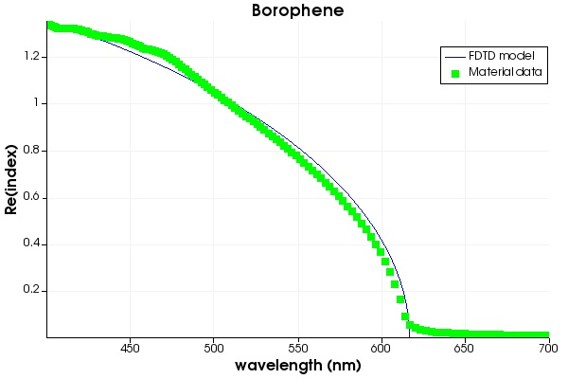

Slide 5

To Do
Heat Map of R/T/A/ vs thickness and lambda
Heat Matp of R/T/A vs angle of incidence and lambda (~1 nm borophene)
$ε\sim \cos\left(θ\right)ε_{x}+\sin\left(θ\right)ε_{z}$for non-normal incidence?

