Slide 1
Technical Sales, Account Management
Root Cause Analysis
Profit & Loss / Business Management
Petroleum Geology, Reservoir Engineering
Drilling & Drill Bit Application Engineering
PDC Design
Data Science, Software Development, Cloud Computing

Slide 2
Technical Sales, Account Management
Root Cause Analysis
Profit & Loss / Business Management
Petroleum Geology, Reservoir Engineering
Drilling & Drill Bit Application Engineering
PDC Design
Data Science, Software Development, Cloud Computing

Slide 3
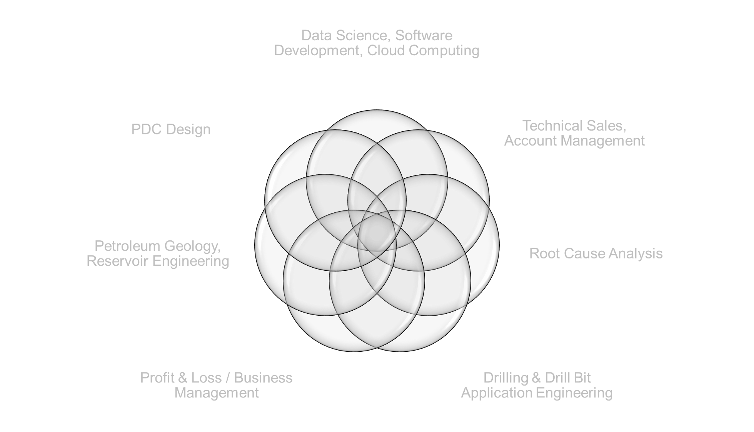

Slide 4
