Slide 1

This Scientific Poster Template Is Provided By Department of Electronics, Enter A Title To Your Poster
Add Author Names and Information
Include University or Department Names if Needed

Slide 2
This Scientific Poster Template Is Provided By Department of Electronics, Enter A Title To Your Poster
Add Author Names and Information
Include University or Department Names if Needed
Tóm Tắt |  | Cơ Sở Lý Thuyết |  |  |  | Kết Luận
Add your information, graphs and images to this section. |  | Add your information, graphs and images to this section. |  |  |  | Add your information, graphs and images to this section.
Giới Thiệu |  | Đặc Tả Thiết Kế |  | Kết Quả |  | Tài Liệu Tham Khảo
Add your information, graphs and images to this section. |  | Add your information, graphs and images to this section. |  | Add your information, graphs and images to this section. |  | Add your information, graphs and images to this section.

Slide 3
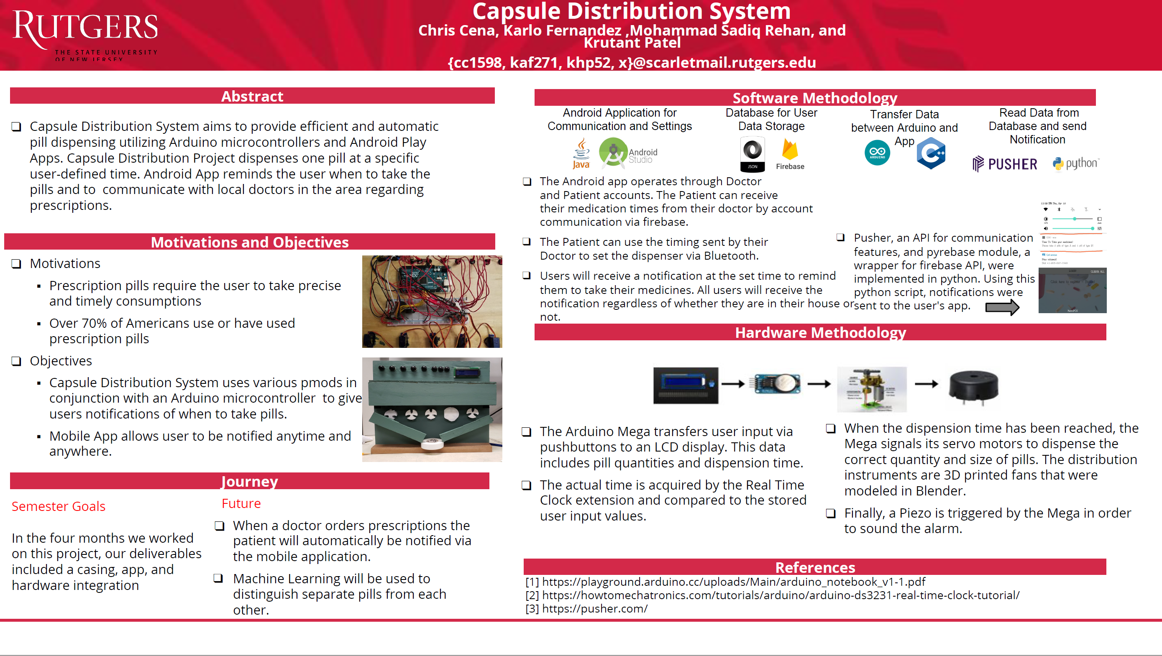
Ví dụ 1:

Slide 4
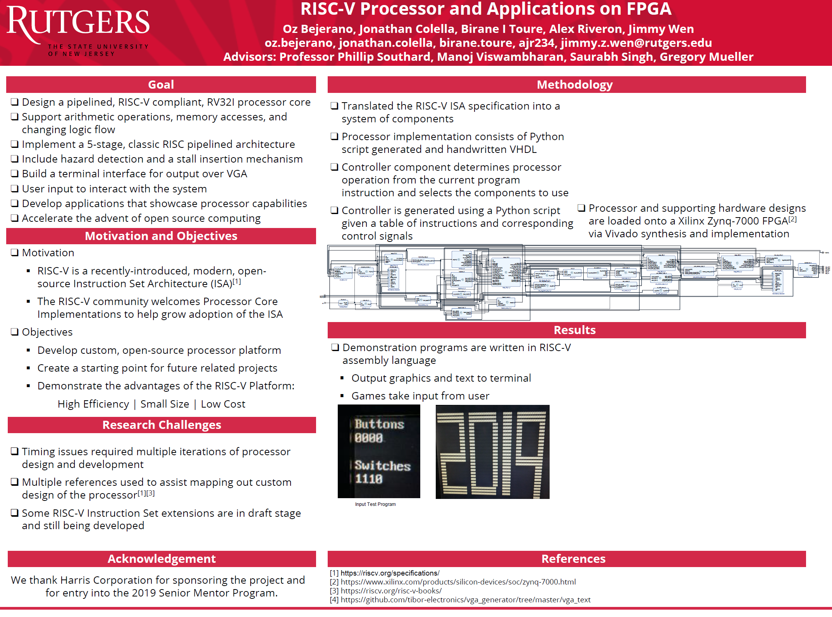
Ví dụ 2:

