Slide 1
针对语法纠错任务的细节处理、数据增强与模型集成
吴修宇 汤宸名 吴云芳

Slide 2
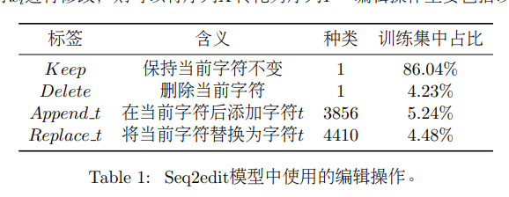
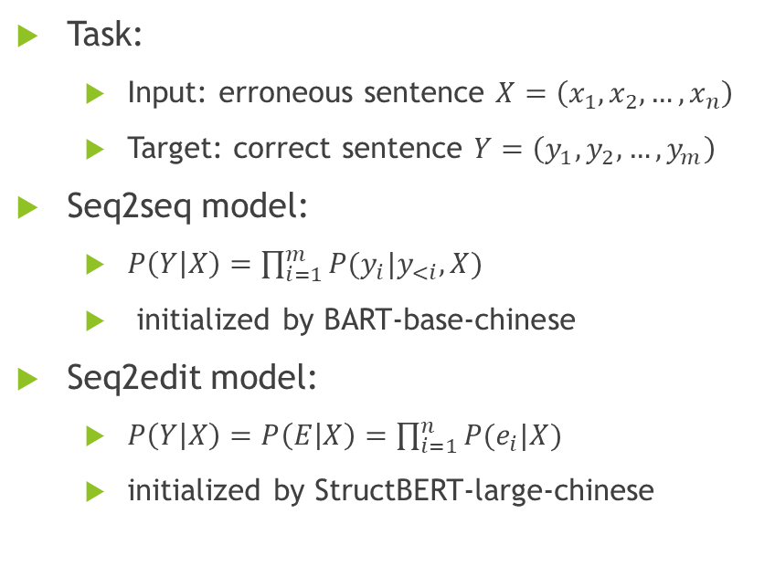
Baseline Models
今 天 天 气 真 好 ！</s>
Encoder
Decoder
Task:
Input: erroneous sentence $X=\left(x_{1},x_{2},…,x_{n}\right)$
Target: correct sentence $Y=\left(y_{1},y_{2},…,y_{m}\right)$
Seq2seq model:
$P\left(Y | X\right)=\prod_{i=1}^{m}{P(y_{i}|y_{<i}, X)}$
initialized by BART-base-chinese
Seq2edit model:
$P\left(Y | X\right)=P\left(E | X\right)=\prod_{i=1}^{n}{P(e_{i}|X) }$
initialized by StructBERT-large-chinese
金 天 气 真 好
<s> 今 天 天 气 真 好 ！
R-今 A-天 K K A-！
Encoder
金 天 气 真 好

Slide 3
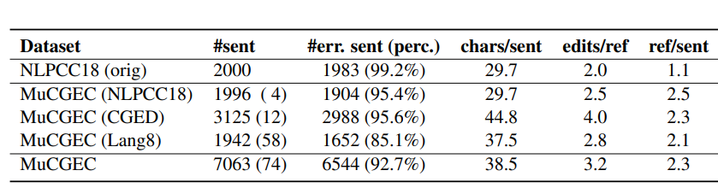
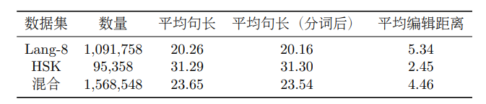
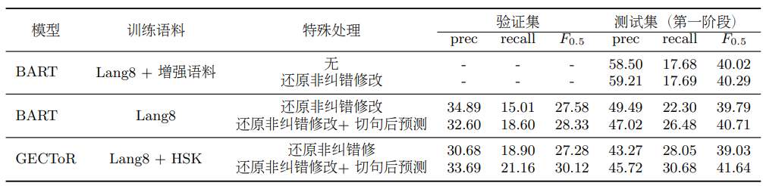
Preprocess & Postprocess
Substitute [unused] token in BERT vocabulary into Chinese punctuation.
313 / 914 tokens in test-1 / test-s2
Cut sentences into pieces based on punctuations before sending it into model.
Average length of training / test-s1 (split) / test-s2 (split) input: 23.7 / 38.5 (→30.0) / 45.1 (→20.7) tokens
Small improvement on NLPCC-2014 (+0.4 BART-large)
Great improvement on others

Slide 4
Preprocess & Postprocess
Replace [UNK] or English words in generated sentence with original words in input sentence according to Levenstein distance.
Package: difflib (SequenceMatcher)
Find substitution: src_part → tgt_part
CASE-1: tgt_part == [UNK]
CASE-2: tgt_part is a English word and tgt_part.lower() == src_part.lower()
Unnecessary substitution:
20+ / 110+ in test-s1 / test-s2
+0.7 / +0.8 precision in test-s1 / test-s2

Slide 5
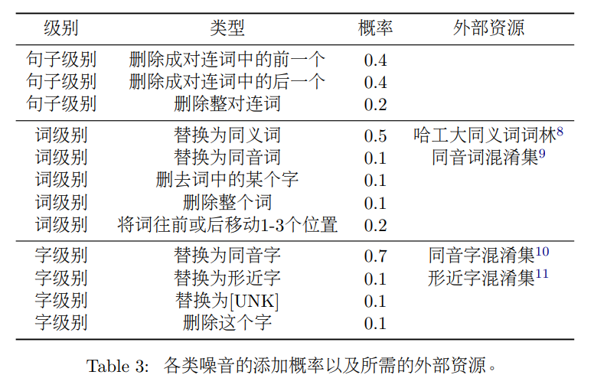
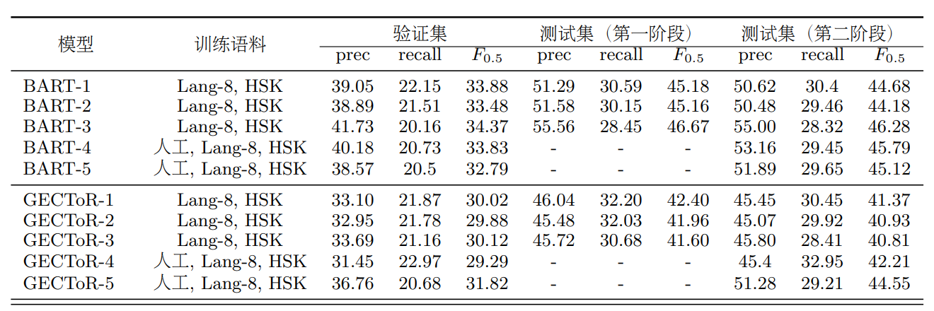
Synthetic Data
Corpus: THUCNews
Original: 740,000 documents from 14 news categories
Selected: 5 million sentences
Corruption Methods:
For suitable sentences:
50% sentence-level noise
50% other
For n-grams in other sentences:
50% word-level
50% char-level
Significant improve on recall

Slide 6
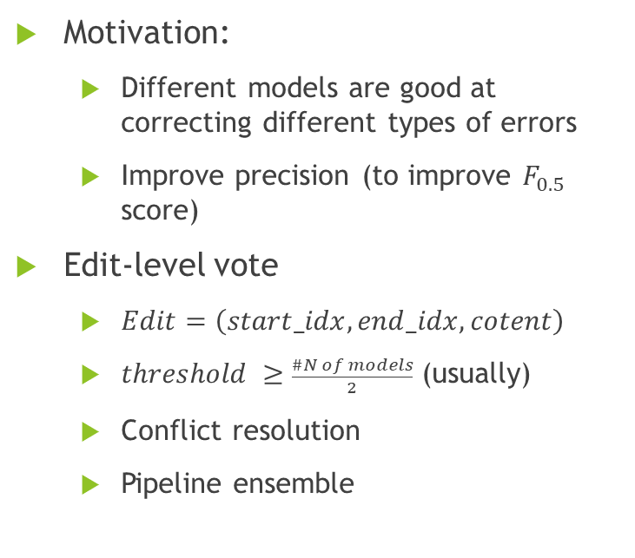
Ensemble methods
Motivation:
Different models are good at correcting different types of errors
Improve precision (to improve $F_{0.5}$ score)
Edit-level vote
$Edit=\left(start_idx, end_idx, cotent\right)$
$threshold ≥\frac{\#N of models}{2}$ (usually)
Conflict resolution
Pipeline ensemble

Slide 7
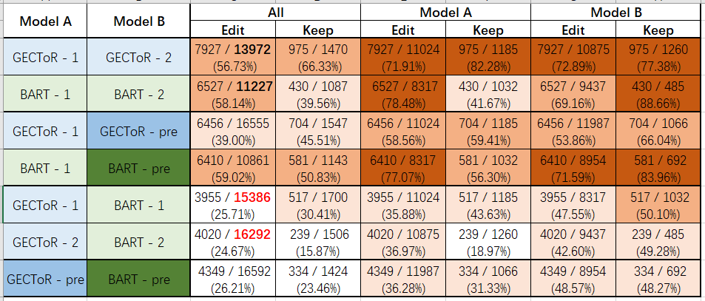
Pipeline Ensemble
Same type of models:
Similar decisions
Seq2seq + seq2edit:
Different decisions
Pretrain:
Prefer to do more editing operation
Difference decision facing the same input

Slide 8
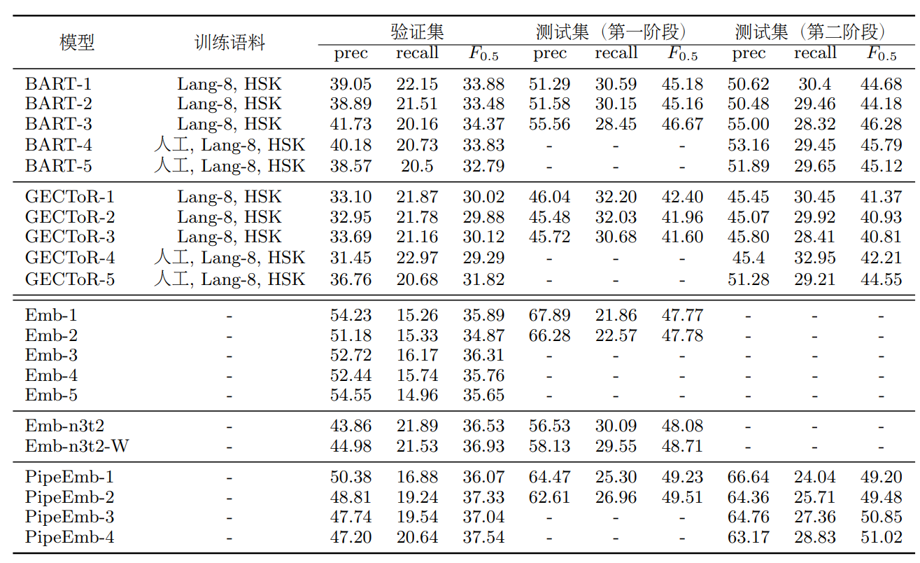
Performance
Emb-i = BART-i + GECTOR-i
Num = 2, threshold = 2
PipeEmb-i = ensemble of Embs
Num = n, threshold = 1
PipeEmb-3: Emb-1、2、4
PipeEmb-4: Emb-1、2、4、5
Trade-off between precision and recall

Slide 9
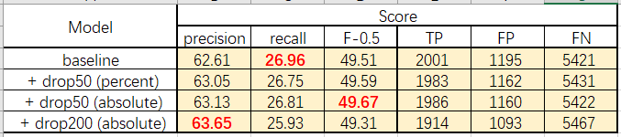
Others
Data augmentation: dropout-src, MaskGEC, …
Methods: improve the performance of single model, but higher overlap (over 80%)
Usage of PLM:
Select the most fluent sentence (evaluated by PPL) from candidates. → not so good
Select the most appropriate edits (evaluated by PPL) from candidates. → not so good
Select the worst edits (evaluated by change of PPL) from the whole generated sentence. → tradeoff between precision and recall

Slide 10
Q&A

Slide 11
Thanks !

