Slide 1
Ozymandias Bar Beer Empire
Created By: Vinh Huynh and Xin Lin

Slide 2
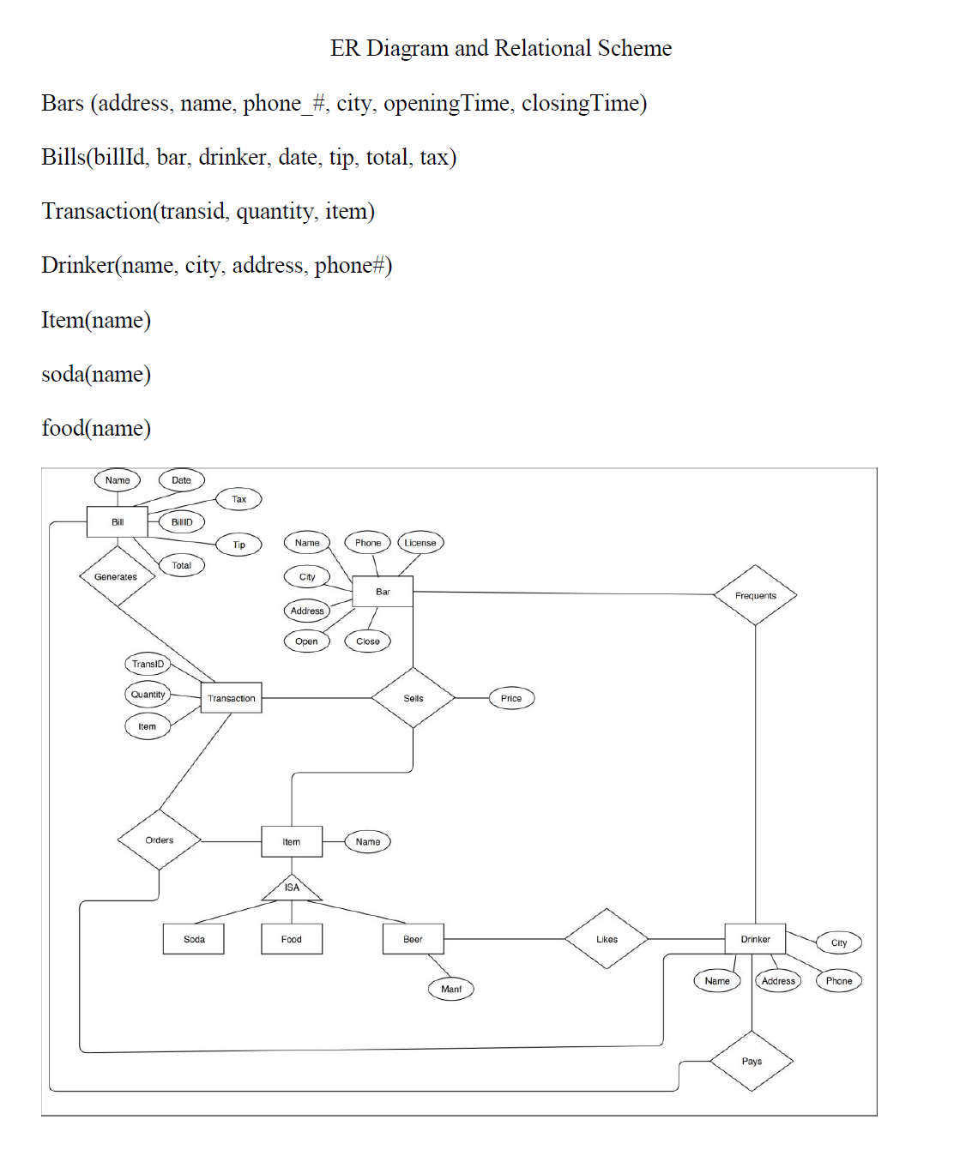
Creating ER Diagram and Relation Scheme
First Part of the Project
Important to give us direction

Slide 3
Generate Random Data
This was done through a combination of Java and SQL Programs
Java program created “Random” Data for a given table
EX: Drinkers, bars, etc
SQL programs helped with creating the bill and transaction table
Since these needed to maintain consistency

Slide 4
Types of Data Generated
So we decided that bars/drinkers should be spread across Four Cities
New York City
Austin
Chicago
Boston
All bars would serve the same menu items
Bars would serve a variety of different beers

Slide 5
Uploading to the Database
This was done using a Java Script
Input was a CSV file
Output: Wrote SQL commands that line by line inserted the data
Done using Java JDBC driver

Slide 6
Double Checking the data
To ensure that the data was valid
(No drinker goes to bar in a different city, etc)
SQL functions from the assignment sheet were used

Slide 7
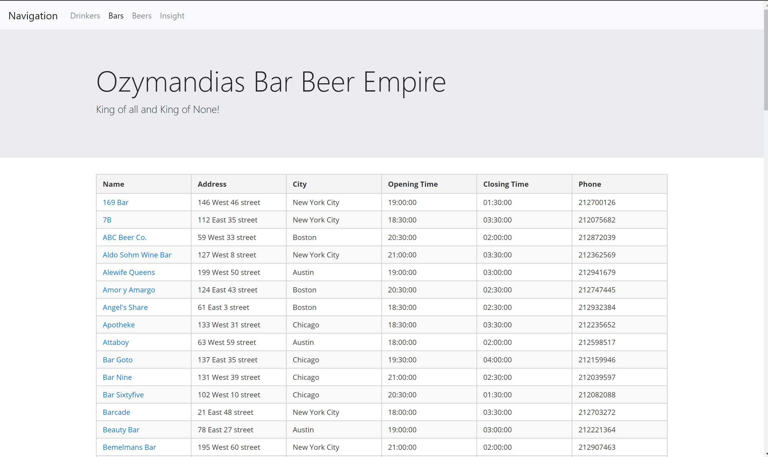
Showing the Pretty Website
We followed the AngularJS/NodeJS tutorial posted on youtube to build up our website.
By Default the webpage would automatically redirect to the bars page

Slide 8
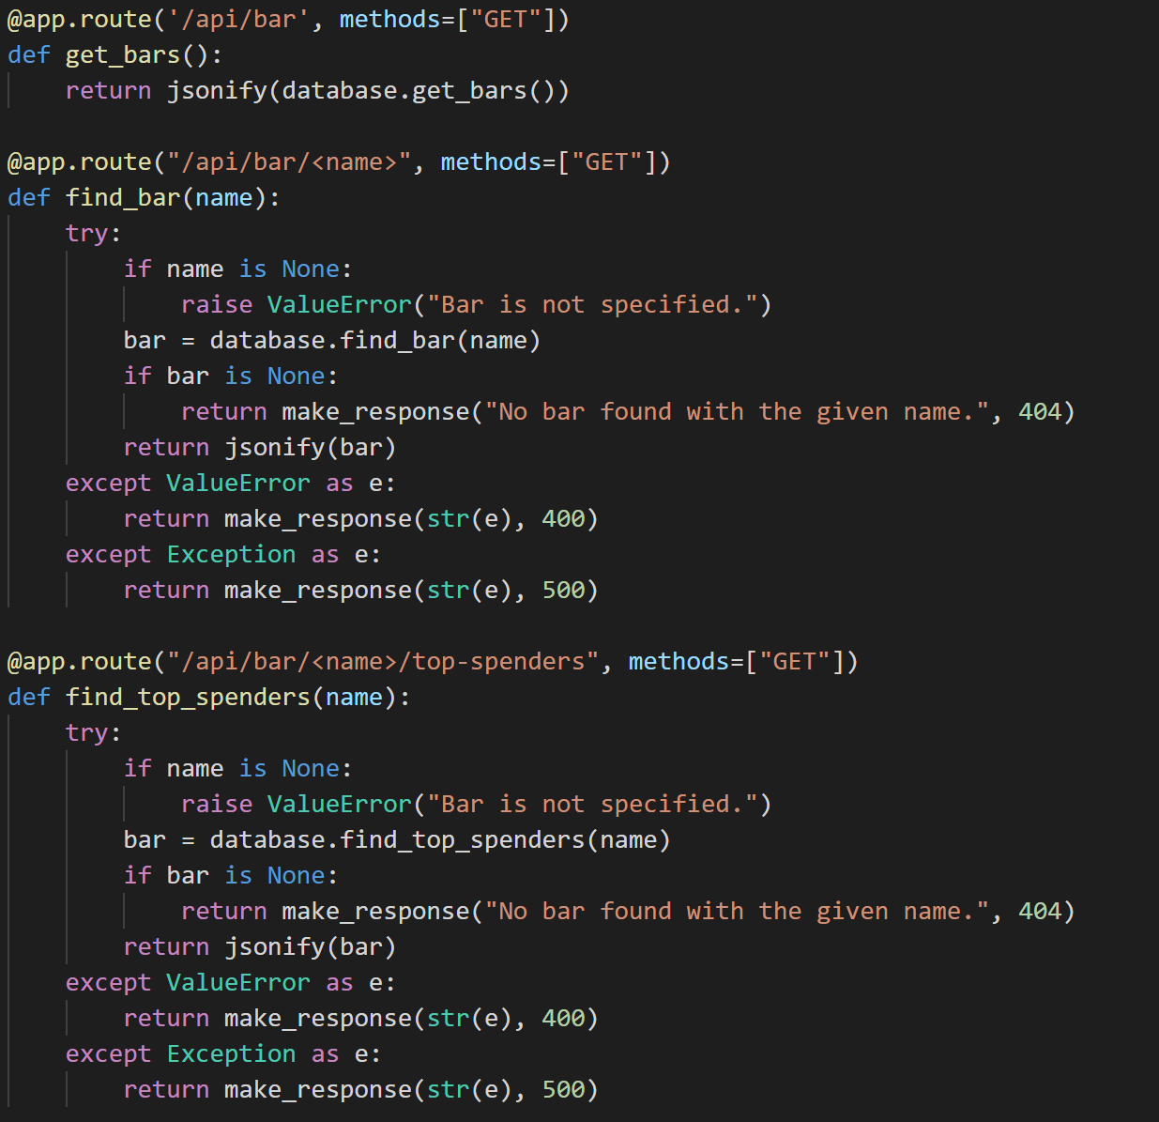
How the website Works
AngularJS provides the front end part of the code
SQL queries are executed using RESTFUL API

Slide 9
Navigation
To navigate between the Bars, drinkers, and beers page we simply added a navigation bar at the top that will redirect you.

Slide 10
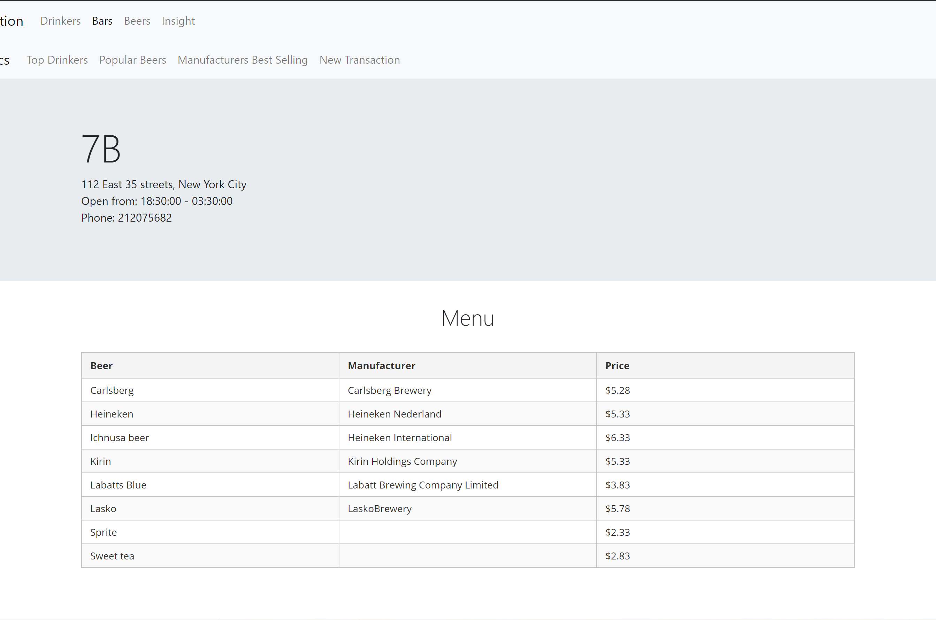
Bars Page
Clicking on a bar displays this information
Also Adds another navigation bar for
Top Drinker
Popular Beers
Manufacturer best selling
New Transaction

Slide 11
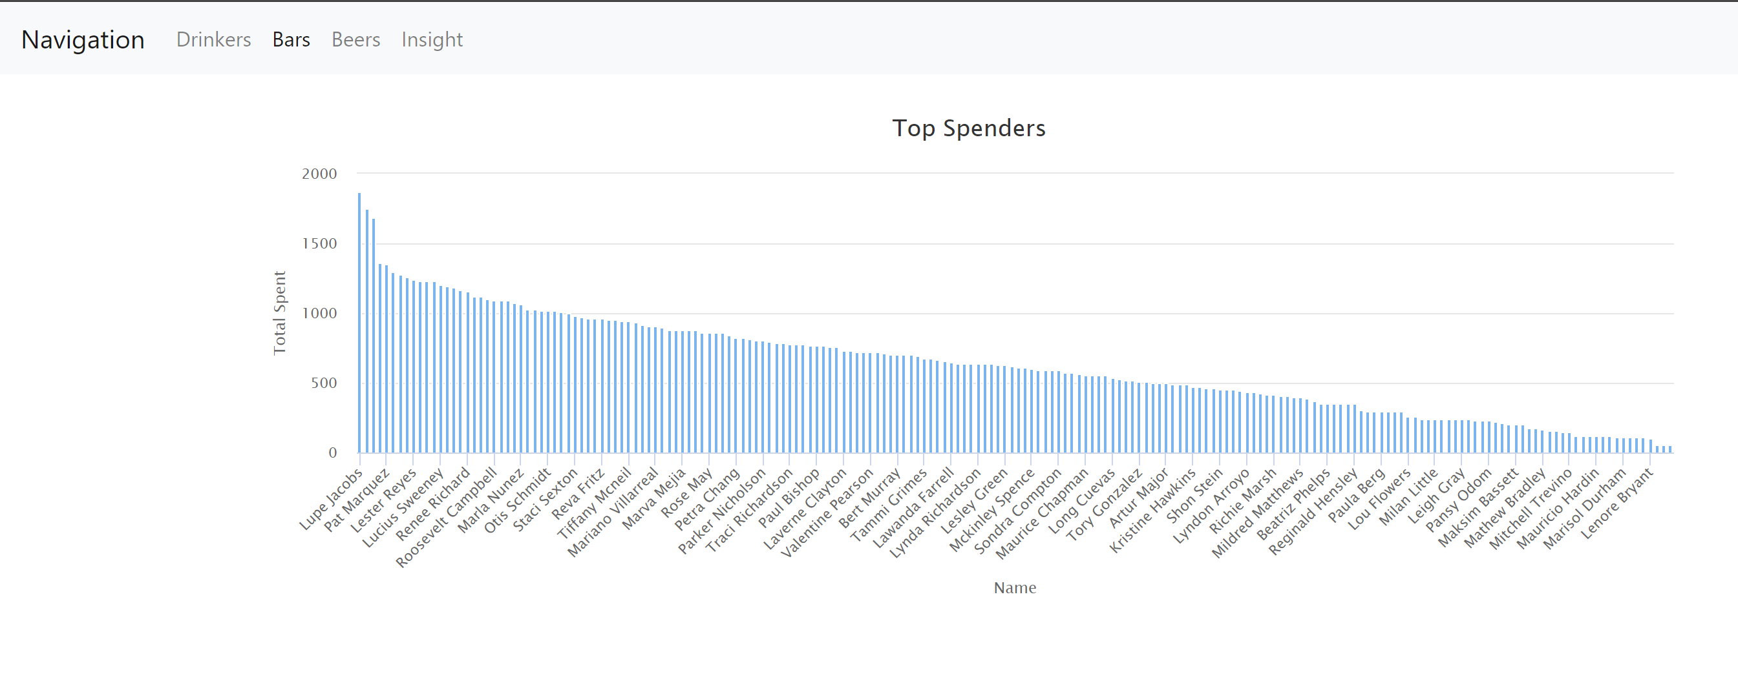
Top Drinkers
Displays a bar graph of who spends the most money at a particular bar

Slide 12
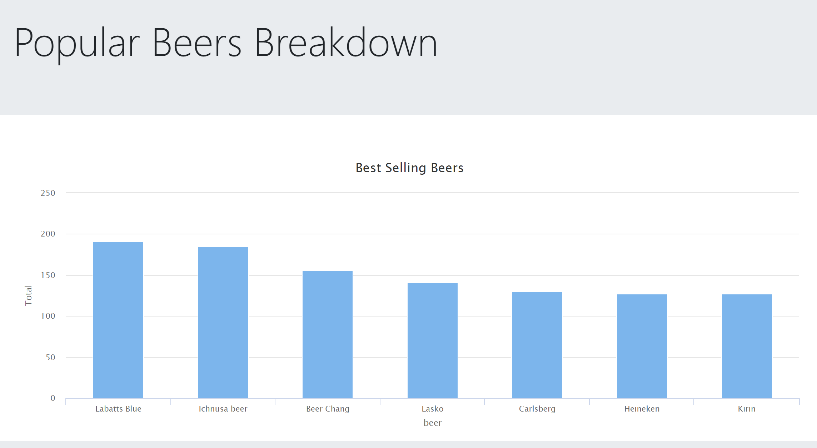
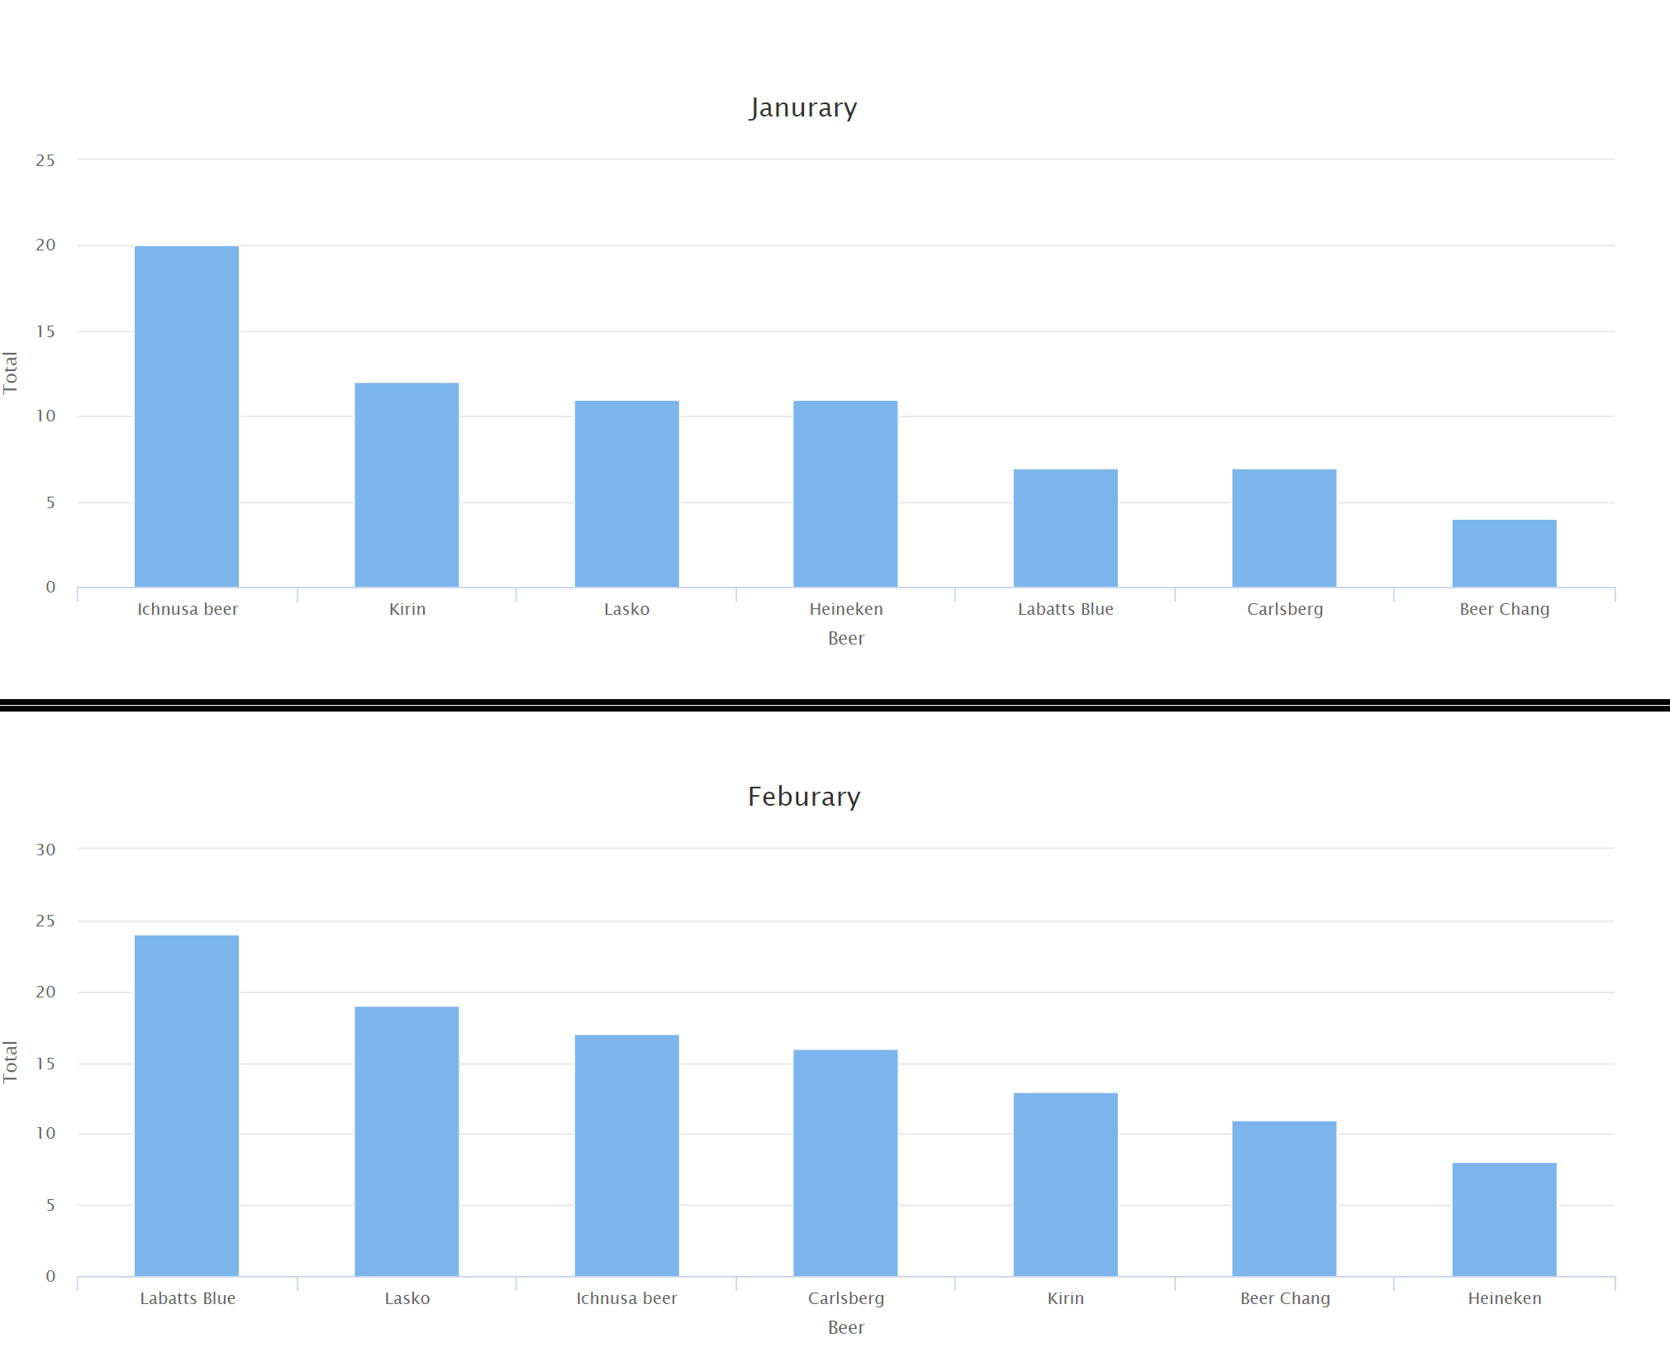
Popular Beers
Shows the best Selling Beer
Overall
Month by Month

Slide 13
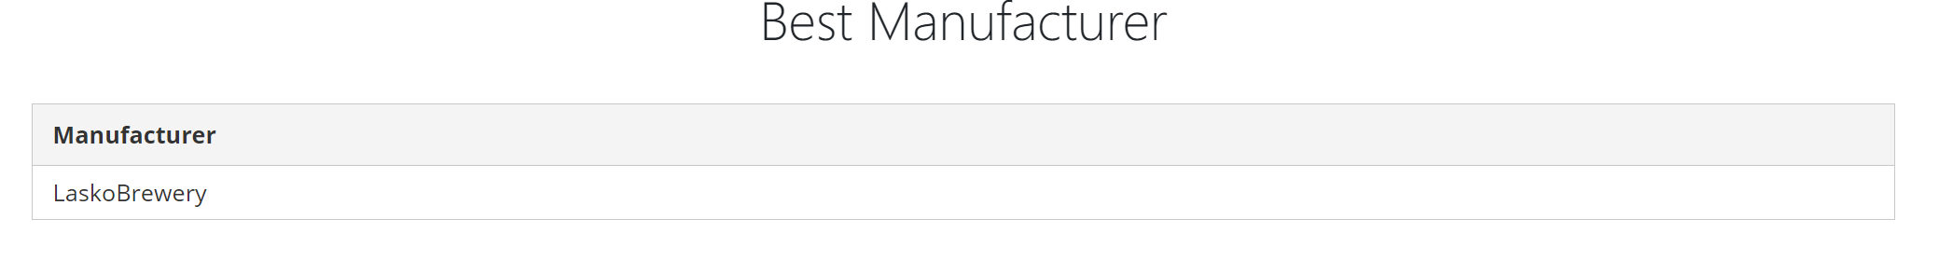
Best Selling Beer Manufacturer
Given the Best Selling Beer display the manufacturer that made the beer

Slide 14
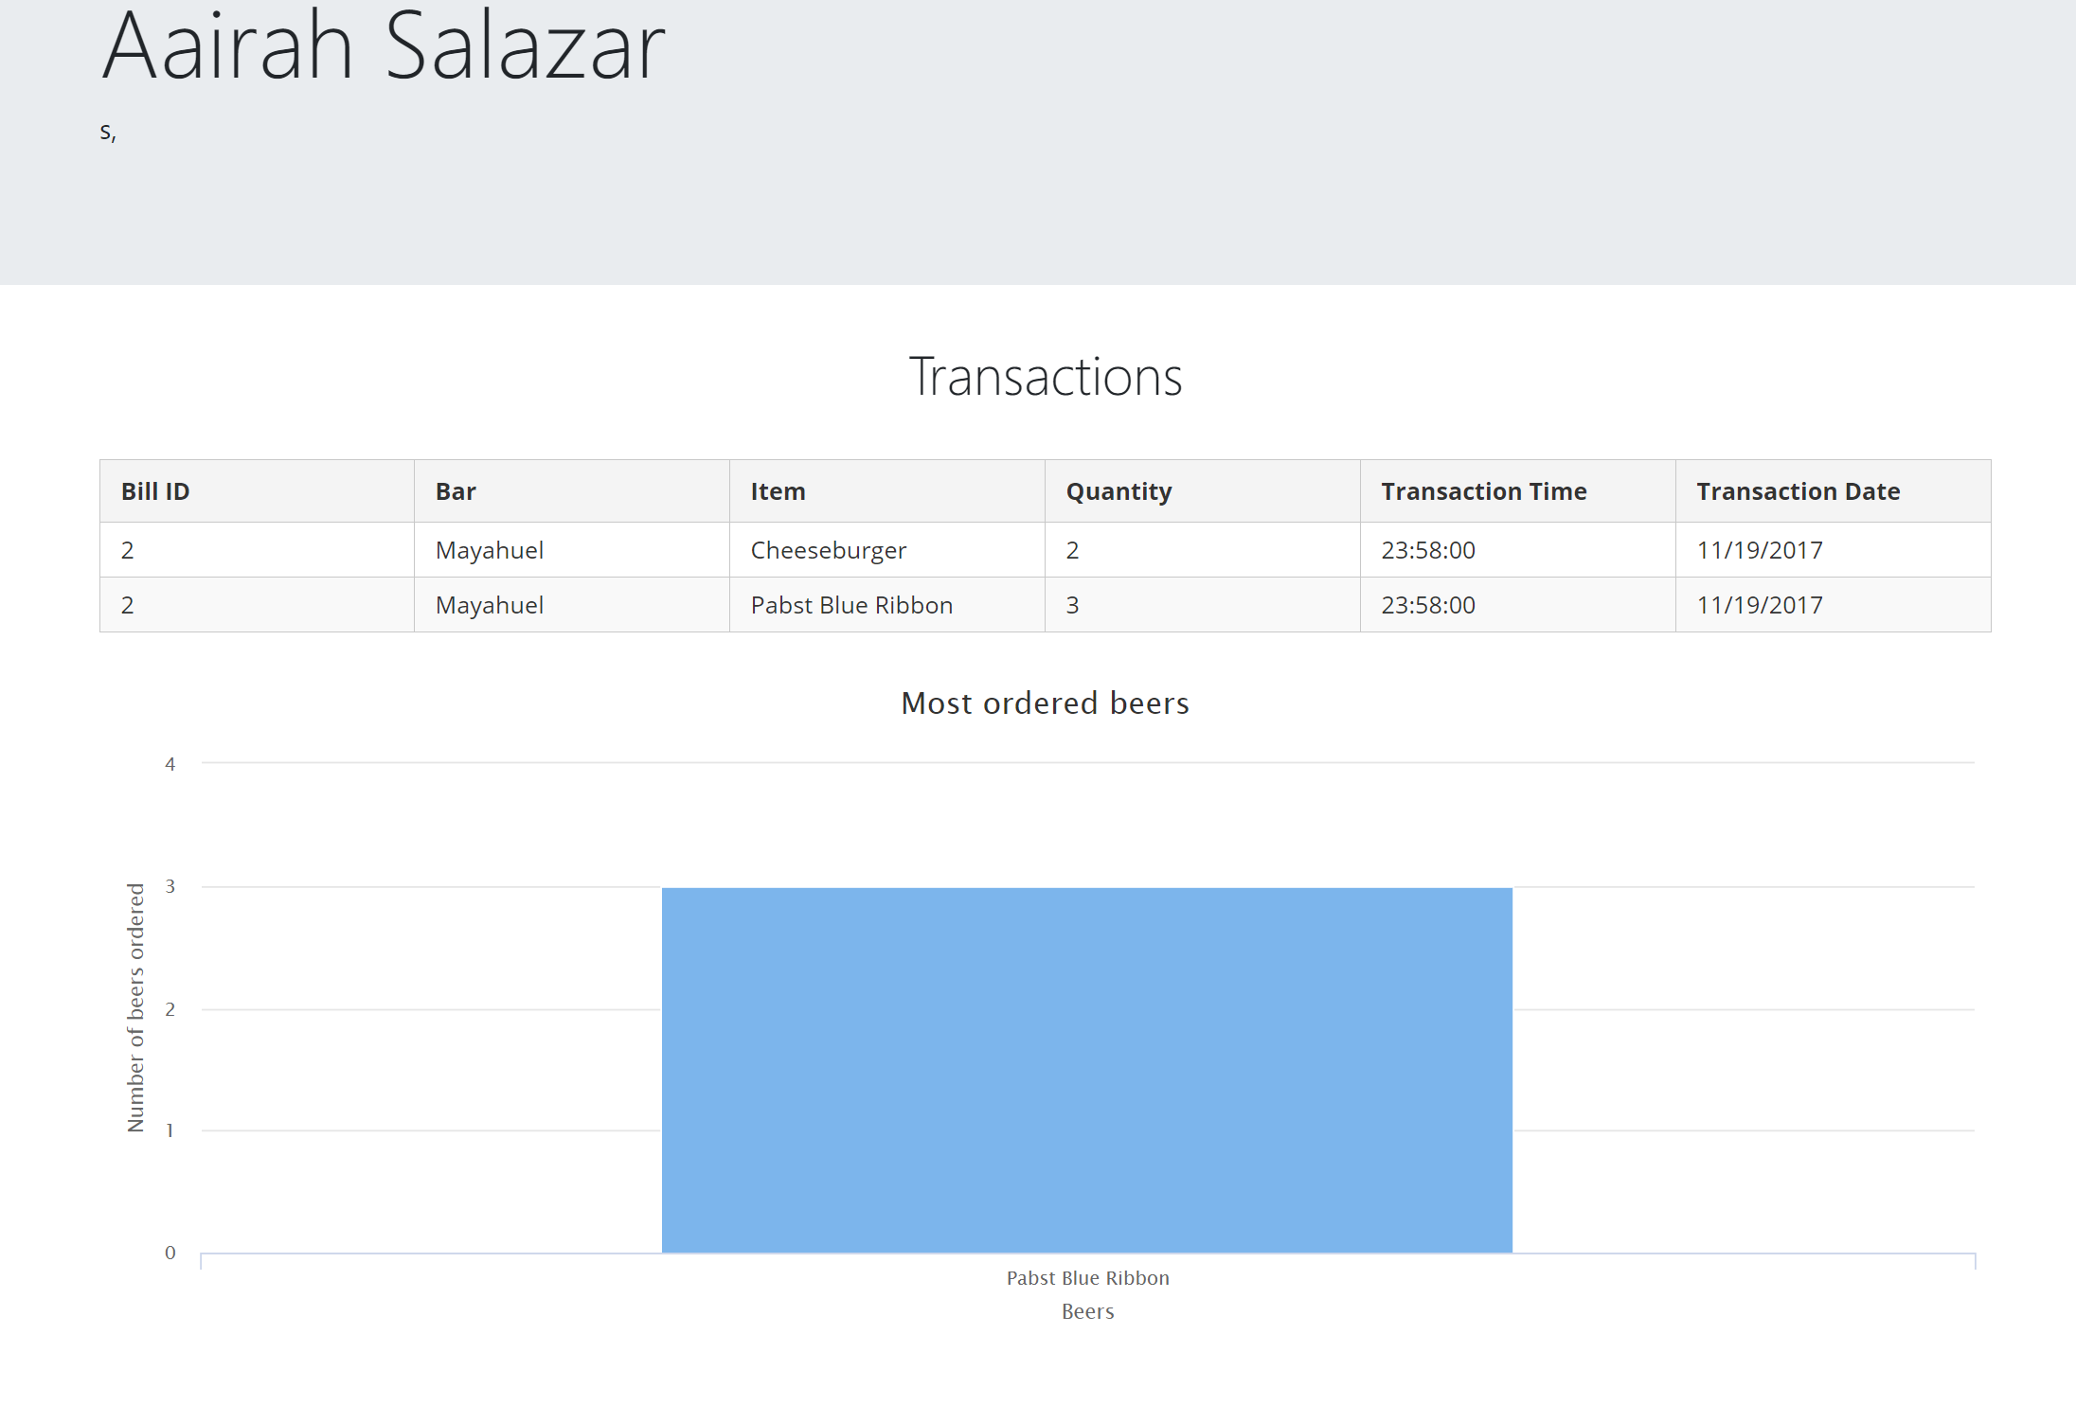
Drinkers Information
List of all drinkers from the database
Address
What they bought
Spending

Slide 15
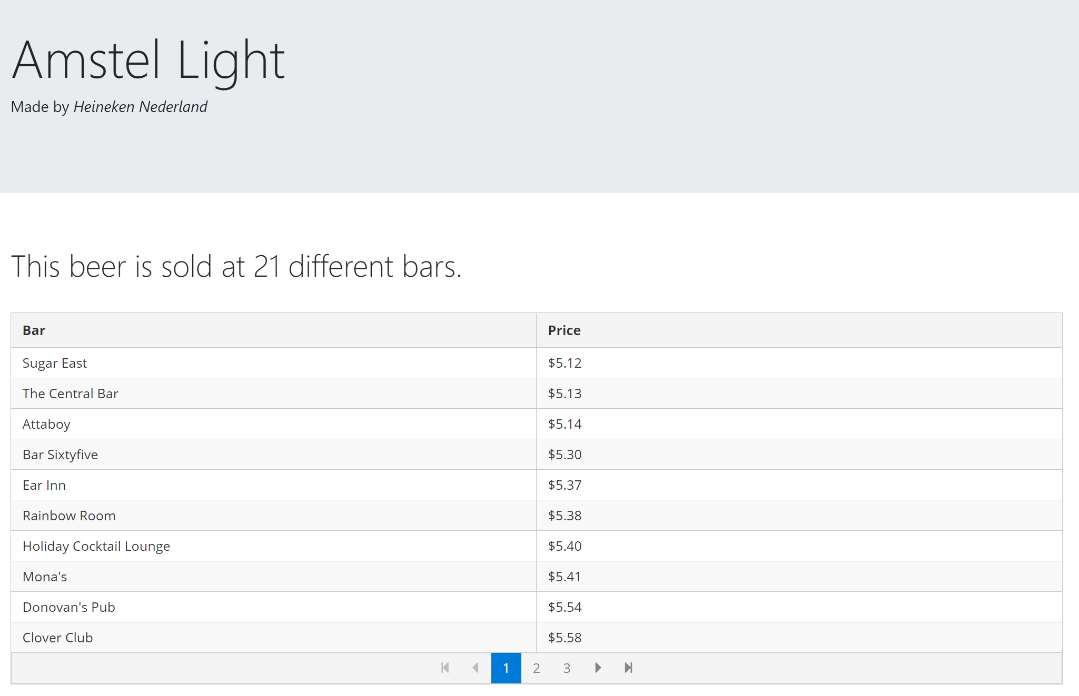
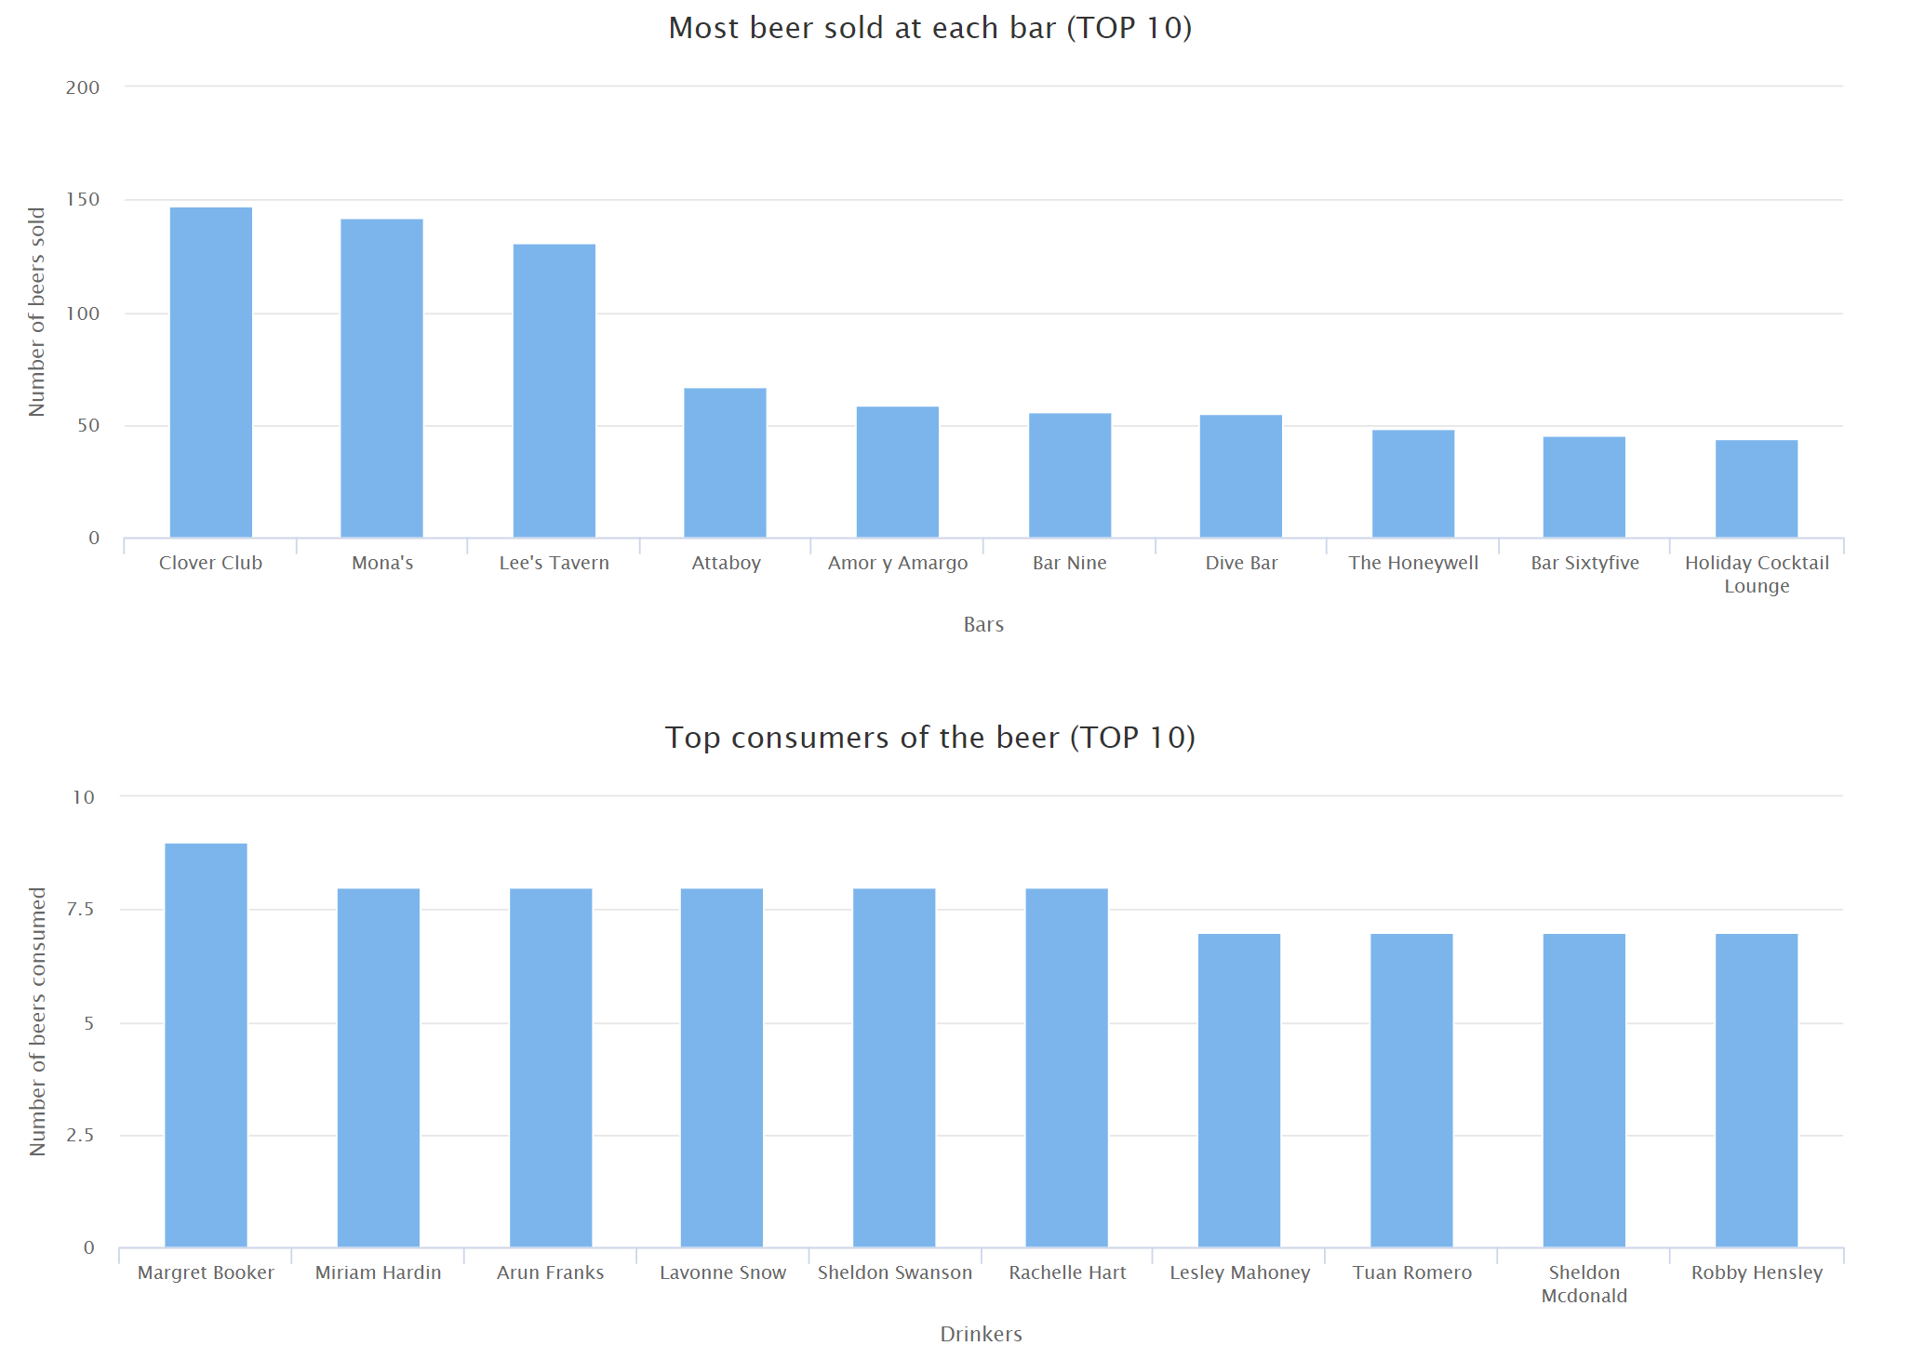
Beers
Same layout as the Drinkers Page
Click on a beer and shows us bars that sell it
Displays Graphs

Slide 16
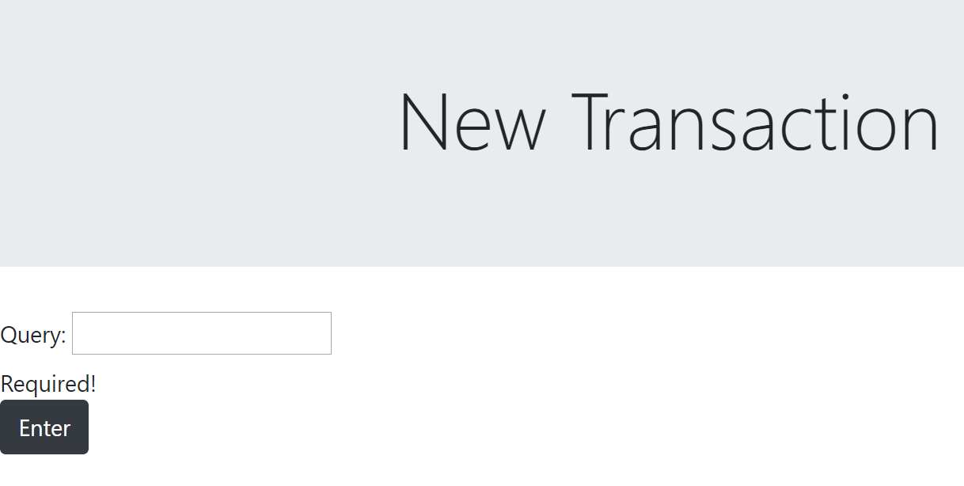
Modification Page
Running out of time!
Just provided a text box and you type out the entire query

