Slide 1


Deep Learning in Windows Malware Detection
VIETNAM NATIONAL UNIVERSITY HO CHI MINH CITY
UNIVERSITY OF INFORMATION TECHNOLOGY
FACULTY OF SOFTWARE ENGINEERING
Student: | Phạm Hữu Danh - 14520134
Supervisor: | Assoc Prof. Dr. Vũ Thanh Nguyên

Slide 2
Malware Detection using Machine Learning in Windows OSs
VIETNAM NATIONAL UNIVERSITY HO CHI MINH CITY
UNIVERSITY OF INFORMATION TECHNOLOGY
FACULTY OF SOFTWARE ENGINEERING
Student: | Phạm Hữu Danh - 14520134
Supervisor: | Assoc Prof. Dr. Vũ Thanh Nguyên

Slide 3
Contents
Introduction
Proposed methods
Issues of using Imbalanced Datasets
Feature Extraction
Gradient Boosting Decision Tree model
Experiment
Evaluation Criteria
Experimental Results
Conclusion

Slide 4
Introduction
1

Slide 5
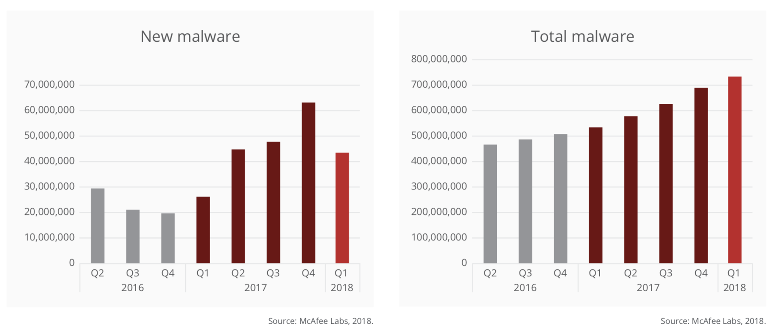
Latest Reports from McAfee

Slide 6
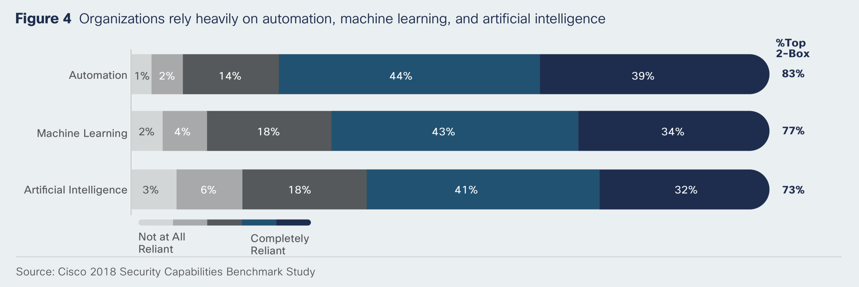
Latest Reports from Cisco

Slide 7
Malware detection methods
Static malware detection
Classifies samples without executing them.
Has datasets which can be created by aggregating the binaries files.
Dynamic malware detection
Detects malware based on its runtime behavior.
Hard to collect a dataset of malware behaviors because the they can identify the sandbox.

Slide 8
Related works
In 2001, Schultz et al. represented PE files by features that included imported functions, strings, and byte sequences.
In 2015, Saxe and Berlin used a histogram of byte entropy values and a multi-layer neural network.
In 2017, Edward Raff et al. used fully connected and recurrent networks and extend their results by training end-to-end deep learning networks.
…

Slide 9
Motivation
Most of the related works:
Incur scalability issues for examples, methods using neural networks usually take a lot of training time.
Use imbalanced datasets which makes validation metrics misleading in reality.

Slide 10
Proposed Method
2

Slide 11
Predictive accuracy, a popular choice for evaluating performance of a classifier, might not be appropriate when the data is imbalanced. - Nitesh V. Chawla

Slide 12
Issues of using Imbalanced Datasets
2.1
 | Malware | Benign
Predicted Malware | 9600 (TP) | 300 (FP)
Predicted Benign | 0 (FN) | 0 (TN)
Accuracy | ACC = (TP + TN) / (P + N) | 96.97 %
Precision | PPV = TP / (TP + FP) | 96.97 %
Recall | TPR = TP / (TP + FN) | 100.00 %
F1-Score | F1 = 2TP / (2TP + FP + FN) | 0.9846
False Alarm Rate | FPR = FP / (FP + TN) | 100 %

Slide 13
Issues of using Imbalanced Datasets
2.1
The number of malicious files is often much more larger than the number of benign files because of copyright laws.
The size of the dataset is often not large enough because the malware analysis and data labeling are consuming processes.
Many risks in publishing a large dataset that includes malicious binaries.

Slide 14
Feature Extraction
2.2
File-format agnostic feature groups decrease privacy concerns.
Byte-Entropy Histogram.
Byte Histogram.
String Information.
Parsed PE feature groups encapsulates the information related to executable code.

Slide 15
The number of new malicious files processed by Kaspersky Lab’s in-lab detection technologies reached 360,000 a day in 2017

Slide 16
Gradient Boosting Decision Trees (GBDT)
2.3
Scalability. The massive number of features causes scalability issues for many machine learning algorithms.
Training time. For examples, MalConv, the end-to-end deep learning model, took 25 hours for each epoch in training with the binaries from EMBER dataset.

Slide 17
Gradient Boosting Decision Trees (GBDT)
2.3
GBDT handles very well a large number of training samples in moderate training times.
GDBT is widely-used and achieves state-of-the-art performances in many tasks, such as ranking and click prediction.

Slide 18
Gradient Boosting Decision Trees
2.3
400 iterations.
64 leaves in one tree.
At least 200 samples in one child.
Learning rate at 5%.

Slide 19
Experiment
3

Slide 20
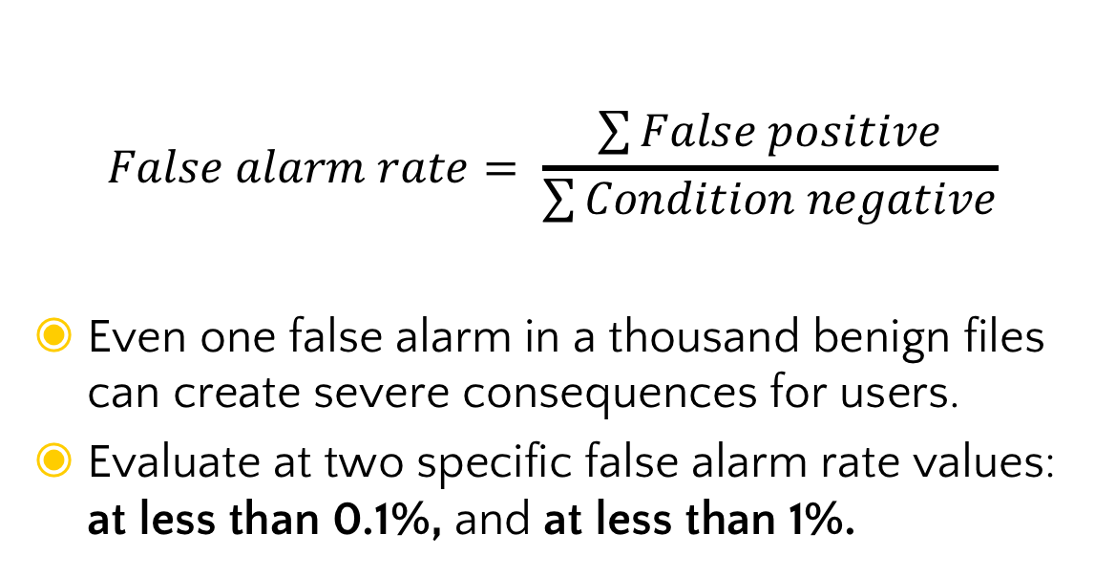
Evaluation Criteria
3.1
$$False alarm rate= \frac{\sum{False positive}}{\sum{Condition negative}}$$
Even one false alarm in a thousand benign files can create severe consequences for users.
Evaluate at two specific false alarm rate values: at less than 0.1%, and at less than 1%.

Slide 21
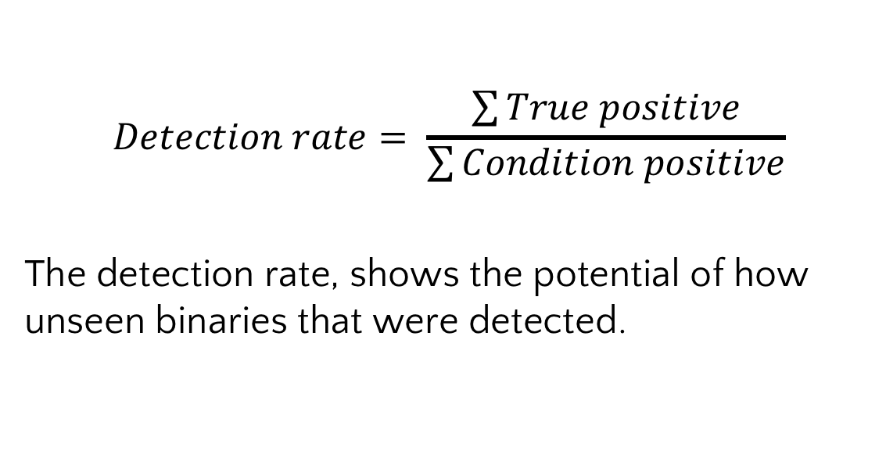
Evaluation Criteria
3.1
$$Detection rate= \frac{\sum{True positive}}{\sum{Condition positive}}$$
The detection rate, shows the potential of how unseen binaries that were detected.

Slide 22
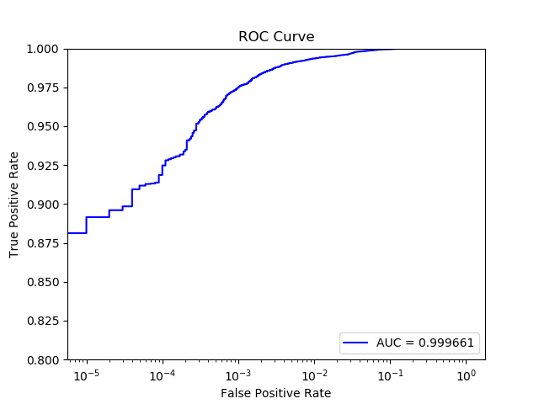
Evaluation Criteria
3.1
Area Under the ROC curve provides an aggregate measure of performance across all possible classification thresholds.
x-axis: False alarm rates
y-axis: Detection rates

Slide 23
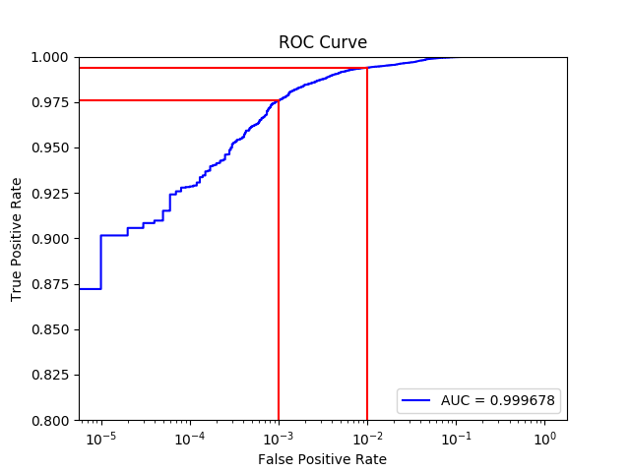
Experimental Results
3.2

Slide 24
Experimental Results
3.2
Model | Input | Specifications | Training time
MalConv | Raw binaries | 2 NVDIA TITAN X (Pascal) GPUs | 10 days (25 hours/epoch)
EMBER | 2351-value vectors | 8 vCPUs (2015 MacBook Pro i7) | 20 hours
Our model | 1711-value vectors | 24 vCPUs (Google Compute Engine) | 5 minutes

Slide 25
Experimental Results
3.2
Model | False Alarm Rate (FPR) | Detection Rate (TPR) | Area Under the ROC curve (AUC)
MalConv | 0.1 % | 92.200 % | 0.998210
 | 1.0 % | 97.300 %
EMBER | 0.1 % | 92.990 % | 0.999110
 | 1.0 % | 98.200 %
Our model | 0.1 % | 97.572 % | 0.999678
 | 1.0 % | 99.394 %

Slide 26
Experimental Results
3.2
Model | False Alarm Rate (FPR) | Detection Rate (TPR) | Area Under the ROC curve (AUC)
MalConv | 0.1 % | 92.200 % | 0.998210
 | 1.0 % | 97.300 %
EMBER | 0.1 % | 92.990 % | 0.999110
 | 1.0 % | 98.200 %
Our model | 0.1 % | 97.572 % | 0.999678
 | 1.0 % | 99.394 %

Slide 27
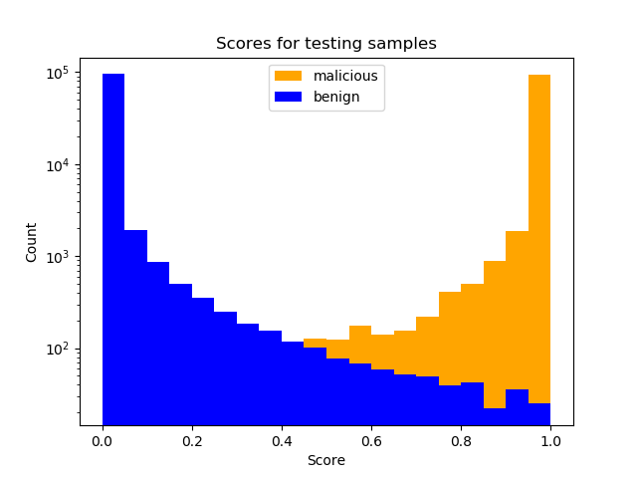
Experimental Results
3.2

Slide 28
Conclusion
4

Slide 29
Results
4.1
Build the background in information security, especially malware detection.
Understand the fundamental knowledge in Machine Learning.
Conduct experiments to apply machine learning models in malware detection.

Slide 30
Results
4.1
Conduct many experiments to apply and optimize gradient-boosting decision trees-based models in malware detection.
Submitted a scientific paper to The 5th International Conference on Future Data and Security Engineering 2018 (FDSE 2018) named “Static PE Malware Detection using Gradient Boosting Decision Trees algorithm”.

Slide 31
Future Works
4.2
Reduce the feature space. It is possible to reduce the dimension of feature vectors. Input vectors with smaller size boost the model and take less training time.
Use other datasets. Collecting a dataset is a task that requires a lot of time and efforts, especially in malware detection domain. With using format-agnostic features, we can receive more samples from security organizations in future.

Slide 32
Thank you for your attention.

Slide 33
Credits
Special thanks to all the people who made and released these awesome resources for free:
Presentation template by SlidesCarnival
Photographs by Unsplash

