Slide 1

Textual Analysis of Communications in COVID-19 Infected Community on Social Media
Yuhan Liu, Zhifan Nan, Yuhan Gao, Long Chen
Team 2

Slide 2
Motivation and Goal
COVID-19 has impacted the global this year.
People are discussing COVID-19 related issues on social media.
On Reddit, users participate in a subreddit, r/COVID-19Positive, to report positive diagnoses and raise questions about the pandemic.
Objective 1: analyze textual characteristics of posts on the subreddit
Objective 2: classify the posts into categories
DS-GA 1011 Project | Team 2

Slide 3
Related Work
Tumasjan et al. (2010) used LIWC¹ (Linguistic Inquiry and Word Count) to capture the political sentiment and predict elections with Twitter.
Zhang et al.(2020) used LIWC to provide insights into the sentiment of the descriptions of crowdfunding campaigns.
Lukasik et al. (2016) used sequence classification to predict rumour stance on Twitter.
Chen et al. (2020) used SOTA deep learning methods (BERT, XLNet) to classify the use of controversial terms associated with COVID-19 on Twitter.
1. Pennebaker, James W., et al. The development and psychometric properties of LIWC2015. 2015.
DS-GA 1011 Project | Team 2

Slide 4
Dataset
We crawled submissions (i.e. the original posts) on the subreddit r/COVID-19Positive from Mar. 14th, 2020 (when the subreddit first created) to Oct. 14th, 2020, using PushShift¹ API.
Removed entries with no flairs (a user-reported label that reflects topic of discussion).
In total, 15,410 entries were collected.
1. Baumgartner, Jason, et al. "The pushshift reddit dataset." Proceedings of the International AAAI Conference on Web and Social Media. Vol. 14. 2020.
DS-GA 1011 Project | Team 2

Slide 5
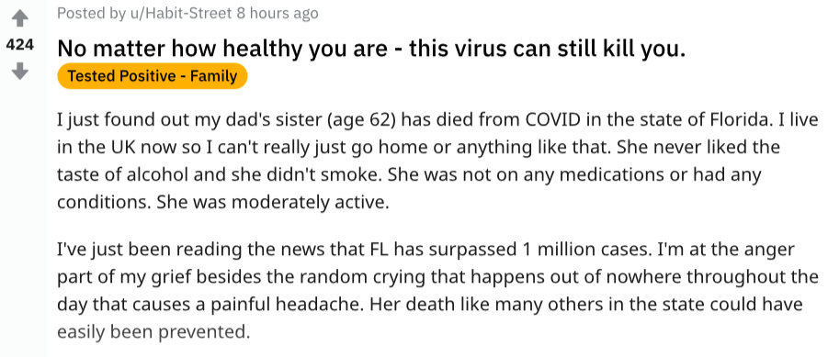
Data Preprocessing
flair
title
body
Merged title and body text into titletext.
Removed emojis, extra separators and repeated punctuations.
Labelled flair into three categories:
question (count=8,687):
Question
Question - to those who tested positive
Question – for medical research
Medical question
tested_positive (count=5,241):
Tested Positive
Tested Positive – Me
Tested Positive – Family
Tested Positive – Friends
presumed_positive (count=1,482):
Presumed Positive – from doctor
Presumed Positive – from test
DS-GA 1011 Project | Team 2

Slide 6
Methodology
LIWC2015 (Linguistic Inquiry and Word Count)
Analyzes linguistic features (e.g. level of emotion)
We concatenated posts in the same category to form three big documents, then use LIWC to get scores for the three documents, respectively.
Select and evaluate LIWC metrics.
Classification
We aim to classify the titletext’s into the three categories.
Models:
Stacking Ensemble Model (w/ TF-IDF enc): Random forest, SVM, Naïve Bayes, XGBoost, Logit Regression, K-nearest Neighbor
Bi-LSTM (w/ spaCy enc, word_vec_dim=50): epoch=5, ADAM, lr=1e-3, eps=1e-8, dropout=0.2
BERT (base, cased): fine-tuned, epoch=5, ADAM, lr=1e-5, eps=1e-8
XLNet (base, cased): fine-tuned, epoch=5, ADAM, lr=3e-5, eps=1e-8
Hyperparameter tuned with grid search.
DS-GA 1011 Project | Team 2

Slide 7
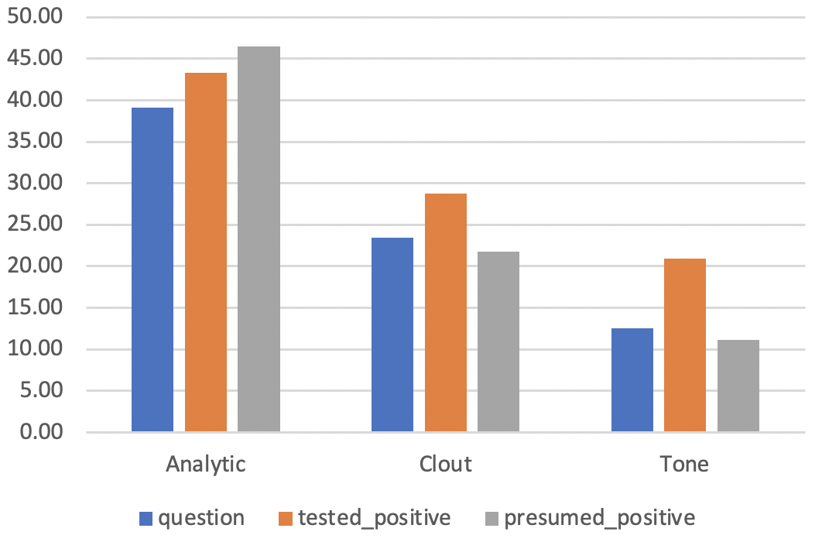
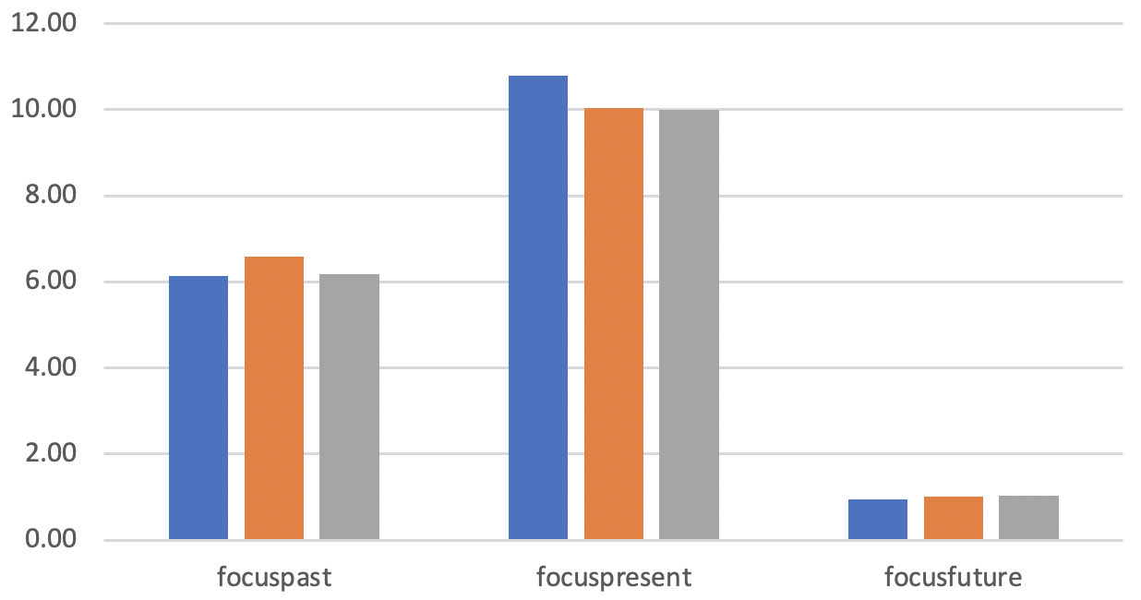
Results – LIWC2015
Presumed_positive posts have higher Analytic (i.e. analytical thinking) score, inferring more logic and formal thinking in discussion.
Tested_positive posts have higher Clout (i.e. confidence) and Tone (i.e. emotional tone), inferring more “certainty” about diagnosis and more “emotional” with getting infected.
Tested_positive posts have higher focus on the past, while question posts have more focus on present. All categories of posts does not have significant difference or level of focus on the future.
DS-GA 1011 Project | Team 2

Slide 8
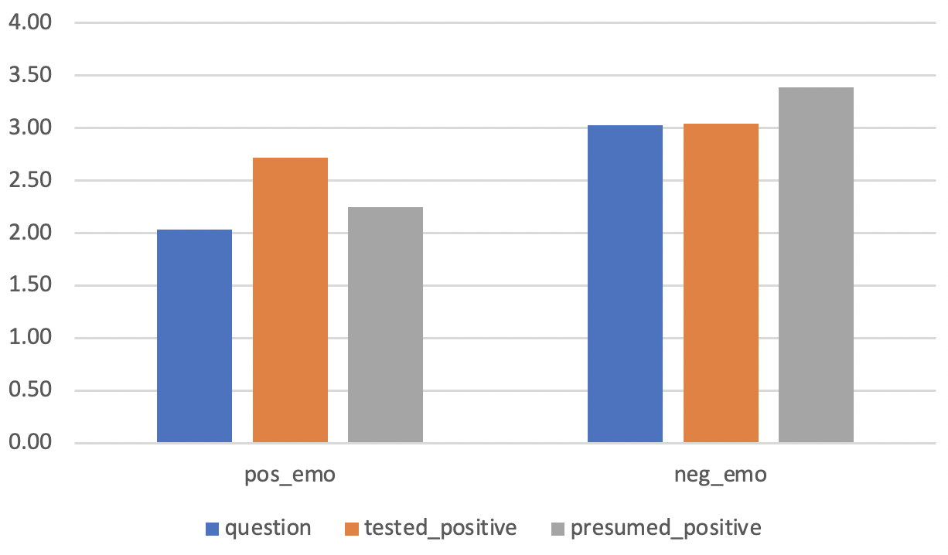
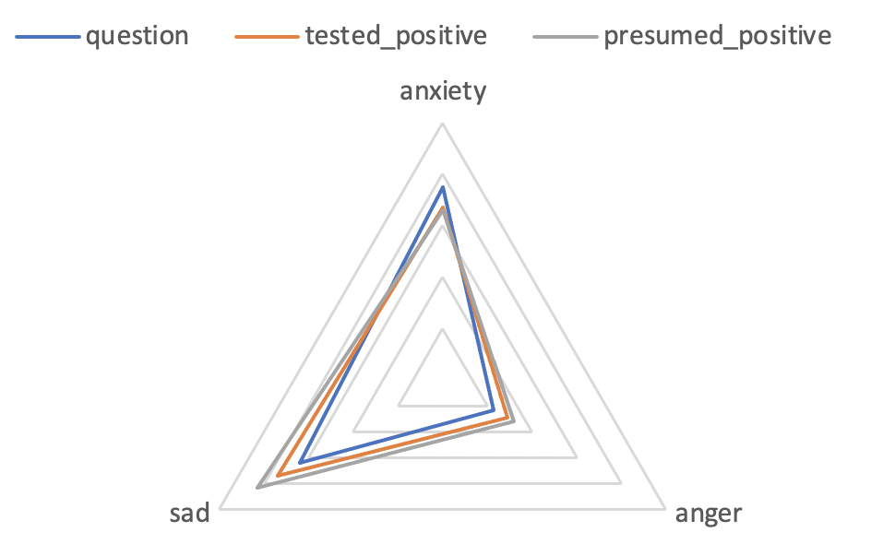
Results – LIWC2015
Surprisingly, tested_positive posts have higher level of positive emotions, while presumed_positive posts have higher level of negative emotions.
For negative emotions, question posts have higher anxiety level but lower sadness and anger level.
Presumed_positive posts have higher sadness and anger level in comparison to tested_positive posts.
All categories of posts contain low levels of anger.
DS-GA 1011 Project | Team 2

Slide 9
Results -- Classification
Fine-tuned BERT achieved best performance at epoch=3. Overfitting started to limit the training afterwards.
Bi-LSTM w/ spaCy does not perform well. Does not improve with higher word embedding dimension.
Ensemble model achieved good performance
Size of dataset (N=15,410) potentially restricted a leap in performance for SOTA pre-trained models.
Model | Accuracy | F1
Ensemble w/ TF-IDF | 0.685 | 0.676
Bi-LSTM w/ spaCy | 0.625 | 0.604
BERT | 0.726 | 0.722
XLNet | 0.711 | 0.702
DS-GA 1011 Project | Team 2

Slide 10
Future Work
Incorporate more features into classification model (e.g. metadata from Reddit including upvotes, downvotes and number of comments; the LIWC scores)
Analysis with Reddit comment could be performed. In fact, there are more than 1 mil comment in the subreddit. They do not contain flairs, but can be useful for unsupervised pattern recognitions (e.g. LDA).
Such model can be used on social media to identify infected people for related study (e.g. psychological evaluation).
DS-GA 1011 Project | Team 2

Slide 11
Thank you!
DS-GA 1011 Project | Team 2

Slide 12
Reference
Despoina Chatzakou and Athena Vakali. 2015. Harvesting opinions and emotions from social media textual resources. IEEE Internet Computing,19(4):46–50.
Long Chen, Hanjia Lyu, Tongyu Yang, Yu Wang, and Jiebo Luo. 2020. In the eyes of the beholder: Sentiment and topic analyses on social media use of neutral and controversial terms for covid-19.arXivpreprint arXiv:2004.10225.
Aysu Ezen-Can. 2020. A comparison of lstm and bert for small corpus. arXiv preprint arXiv:2009.05451.
Qianjia Huang, Vivek Kumar Singh, and Pradeep Kumar Atrey. 2014. Cyber bullying detection using social and textual analysis. In Proceedings of the 3rdInternational Workshop on Socially-Aware Multimedia, pages 3–6.
Michal Lukasik, PK Srijith, Duy Vu, Kalina Bontcheva, Arkaitz Zubiaga, and Trevor Cohn. 2016. Hawkes processes for continuous time sequence classification: an application to rumour stance classification in twitter. In Proceedings of the 54th Annual Meeting of the Association for Computational Linguistics(Volume 2: Short Papers), pages 393–398.
K Mouthami, K Nirmala Devi, and V Murali Bhaskaran. 2013. Sentiment analysis and classification based on textual reviews. In2013 international conference on Information communication and embedded systems (ICICES), pages 271–276. IEEE.
Andranik Tumasjan, Timm O Sprenger, Philipp G Sandner, and Isabell M Welpe. 2010. Predicting elections with twitter: What 140 characters reveal about political sentiment. In Fourth international AAAI conference on weblogs and social media.
Bei Yu, Stefan Kaufmann, and Daniel Diermeier. 2008.Exploring the characteristics of opinion expressions for political opinion classification. In Proceedings of the 2008 international conference on Digital government research, pages 82–91. Digital Government Society of North America.
Xupin Zhang, Hanjia Lyu, and Jiebo Luo. 2020. What contributes to a crowdfunding campaign’s success? evidence and analyses from gofundme data. arXiv preprint arXiv:2001.05446.
DS-GA 1011 Project | Team 2

