Slide 1


Python^{3.7}

Slide 2

Agenda
Python Essentials- Day 4
01 | File Handling Overview | 05 | Exercises
02 | File Modes
03 | File Reading
04 | File Writing

Slide 3
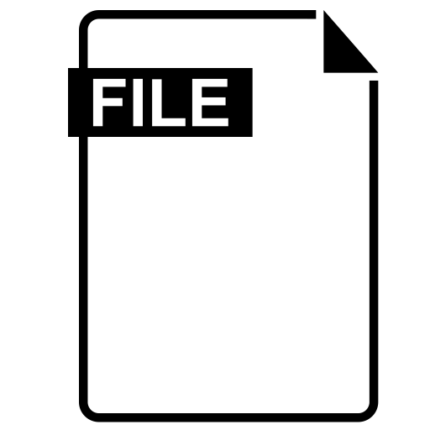
What is a File?
File is a named location on disk to store related information.
It is used to permanently store data in a non-volatile memory (e.g. hard disk).
Since, random access memory (RAM) is volatile which loses its data when computer is turned off,
we use files for future use of the data.

Slide 4
File Operation Order
Open a file > Read or write > Close the file

Slide 5
File Modes
The modes are:
‘r’ – Read mode which is used when the file is only being read
‘w’ – Write mode which is used to edit and write new information to the file (any existing files with the same name will be erased when this mode is activated)
‘a’ – Appending mode, which is used to add new data to the end of the file; that is new information is automatically amended to the end
‘r+’ – Special read and write mode, which is used to handle both actions when working with a file

Slide 6

Practical Lab
hisss…ss…
Lets Python!

Slide 7
Summary
File Handling is an Important Aspect of Application Development
-it Helps Developer Store Data Permanently
Reading and Writing Of Files

