Slide 1
Announcements
Midterms are marked
Assignment 2:
  Still analyzing

Slide 2
Loop Invariants (Revisited)
Question 5(a): Design an iterative algorithm for Parity:
Loop Invariant?
LI: After i iterations are performed, p=Parity(s[1…i])

Slide 3
What is a loop invariant?
An assertion about the state of one or more variables used in the loop.
When the exit condition is met, the LI leads naturally to the postcondition (the goal of the algorithm).
Thus the LI must be a statement about the variables that store the results of the computation.

Slide 4
Know What an LI Is Not
``the LI is NOT...''
  code
  The steps taken by the algorithm
  A statement about the range of values assumed by the loop index.

Slide 5
Dynamic Programming: Recurrence

Slide 6
Dynamic programming
Step 1: Describe an array of values you want to compute.
Step 2: Give a recurrence for computing later values from earlier (bottom-up).
Step 3: Give a high-level program.
Step 4: Show how to use values in the array to compute an optimal solution.

Slide 7

Example 1. Rock climbing
4
5
3
2
At every step our climber can reach exactly three handholds: above, above and to the right and above and to the left.
There is a table of “danger ratings” provided. The “Danger” of a path is the sum of danger ratings of all handholds on the path.

Slide 8
For every handhold, there is only one “path” rating. Once we have reached a hold, we don’t need to know how we got there to move to the next level.
This is called an “optimal substructure” property. Once we know optimal solutions to subproblems, we can compute an optimal solution to the problem itself.

Slide 9
Step 2. Define a Recurrence
Let C(i,j) represent the danger of hold (i,j)
Let A(i,j) represent the cumulative danger of the safest path from the bottom to hold (i,j)
Then
A(i,j) = C(i,j)+min{A(i-1,j-1),A(i-1,j),A(i-1,j+1)}
i.e., the safest path to hold (i,j) subsumes the safest path to holds at level i-1 from which hold (i,j) can be reached.

Slide 10
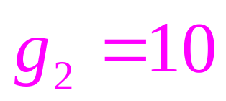
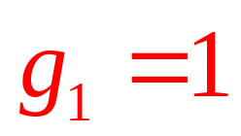
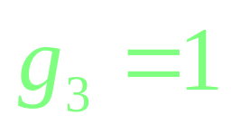
Example 2. Activity Scheduling with Profits

Slide 11
Step 2. Provide a Recurrent Solution
Decide not to schedule activity i
Profit from scheduling activity i
Optimal profit from scheduling activities that end before activity i begins

Slide 12
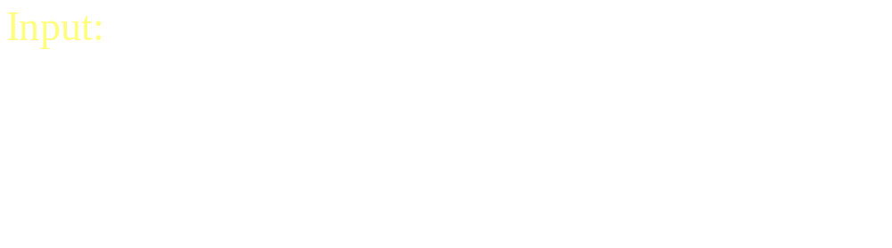
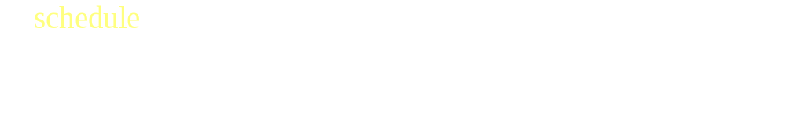

Example 3: Scheduling Jobs with Deadlines, Profits and Durations

Slide 13
Dynamic Programming Solution

Slide 14
Step 2. Provide a Recurrent Solution
Decide not to schedule job i
Profit from job i
Profit from scheduling activities that end before job i begins

Slide 15
Step 2. (cntd…) Proving the Recurrent Solution
We effectively schedule job i at the latest possible time.
This leaves the largest and earliest contiguous block of time for scheduling jobs with earlier deadlines.

Slide 16



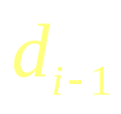



Case 1
event i
…
Case 2
event i
…

Slide 17
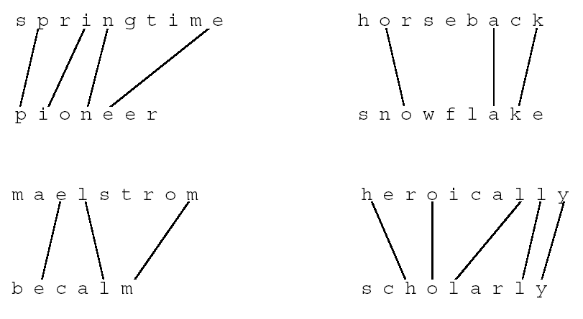
Example 3. Longest Common Subsequence

Slide 18
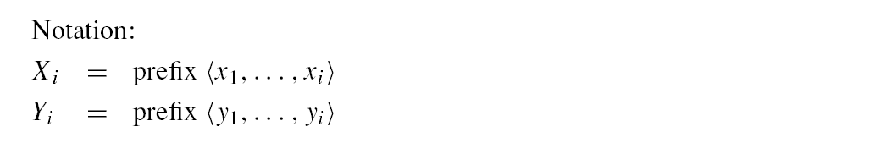
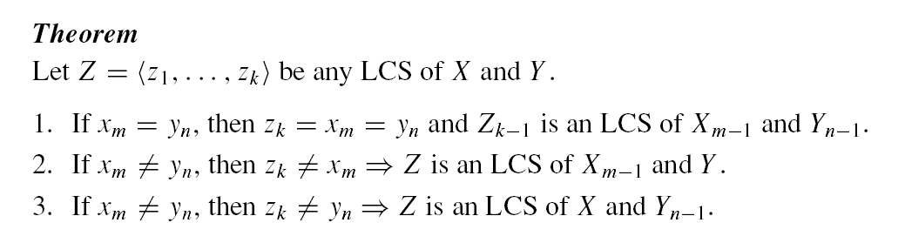
Optimal Substructure
Input: 2 sequences, X = x₁, . . . , x_{m} and Y = y₁, . . . , y_{n}.

Slide 19
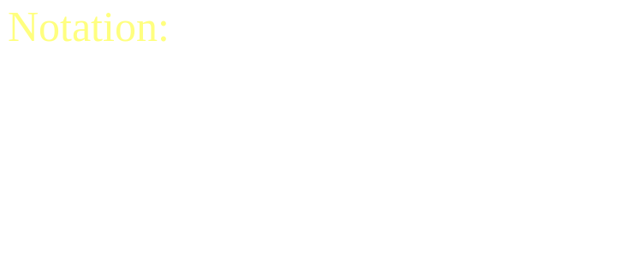
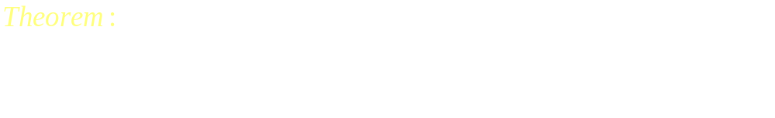

Proof of Optimal Substructure Part 1

Slide 20
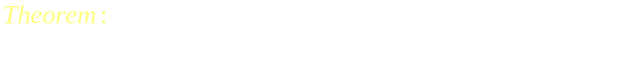

Proof of Optimal Substructure Part 2

Slide 21
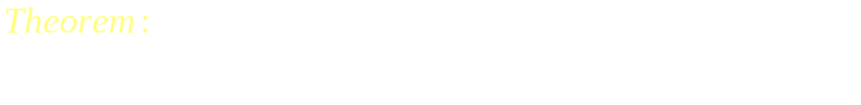
Proof of Optimal Substructure Part 3

Slide 22
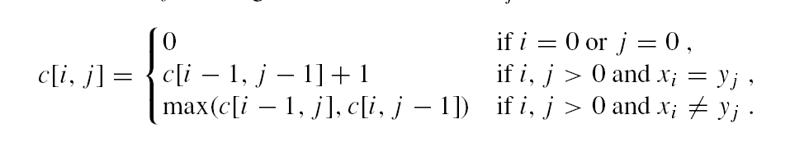
Step 2. Provide a Recurrent Solution
Input sequences are empty
Last elements match: must be part of LCS
Last elements don’t match: at most one of them is part of LCS

Slide 23
Example 6: Longest Increasing Subsequence
Input: 1 sequence, X = x₁, . . . , x_{n}.
Output: the longest increasing subsequence of X.
Note: A subsequence doesn’t have to be consecutive, but it has to be in order.

Slide 24
Step 1. Define an array of values to compute

Slide 25
Step 2. Provide a Recurrent Solution

Slide 26
Step 3. Provide an Algorithm
function A=LIS(X)
for i=1:length(X)
m=0;
for j=1:i-1
if X(j) < X(i) & A(j) > m
m=A(j);
end
end
A(i)=m+1;
end
Running time?
O(n²)

Slide 27
Step 4. Compute Optimal Solution
function lis=printLIS(X, A)
[m,mi]=max(A);
lis=printLISm(X,A,mi,'LIS: ');
lis=[lis,sprintf('%d', X(mi))];
Running time?
O(n)
function lis=printLISm(X, A, mi, lis)
if A(mi) > 1
i=mi-1;
while ~(X(i) < X(mi) & A(i) == A(mi)-1)
i=i-1;
end
lis=printLISm(X, A, i, lis);
lis=[lis, sprintf('%d ', X(i))];
end

Slide 28
LIS Example
X = 96 24 61 49 90 77 46 2 83 45
A = 1 1 2 2 3 3 2 1 4 2
> printLIS(X,A)
> LIS: 24 49 77 83

Slide 29
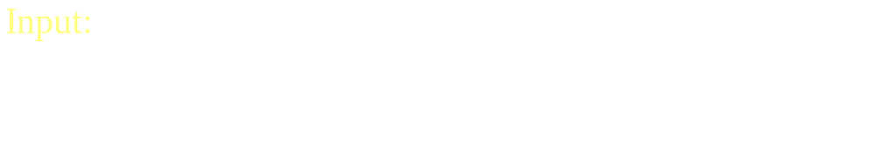
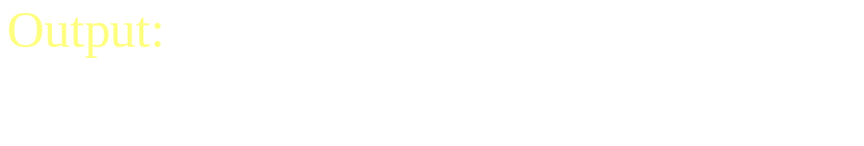
Example 6: Optimal Binary Search Trees

Slide 30
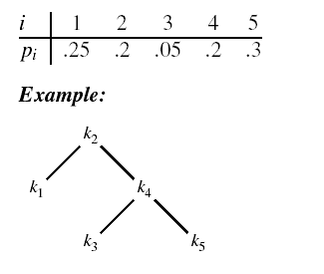
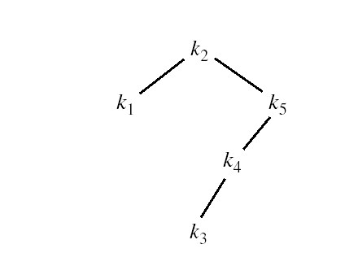
Expected Search Cost
Which BST is more efficient?

Slide 31
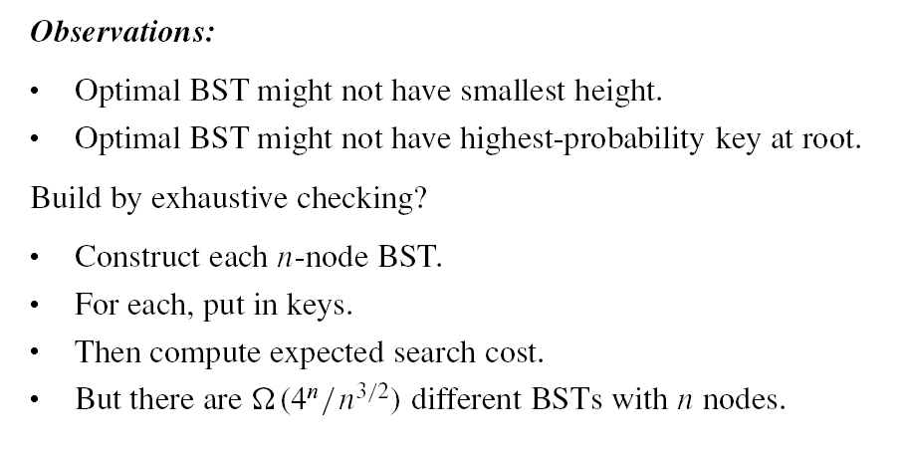
Observations

Slide 32
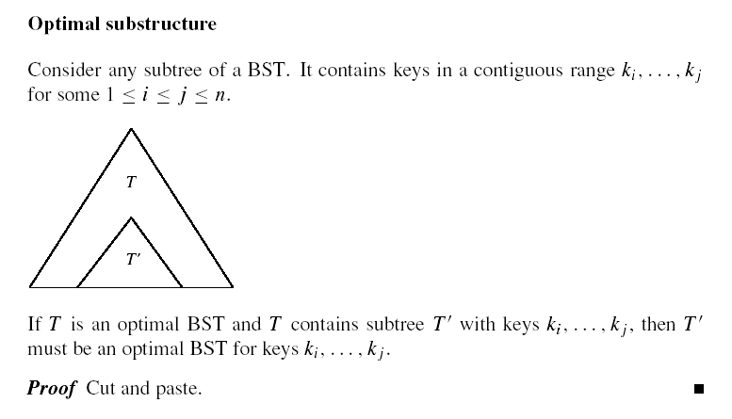
Optimal Substructure

Slide 33

Optimal Substructure (cntd…)
T

Slide 34
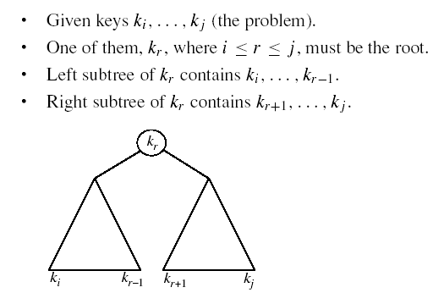
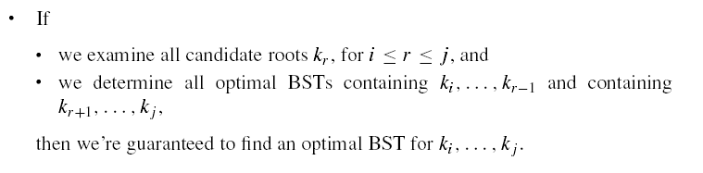
Recursive Solution

Slide 35
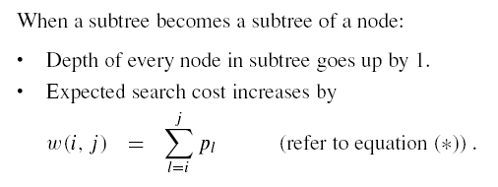
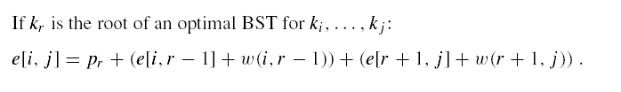

Recursive Solution (cntd…)

Slide 36
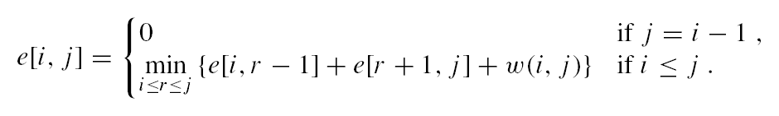
Step 2. Provide a Recurrent Solution
Expected cost of search for left subtree
Expected cost of search for right subtree
Added cost when subtrees embedded under root

Slide 37
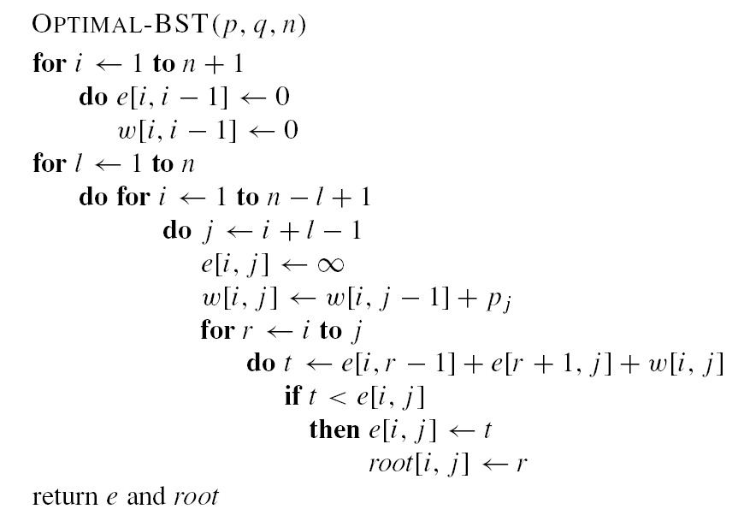
Step 3. Provide an Algorithm
n)
Running time?
O(n³)
work on subtrees of increasing size l

Slide 38
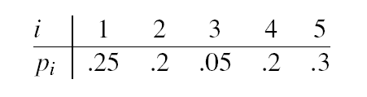
Example

Slide 39
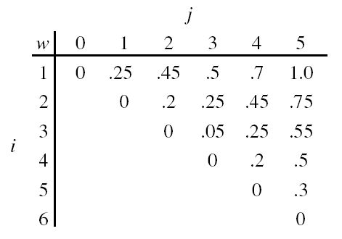
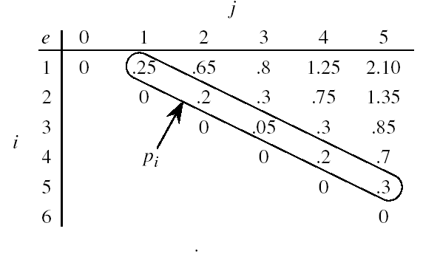
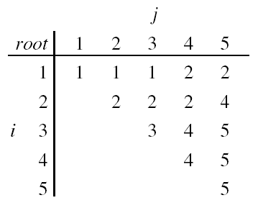
Example (cntd…)

Slide 40
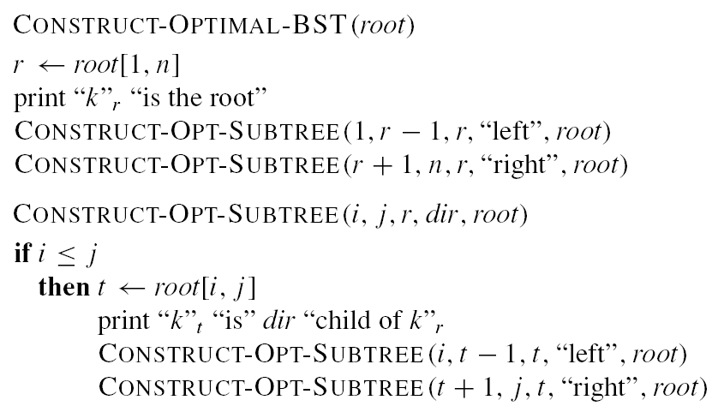
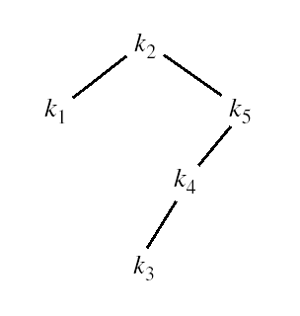
Step 4. Compute Optimal Solution
Running time?
O(n)

Slide 41
Elements of Dynamic Programming
Optimal substructure:
  an optimal solution to the problem contains within it optimal solutions to subproblems.

Slide 42
Elements of Dynamic Programming
Cut and paste: prove optimal substructure by contradiction:
  assume an optimal solution to a problem with suboptimal solution to subproblem
  cut out the suboptimal solution to the subproblem.
  paste in the optimal solution to the subproblem.
  show that this results in a better solution to the original problem.
  This contradicts our assertion that our original solution is optimal.

Slide 43
Elements of Dynamic Programming
Dynamic programming uses optimal substructure from the bottom up:
  First find optimal solutions to subproblems
  Then choose which to use in optimal solution to problem.

Slide 44
Section V. Graph Algorithms

Slide 45
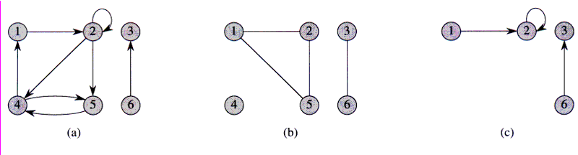
Directed and Undirected Graphs
A directed graph G = (V, E), where V = {1,2,3,4,5,6} and
E = {(1,2), (2,2), (2,4), (2,5), (4,1), (4,5), (5,4), (6,3)}.
The edge (2,2) is a self-loop.
(b) An undirected graph G = (V,E), where V = {1,2,3,4,5,6} and
E = {(1,2), (1,5), (2,5), (3,6)}. The vertex 4 is isolated.
(c) The subgraph of the graph in part (a) induced by the vertex set {1,2,3,6}.

Slide 46
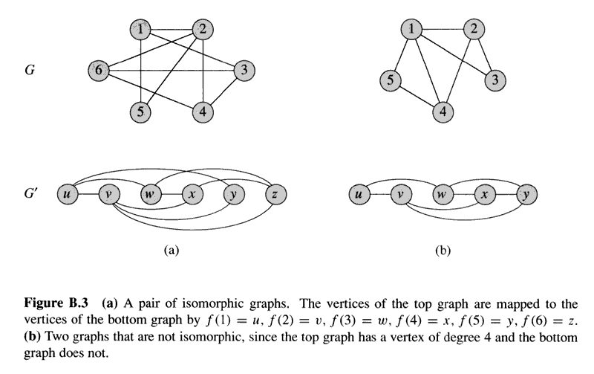
Graph Isomorphism

Slide 47
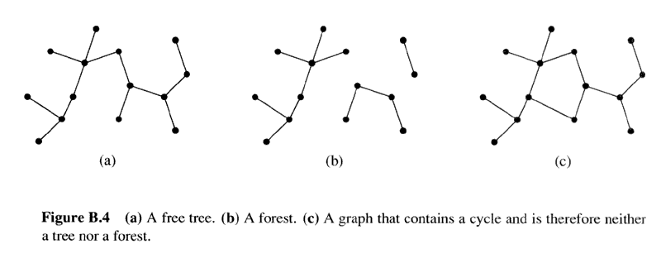
Trees

Slide 48
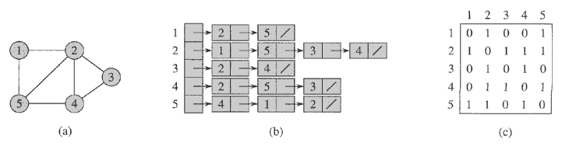
Representations: Undirected Graphs
Adjacency List
Adjacency Matrix

Slide 49
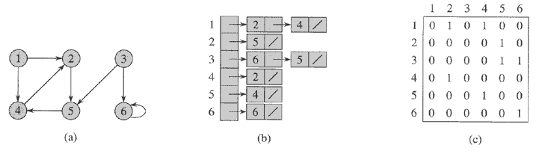
Representations: Directed Graphs
Adjacency List
Adjacency Matrix

