Slide 1
Introduction to Algorithms
Jiafen Liu
Sept. 2013

Slide 2
Today’s Tasks
Graphs and Greedy Algorithms
  Graph representation
  Minimum spanning trees
  Optimal substructure
  Greedy choice
  Prim’s greedy MST algorithm

Slide 3
Graphs(for review)
A directed graph (digraph) G= (V, E) is consisting of
  a set V of vertices(singular: vertex),
  a set E⊆V×V of ordered edges.
In an undirected graph G= (V, E),the edge set E consists of unordered pairs of vertices.
In either case, we have |E|= O(|V|²).
if G is connected, then |E|≥|V|–1
Both of the above 2 imply that lg|E|= Θ(lg|V|). (Review Appendix B.)

Slide 4
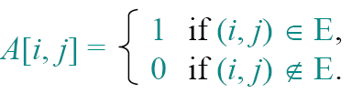
How to store a graph in computer
The adjacency matrix of a graph G= (V, E), where V= {1, 2, …, n}, is the matrix A[1 . . n, 1 . . n] given by
An adjacency list of a vertex v∈V is the list Adj[v] of vertices adjacent to v.

Slide 5
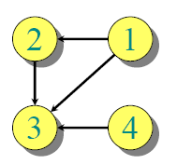
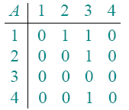
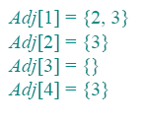
Example
What’s the representation of this graph with matrix and list?

Slide 6
Analysis of adjacency matrix
We say that, vertices are adjacent, but edges are incident on vertices.
With |V| nodes, how much space the matrix takes?
  Θ(|V| ²)storage
  It applies to?
  Dense representation

Slide 7
Analysis of adjacency list
For undirected graphs, |Adj[v]|=degree(v).
For digraphs, |Adj[v]|= out-degree(v).

Slide 8
Handshaking Lemma
Handshaking Lemma: Σ_{v∈V}degree(v)=2|E| for undirected graphs
Under Handshaking Lemma, adjacency lists use how much storage?
  Θ(V+E)
a sparse representation (for either type of graph).

Slide 9

Minimum spanning trees
Input: A connected, undirected graph G= (V, E) with weight function w: E→R.
  For simplicity, assume that all edge weights are distinct.
Output: A spanning tree T —a tree that connects all vertices —of minimum weight:

Slide 10
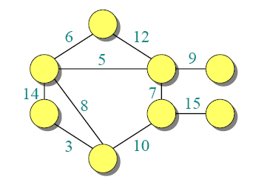
Example of MST

Slide 11
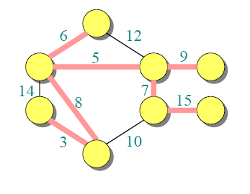
Example of MST

Slide 12
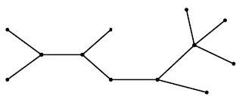
MST and dynamic programming
MST T(Other edges of G are not shown.)
What’s the connection of these two problem?

Slide 13
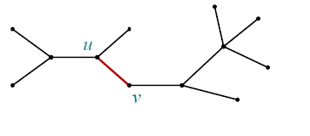
MST and dynamic programming
MST T(Other edges of G are not shown.)
Remove any edge (u, v) ∈T.

Slide 14
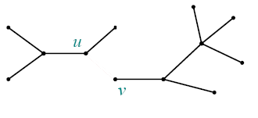
MST and dynamic programming
MST T(Other edges of G are not shown.)
Remove any edge (u, v) ∈T.

Slide 15
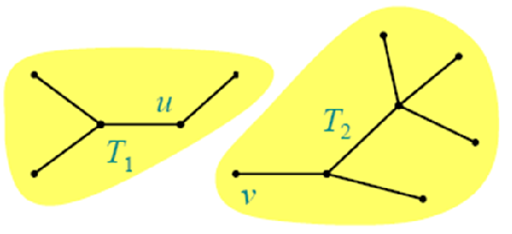
MST and dynamic programming
MST T(Other edges of G are not shown.)
Remove any edge (u, v) ∈T. Then, T is partitioned into two subtrees T₁ and T₂.

Slide 16
Theorem of optimal substructure
Theorem. The subtree T₁ is an MST of G₁= (V₁, E₁), G₁ is a subgraph of G induced by the vertices of T₁:
V₁=vertices of T₁
E₁= { (x, y) ∈E: x, y∈V₁ }.
Similarly for T₂.
How to prove?
  Cut and paste

Slide 17
Proof of optimal substructure
Proof.
w(T) = w(u, v) + w(T₁) + w(T₂).
If T₁′ were a lower-weight spanning tree than T₁ for G₁, then T′= {(u, v)} ∪T₁′∪T₂ would be a lower-weight spanning tree than T for G.
Another hallmark of dynamic programming?
Do we also have overlapping subproblems?
  Yes.

Slide 18
MST and dynamic programming
Great, then dynamic programming may work!
Yes, but MST exhibits another powerful property which leads to an even more efficient algorithm.

Slide 19
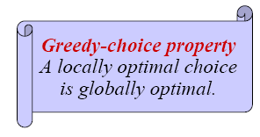
Hallmark for “greedy” algorithms
Theorem. Let T be the MST of G= (V, E), and let A⊆V. Suppose that (u, v) ∈E is the least-weight edge connecting A to V–A. Then (u, v) ∈T.

Slide 20
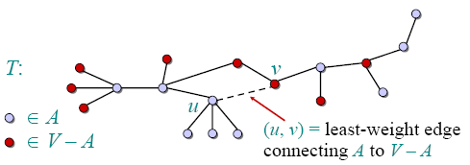
Proof of theorem
Proof. Suppose (u, v) ∉T. Cut and paste.

Slide 21
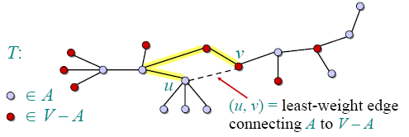
Proof of theorem
Proof. Suppose (u, v) ∉T. Cut and paste.
Consider the unique simple path from u to v in T.

Slide 22
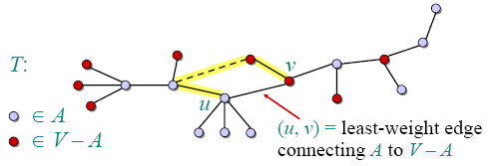
Proof of theorem
Proof. Suppose (u, v) ∉T. Cut and paste.
Consider the unique simple path from u to v in T.
Swap (u, v) with the first edge on this path that connects a vertex in A to a vertex in V–A.

Slide 23
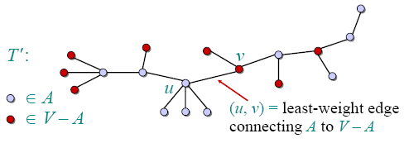
Proof of theorem
Proof. Suppose (u, v) ∉T. Cut and paste.
Consider the unique simple path from u to v in T.
Swap (u, v) with the first edge on this path that connects a vertex in A to a vertex in V–A.
A lighter-weight spanning tree than T !

Slide 24
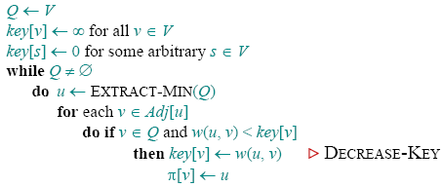

Prim’s algorithm
IDEA: Maintain V–A as a priority queue Q. Key each vertex in Q with the weight of the least-weight edge connecting it to a vertex in A.
At the end,
forms the MST.

Slide 25
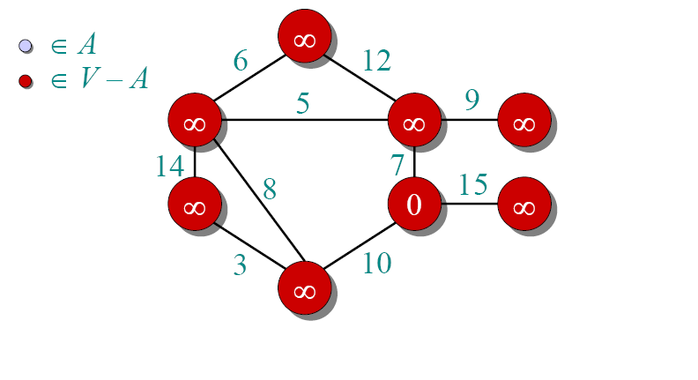
Example of Prim’s algorithm

Slide 26
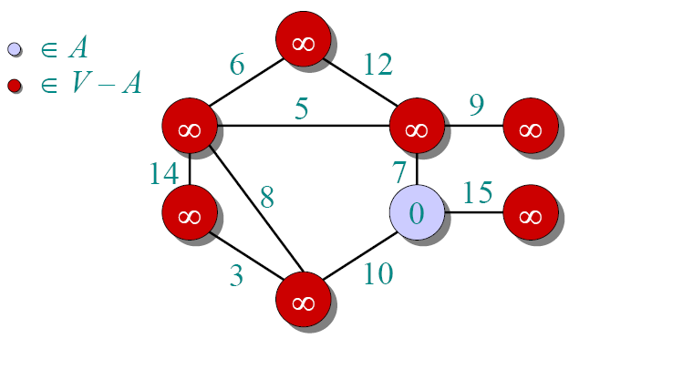
Example of Prim’s algorithm

Slide 27
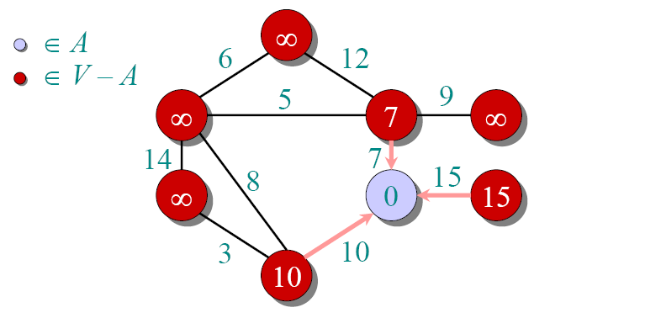
Example of Prim’s algorithm

Slide 28
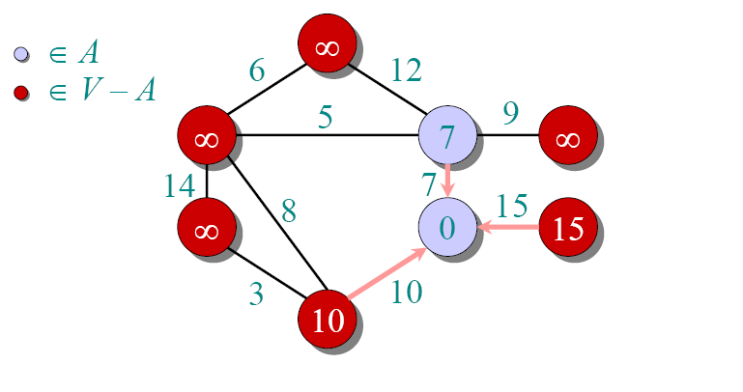
Example of Prim’s algorithm

Slide 29
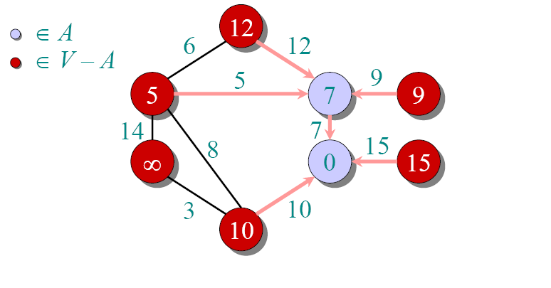
Example of Prim’s algorithm

Slide 30
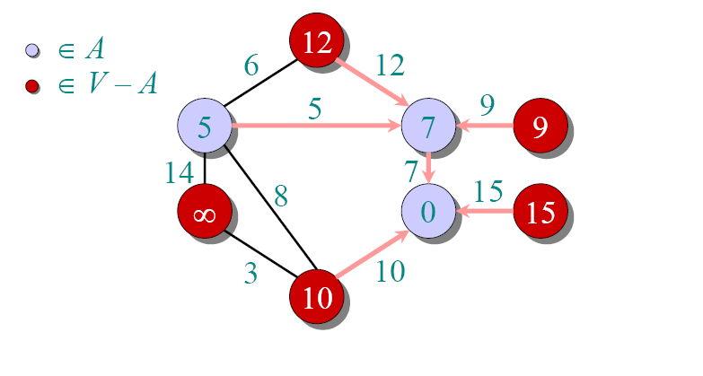
Example of Prim’s algorithm

Slide 31
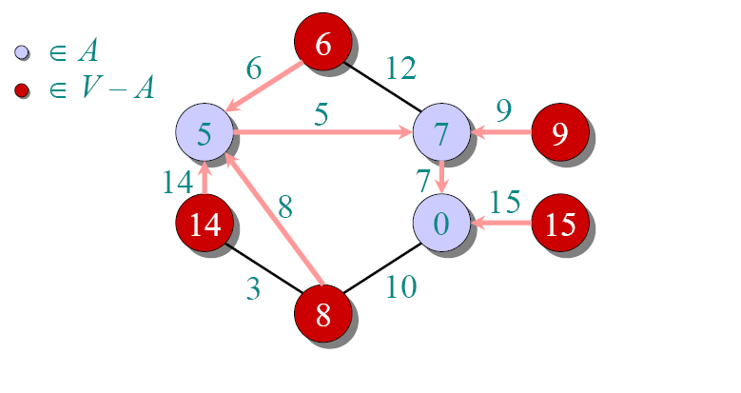
Example of Prim’s algorithm

Slide 32
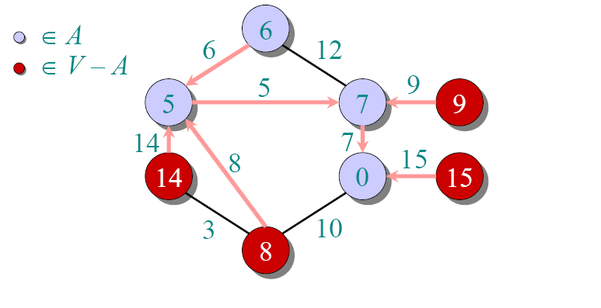
Example of Prim’s algorithm

Slide 33
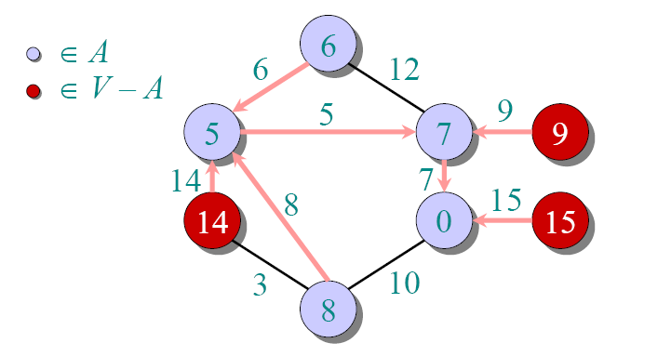
Example of Prim’s algorithm

Slide 34
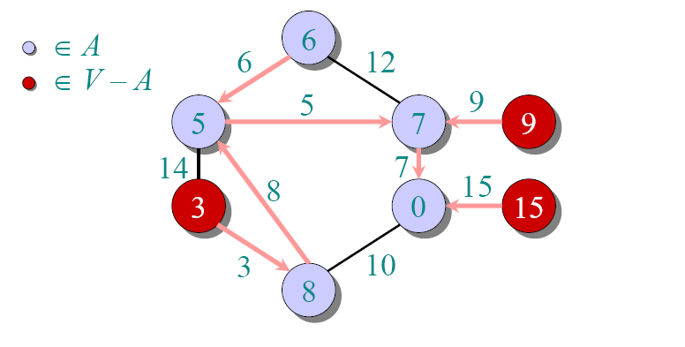
Example of Prim’s algorithm

Slide 35
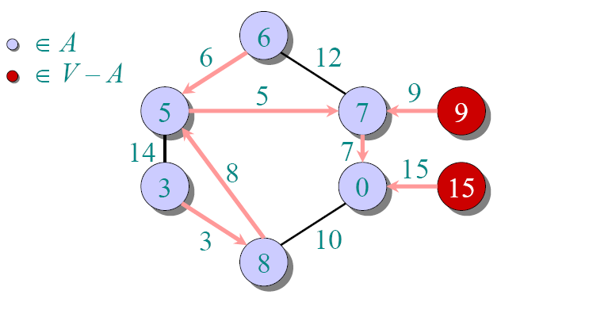
Example of Prim’s algorithm

Slide 36
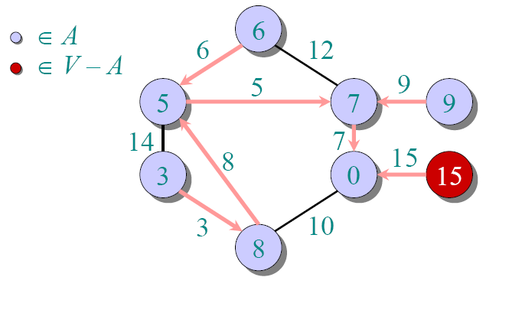
Example of Prim’s algorithm

Slide 37
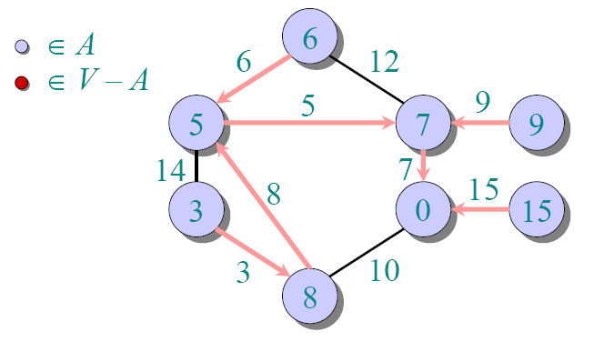
Example of Prim’s algorithm

Slide 38
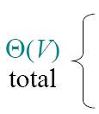
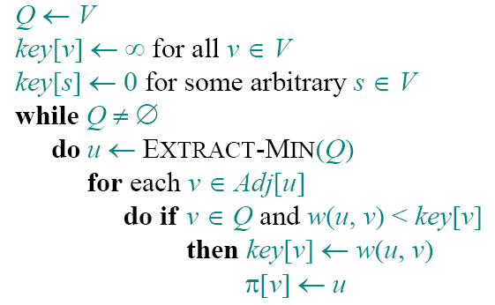
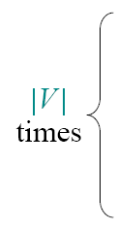
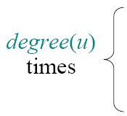
Analysis of Prim

Slide 39
Analysis of Prim
Handshaking Lemma ⇒Θ(E) implicit DECREASE-KEY’s.

Slide 40
Analysis of Prim

Slide 41
MST algorithms
Kruskal’s algorithm (see the book):
  Uses the disjoint-set data structure
  Running time = O(ElgV).
Best to date:
  Karger, Klein, and Tarjan [1993].
  Randomized algorithm.
  O(V+ E)expected time.

Slide 42
More Applications
Activity-Selection Problem
0-1 knapsack

Slide 43
Activity-Selection Problem
Problem: Given a set A = {a₁, a₂, …, a_{n}} of n activities with start and finish times (s_{i}, f_{i}), 1 ≤ i ≤ n, select maximal set S of non-overlapping activities.

Slide 44

Activity Selection
Here is the problem from the book:
  Activity a₁ starts at s₁ = 1, finishes at f₁ = 4.
  Activity a₂ starts at s₂ = 3, finishes at f₂ = 5.
Got the idea?
  The set S is sorted in monotonically increasing order of finish time.The subsets of {a₃, a₉, a₁₁} and {a₁, a₄, a₈ , a₁₁}are mutually compatible.

Slide 45
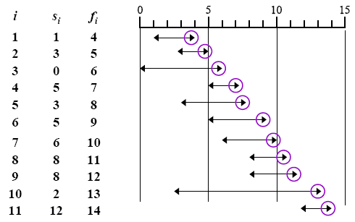
Activity Selection
Software School of XiDian University

Slide 46
Activity Selection
Objective: to create a set of maximum activities a_{i} that are compatible.
  Modeling the subproblems: Create a set of activities that can start after a_{i} finishes, and finish before activity a_{j} starts.
  Let S_{ij} be that set of activities. S_{ij} = { a_{k} ∈ S : f_{i} ≤ s_{k} < f_{k} ≤ s_{j} } ⊆ S where S is the complete set of activities, only one of which can be scheduled at any particular time. (They share a resource, which happens, in a way, to be a room).

Slide 47
Property of S_{ij}
We add fictitious activities a₀ and a_{n+1} and adopt the conventions that f₀ = 0, s_{n+1} = ∞. Assume activities are sorted by increasing finishing times:f₀ ≤ f₁ ≤ f₂ ≤ ... ≤ f_{n}< f_{n+1}. Then S = S_{0, n+1}, for 0 ≤ i, j ≤ n+1.
Property 1. S_{ij} = φ if i ≥ j.
  Proof Suppose i ≥ j and S_{ij} ≠ φ, then there exists a_{k} such that f_{i} ≤ s_{k} < f_{k} ≤ s_{j}< f_{j}, therefore f_{i} < f_{j}. But i ≥ j implies that f_{i} ≥ f_{j}, that’s a contradiction.
Notes:
Fictitious:假想的, 编造的, 虚伪的, 习惯上假定的, 假想的

Slide 48
Optimal Substructure
The optimal substructure of this problem is as follows:
  Suppose we have an optimal solution A_{ij} to S_{ij} include a_{k}, i.e., a_{k} ∈ S_{ij}. Then the activities that make up S_{ij} can be represented by A_{ij} = A_{ik} ∪ {a_{k}} ∪ A_{kj}
We apply cut-and-paste argument to prove the optimal substructure property.

Slide 49

A recursive solution
Define c[i, j] as the number of activities in a maximum-size subset of mutually compatible activities. Then
Converting a dynamic-programming solution to a greedy solution.
  We may still write a tabular, bottom-up, dynamic programming algorithm based on recurrence.
  But we can obtain a simplified solution by transforming a dynamic-programming solution into a greedy solution.

Slide 50
Greedy choice property
Theorem 16.1 Consider any nonempty subproblem S_{ij}, and let a_{m} be the activity in S_{ij} with the earliest finish time: f_{m} = min{ f_{k} : a_{k} ∈ S_{ij} }.
  Activity a_{m} is used in some maximum-size subset of mutually compatible activities of S_{ij}.
  The subproblem S_{im} is empty, so that choosing a_{m} leaves the subproblem S_{mj} as the only one that may be nonempty.

Slide 51
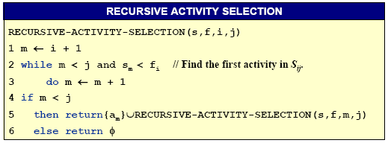
A recursive greedy algorithm
The procedure RECURSIVE-ACTIVITY-SELECTION is almost “tail recursive”: it ends with a recursive call to itself followed by a union operation. It is a straightforward task to transform a tail-recursive procedure to an iterative form.

Slide 52
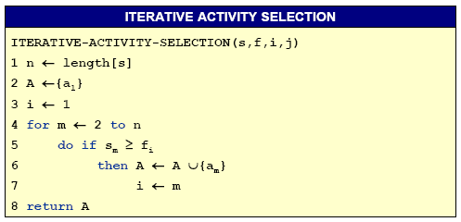
An iterative greedy algorithm
This procedure schedules a set of n activities in Θ(n) time, assuming that the activities were already sorted initially by their finish times.

Slide 53
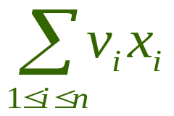
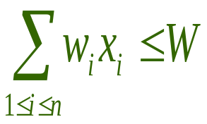
0-1 knapsack
    A thief robs a store and finds n items, with item i being worth $v_{i} and having weight w_{i} pounds, The thief can carry at most W ∈ N in his knapsack but he wants to take as valuable a load as possible. Which item should he take?
    i.e., is maximized and s.t.

Slide 54
Fractional knapsack problem
The setup is the same, but the thief can take fractions of items.

Slide 55
Optimal substructure
Do they exhibit the optimal substructure property?
  For 0-1 knapsack problem, if we remove item j from this load, the remaining load must be at most valuable items weighing at most W-w_{j} from n -1 items.
  For fractional one, if we remove a weight w of one item j from the optimal load, then the remaining load must be the most valuable load weighing at most W -w that the thief can take from the n-1 original items plus w_{j} –w pounds of item j.

Slide 56
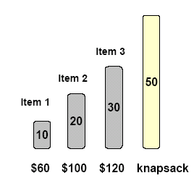
Different solving method
Can Fractional knapsack problem use Greedy Choice?
  Yes
How?

Slide 57
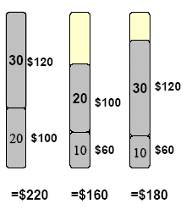
Different solving method
Can Fractional knapsack problem use Greedy Choice?
  No
WHY?
Then, How?

Slide 58
Optimal Substructure (0/1sack)
Objectives:
  Let c[i, j] represents the total value that can be taken from the first i items when the knapsack can hold j.
  Our Objective is to get the maximum value for c[n, W]
    where n is the number of given items and W is the maximum weight of items that the thief can put it in his knapsack.
Optimal Substructure
  If an optimal solution contains item n, the remaining choices must constitute an optimal solution to similar problem on items 1, 2, …,n –1 with bound W–w_{n}.
  If an optimal solution does not contain item n, the solution must also be an optimal solution to similar problem on items 1, 2, …, n –1 with bound W.

Slide 59
0-1 Knapsack problem
Let c[i, j] denote the maximum value of the objects that fit in the knapsack, selecting objects from 1 through i with the sack’s weight capacity equal to j. An application of the principle of optimality we have derived the following recurrence for c[i, j]:
c[i, j] = max(c[i –1, j], c[i –1, j – w_{i}] + vi)
The boundary conditions are c[0, j] = 0 if j ≥ 0, and c[i, j] = −∞ when j < 0.

Slide 60
0-1 Knapsack problem
There are n = 5 objects with integer weights w[1..5] = {1, 2, 5, 6, 7}, and values v[1..5] = {1, 6, 18, 22, 28}. The following table shows the computations leading to c[5,11] (i.e., assuming a knapsack capacity of 11).
Sack’s Capacity |  |  |  | 0 | 1 | 2 | 3 | 4 | 5 | 6 | 7 | 8 | 9 | 10 | 11
 | w_{i} | v_{i} |  | 0 | 0 | 0 | 0 | 0 | 0 | 0 | 0 | 0 | 0 | 0 | 0
 | 1 | 1 |  | 0 | 1 | 1 | 1 | 1 | 1 | 1 | 1 | 1 | 1 | 1 | 1
 | 2 | 6 |  | 0 | 1 | 6 | 7 | 7 | 7 | 7 | 7 | 7 | 7 | 7 | 7
 | 5 | 18 |  | 0 | 1 | 6 | 7 | 7 | 18 | 19 | 24 | 25 | 25 | 25 | 25
 | 6 | 22 |  | 0 | 1 | 6 | 7 | 7 | 18 | 22 | 24 | 28 | 29 | 29 | 40
 | 7 | 28 |  | 0 | 1 | 6 | 7 | 7 | 18 | 22 | 28 | 29 | 34 | 35 | 40
c[3, 8]
c[4, 8] =max (c[3,8], 22 + c[3, 2])
c[3, 2]

Slide 61
Further Thought
Connection and Difference：
Divide and Conquer
  Subproblems are independent
Dynamic Programming
Greedy Algorithm
  The same direction
  Optimal Substructure
  Overlapping Subproblems

Slide 62
When Greedy Algorithm Works?
There is no way in general. If we can demonstrate the following properties, then it is probable to use greedy algorithm:
  Greedy-choice property
  a global optimal solution can be arrived at by making local optimal (greedy) choice
  Optimal substructure (the same with that of dynamic programming)
  if an optimal solution to the problem contains within it optimal solutions to subproblems

Slide 63
Have FUN !

