Slide 1
AVL Trees
Balanced Trees

Slide 2
AVL Tree Property
A Binary search tree is an AVL tree if :
  the height of the left subtree and the height of the right subtree differ at most by one, and
  the left and right subtrees are also AVL trees
The next few slides show AVL trees if different heights which have the fewest number of nodes possible

Slide 3
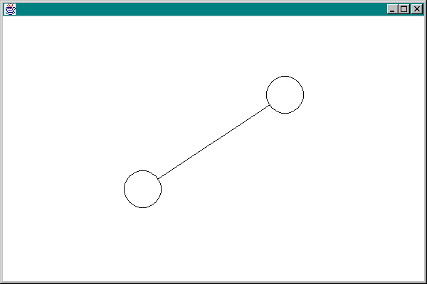
AVL - height 1

Slide 4
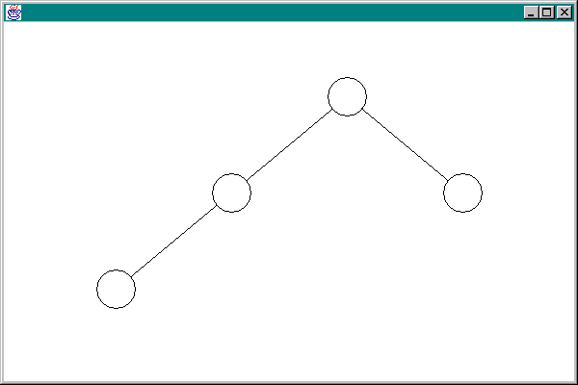
AVL - height 2

Slide 5
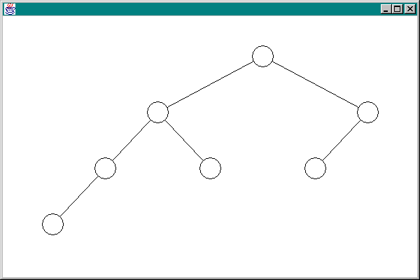
AVL - height 3

Slide 6
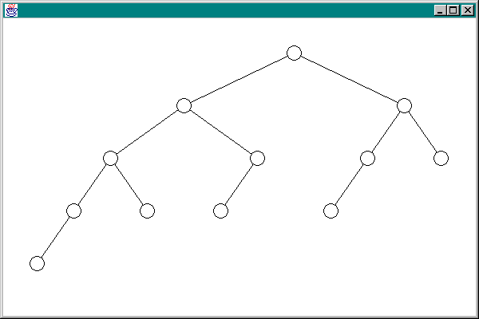
AVL - height 4

Slide 7
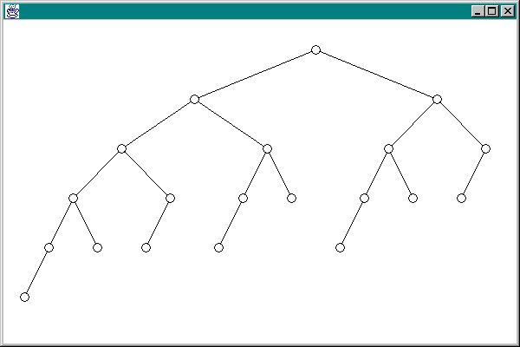
AVL - height 5

Slide 8
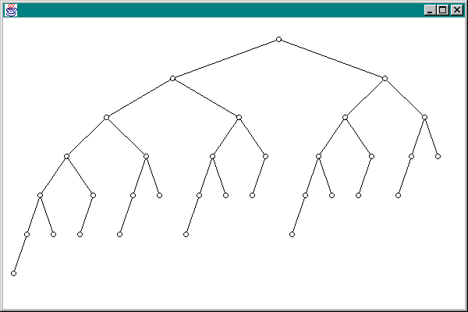
AVL - height 6

Slide 9
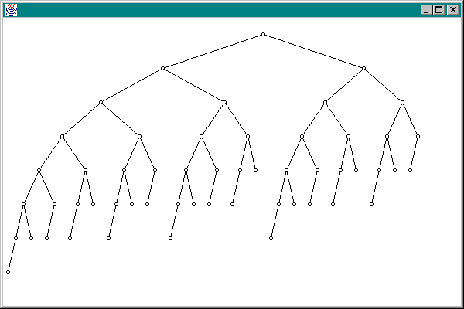
AVL - height 7

Slide 10
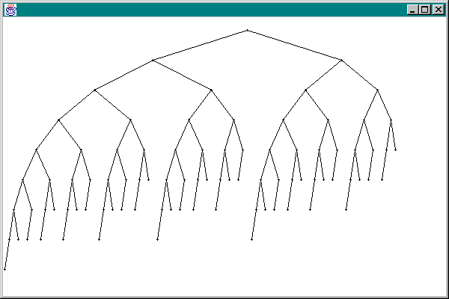
AVL - height 8

Slide 11
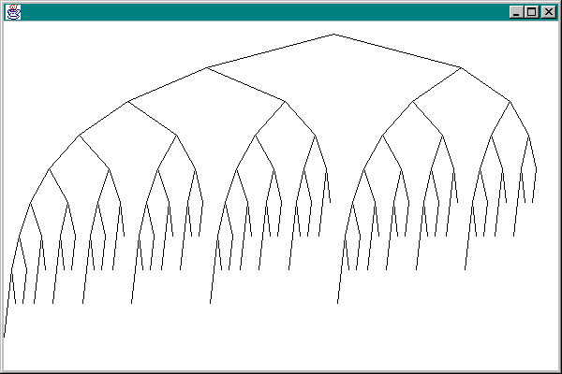
AVL - height 9

Slide 12
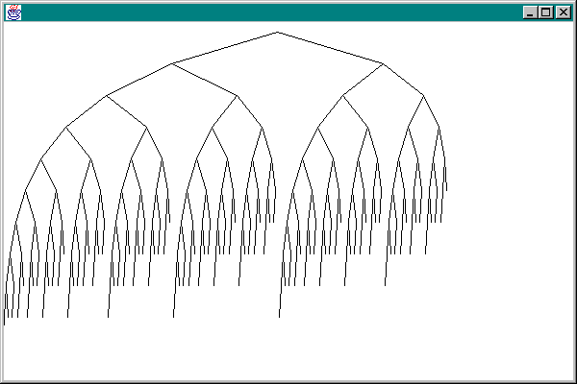
AVL - height 10

Slide 13
Counting nodes

Slide 14
Relationship to Fibonacci
Let N be the fewest number of nodes in an AVL tree of height H
It is straightforward to show that
N = F(H+3) - 1,
where F(k) is the k^{th} Fibonacci number
For large values of k,

Slide 15
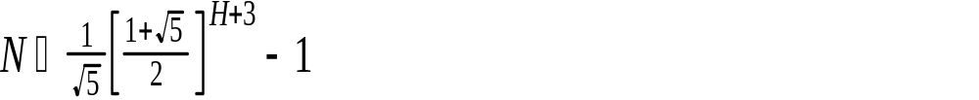
number of nodes
The fewest number of nodes in an AVL tree with height H is given by

Slide 16
Solving for H
if we solve this near equality for H, we get
H  1.44 log₂ N
This means that the height of an AVL tree with N nodes is no more than 44% larger than the optimal height of a binary search tree with N nodes

Slide 17
Building an AVL tree
During the building of an AVL tree, the only time a node can possibly get out of balance is when a new node is inserted.
Our attention is on the ancestor closest to the newly inserted node which has become unbalanced
There are basically two cases

Slide 18

The “outie” case
r
r - the nearest ancestor which is out of balance
n - the newly inserted node
height of T1, T2, and T3 are all the same, say h
x
T1
T2
T3
n

Slide 19
single rotation
x
r
r
x
T3
T1
T2
T3
T1
T2
n
n

Slide 20
After the rotation
x
x is now the root
the height of the tree is the same as it was before inserting the node, so no other ancestor is unbalanced
the root x is balanced
r
T3
T1
T2
n

Slide 21
The “innie” case
r
r is the nearest out-of-balance ancestor
T1 and T4 have height h
T2 and T3 have height h-1
n is the newly inserted node - either in T2 or T3
x
T1
w
T4
T2
T3
n

Slide 22
Double Rotation
w
r
x
r
x
T1
w
T4
T2
T3
T1
T2
T3
T4
n
n

Slide 23
After the Rotation
w
w is now the root with left child r and right child x
The height of the tree is the same as before the insertion, so no other ancestor is now out-of-balance
This tree is balanced
r
x
T1
T2
T3
T4
n

Slide 24
The other rotations
These two demonstrations show the Single Left rotation and the Double Left rotation (used when the nearest out-of-balance ancestor is too heavy on the right)
Similar rotations are performed when the nearest out-of-balance ancestor is heavy on the left -- these are called Single Right and Double Right Rotations

Slide 25
Deletion from an AVL Tree
Deletion of a node from an AVL tree requires the same basic ideas, including single and double rotations, that are used for insertion
The steps are on the next slide

Slide 26
Steps in deleting X
reduce the problem to the case where X has only one child
Delete the node X. The height of the subtree formerly rooted at X has been reduced by one
We must trace the effect on the balance from X all the way back to the root until we reach a node which does not need adjustment

