Slide 1
CMSC420: Splay Trees
Kinga Dobolyi
Based off notes by Dave Mount

Slide 2

What is the purpose of this class?
Data storage
  Speed
Trees
  Binary search tree
    Expected runtime for search is O(logn)
    Could degenerate into a linked list O(n)
  AVL tree
    Operations are guaranteed to be O(logn)
    But must do rotations and maintain balance information in the nodes

Slide 3

Splay Tree
Similar to AVL tree
  Uses rotations to maintain balance
  However, no balance information needs to be stored
    Makes it possible to
    create unbalanced trees
    Splay trees have a self-
    adjusting nature (despite
    not storing balance
    information!)

Slide 4
So what is the runtime?
Search could still be O(n) in the worst case
  Like a binary tree
However, the total time to perform m insert, delete, and search operations is O(mlogn)
  We call this the amortized cost/analysis
  This is not the same as average case analysis
    An adversary could only force bad behavior once in a while
    On average splay tree runtime is O(logn)

Slide 5
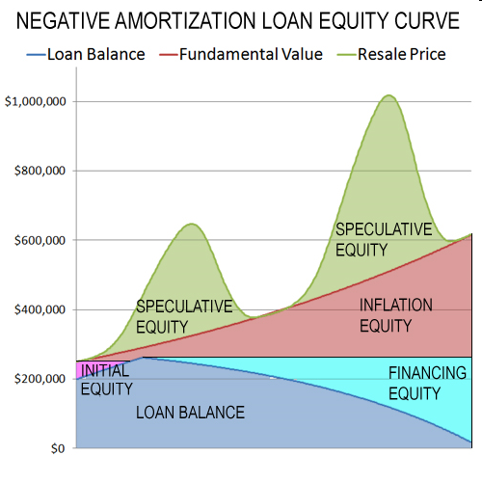
Analyzing cost
What is more important?
  Best case?
  Worst case?
  Average case?
  Amortized cost?
If we relax the rule that we must always be efficient, it is possible to generate more efficient and simpler data structures

Slide 6

Self organization
No balance information is stored
  How do we balance the tree then?
  Perform balancing across the
  search path
    What is a side effect of doing this,
    besides balance?
Splaying
  An operation that has the tendency to mix up the tree
    Random binary trees tend towards O(logn) height

Slide 7
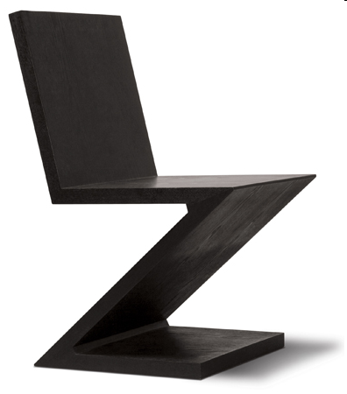
The splay operation
splay(node,Tree): brings node to the root of the tree
  Perform binary search for node
  Then perform one of four possible rotations
    Zig-zag case
    Zig-zig case

Slide 8
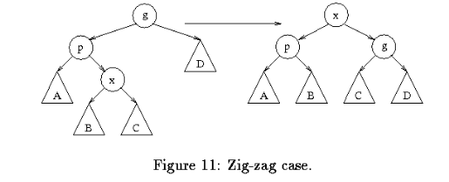
Zig-zag case
If node is the left child of a right child, or
If node is the right child of a left child;
Perform double rotation to bring node up to the top

Slide 9
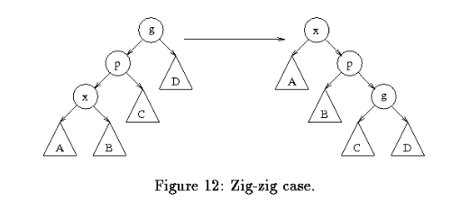
Zig-zig case
Node is the left child of a left child, or
Node is the right child of a right child;
Perform new kind of double rotation

Slide 10
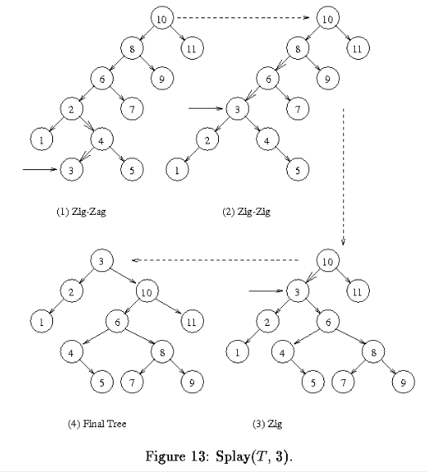
Example
Splay(3,t)

Slide 11
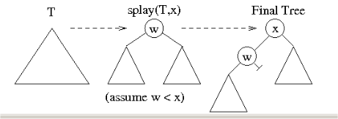
How is splay used?
Search: simply call splay(x,T)
Insert: call to splay(x,T)
  If x is in tree, ERROR
  Else the root is the closest value to x after the splay operation; make x the new root

Slide 12
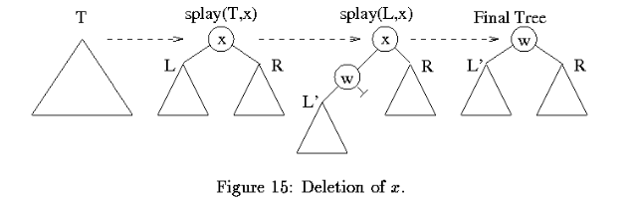
How is splay used?
Deletion: call to splay(x,T)
  Then call splay(x,L’) – generates new root
  Combine L’ and R with new root

Slide 13

Amortized cost
Over m operations, runtime is O(mlogn)
Going to skip the proof for this today – see Dave Mount’s lecture notes if you’re interested
Instead let’s get an intuition
about why we have good
performance

Slide 14
Worst case
We have a tree that is completely unbalanced, with height O(n)
When we search for an element, we automatically reduce the average node depth by half
Example: http://www.cs.nyu.edu/algvis/java/SplayTree.html

Slide 15
Analysis
Real cost: the time that the splay takes (depends on depth of node in tree)
Increase in balance
Tradeoffs:
  If real cost is high, subsequent calls will reduce the real cost
  If the real cost is low, then we are happy, regardless of the balance of the tree

Slide 16
Tree options
Binary search tree
AVL tree
  For every node in the tree, the heights of its two subtrees differ by at most 1
  Managed using rotations and bookkeeping
Splay tree
  Amortized good performance
  Managed using rotations but no bookkeeping

