Slide 1
Backtracking

Slide 2
General Concepts
Algorithm strategy
  Approach to solving a problem
  May combine several approaches
Algorithm structure
  Iterative ⇒ execute action in loop
  Recursive ⇒ reapply action to subproblem(s)
Problem type
  Satisfying ⇒ find any satisfactory solution
  Optimization ⇒ find best solutions (vs. cost metric)

Slide 3
A short list of categories
Many Algorithm types are to be considered:
  Simple recursive algorithms
  Backtracking algorithms
  Divide and conquer algorithms
  Dynamic programming algorithms
  Greedy algorithms
  Branch and bound algorithms
  Brute force algorithms
  Randomized algorithms

Slide 4
Backtracking
Suppose you have to make a series of decisions, among various choices, where
  You don’t have enough information to know what to choose
  Each decision leads to a new set of choices
  Some sequence of choices (possibly more than one) may be a solution to your problem
Backtracking is a methodical way of trying out various sequences of decisions, until you find one that “works”

Slide 5
Backtracking Algorithm
Based on depth-first recursive search
Approach
  Tests whether solution has been found
  If found solution, return it
  Else for each choice that can be made
    Make that choice
    Recur
    If recursion returns a solution, return it
  If no choices remain, return failure
Some times called “search tree”

Slide 6
Backtracking Algorithm – Example
Find path through maze
  Start at beginning of maze
  If at exit, return true
  Else for each step from current location
    Recursively find path
    Return with first successful step
    Return false if all steps fail

Slide 7
Backtracking Algorithm – Example
Color a map with no more than four colors
  If all countries have been colored return success
  Else for each color c of four colors and country n
    If country n is not adjacent to a country that has been colored c
      Color country n with color c
      Recursively color country n+1
      If successful, return success
  Return failure

Slide 8
Backtracking
Start
Success!
Success!
Failure
Problem space consists of states (nodes) and actions
(paths that lead to new states). When in a node can
can only see paths to connected nodes
If a node only leads to failure go back to its "parent"
node. Try other alternatives. If these all lead to failure
then more backtracking may be necessary.

Slide 9
Recursive Backtracking
Pseudo code for recursive backtracking algorithms
If at a solution, return success
for( every possible choice from current state / node)
Make that choice and take one step along path
Use recursion to solve the problem for the new node / state
If the recursive call succeeds, report the success to the next high level
Back out of the current choice to restore the state at the beginning of the loop.
Report failure

Slide 10
Backtracking
Construct the state space tree:
  Root represents an initial state
  Nodes reflect specific choices made for a solution’s components.
    Promising and nonpromising nodes
    leaves
Explore the state space tree using depth-first search
“Prune” non-promising nodes
  dfs stops exploring subtree rooted at nodes leading to no solutions and...
  “backtracks” to its parent node

Slide 11
Example: The n-Queen problem
Place n queens on an n by n chess board so that no two of them are on the same row, column, or diagonal

Slide 12
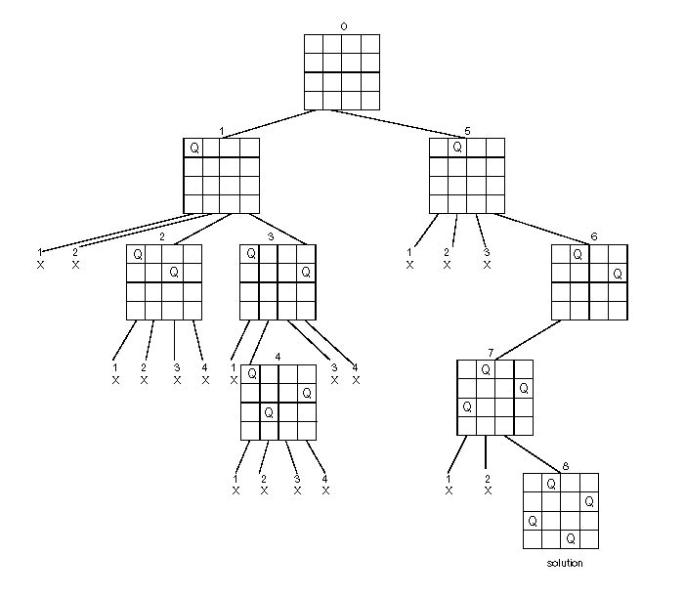
State Space Tree of the Four-queens Problem

Slide 13
The backtracking algorithm
Backtracking is really quite simple--we “explore” each node, as follows:
To “explore” node N:
  1. If N is a goal node, return “success”
  2. If N is a leaf node, return “failure”
  3. For each child C of N,
    3.1. Explore C
      3.1.1. If C was successful, return “success”
  4. Return “failure”

Slide 14
Exercises
Continue the backtracking search for a solution to the four-queens problem to find the second solution to the problem.
A trick to use: the board is symmetric, obtain another solution by reflections.
Get a solution to the 5-queens problem found by the back-tracking algorithm?
Can you (quickly) find at least 3 other solutions?

Slide 15
The m-Coloring Problem and Hamiltonian Problem
2-color
3-color
Hamiltonian Circuit
  (use alphabet order to
  break the ties)
a
c
d
b
e
Notes:
Careful to draw the state-space by coloring vertices in alphabetical order.
This way you get some actual “backtracking” – most small examples of graph coloring
yield a solution so fast that it is hard to appreciate what is going on.

Slide 16
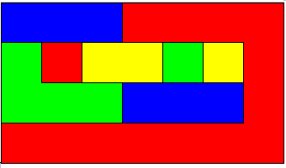
Coloring a map
You wish to color a map with
not more than four colors
  red, yellow, green, blue
Adjacent countries must be in
different colors
You don’t have enough information to choose colors
Each choice leads to another set of choices
One or more sequences of choices may (or may not) lead to a solution
Many coloring problems can be solved with backtracking

Slide 17
Comments
  Backtracking provides the hope to solve some problem instances of nontrivial sizes by pruning non-promising branches of the state-space tree.
  The success of backtracking varies from problem to problem and from instance to instance.
  Backtracking possibly generates all possible candidates in an exponentially growing state-space tree.
Notes:
Generate all n-bit binary strings.

Slide 18
Other Backtracking Problems *
8 Queens
Knight's Tour
Knapsack problem / Exhaustive Search
  Filling a knapsack. Given a choice of items with various weights and a limited carrying capacity find the optimal load out. 50 lb. knapsack. items are 1 40 lb, 1 32 lb. 2 22 lbs, 1 15 lb, 1 5 lb. A greedy algorithm would choose the 40 lb item first. Then the 5 lb. Load out = 45lb. Exhaustive search 22 + 22 + 5 = 49.

Slide 19
Branch and Bound

Slide 20
Branch and Bound ( B& B)
An enhancement of backtracking
  Similarity
    A state space tree is used to solve a problem.
  Difference
    The branch-and-bound algorithm does not limit us to any particular way of traversing the tree.
    Used only for optimization problems (since the backtracking algorithm requires the using of DFS traversal and is used for non-optimization problems.

Slide 21
Branch and Bound
The idea:
Set up a bounding function, which is used to compute a bound (for the value of the objective function) at a node on a state-space tree and determine if it is promising
  Promising (if the bound is better than the value of the best solution so far): expand beyond the node.
  Nonpromising (if the bound is no better than the value of the best solution so far): not expand beyond the node (pruning the state-space tree).

Slide 22
Traveling Salesman Problem
  Construct the state-space tree:
  A node = a vertex: a vertex in the graph.
  A node that is not a leaf represents all the tours that start with the path stored at that node; each leaf represents a tour (or non-promising node).
  Branch-and-bound: we need to determine a lower bound for each node
    For example, to determine a lower bound for node [1, 2] means to determine a lower bound on the length of any tour that starts with edge 1—2.
  Expand each promising node, and stop when all the promising nodes have been expanded. During this procedure, prune all the nonpromising nodes.
    Promising node: the node’s lower bound is less than current minimum tour length.
    Non-promising node: the node’s lower bound is NO less than current minimum tour length.

Slide 23
Traveling Salesman Problem—Bounding Function 1
Because a tour must leave every vertex exactly once, a lower bound on the length of a tour is b (lower bound) minimum cost of leaving every vertex.
  The lower bound on the cost of leaving vertex v₁ is given by the minimum of all the nonzero entries in row 1 of the adjacency matrix.
  …
  The lower bound on the cost of leaving vertex v_{n} is given by the minimum of all the nonzero entries in row n of the adjacency matrix.
Note: This is not to say that there is a tour with this length. Rather, it says that there can be no shorter tour.
Assume that the tour starts with v1.

Slide 24
Traveling Salesman Problem—Bounding Function 2
Because every vertex must be entered and exited exactly once, a lower bound on the length of a tour is the sum of the minimum cost of entering and leaving every vertex.
  For a given edge (u, v), think of half of its weight as the exiting cost of u, and half of its weight as the entering cost of v.
  The total length of a tour = the total cost of visiting( entering and exiting) every vertex exactly once.
  The lower bound of the length of a tour = the lower bound of the total cost of visiting (entering and exiting ) every vertex exactly once.
    Calculation:
      for each vertex, pick top two shortest adjacent edges (their sum divided by 2 is the lower bound of the total cost of entering and exiting the vertex);
      add up these summations for all the vertices.
Assume that the tour starts with vertex a and that b is visited before c.

Slide 25
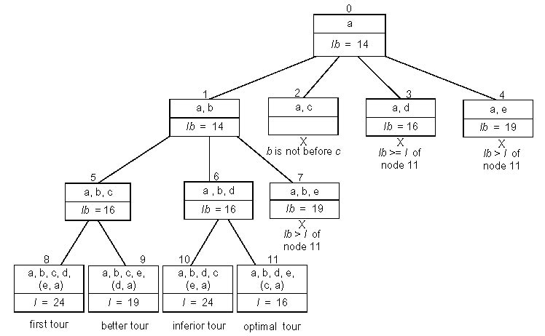
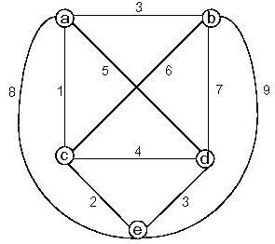
Traveling salesman example 2

