Slide 1
Informed search algorithms
Chapter 4

Slide 2
Outline
Best-first search
Greedy best-first search
A* search
Heuristics
Memory Bounded A* Search

Slide 3
Best-first search
Idea: use an evaluation function f(n) for each node
  f(n) provides an estimate for the total cost.
  Expand the node n with smallest f(n).
Implementation:
Order the nodes in fringe increasing order of cost.
Special cases:
  greedy best-first search
  A* search

Slide 4

Romania with straight-line dist.

Slide 5
Greedy best-first search
f(n) = estimate of cost from n to goal
e.g., f(n) = straight-line distance from n to Bucharest
Greedy best-first search expands the node that appears to be closest to goal.

Slide 6

Greedy best-first search example

Slide 7

Greedy best-first search example

Slide 8

Greedy best-first search example

Slide 9

Greedy best-first search example

Slide 10
GBFS is not complete
d
c
b
g
a
goal state
start state
f(n) = straightline distance

Slide 11
Properties of greedy best-first search
Complete? No – can get stuck in loops.
Time? O(b^{m}), but a good heuristic can give dramatic improvement
Space? O(b^{m}) - keeps all nodes in memory
Optimal? No
e.g. Arad→Sibiu→Rimnicu Virea→Pitesti→Bucharest is shorter!

Slide 12
A* search
Idea: avoid expanding paths that are already expensive
Evaluation function f(n) = g(n) + h(n)
g(n) = cost so far to reach n
h(n) = estimated cost from n to goal
f(n) = estimated total cost of path through n to goal
Best First search has f(n)=h(n)
Uniform Cost search has f(n)=g(n)

Slide 13
Admissible heuristics
A heuristic h(n) is admissible if for every node n,
h(n) ≤ h*(n), where h*(n) is the true cost to reach the goal state from n.
An admissible heuristic never overestimates the cost to reach the goal, i.e., it is optimistic
Example: h_{SLD}(n) (never overestimates the actual road distance)
Theorem: If h(n) is admissible, A* using TREE-SEARCH is optimal

Slide 14

Admissible heuristics
E.g., for the 8-puzzle:
h₁(n) = number of misplaced tiles
h₂(n) = total Manhattan distance
(i.e., no. of squares from desired location of each tile)
h₁(S) = ?
h₂(S) = ?

Slide 15
Admissible heuristics
E.g., for the 8-puzzle:
h₁(n) = number of misplaced tiles
h₂(n) = total Manhattan distance
(i.e., no. of squares from desired location of each tile)
h₁(S) = ? 8
h₂(S) = ? 3+1+2+2+2+3+3+2 = 18

Slide 16
Dominance
If h₂(n) ≥ h₁(n) for all n (both admissible)
then h₂ dominates h₁
h₂ is better for search: it is guaranteed to expand
less or equal nr of nodes.
Typical search costs (average number of nodes expanded):
d=12 IDS = 3,644,035 nodes
A*(h₁) = 227 nodes
A*(h₂) = 73 nodes
d=24 IDS = too many nodes
A*(h₁) = 39,135 nodes
A*(h₂) = 1,641 nodes

Slide 17
Relaxed problems
A problem with fewer restrictions on the actions is called a relaxed problem
The cost of an optimal solution to a relaxed problem is an admissible heuristic for the original problem
If the rules of the 8-puzzle are relaxed so that a tile can move anywhere, then h₁(n) gives the shortest solution
If the rules are relaxed so that a tile can move to any adjacent square, then h₂(n) gives the shortest solution

Slide 18

Consistent heuristics
A heuristic is consistent if for every node n, every successor n' of n generated by any action a,
h(n) ≤ c(n,a,n') + h(n')
If h is consistent, we have
f(n’) = g(n’) + h(n’) (by def.)
= g(n) + c(n,a,n') + h(n’) (g(n’)=g(n)+c(n.a.n’))
≥ g(n) + h(n) = f(n) (consistency)
f(n’) ≥ f(n)
i.e., f(n) is non-decreasing along any path.
Theorem:
If h(n) is consistent, A* using GRAPH-SEARCH is optimal
It’s the triangle
inequality !
keeps all checked nodes
in memory to avoid repeated
states

Slide 19

A* search example

Slide 20

A* search example

Slide 21

A* search example

Slide 22

A* search example

Slide 23

A* search example

Slide 24

A* search example

Slide 25
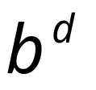
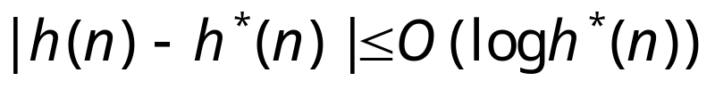
Properties of A*
Complete? Yes (unless there are infinitely many nodes with f ≤ f(G) , i.e. step-cost > ε)
Time/Space? Exponential
except if:
Optimal? Yes
Optimally Efficient: Yes (no algorithm with the
same heuristic is guaranteed to expand fewer nodes)

Slide 26

Optimality of A* (proof)
Suppose some suboptimal goal G₂ has been generated and is in the fringe. Let n be an unexpanded node in the fringe such that n is on a shortest path to an optimal goal G.
f(G₂) = g(G₂) since h(G₂) = 0
f(G) = g(G) since h(G) = 0
g(G₂) > g(G) since G₂ is suboptimal
f(G₂) > f(G) from above
h(n) ≤ h*(n) since h is admissible (under-estimate)
g(n) + h(n) ≤ g(n) + h*(n) from above
f(n) ≤ f(G) since g(n)+h(n)=f(n) & g(n)+h*(n)=f(G)
f(n) < f(G2) from
We want to prove:
f(n) < f(G2)
(then A* will prefer n over G2)

Slide 27
Exercise
SEARCH TREE
R
9
1
1) Consider the search tree to the right.
There are 2 goal states, G1 and G2.
The numbers on the edges represent step-costs.
You also know the following heuristic estimates:
h(B→G2) = 9, h(D→G2)=10, h(A→G1)=2, h(C→G1)=1
a) In what order will A* search visit the
nodes? Explain your answer by indicating the value of
the evaluation function for those nodes that the
algorithm considers.
A
B
1
2
C
D
1
10
G1
G2

Slide 28
straight-line distances
A
6
D
1
F
3
1
h(S-G)=10
h(A-G)=7
h(D-G)=1
h(F-G)=1
h(B-G)=10
h(E-G)=8
h(C-G)=20
S
2
4
8
G
B
E
1
20
C
try yourself
The graph above shows the step-costs for different paths going from the start (S) to
the goal (G). On the right you find the straight-line distances.
Draw the search tree for this problem. Avoid repeated states.
Give the order in which the tree is searched (e.g. S-C-B...-G) for A* search.
Use the straight-line dist. as a heuristic function, i.e. h=SLD,
and indicate for each node visited what the value for the evaluation function, f, is.

Slide 29
Memory Bounded Heuristic Search: Recursive BFS
How can we solve the memory problem for A* search?
Idea: Try something like depth first search, but let’s not forget everything about the branches we have partially explored.
We remember the best f-value we have found so far in the branch we are deleting.

Slide 30
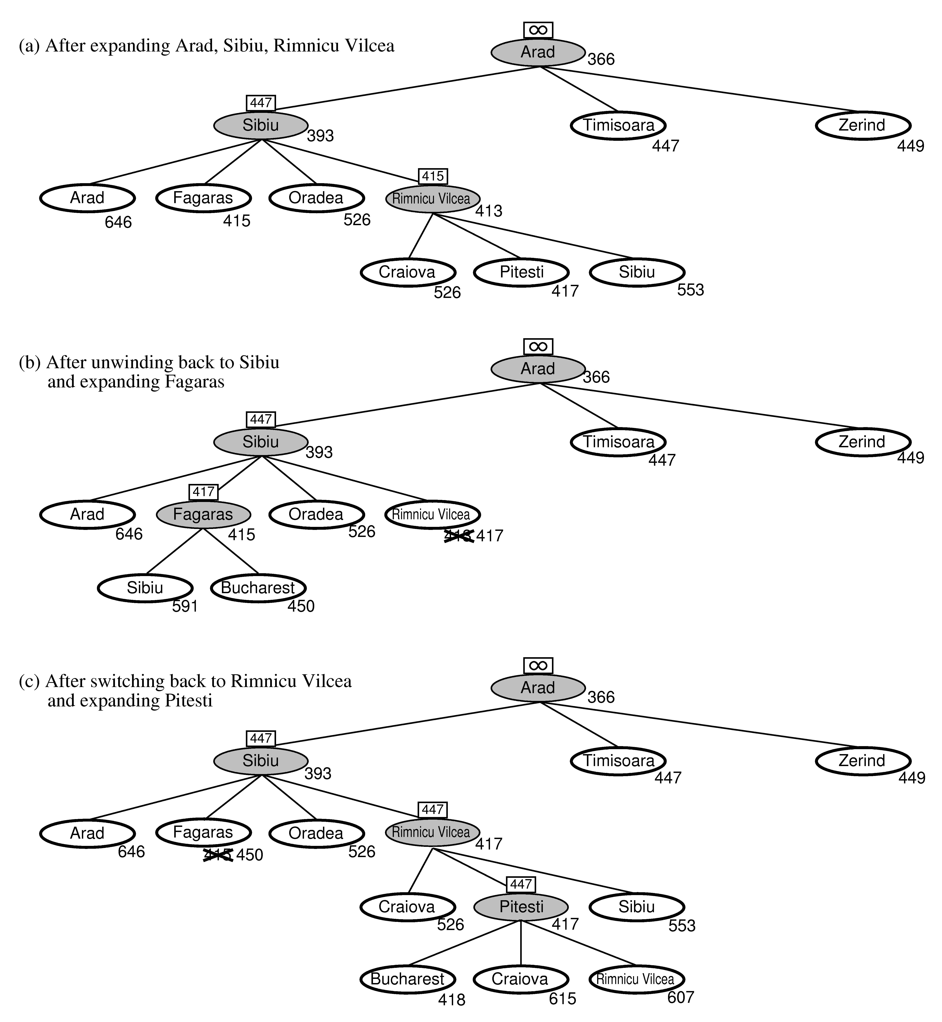
RBFS:
best alternative
over fringe nodes,
which are not children:
i.e. do I want to back up?
RBFS changes its mind
very often in practice.
This is because the
f=g+h become more
accurate (less optimistic)
as we approach the goal.
Hence, higher level nodes
have smaller f-values and
will be explored first.
Problem: We should keep
in memory whatever we can.

Slide 31
Simple Memory Bounded A*
This is like A*, but when memory is full we delete the worst node (largest f-value).
Like RBFS, we remember the best descendent in the branch we delete.
If there is a tie (equal f-values) we delete the oldest nodes first.
simple-MBA* finds the optimal reachable solution given the memory constraint.
Time can still be exponential.
A Solution is not reachable
if a single path from root to goal
does not fit into memory

Slide 32
Local search algorithms
In many optimization problems, the path to the goal is irrelevant; the goal state itself is the solution
State space = set of "complete" configurations
Find configuration satisfying constraints, e.g., n-queens
In such cases, we can use local search algorithms
keep a single "current" state, try to improve it.
Very memory efficient (only remember current state)

Slide 33

Example: n-queens
Put n queens on an n × n board with no two queens on the same row, column, or diagonal
Note that a state cannot be an incomplete configuration with m<n queens

Slide 34

Hill-climbing search
Problem: depending on initial state, can get stuck in local maxima

Slide 35
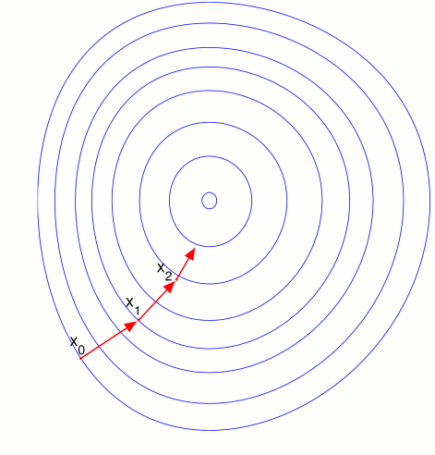

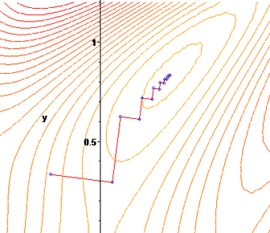
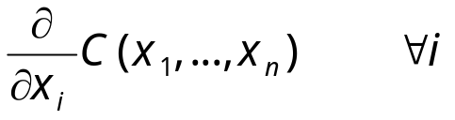
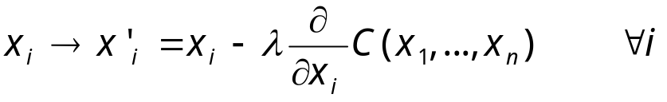
Gradient Descent
Assume we have some cost-function:
and we want minimize over continuous variables X1,X2,..,Xn
1. Compute the gradient :
2. Take a small step downhill in the direction of the gradient:
3. Check if
4. If true then accept move, if not reject.
5. Repeat.

Slide 36
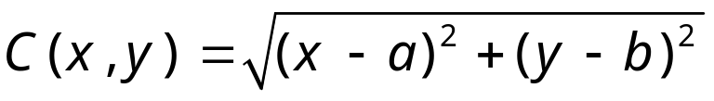
Exercise
Describe the gradient descent algorithm for the cost function:

Slide 37

Line Search
In GD you need to choose a step-size.
Line search picks a direction, v, (say the gradient direction) and
searches along that direction for the optimal step:
Repeated doubling can be used to effectively search for the optimal step:
There are many methods to pick search direction v.
Very good method is “conjugate gradients”.

Slide 38

Hill-climbing search: 8-queens problem
Each number indicates h if we move
a queen in its corresponding column
h = number of pairs of queens that are attacking each other, either directly or indirectly (h = 17 for the above state)

Slide 39

Hill-climbing search: 8-queens problem
A local minimum with h = 1
what can you do to get out of this local minima?)

Slide 40
Simulated annealing search
Idea: escape local maxima by allowing some "bad" moves but gradually decrease their frequency.
This is like smoothing the cost landscape.

Slide 41
Properties of simulated annealing search
One can prove: If T decreases slowly enough, then simulated annealing search will find a global optimum with probability approaching 1 (however, this may take VERY long)
Widely used in VLSI layout, airline scheduling, etc.

Slide 42
Local beam search
Keep track of k states rather than just one.
Start with k randomly generated states.
At each iteration, all the successors of all k states are generated.
If any one is a goal state, stop; else select the k best successors from the complete list and repeat.

Slide 43
Genetic algorithms
A successor state is generated by combining two parent states
Start with k randomly generated states (population)
A state is represented as a string over a finite alphabet (often a string of 0s and 1s)
Evaluation function (fitness function). Higher values for better states.
Produce the next generation of states by selection, crossover, and mutation

Slide 44


Fitness function: number of non-attacking pairs of queens (min = 0, max = 8 × 7/2 = 28)
P(child) = 24/(24+23+20+11) = 31%
P(child) = 23/(24+23+20+11) = 29% etc
fitness:
#non-attacking queens
probability of being
regenerated
in next generation

Slide 45
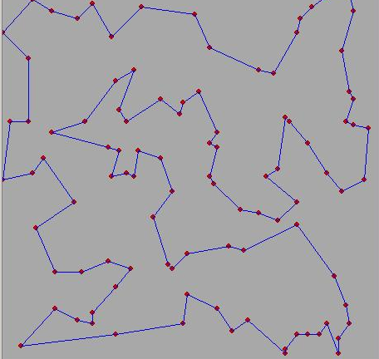
Travelling Salesman Problem
Given N cities and all their distances, find the shortest tour through all cities.
Try formulating this as a search problem.
Ie what are the states, step-cost, initial state,
goal state, successor function.
Can you think of ways to try to solve these problems?

Slide 46
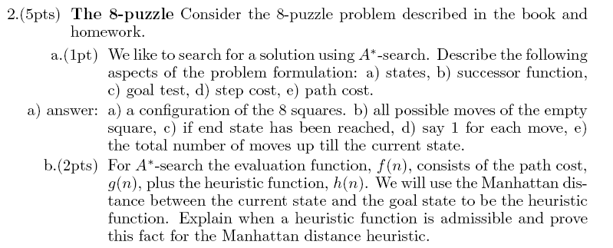


Slide 47
