Slide 1
Lecture 7:
Greedy Algorithms II
Shang-Hua Teng

Slide 2
Greedy algorithms
A greedy algorithm always makes the choice that looks best at the moment
  My everyday examples:
    Driving in Los Angeles, NY, or Boston for that matter
    Playing cards
    Invest on stocks
    Choose a university
  The hope: a locally optimal choice will lead to a globally optimal solution
  For some problems, it works
greedy algorithms tend to be easier to code

Slide 3
An Activity Selection Problem
(Conference Scheduling Problem)
Input: A set of activities S = {a₁,…, a_{n}}
Each activity has start time and a finish time
  a_{i}=(s_{i}, f_{i})
Two activities are compatible if and only if their interval does not overlap
Output: a maximum-size subset of mutually compatible activities

Slide 4
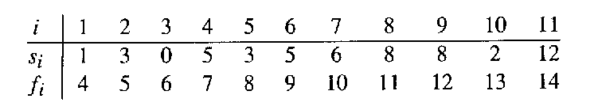
The Activity Selection Problem
Here are a set of start and finish times
What is the maximum number of activities that can be completed?
  {a₃, a₉, a₁₁} can be completed
  But so can {a₁, a₄, a_{8’} a₁₁} which is a larger set
  But it is not unique, consider {a₂, a₄, a_{9’} a₁₁}

Slide 5
Interval Representation

Slide 6
0 1 2 3 4 5 6 7 8 9 10 11 12 13 14 15

Slide 7
0 1 2 3 4 5 6 7 8 9 10 11 12 13 14 15

Slide 8
0 1 2 3 4 5 6 7 8 9 10 11 12 13 14 15

Slide 9
0 1 2 3 4 5 6 7 8 9 10 11 12 13 14 15

Slide 10
Early Finish Greedy
Select the activity with the earliest finish
Eliminate the activities that could not be scheduled
Repeat!

Slide 11
0 1 2 3 4 5 6 7 8 9 10 11 12 13 14 15

Slide 12
0 1 2 3 4 5 6 7 8 9 10 11 12 13 14 15

Slide 13
0 1 2 3 4 5 6 7 8 9 10 11 12 13 14 15

Slide 14
0 1 2 3 4 5 6 7 8 9 10 11 12 13 14 15

Slide 15
0 1 2 3 4 5 6 7 8 9 10 11 12 13 14 15

Slide 16
0 1 2 3 4 5 6 7 8 9 10 11 12 13 14 15

Slide 17
0 1 2 3 4 5 6 7 8 9 10 11 12 13 14 15

Slide 18
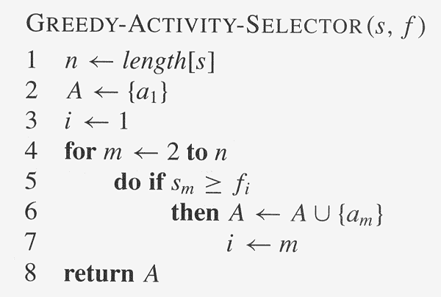
Assuming activities are sorted by finish time

Slide 19
Why it is Greedy?
Greedy in the sense that it leaves as much opportunity as possible for the remaining activities to be scheduled
The greedy choice is the one that maximizes the amount of unscheduled time remaining

Slide 20
Why this Algorithm is Optimal?
We will show that this algorithm uses the following properties
  The problem has the optimal substructure property
  The algorithm satisfies the greedy-choice property
Thus, it is Optimal

Slide 21
Greedy-Choice Property
Show there is an optimal solution that begins with a greedy choice (with activity 1, which as the earliest finish time)
Suppose A ⊆ S in an optimal solution
  Order the activities in A by finish time. The first activity in A is k
    If k = 1, the schedule A begins with a greedy choice
    If k ≠ 1, show that there is an optimal solution B to S that begins with the greedy choice, activity 1
  Let B = A – {k} ∪ {1}
    f₁ ≤ f_{k} → activities in B are disjoint (compatible)
    B has the same number of activities as A
    Thus, B is optimal

Slide 22
Optimal Substructures
  Once the greedy choice of activity 1 is made, the problem reduces to finding an optimal solution for the activity-selection problem over those activities in S that are compatible with activity 1
    Optimal Substructure
    If A is optimal to S, then A’ = A – {1} is optimal to S’={i ∈S: s_{i} ≥ f₁}
    Why?
      If we could find a solution B’ to S’ with more activities than A’, adding activity 1 to B’ would yield a solution B to S with more activities than A ➔ contradicting the optimality of A
  After each greedy choice is made, we are left with an optimization problem of the same form as the original problem
    By induction on the number of choices made, making the greedy choice at every step produces an optimal solution

Slide 23
Elements of Greedy Strategy
An greedy algorithm makes a sequence of choices, each of the choices that seems best at the moment is chosen
  NOT always produce an optimal solution
Two ingredients that are exhibited by most problems that lend themselves to a greedy strategy
  Greedy-choice property
  Optimal substructure

Slide 24
Greedy-Choice Property
A globally optimal solution can be arrived at by making a locally optimal (greedy) choice
  Make whatever choice seems best at the moment and then solve the sub-problem arising after the choice is made
  The choice made by a greedy algorithm may depend on choices so far, but it cannot depend on any future choices or on the solutions to sub-problems
Of course, we must prove that a greedy choice at each step yields a globally optimal solution

Slide 25
Optimal Substructures
A problem exhibits optimal substructure if an optimal solution to the problem contains within it optimal solutions to sub-problems
  If an optimal solution A to S begins with activity 1, then A’ = A – {1} is optimal to S’={i ∈S: s_{i} ≥ f₁}

Slide 26
Knapsack Problem
One wants to pack n items in a luggage
  The ith item is worth v_{i} dollars and weighs w_{i} pounds
  Maximize the value but cannot exceed W pounds
  v_{i} , w_{i}, W are integers
0-1 knapsack → each item is taken or not taken
Fractional knapsack → fractions of items can be taken
Both exhibit the optimal-substructure property
  0-1: If item j is removed from an optimal packing, the remaining packing is an optimal packing with weight at most W-w_{j}
  Fractional: If w pounds of item j is removed from an optimal packing, the remaining packing is an optimal packing with weight at most W-w that can be taken from other n-1 items plus w_{j} – w of item j

Slide 27
Greedy Algorithm for Fractional Knapsack problem
Fractional knapsack can be solvable by the greedy strategy
  Compute the value per pound v_{i}/w_{i} for each item
  Obeying a greedy strategy, take as much as possible of the item with the greatest value per pound.
  If the supply of that item is exhausted and there is still more room, take as much as possible of the item with the next value per pound, and so forth until there is no more room
  O(n lg n) (we need to sort the items by value per pound)
  Greedy Algorithm?
  Correctness?

Slide 28
O-1 knapsack is harder!
0-1 knapsack cannot be solved by the greedy strategy
  Unable to fill the knapsack to capacity, and the empty space lowers the effective value per pound of the packing
  We must compare the solution to the sub-problem in which the item is included with the solution to the sub-problem in which the item is excluded before we can make the choice
  Dynamic Programming

Slide 29
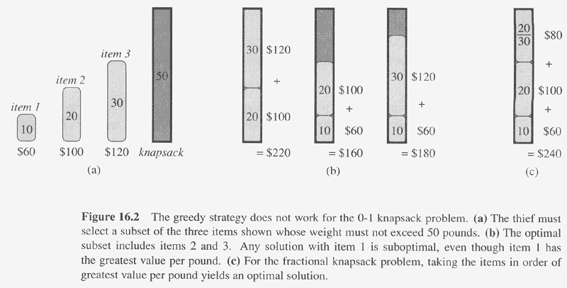

Slide 30
Next Week
Dynamic programming

Slide 31
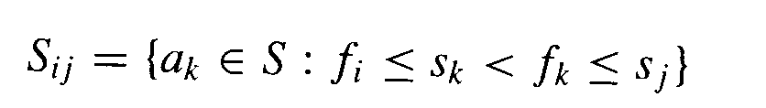
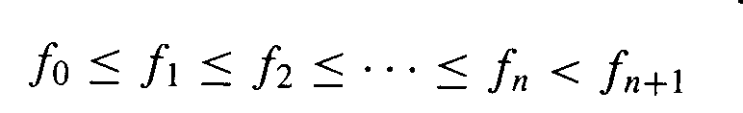
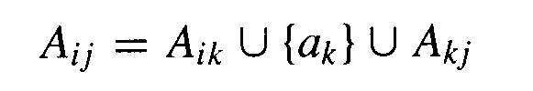
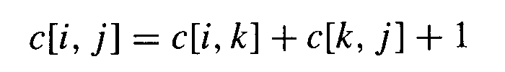
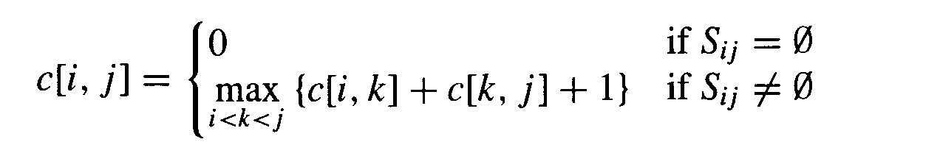
Optimal substructures
Define the following subset of activities which are activities that can start after a_{i} finishes and finish before a_{j} starts
Sort the activities according to finish time
We now define the the maximal set of activities from i to j as
Let c[i,j] be the maximal number of activities
Our recurrence relation for finding c[i, j] becomes
We can solve this using dynamic programming, but a simpler approach exists

