Slide 1
Greedy Algorithms
CIS 606
Spring 2010

Slide 2
Greedy Algorithms
Similar to dynamic programming.
Used for optimization problems.
Idea
When we have a choice to make, make the one that looks best right now. Make a locally optimal choice in hope of getting a globally optimal solution.
Greedy algorithms don’t always yield an optimal solution. But sometimes they do. We’ll see a problem for which they do. Then we’ll look at some general characteristics of when greedy algorithms give optimal solutions.

Slide 3
Activity selection
n activities require exclusive use of a common resource. For example, scheduling the use of a classroom.
Set of activities S = {a₁, . . . , a_{n}}.
a_{i} needs resource during period [s_{i}, f_{i}), which is a half-open interval, where s_{i} = start time and f_{i} = finish time.
Goal
Select the largest possible set of nonoverlapping (mutually compatible) activities.

Slide 4
Activity selection
Note
Could have many other objectives:
Schedule room for longest time.
Maximize income rental fees.
Assume that activities are sorted by finish time: f₁ ≤ f₂ ≤ f₃ ≤ . . . ≤ f_{n-1} ≤ f_{n}.

Slide 5
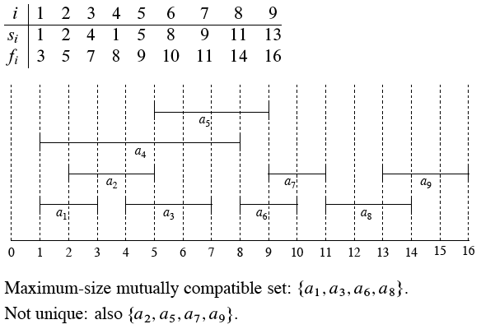
Example
S sorted by finish time:

Slide 6

Optimal substructure of activity selection
S_{ij} = {a_{k} ∈ S : f_{i} ≤ s_{k} < f_{k} ≤ s_{j}}
= activities that start after a_{i} finishes and finish before a_{j} starts :
Activities in S_{ij} are compatible with
all activities that finish by f_{i} , and
all activities that start no earlier than s_{j}.

Slide 7
Optimal substructure of activity selection
Let A_{ij} be a maximum-size set of mutually compatible activities in S_{ij} .
Let a_{k} ∈ A_{ij} be some activity in A_{ij} . Then we have two subproblems:
Find mutually compatible activities in S_{ik} (activities that start after a_{i} finishes and that finish before a_{k} starts).
Find mutually compatible activities in S_{kj} (activities that start after a_{k} finishes and that finish before a_{j} starts).

Slide 8
Optimal substructure of activity selection
Let
A_{ik} = A_{ij} ∩ S_{ik} = activities in A_{ij} that finish before a_{k} starts ;
A_{kj} = A_{ij} ∩ S_{kj} = activities in A_{ij} that start afer a_{k} finishes :
Then A_{ij} = A_{ik} ∪{a_{k} } ∪A_{kj}
⇒ ⎮A_{ij}⎮= ⎮A_{ik}⎮ + ⎮A_{kj}⎮+ 1.
Claim
Optimal solution A_{ij} must include optimal solutions for the two subproblems for S_{ik} and S_{kj}.

Slide 9
Proof
Use the usual cut-and-paste argument. Will show the claim for S_{kj}; proof for S_{ik} is symmetric.
Suppose we could find a set A’_{kj} of mutually compatible activities in S_{kj}, where ⎮A’_{kj}⎮> ⎮A_{kj}⎮
Then use A’_{kj} instead of A_{kj}when solving the subproblem for S_{ij}.
Size of resulting set of mutually compatible activities would be ⎮A_{ik}⎮+ ⎮A’_{kj}⎮ + 1 >
⎮A_{ik}⎮+ ⎮A_{kj}⎮ + 1 = ⎮A⎮. Contradicts assumption that A_{ij} is optimal.

Slide 10

One recursive solution
Since optimal solution A_{ij} must include optimal solutions to the subproblems for S_{ik} and S_{kj}, could solve by dynamic programming.
Let c[i, j] = size of optimal solution for S_{ij}. Then
c[i, j] = c[i, k] + c[k, j] + 1:
But we don’t know which activity a_{k} to choose, so we have to try them all:
Could then develop a recursive algorithm and memoize it. Or could develop a bottom-up algorithm and fill in table entries.
Instead, we will look at a greedy approach.

Slide 11
Making the greedy choice
Choose an activity to add to optimal solution before solving subproblems. For activity-selection problem, we can get away with considering only the greedy choice: the activity that leaves the resource available for as many other activities as possible.
Question: Which activity leaves the resource available for the most other activities?
Answer: The first activity to finish. (If more than one activity has earliest finish time, can choose any such activity.)
Since activities are sorted by finish time, just choose activity a₁.

Slide 12
Making the greedy choice
That leaves only one subproblem to solve: finding a maximum size set of mutually compatible activities that start after a₁ finishes. (Don’t have to worry about activities that finish before a₁ starts, because s₁ < f₁ and no activity a_{i} has finish time f_{i} < f₁ ⇒ no activity a_{i} has f_{i} ≤ s₁ .)
Since have only subproblem to solve, simplify notation:
S_{k} = {a_{i} ∈ S : s_{i} ≥ f_{k}} = activities that start after a_{k} finishes.

Slide 13
Making the greedy choice
Making greedy choice of a₁ ⇒ S₁ remains as only subproblem to solve.
By optimal substructure, if a₁ is in an optimal solution, then an optimal solution to the original problem consists of a₁ plus all activities in an optimal solution to S₁ .
But need to prove that a₁ is always part of some optimal solution.

Slide 14
Theorem
If S_{k} is nonempty and a_{m} has the earliest finish time in S_{k}, then a_{m} is included in some optimal solution.
Proof Let A_{k} be an optimal solution to S_{k}, and let a_{j} have the earliest finish time of any activity in A_{k} . If a_{j} = a_{m} , done. Otherwise, let A’_{k} = A_{k} – {a_{j}} ∪ {a_{m}} but with a_{m} substituted for a_{j}.
Claim
Activities in A’_{k} are disjoint.
Proof Activities in A_{k} are disjoint, a_{j} is first activity in A_{k} to finish, and f_{m} ≤ f_{j}. (proves claim)
Since |A’_{k}| = |A_{k}|, conclude that A’_{k} is an optimal solution to S_{k}, and it includes a_{m}. (proves theorem)

Slide 15
So, don’t need full power of dynamic programming. Don’t need to work bottomup.
Instead, can just repeatedly choose the activity that finishes first, keep only the activities that are compatible with that one, and repeat until no activities remain.
Can work top-down: make a choice, then solve a subproblem. Don’t have to solve subproblems before making a choice.

Slide 16
Recursive greedy algorithm
Start and finish times are represented by arrays s and f , where f is assumed to be already sorted in monotonically increasing order.
To start, add fictitious activity a₀ with f₀ = 0, so that S₀ = S, the entire set of activities.
Procedure REC-ACTIVITY-SELECTOR takes as parameters the arrays s and f, index k of current subproblem, and number n of activities in the original problem.

Slide 17
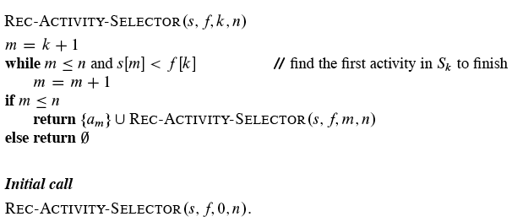
Recursive greedy algorithm

Slide 18
Recursive greedy algorithm
Idea
The while loop checks a_{k+1}, a_{k+2}, . . . , a_{n} until it finds an activity a_{m} that is compatible with a_{k} (need s_{m} ≥ f_{k}).
If the loop terminates because a_{m} is found (m > n), then recursively solve S_{m} , and return this solution, along with a_{m} .
If the loop never finds a compatible a_{m} (m > n), then just return empty set.
Time
Θ(n) —each activity examined exactly once, assuming that activities are already sorted by finish times.

Slide 19
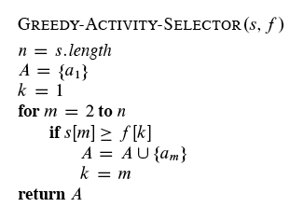
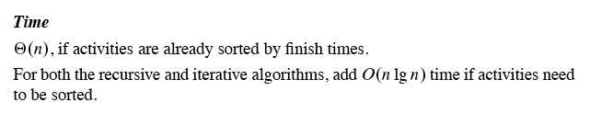
Iterative greedy algorithm
Can convert the recursive algorithm to an iterative one. It’s already almost tail recursive.

Slide 20
Greedy strategy
The choice that seems best at the moment is the one we go with.
What did we do for activity selection?
Determine the optimal substructure.
Develop a recursive solution.
Show that if we make the greedy choice, only one subproblem remains.
Prove that it’s always safe to make the greedy choice.
Develop a recursive greedy algorithm.
Convert it to an iterative algorithm.

Slide 21
Greedy strategy
At first, it looked like dynamic programming. In the activity-selection problem, we started out by defining subproblems S_{ij}, where both i and j varied. But then found that making the greedy choice allowed us to restrict the subproblems to be of the form S_{k}.
Could instead have gone straight for the greedy approach: in our first crack at defining subproblems, use the S_{k} form. Could then have proven that the greedy choice am (the first activity to finish), combined with optimal solution to the remaining compatible activities S_{m}, gives an optimal solution to S_{k}.

Slide 22
Greedy strategy
Typically, we streamline these steps:
Cast the optimization problem as one in which we make a choice and are left with one subproblem to solve.
Prove that there’s always an optimal solution that makes the greedy choice, so that the greedy choice is always safe.
Demonstrate optimal substructure by showing that, having made the greedy choice, combining an optimal solution to the remaining subproblem with the greedy choice gives an optimal solution to the original problem.

Slide 23
Greedy strategy
No general way to tell whether a greedy algorithm is optimal, but two key ingredients are
greedy-choice property and
optimal substructure.

Slide 24
Greedy-choice property
Can assemble a globally optimal solution by making locally optimal (greedy) choices.
Dynamic programming
Make a choice at each step.
Choice depends on knowing optimal solutions to subproblems. Solve subproblems first.
Solve bottom-up.
Greedy
Make a choice at each step.
Make the choice before solving the subproblems.
Solve top-down.

Slide 25
Greedy-choice property
Typically show the greedy-choice property by what we did for activity selection:
Look at an optimal solution.
If it includes the greedy choice, done.
Otherwise, modify the optimal solution to include the greedy choice, yielding another solution that’s just as good.
Can get efficiency gains from greedy-choice property.
Preprocess input to put it into greedy order.
Or, if dynamic data, use a priority queue.

Slide 26
Optimal substructure
The knapsack problem is a good example of the difference.
0-1 knapsack problem
n items.
Item i is worth $v_{i}, weighs w_{i} pounds.
Find a most valuable subset of items with total weight ≤ W.
Have to either take an item or not take it—can’t take part of it.

Slide 27
Optimal substructure
Fractional knapsack problem
Like the 0-1 knapsack problem, but can take fraction of an item.
Both have optimal substructure.
But the fractional knapsack problem has the greedy-choice property, and the 0-1 knapsack problem does not.
To solve the fractional problem, rank items by value/weight: v_{i}/w_{i} . Let v_{i}/w_{i} ≥ v_{i+1}/w_{i+1} for all i. Take items in decreasing order of value/weight. Will take all of the items with the greatest value/weight, and possibly a fraction of the next item.

Slide 28
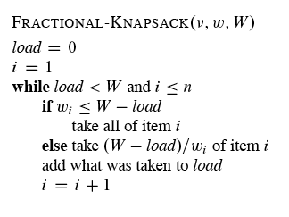


Slide 29
