Slide 1
AVL Trees
CENG 213 Data Structures

Slide 2
AVL Trees
An AVL tree is a binary search tree with a balance condition.
AVL is named for its inventors: Adel’son-Vel’skii and Landis
AVL tree approximates the ideal tree (completely balanced tree).
AVL Tree maintains a height close to the minimum.
Definition:
  An AVL tree is a binary search tree such that
  for any node in the tree, the height of the left and
  right subtrees can differ by at most 1.
CENG 213 Data Structures

Slide 3
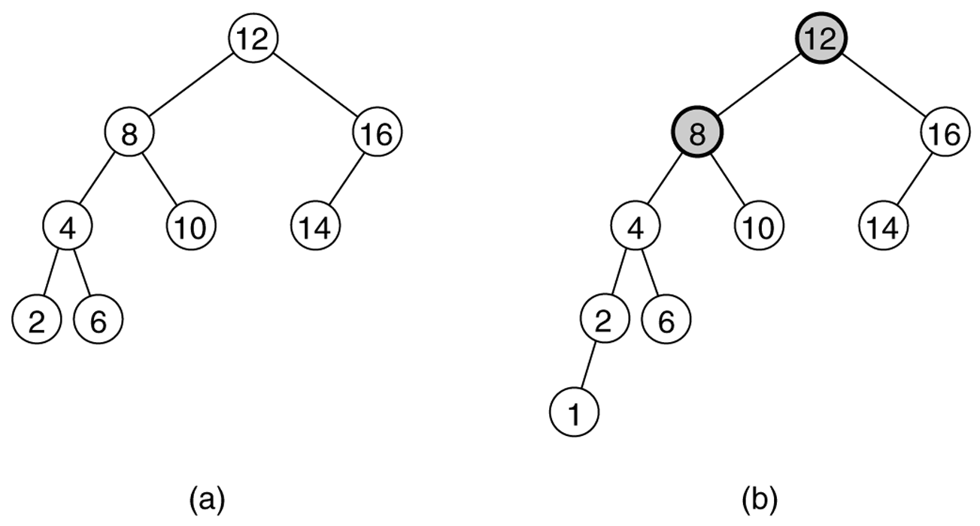
Figure 19.21
Two binary search trees: (a) an AVL tree; (b) not an AVL tree (unbalanced nodes are darkened)
CENG 213 Data Structures

Slide 4
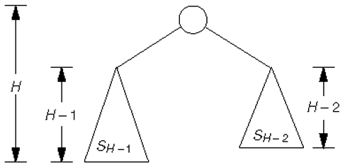
Figure 19.22
Minimum tree of height H
CENG 213 Data Structures

Slide 5
Properties
The depth of a typical node in an AVL tree is very close to the optimal log N.
Consequently, all searching operations in an AVL tree have logarithmic worst-case bounds.
An update (insert or remove) in an AVL tree could destroy the balance. It must then be rebalanced before the operation can be considered complete.
After an insertion, only nodes that are on the path from the insertion point to the root can have their balances altered.
CENG 213 Data Structures

Slide 6
Rebalancing
Suppose the node to be rebalanced is X. There are 4 cases that we might have to fix (two are the mirror images of the other two):
  An insertion in the left subtree of the left child of X,
  An insertion in the right subtree of the left child of X,
  An insertion in the left subtree of the right child of X, or
  An insertion in the right subtree of the right child of X.
Balance is restored by tree rotations.
CENG 213 Data Structures

Slide 7
Balancing Operations: Rotations
Case 1 and case 4 are symmetric and requires the same operation for balance.
  Cases 1,4 are handled by single rotation.
Case 2 and case 3 are symmetric and requires the same operation for balance.
  Cases 2,3 are handled by double rotation.
CENG 213 Data Structures

Slide 8
Single Rotation
A single rotation switches the roles of the parent and child while maintaining the search order.
Single rotation handles the outside cases (i.e. 1 and 4).
We rotate between a node and its child.
  Child becomes parent. Parent becomes right child in case 1, left child in case 4.
The result is a binary search tree that satisfies the AVL property.
CENG 213 Data Structures

Slide 9
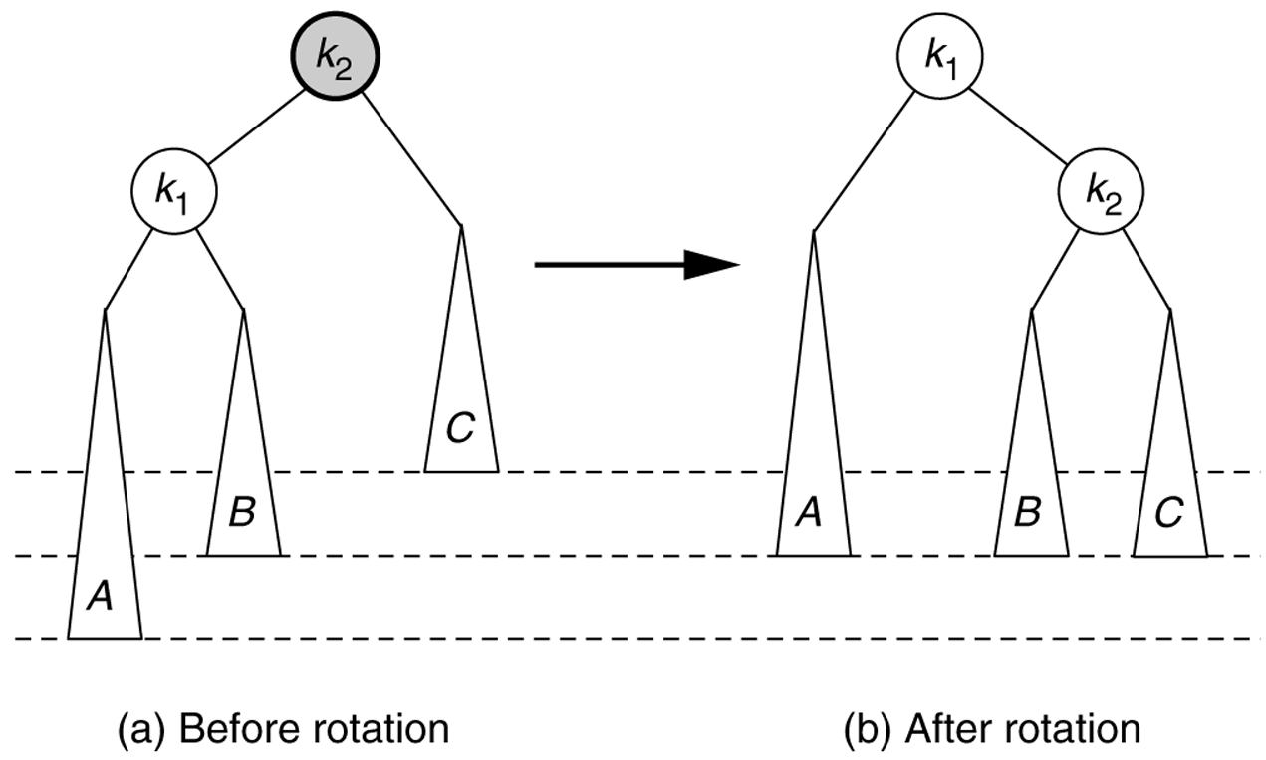
Figure 19.23
Single rotation to fix case 1: Rotate right
CENG 213 Data Structures

Slide 10
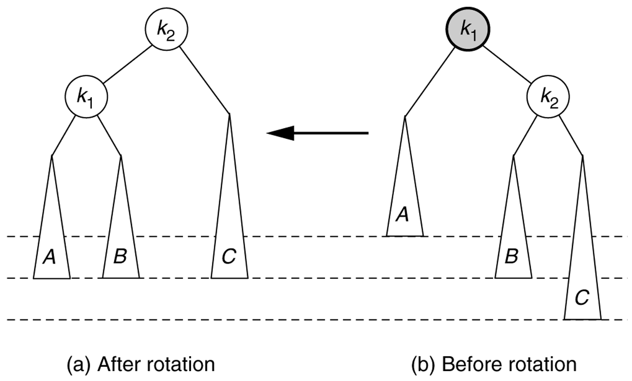
Figure 19.26
Symmetric single rotation to fix case 4 : Rotate left
CENG 213 Data Structures

Slide 11
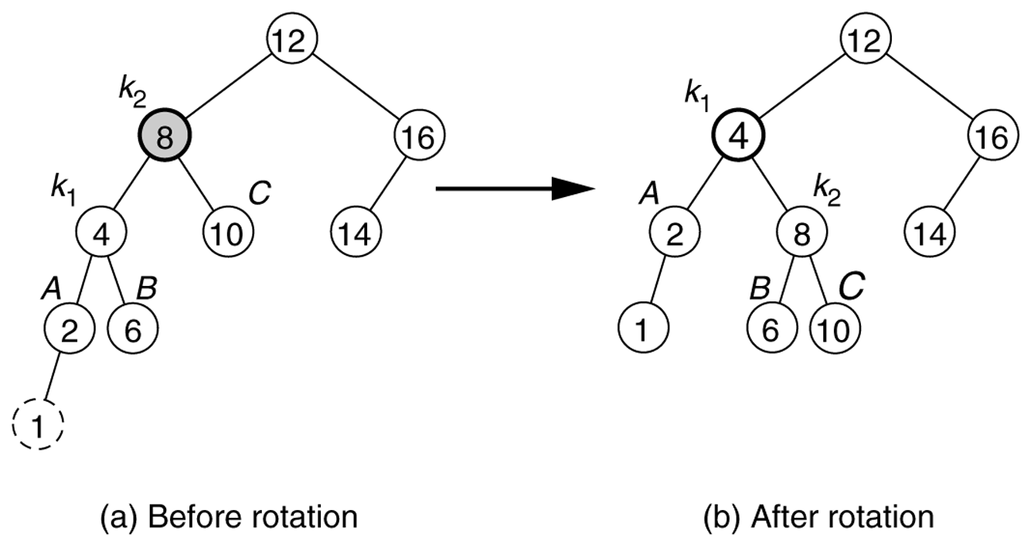
Figure 19.25
Single rotation fixes an AVL tree after insertion of 1.
CENG 213 Data Structures

Slide 12
Example
Start with an empty AVL tree and insert the items 3,2,1, and then 4 through 7 in sequential order.
Answer:
4
2
6
1
3
5
7
CENG 213 Data Structures

Slide 13
Analysis
One rotation suffices to fix cases 1 and 4.
Single rotation preserves the original height:
  The new height of the entire subtree is exactly the same as the height of the original subtree before the insertion.
Therefore it is enough to do rotation only at the first node, where imbalance exists, on the path from inserted node to root.
Thus the rotation takes O(1) time.
Hence insertion is O(logN)
CENG 213 Data Structures

Slide 14
Double Rotation
Single rotation does not fix the inside cases (2 and 3).
These cases require a double rotation, involving three nodes and four subtrees.
CENG 213 Data Structures

Slide 15
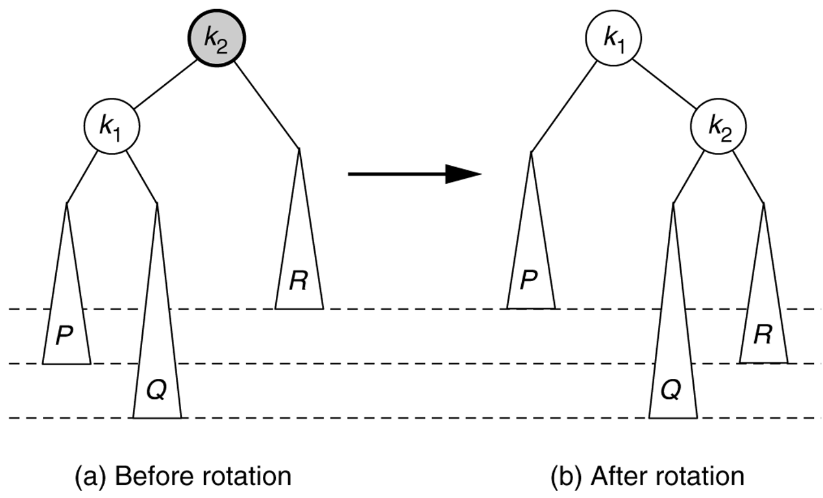
Figure 19.28
Single rotation does not fix case 2.
CENG 213 Data Structures

Slide 16
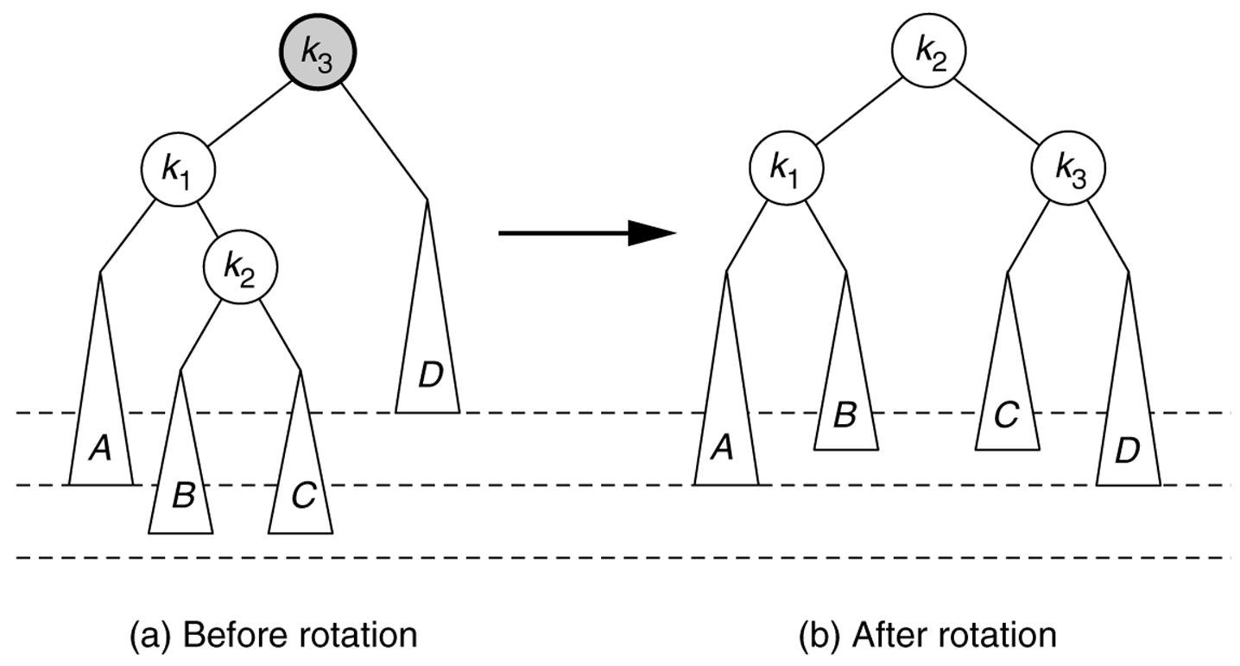
Left–right double rotation to fix case 2
Lift this up:
first rotate left between (k_{1,}k₂),
then rotate right betwen (k₃,k₂)
CENG 213 Data Structures

Slide 17
Left-Right Double Rotation
A left-right double rotation is equivalent to a sequence of two single rotations:
  1st rotation on the original tree:
  a left rotation between X’s left-child and grandchild
  2nd rotation on the new tree:
  a right rotation between X and its new left child.
CENG 213 Data Structures

Slide 18
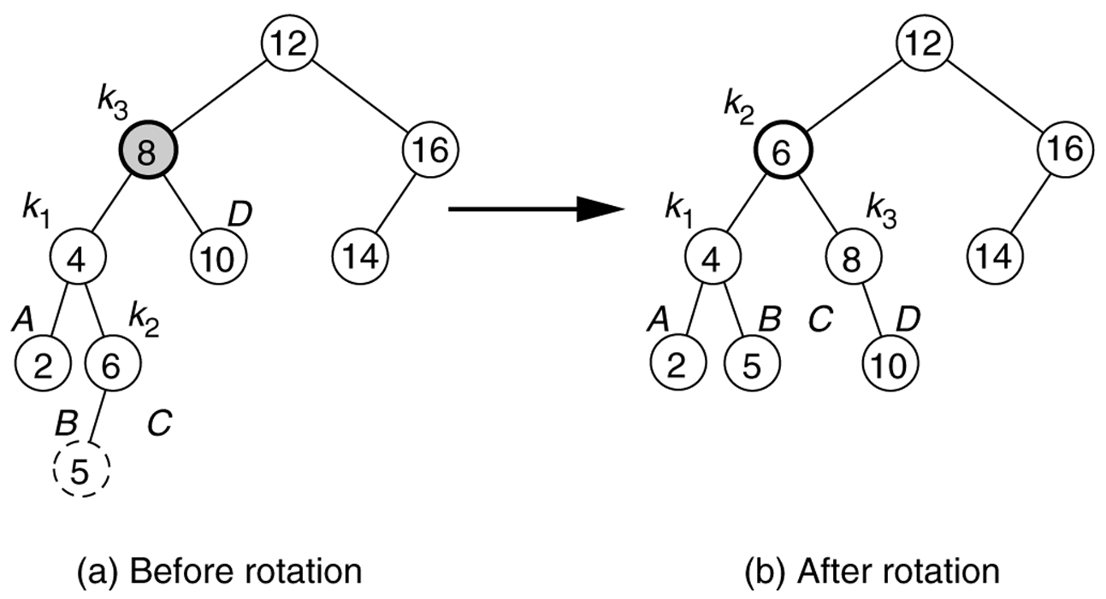
Figure 19.30
Double rotation fixes AVL tree after the insertion of 5.
CENG 213 Data Structures

Slide 19
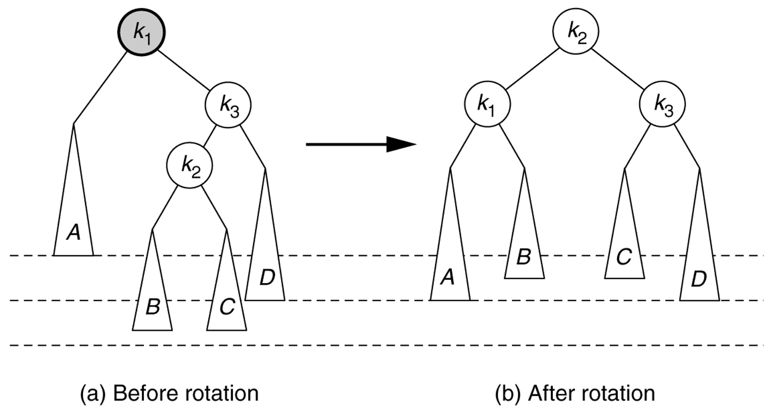
Right–Left double rotation to fix case 3.
CENG 213 Data Structures

Slide 20
Example
Insert 16, 15, 14, 13, 12, 11, 10, and 8, and 9 to the previous tree obtained in the previous single rotation example.
Answer:
7
4
13
2
6
11
15
1
3
5
9
12
14
16
8
10
CENG 213 Data Structures

Slide 21
Node declaration for AVL trees
template <class Comparable>
class AvlTree;
template <class Comparable>
class AvlNode
{
Comparable element;
AvlNode *left;
AvlNode *right;
int height;
AvlNode( const Comparable & theElement, AvlNode *lt,
AvlNode *rt, int h = 0 )
: element( theElement ), left( lt ), right( rt ),
height( h ) { }
friend class AvlTree<Comparable>;
};
CENG 213 Data Structures

Slide 22
Height
template class <Comparable>
int AvlTree<Comparable>::height( AvlNode<Comparable> *t) const
{
return t == NULL ? -1 : t->height;
}
CENG 213 Data Structures

Slide 23
Single right rotation
/**
* Rotate binary tree node with left child.
* For AVL trees, this is a single rotation for case 1.
* Update heights, then set new root.
*/
template <class Comparable>
void AvlTree<Comparable>::rotateWithLeftChild( AvlNode<Comparable> * & k2 ) const
{
AvlNode<Comparable> *k1 = k2->left;
k2->left = k1->right;
k1->right = k2;
k2->height = max( height( k2->left ), height( k2->right ))+1;
k1->height = max( height( k1->left ), k2->height ) + 1;
k2 = k1;
}
CENG 213 Data Structures

Slide 24
Double Rotation
/**
* Double rotate binary tree node: first left child.
* with its right child; then node k3 with new left child.
* For AVL trees, this is a double rotation for case 2.
* Update heights, then set new root.
*/
template <class Comparable>
void AvlTree<Comparable>::doubleWithLeftChild( AvlNode<Comparable> * & k3 ) const
{
rotateWithRightChild( k3->left );
rotateWithLeftChild( k3 );
}
CENG 213 Data Structures

Slide 25
/* Internal method to insert into a subtree.
* x is the item to insert.
* t is the node that roots the tree.
*/
template <class Comparable>
void AvlTree<Comparable>::insert( const Comparable & x, AvlNode<Comparable> * & t ) const
{
if( t == NULL )
t = new AvlNode<Comparable>( x, NULL, NULL );
else if( x < t->element )
{
insert( x, t->left );
if( height( t->left ) - height( t->right ) == 2 )
if( x < t->left->element )
rotateWithLeftChild( t );
else
doubleWithLeftChild( t );
}
else if( t->element < x )
{
insert( x, t->right );
if( height( t->right ) - height( t->left ) == 2 )
if( t->right->element < x )
rotateWithRightChild( t );
else
doubleWithRightChild( t );
}
else
; // Duplicate; do nothing
t->height = max( height( t->left ), height( t->right ) ) + 1;
}
CENG 213 Data Structures

Slide 26
AVL Tree -- Deletion
Deletion is more complicated.
We may need more than one rebalance on the path from deleted node to root.
Deletion is O(logN)
CENG 213 Data Structures

Slide 27
Deletion of a Node
Deletion of a node x from an AVL tree requires the same basic ideas, including single and double rotations, that are used for insertion.
With each node of the AVL tree is associated a balance factor that is left high, equal or right high according, respectively, as the left subtree has height greater than, equal to, or less than that of the right subtree.
CENG 213 Data Structures

Slide 28
Method
Reduce the problem to the case when the node x to be deleted has at most one child.
  If x has two children replace it with its immediate predecessor y under inorder traversal (the immediate successor would be just as good)
  Delete y from its original position, by proceeding as follows, using y in place of x in each of the following steps.
CENG 213 Data Structures

Slide 29
Method (cont.)
Delete the node x from the tree.
  We’ll trace the effects of this change on height through all the nodes on the path from x back to the root.
  We use a Boolean variable shorter to show if the height of a subtree has been shortened.
  The action to be taken at each node depends on
    the value of shorter
    balance factor of the node
    sometimes the balance factor of a child of the node.
shorter is initially true. The following steps are to be done for each node p on the path from the parent of x to the root, provided shorter remains true. When shorter becomes false, the algorithm terminates.
CENG 213 Data Structures

Slide 30
Case 1
Case 1: The current node p has balance factor equal.
  Change the balance factor of p.
  shorter becomes false
p
p
No rotations
Height unchanged
−
\
T₁
T₂
T₁
T₂
deleted
CENG 213 Data Structures

Slide 31
Case 2
Case 2: The balance factor of p is not equal and the taller subtree was shortened.
  Change the balance factor of p to equal
  Leave shorter true.
p
p
No rotations
Height reduced
/
−
T₁
T₂
T₁
T₂
deleted
CENG 213 Data Structures

Slide 32
Case 3
Case 3: The balance factor of p is not equal, and the shorter subtree was shortened.
  Rotation is needed.
  Let q be the root of the taller subtree of p. We have three cases according to the balance factor of q.
CENG 213 Data Structures

Slide 33
Case 3a
Case 3a: The balance factor of q is equal.
  Apply a single rotation
  shorter becomes false.
height unchanged
p
q
/
\
q
−
p
\
h-1
T₁
h
T₃
h
T₂
h
T₃
deleted
h-1
T₁
T₂
h
CENG 213 Data Structures

Slide 34
Case 3b
Case 3b: The balance factor of q is the same as that of p.
  Apply a single rotation
  Set the balance factors of p and q to equal
  leave shorter as true.
height reduced
p
q
-
\
q
p
-
\
h-1
T₁
T₃
h
h-1
h-1
h-1
T₁
T₂
T₂
h
T₃
deleted
CENG 213 Data Structures

Slide 35
Case 3c
Case 3c: The balance factors of p and q are opposite.
  Apply a double rotation
  set the balance factors of the new root to equal
  leave shorter as true.
height reduced
p
r
\
-
/
q
p
q
h-1
r
T₁
h-1
T₄
h-1 or
h-2
T₄
h-1
T₂
T₃
T₁
h-1
h-1 or
h-2
T₂
T₃
CENG 213 Data Structures

Slide 36
Example
Delete p.
m
p
e
c
j
n
s
d
h
k
r
u
b
o
a
g
i
l
t
f
CENG 213 Data Structures

Slide 37
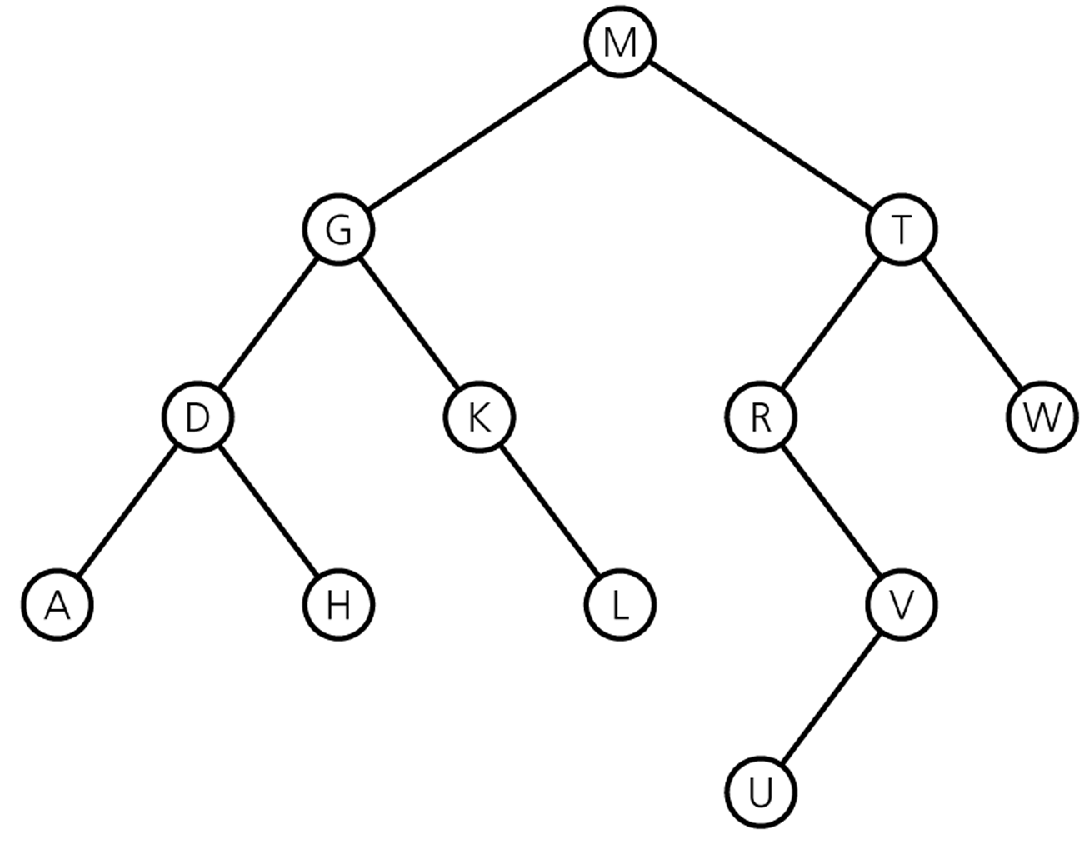
Exercises
What are preorder, postorder and inorder traversals of the following binary tree.
CENG 213 Data Structures

Slide 38
Assume that the inorder traversal of a binary tree is
  C G A H F D E I B J
  and its postorder traversal is
  G C H F A I E J B D
  Draw this binary tree.
CENG 213 Data Structures

