Slide 1
Splay Trees
CSCI 2720
Spring 2007
Splay Trees

Slide 2
Binary Search Trees
Random binary search trees can have worst case time bound of O(n) per operation for an n-node tree
Balanced trees have worst case bound of O(lg n) per operation
  However, balanced trees are not as efficient as possible if the access pattern is non-uniform.
  Also require extra storage for balance information
Optimum search trees guarantee minimum average access time
  However, this is only under assumption of fixed, known access probabilities and no correlation among accesses.
  Construction requires dynamic programming for efficiency.
Splay Trees

Slide 3
Self Adjusting Trees
  Tree itself is a simple binary search tree
  Algorithms for Lookup, Insert, Delete, do “something special”
    After each operation, apply a simple restructuring heuristic intended to improve future performance
    NOT guaranteed to operate in O(log n)
    but we do have a guarantee of amortized cost
    Much simpler to code than AVL, Red-black, etc.
Splay Trees

Slide 4
Amortized cost
For a tree with n nodes, any sequence of m operations, starting from an empty tree, is guaranteed to take a total of O(m log n)
Amortized cost is average cost per operation, which is O(log n)
Some operations may cost Ω(n)
Splay Trees

Slide 5
Pros and Cons
Advantages:
  Can be much more efficient if usage pattern is skewed. Good heuristics can have amortized running time similar to the running time of the best structure
  Require less space as no balance information is required
Disadvantages:
  More local adjustments during look-up operations (balanced trees only make adjustments during updates)
  Individual operations can be expensive – drawback for real-time applications
Splay Trees

Slide 6
How to Restructure?
Primitive operation is rotation
  Rotation preserves order of the BST.
Candidates:
  Single rotation: After accessing item i in node x, rotate parent(x) to move x one step closer to the root
  Move to root: After accessing item i in node x, repeatedly rotate parent(x) until x is the root
Both candidates can have worst case amortized cost of Ω(n) per access.
  Desirable to have a restructuring heuristic with better worst case properties!
Splay Trees

Slide 7
Bad Sequences for Move to Root and Single Rotation
For Move to Root, the input sequence 1,2,3,4,5,....,n will result in the following tree
n
4
3
2
1
Splay Trees

Slide 8
Next inputs of 1,2,3,...,n
Access to i takes n-i+1 steps
Ω(n²) for 2n operations, so amortized cost of Ω(n) per operation.
Bad sequence for single rotation is the same, except rotation of element i is repeated n-i times to get it to the root. Total cost is Ω(n³) for O(n²) operations, so amortized cost of Ω(n) per operation.
1
2
3
n
1
n
2
n
1
4
4
4
3
3
2
Splay Trees

Slide 9
The restructuring heuristic
A version of the Move-to-Front heuristic that we applied to lists
Each time a key is the object of a successful search, we move it to the root
Splay Trees

Slide 10
The Splay operation
Given a binary search tree, T, and a key, K, Splay(K,T) modifies T so that:
  If K is in the tree, K is now the root
  If K is not in the tree, then the root is the in-order successor or in-order predecessor
  T remains a binary search tree on the same keys
Splay Trees

Slide 11
Then …
Lookup(K,T)
  Splay(K,T)
  Examine root – does it contain K?
Insert(K,I,T)
  Splay(K,T)
  Examine root:
    If root == K, update root with info I
    If root != K, create new node contain (K,I), break one link to add new root
Splay Trees

Slide 12
Then …
Delete(K,T)
  Splay(K,T)
  Examine root
    If root != K do nothing
    Else Concat(T1,T2) (two subtrees of root)
Concat(T1,T2)
  Splay(+inf, T1)
    T1 now has no right subtree
    Attach T2 as right child of T1
Splay Trees

Slide 13
Splay Operations (1)
Instead of repeatedly using rotation to move x to the root, use the following three types of splaying operations to move x to the root
Case 1:
  Zig: If parent(x) is the root, rotate parent(x) to get x to the root (This is a terminal case).
y
x
x
C
y
A
A
B
B
C
Splay Trees

Slide 14
Splay Operations (2)
Case 2:
  Zig-zig: If parent(x) is not the root and x and parent(x) are both left or both right children, rotate grandparent(x) followed by rotate parent(x).
z
x
y
y
D
A
x
z
C
B
A
B
C
D
Splay Trees

Slide 15
Splay Operations (3)
Case 3:
  Zig-zag: If parent(x) is not the root and x is a left child and parent(x) a right child or vice-versa, rotate parent(x) and then rotate the new parent(x).
z
x
y
y
z
D
x
A
C
D
A
B
B
C
Splay Trees

Slide 16
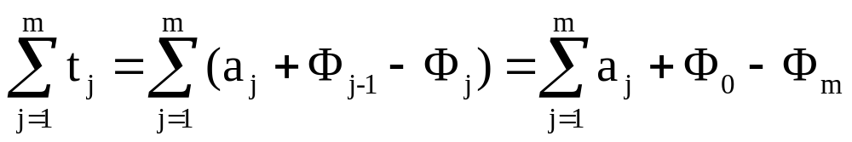
Analysis
Let n denote the number of nodes and m denote the number of look-up operations.
Use potential method. Let a be the amortized cost of an operation a = t + Φ’ - Φ, where t is the actual cost, Φ is the potential before an operation and Φ’ is the potential after the operation. Then
Sum of amortized cost
Decrease in
potential
Sum of actual cost
Splay Trees

Slide 17
For item i, define positive weight w(i) which is arbitrary but fixed.
Define size s(x) of a node x to be the sum of the weights of all items in the subtree rooted at x.
Define rank r(x) to be floor(lg s(x)).
The potential Φ is the sum of the ranks of all the nodes in the tree.
The cost of an operation is the number of rotations done, or one if there are no rotations.
Splay Trees

Slide 18
Access Lemma
Lemma 1: The amortized cost to splay a tree with root t at a node x is at most 3(r(t)-r(x)) + 1 = O(lg(s(t)/s(x))).
Proof:
  No rotation case is immediate
  Assume at least one rotation. Consider one splaying step. Let s and s’, r and r’ denote the size and rank functions just before and just after splaying. Let y be parent of x and z be parent of y before the step.
Splay Trees

Slide 19
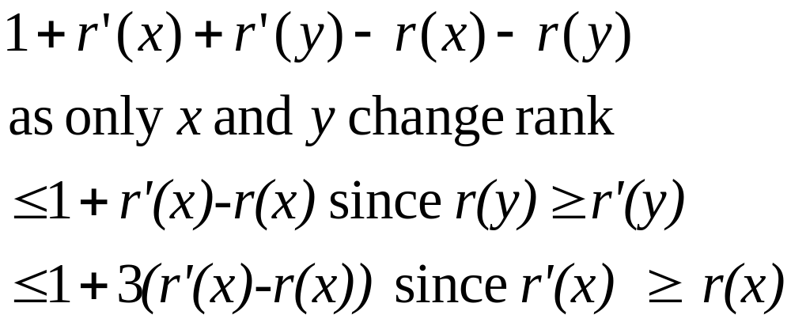
  Claim: The amortized time for one step is at most 3(r’(x)-r(x))+1 for step 1 and 3(r’(x)-r(x)) for steps 2 and 3.
  Since each step of splaying except the last one has amortized cost at most 3(r’(x)-r(x)) and the last has cost at most 3(r’(x)-r(x))+1, the sum telescopes to obtain a bound of at most 3(r(t)-r(x))+1.
  Proof of claim:
  Case 1: Only one rotation in case 1. Amortized cost is
Splay Trees

Slide 20
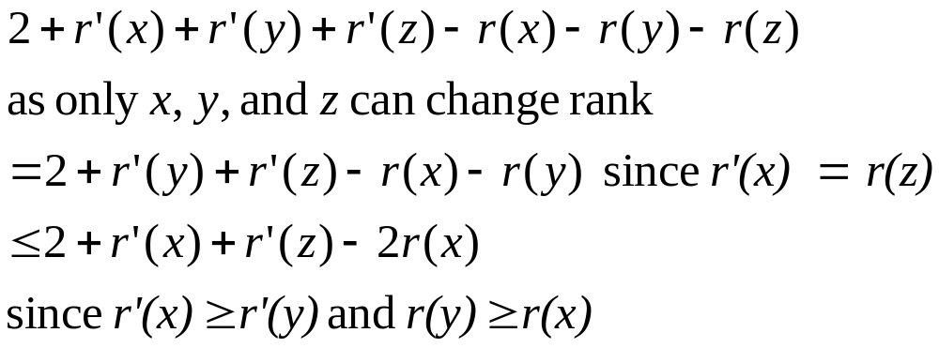
  Case 2: Two rotations, so amortized time is
Splay Trees

Slide 21
Proof, continued
  Now want to show 3(r’(x)-r(x))≥2+r’(x)+r’(z)-2r(x) or equivalently 2r’(x)-r(x)-r’(z) ≥2.
  We use the following fact: lg x + lg y is maximized at x=y=1/2 with value -2 for x,y>0 and x+y≤1.
  Hence, r(x)+r’(z)-2r’(x)=lg(s(x)/s’(x))+lg(s’(z)/s’(x)) ≤-2 since s(x)+s’(z) ≤ s’(x), giving the desired result
Splay Trees

Slide 22
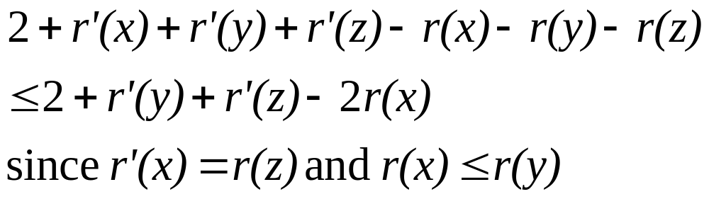
  Case 3: Two rotations as well
  We show that 2+r’(y)+r’(z)-2r(x)≤2(r’(x)-r(x)) or equivalently r’(y)+r’(z)-2r’(x) ≤ -2.
  As r’(y)+r’(z)-2r’(x)=lg(s’(y)/s’(x))+lg(s’(z)/s’(x)), this follows from the inequality s’(y)+s’(z) ≤ s’(x).
  Hence the amortized cost is at most 2(r’(x)-r(x)) ≤ 3(r’(x)-r(x)).
Splay Trees

Slide 23
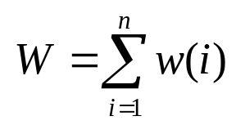
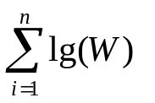
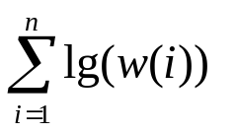
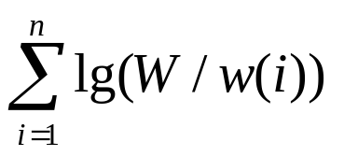
Decrease in Potential
We now consider the decrease in potential Φ₀ - Φ_{m} over the entire sequence of m operations.
Recall that rank r(x) is lg s(x) where s(x) is the size of the subtree rooted at x and the potential Φ is the sum of the ranks of all the nodes in the tree.
Let
Then Φ₀ is no more than
and Φ_{m} is at least
The net decrease in potential is then at most
Splay Trees

Slide 24
Balance Theorem
Theorem: The total access time is
O((m+n) lg n + m).
Proof: Assign weight 1/n to each item. Then W=1, the amortized access cost is at most 3lg n+1 and net potential drop is at most n lg n.
Splay Trees

Slide 25
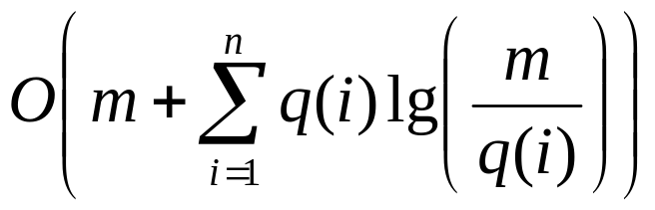
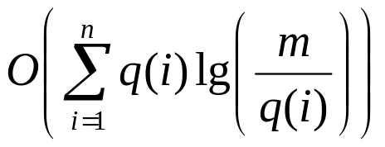
Static Optimality Theorem
For any item i, let q(i) be the total number of times i is accessed
Theorem: If every item is accessed at least once, then the total access time is
Proof: Assign weight q(i)/m to item i. Then W=1, amortized access time of item i is O(lg(m/q(i))) and net potential drop is at most
Splay Trees

Slide 26
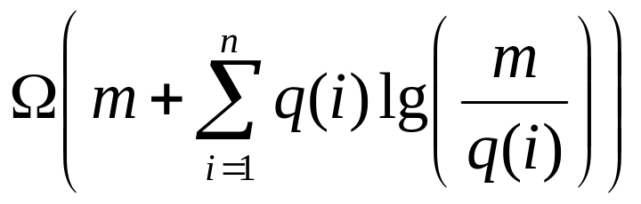
The balance theorem states that on a sufficiently long sequence of access, the running time of a splay tree is within a constant factor of a uniformly balanced tree.
The static optimality theorem implies that a splay tree is within a constant factor of the optimum tree for any fixed sequence as the total access time for the optimum tree is
Splay Trees

