Slide 1
Classes:
A Deeper Look
Systems Programming

Slide 2
Deeper into C++ Classes
const objects and const member functions
Composition
Friendship
this pointer
Dynamic memory management
  new and delete operators
static class members and member functions
Abstract Data Types
Systems Programming: Deeper into C++ Classes

Slide 3

21.2 const (Constant) Objects and const Member Functions
Principle of least privilege
  One of the most fundamental principles of good software engineering
  Applies to objects, too
const objects
  Keyword const
  Specifies that an object is not modifiable.
  Attempts to modify the object will result in compilation errors.
Example
  Const Time noon (12, 0, 0);
Systems Programming: Deeper into C++ Classes

Slide 4
const (Constant) Objects and const Member Functions
const member functions
  Only const member function can be called for const objects.
  Member functions declared const are not allowed to modify the object.
  A function is specified as const both in its prototype and in its definition.
  const declarations are not allowed for constructors and destructors.
Systems Programming: Deeper into C++ Classes

Slide 5
Software Engineering Observation 21.2
A const member function can be overloaded with a non-const version. The compiler chooses which overloaded member function to use based on the object on which the function is invoked. If the object is const, the compiler uses the const version. If the object is not const, the compiler uses the non-const version.
Systems Programming: Deeper into C++ Classes

Slide 6
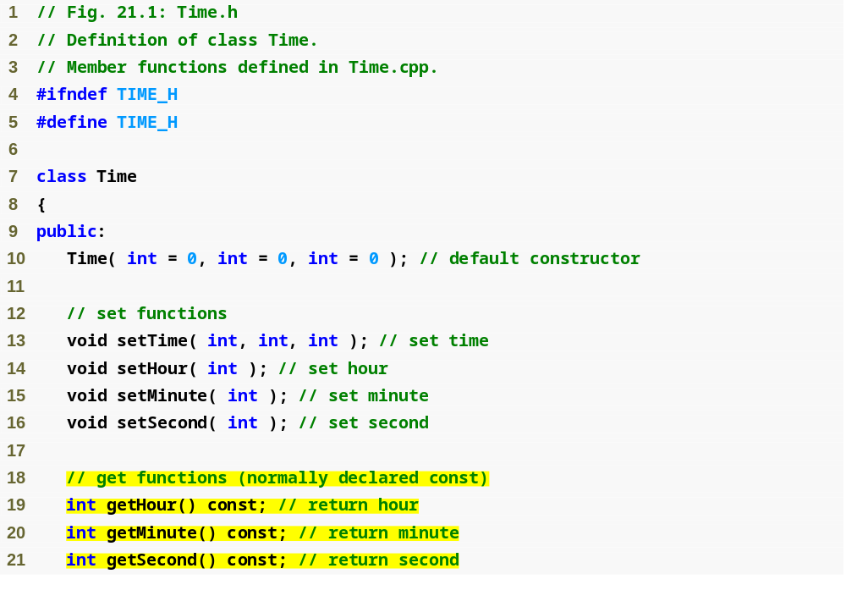
const Example
Systems Programming: Deeper into C++ Classes

Slide 7
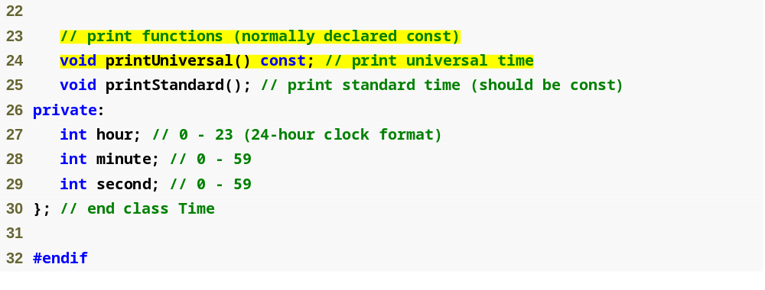
const Example
Systems Programming: Deeper into C++ Classes

Slide 8
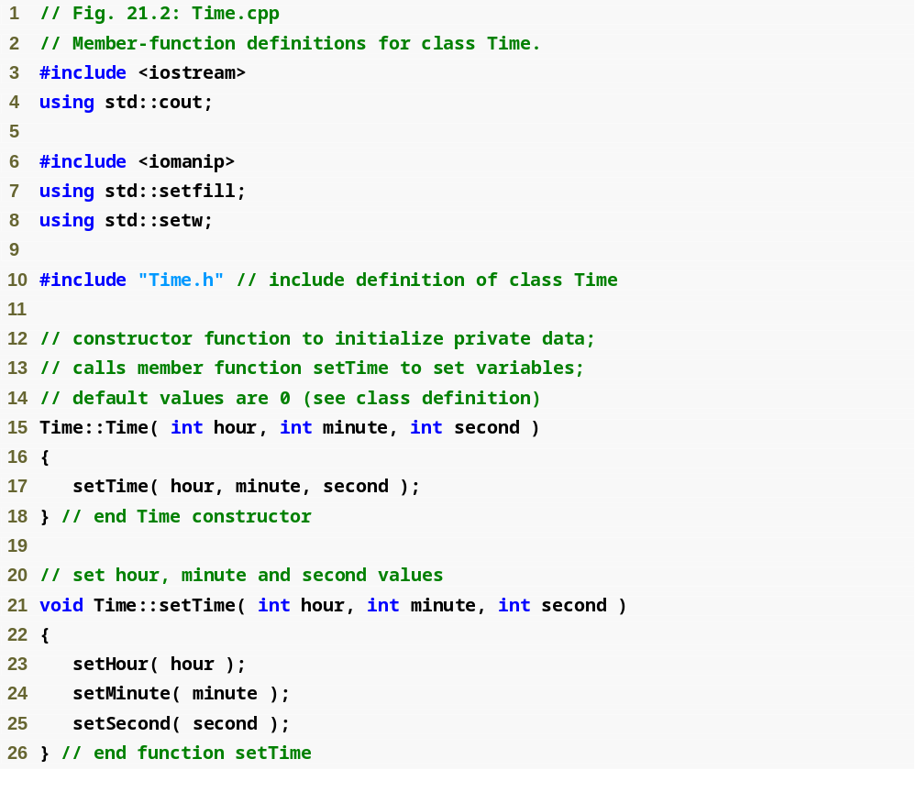
const Example
Systems Programming: Deeper into C++ Classes

Slide 9
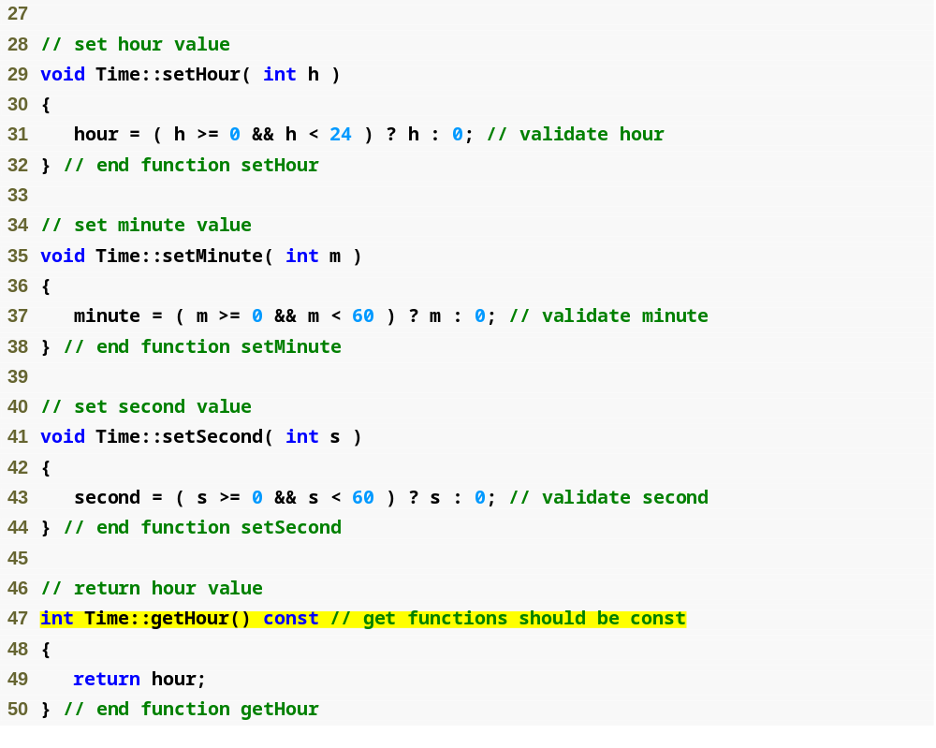
const Example
const keyword in function definition, as well as in function prototype
Systems Programming: Deeper into C++ Classes

Slide 10
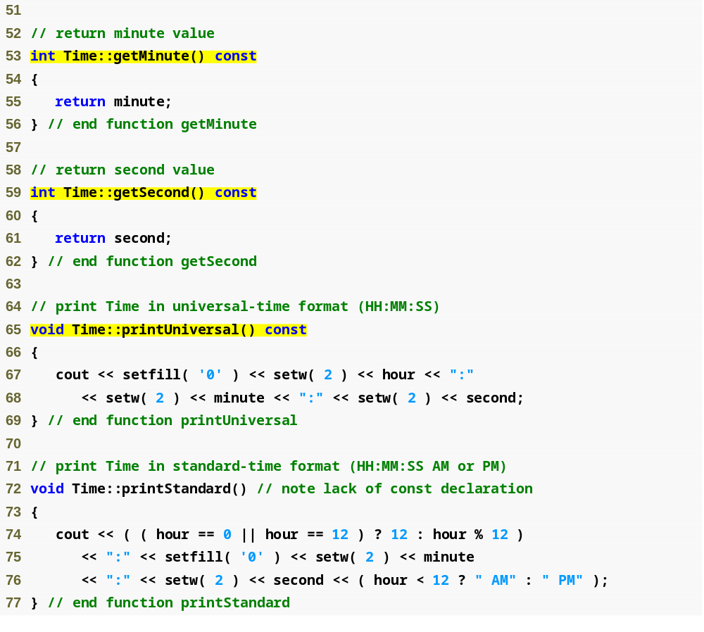
const Example
Systems Programming: Deeper into C++ Classes

Slide 11
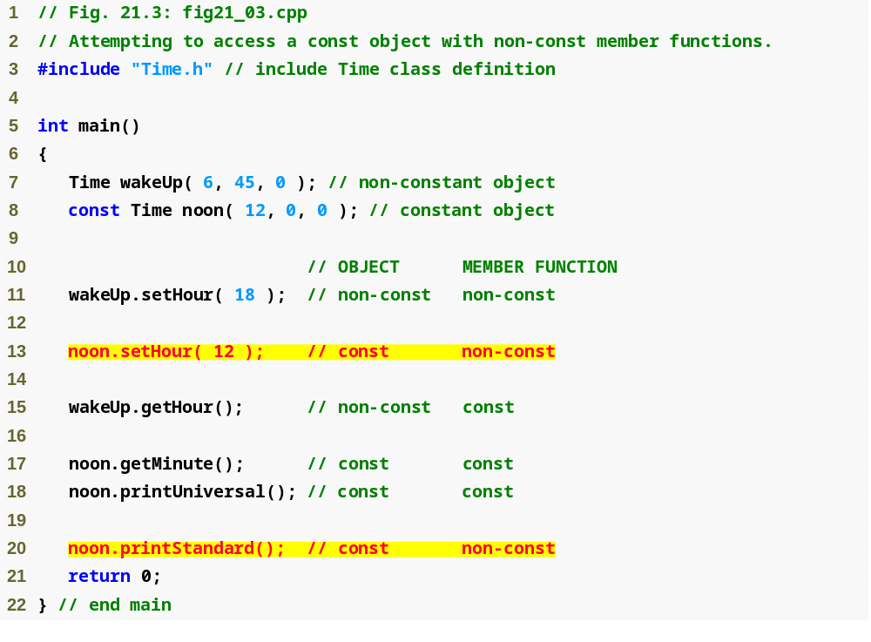
const Example
Cannot invoke non-const member functions on a const object
Systems Programming: Deeper into C++ Classes

Slide 12
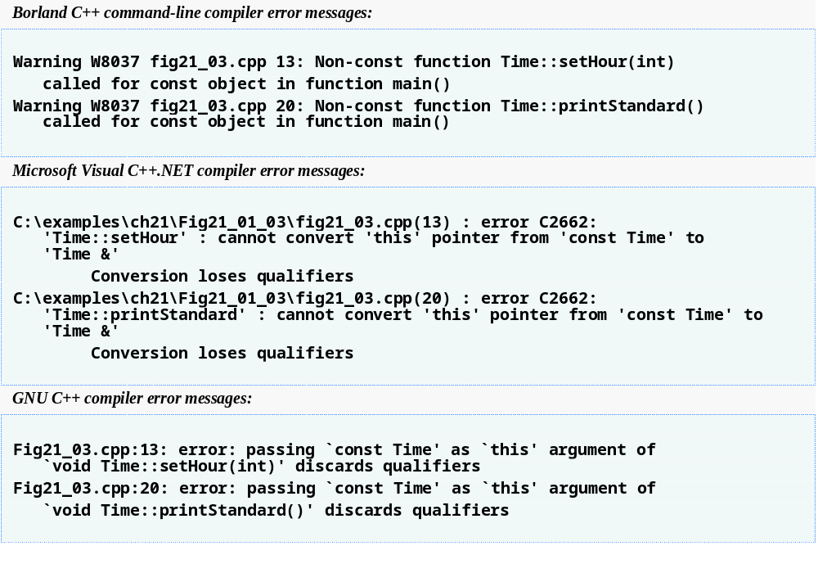
const Example
Systems Programming: Deeper into C++ Classes

Slide 13
Member Initializer
Required for initializing
  const data members
  Data members that are references.
Can be used for any data member.
Member initializer list
  Appears between a constructor’s parameter list and the left brace that begins the constructor’s body.
  Separated from the parameter list with a colon (:).
  Each member initializer consists of the data member name followed by parentheses containing the member’s initial value.
  Multiple member initializers are separated by commas.
  Executes before the body of the constructor executes.
Systems Programming: Deeper into C++ Classes

Slide 14
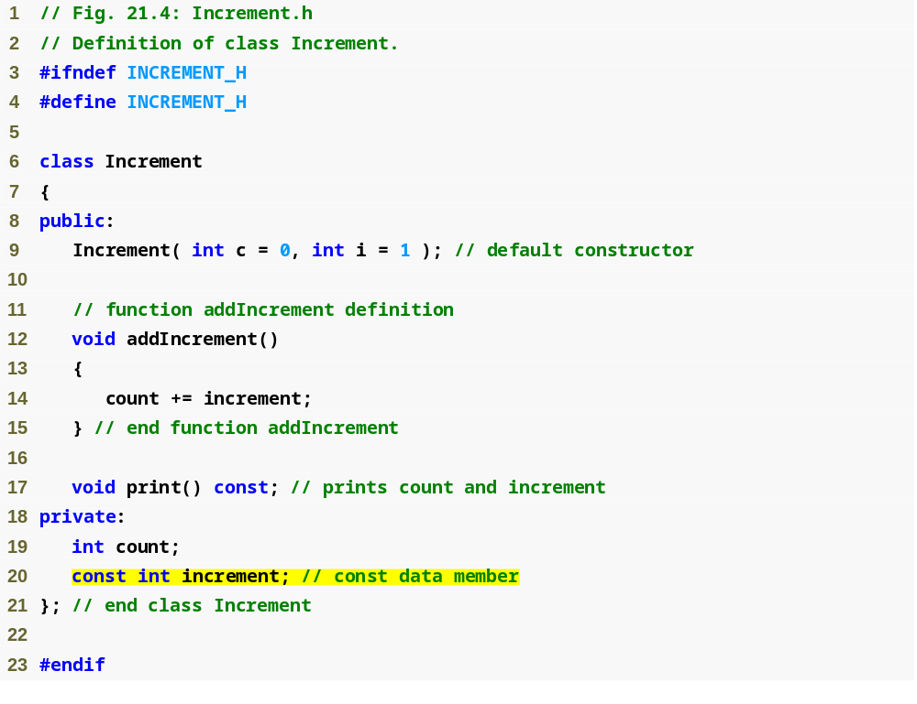
Member Initializer
const data member that must be initialized using a member initializer
Systems Programming: Deeper into C++ Classes

Slide 15
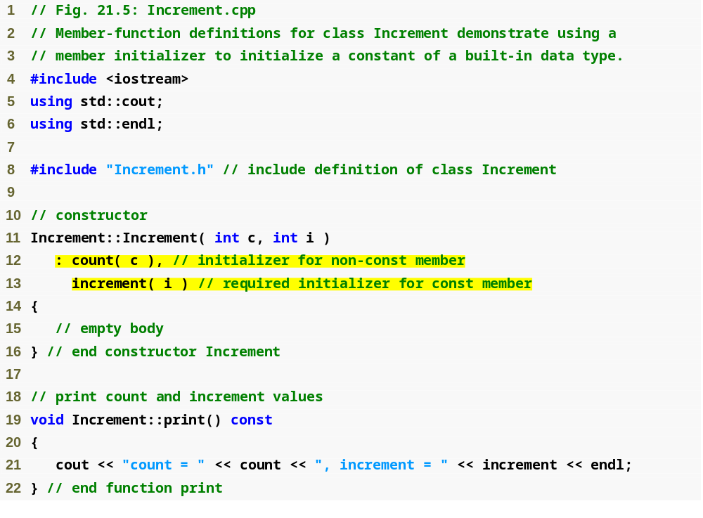
Member Initializer
Colon (:) marks the start of a member initializer list
Member initializer for non-const member count
Required member initializer for const member increment
Systems Programming: Deeper into C++ Classes

Slide 16
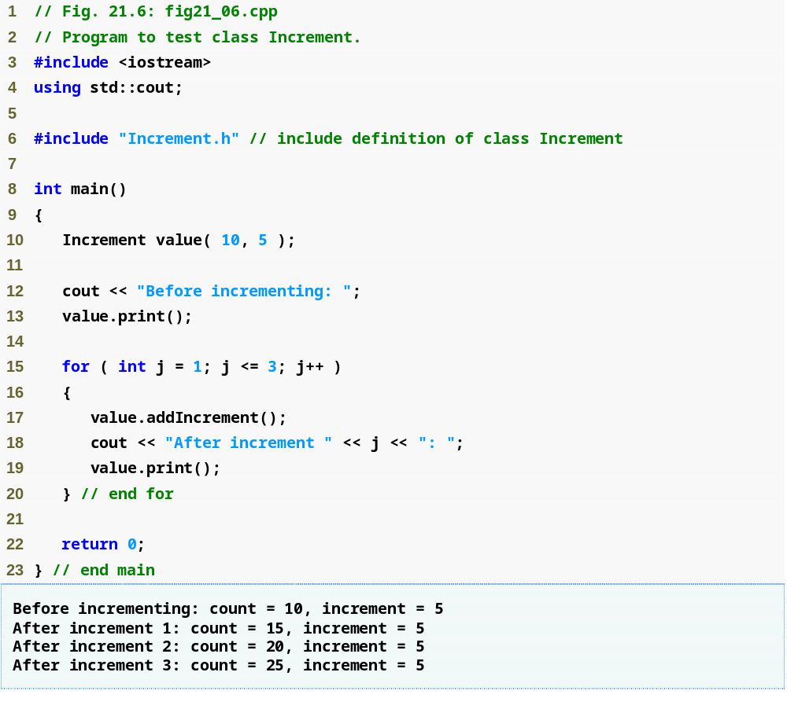
Member Initializer
Systems Programming: Deeper into C++ Classes

Slide 17
Software Engineering Observation 21.3
A const object cannot be modified by assignment, so it must be initialized. When a data member of a class is declared const, a member initializer must be used to provide the constructor with the initial value of the data member for an object of the class. The same is true for references.
Systems Programming: Deeper into C++ Classes

Slide 18
Common Programming Error 21.5
Not providing a member initializer for a const data member is a compilation error.
Systems Programming: Deeper into C++ Classes

Slide 19
Software Engineering Observation 21.4
Constant data members (const objects and const variables) and data members declared as references must be initialized with member initializer syntax; assignments for these types of data in the constructor body are not allowed.
Systems Programming: Deeper into C++ Classes

Slide 20
21.3 Composition:
Objects as Members of Classes
Composition
  Sometimes referred to as a has-a relationship.
  A class can have objects of other classes as members.
  Example
    AlarmClock object with a Time object as a member
Systems Programming: Deeper into C++ Classes

Slide 21
Composition: Objects as Members of Classes
Initializing member objects
  Member initializers pass arguments from the object’s constructor to member-object constructors.
  Member objects are constructed in the order in which they are declared in the class definition.
    Not in the order they are listed in the constructor’s member initializer list.
    Before the enclosing class object (host object) is constructed.
  If a member initializer is not provided
    The member object’s default constructor will be called implicitly.
Systems Programming: Deeper into C++ Classes

Slide 22
Software Engineering Observation 21.5
A common form of software reusability is composition, in which a class has objects of other classes as members.
Systems Programming: Deeper into C++ Classes

Slide 23
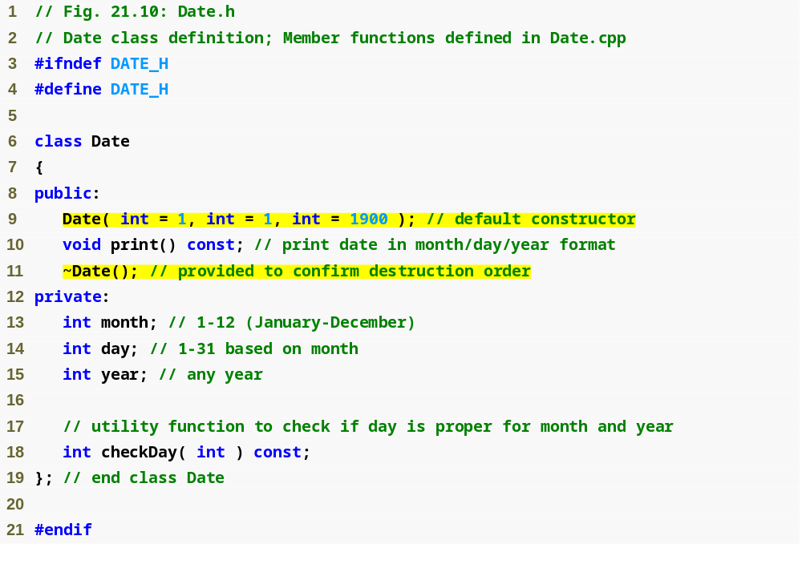
Composition Example
Systems Programming: Deeper into C++ Classes

Slide 24
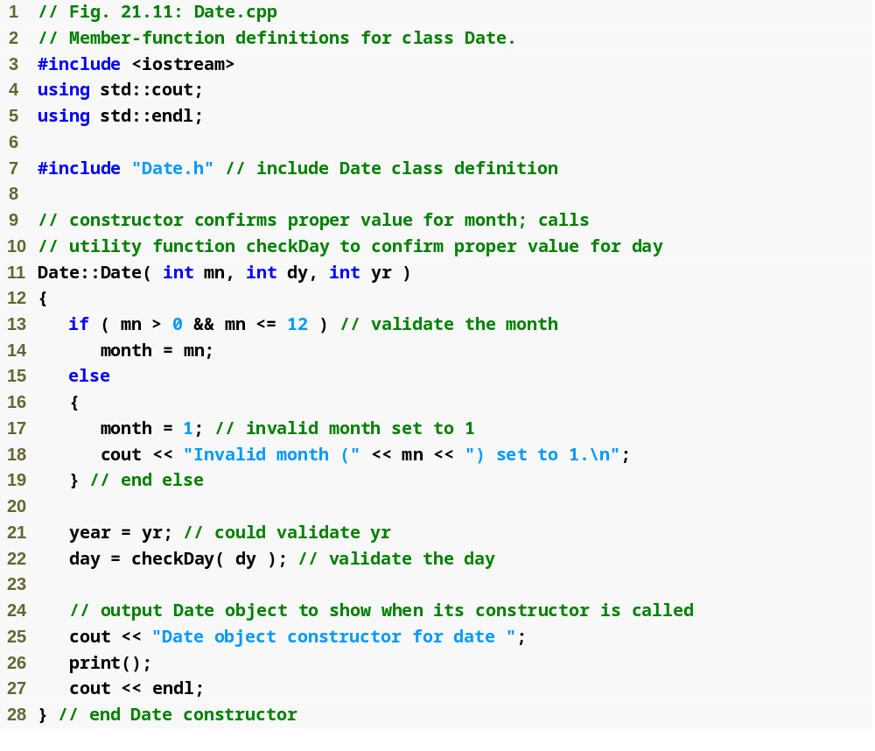
Composition Example
Systems Programming: Deeper into C++ Classes

Slide 25
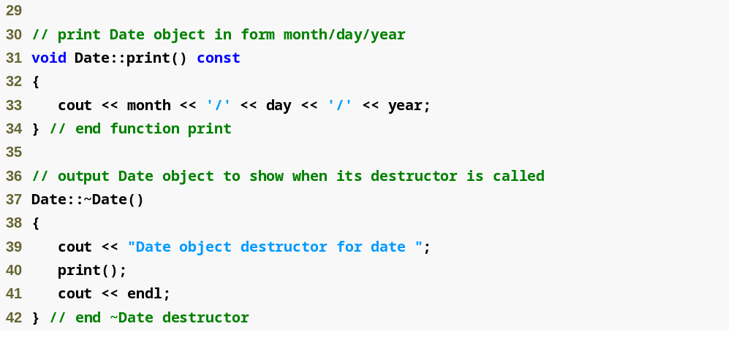
Composition Example
Systems Programming: Deeper into C++ Classes

Slide 26
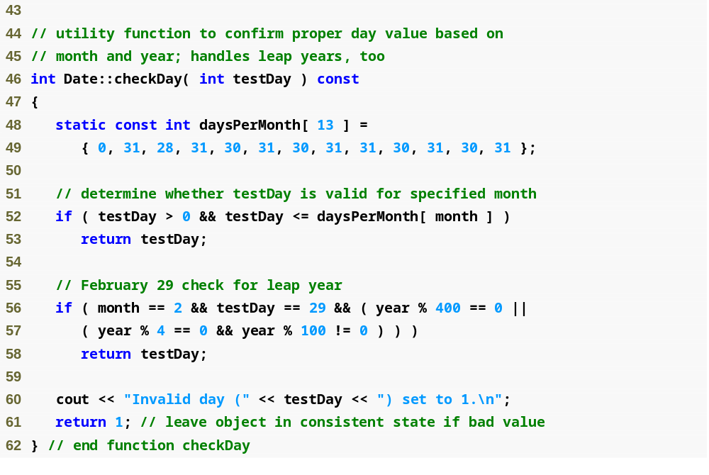
Composition Example
Systems Programming: Deeper into C++ Classes

Slide 27
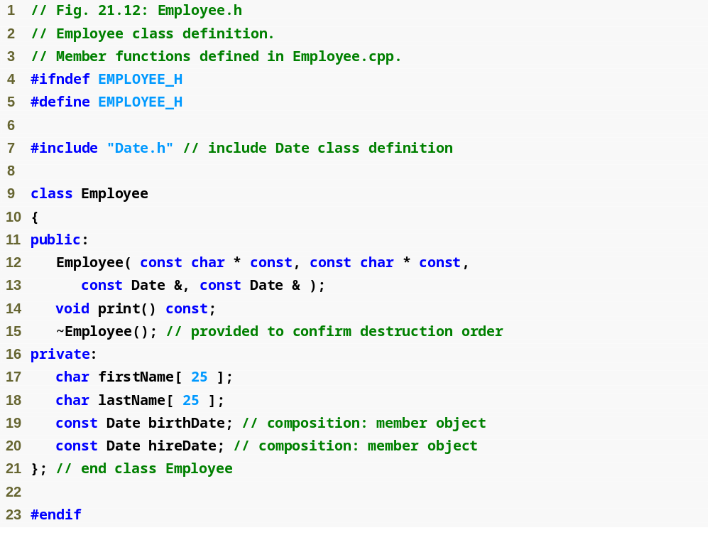
Composition Example
Parameters to be passed via member initializers to the constructor for class Date
const objects of class Date as members
Systems Programming: Deeper into C++ Classes

Slide 28
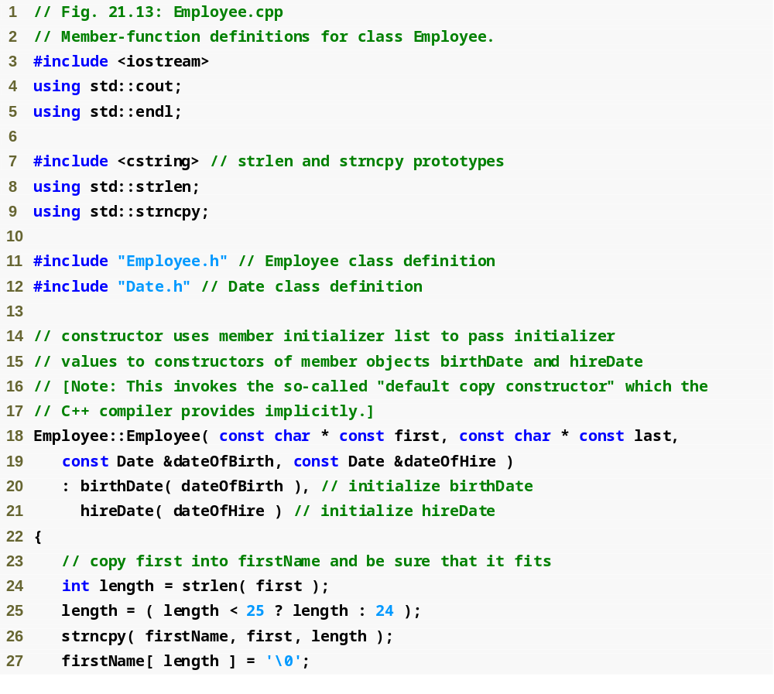
Composition Example
Member initializers that pass arguments to Date’s implicit default copy constructor
Systems Programming: Deeper into C++ Classes

Slide 29
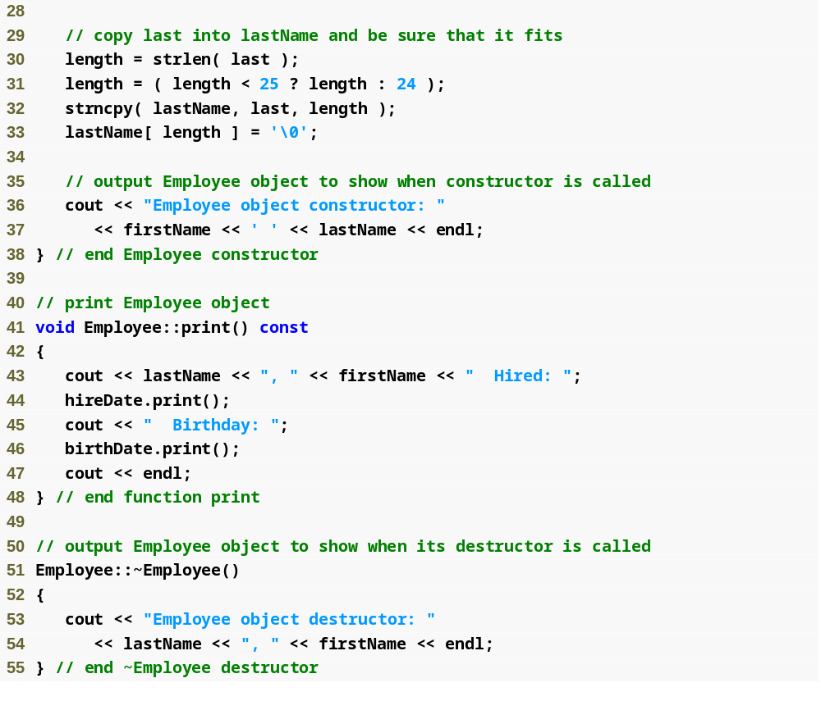
Composition Example
Systems Programming: Deeper into C++ Classes

Slide 30
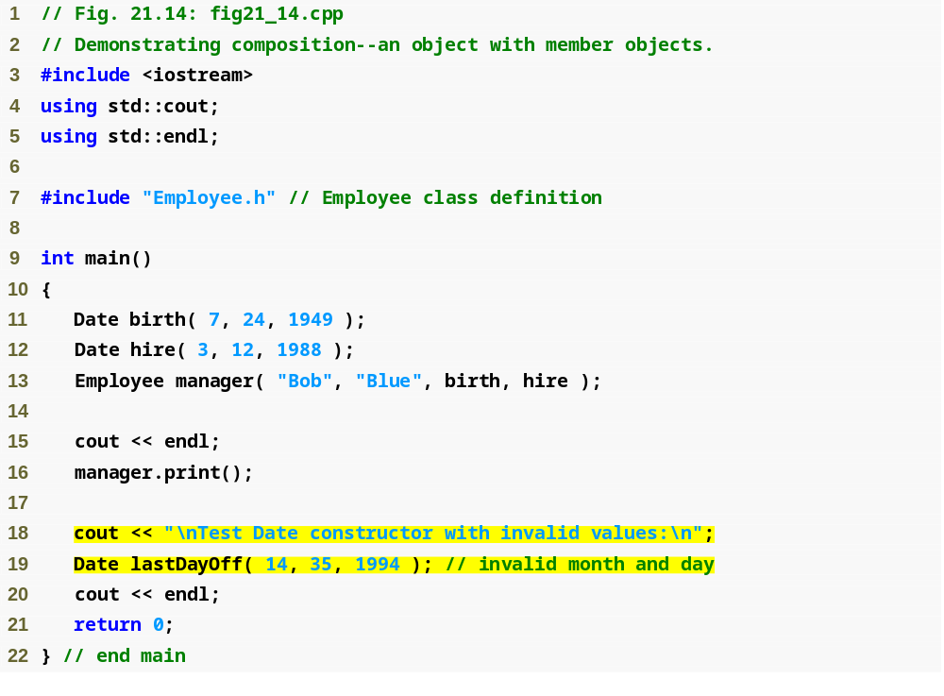
Composition Example
Passing objects to a host object constructor
Systems Programming: Deeper into C++ Classes

Slide 31
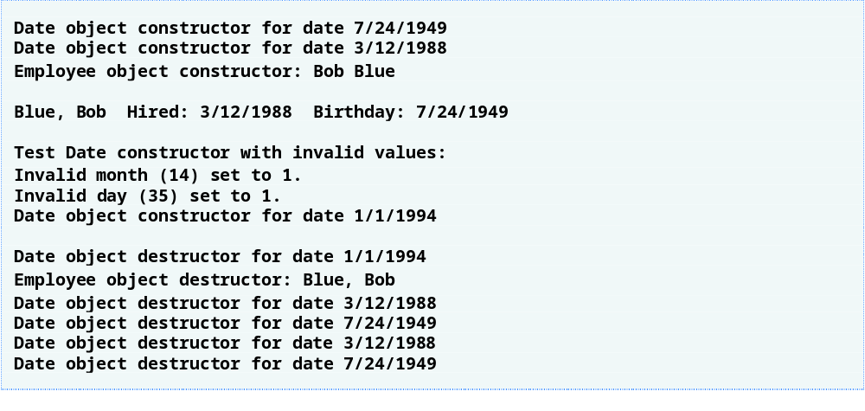
Composition Example
Systems Programming: Deeper into C++ Classes

Slide 32
Common Programming Error 21.6
A compilation error occurs if a member object is not initialized with a member initializer and the member object’s class does not provide a default constructor (i.e., the member object’s class defines one or more constructors, but none is a default constructor).
Systems Programming: Deeper into C++ Classes

Slide 33
21.4 friend Functions and friend Classes
friend function of a class
  Defined outside that class’s scope.
  Not a member function of that class.
  has the right to access the non-public and public members of that class.
  Standalone functions or entire classes may be declared to be friends of a class.
  Can enhance performance.
  Often appropriate when a member function cannot be used for certain operations.
Systems Programming: Deeper into C++ Classes

Slide 34
friend Functions and friend Classes
To declare a function as a friend of a class:
  Provide the function prototype in the class definition preceded by keyword friend.
To declare a class as a friend of another class:
  Place a declaration of the form
  friend class ClassTwo;
  in the definition of class ClassOne
All member functions of class ClassTwo are friends of class ClassOne.
Systems Programming: Deeper into C++ Classes

Slide 35
friend Functions and friend Classes
Friendship is granted, not taken.
  For class B to be a friend of class A, class A must explicitly declare that class B is its friend.
Friendship relation is neither symmetric nor transitive
  If class A is a friend of class B, and class B is a friend of class C, you cannot infer that class B is a friend of class A, that class C is a friend of class B, or that class A is a friend of class C.
Systems Programming: Deeper into C++ Classes

Slide 36
friend Functions and friend Classes
It is possible to specify overloaded functions as friends of a class.
  Each overloaded function intended to be a friend must be explicitly declared as a friend of the class.
Systems Programming: Deeper into C++ Classes

Slide 37
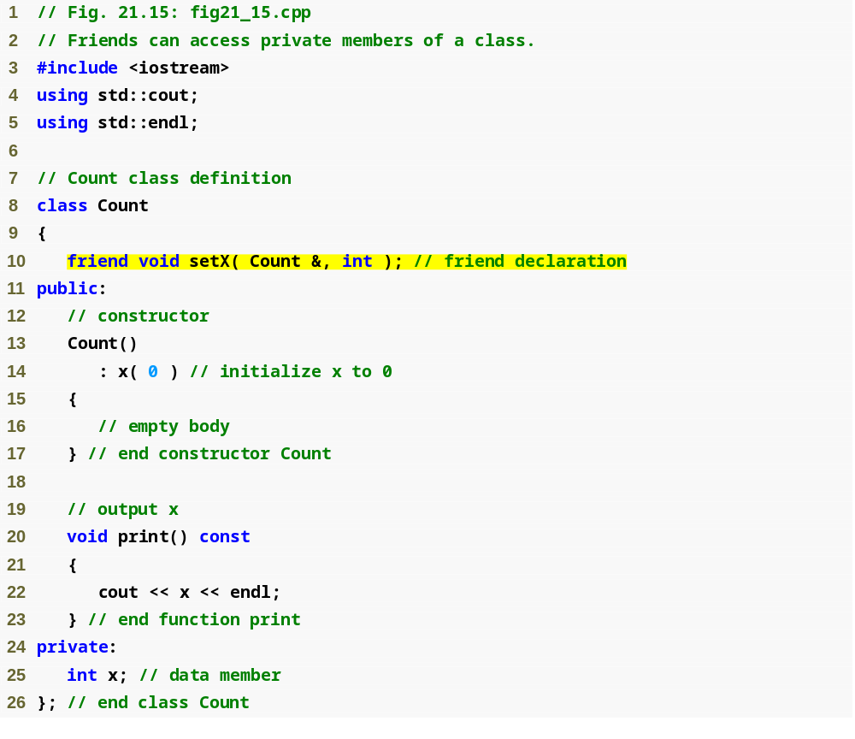
friend Function Example
friend function declaration (can appear anywhere in the class)
Systems Programming: Deeper into C++ Classes

Slide 38
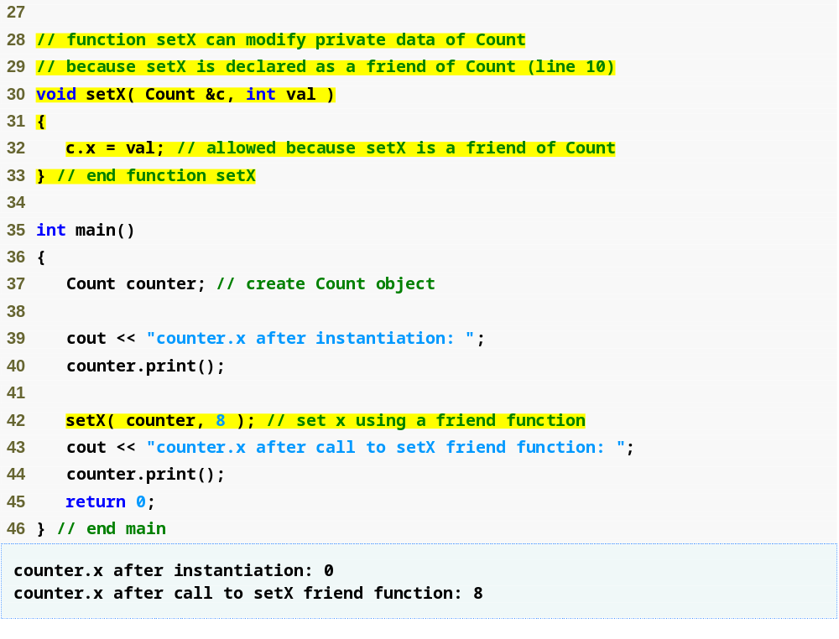
friend Function Example
friend function can modify Count’s private data
Calling a friend function; note that we pass the Count object to the function
Systems Programming: Deeper into C++ Classes

Slide 39
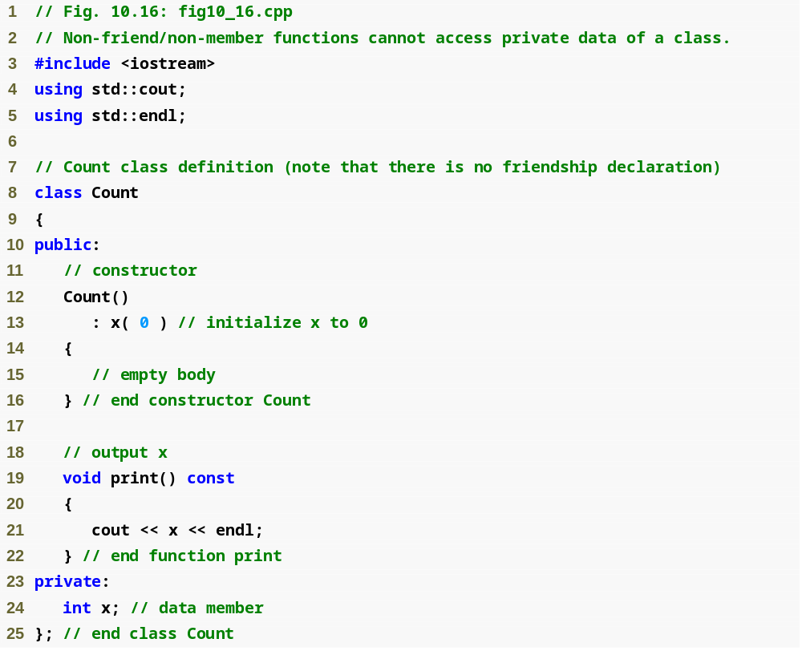
friend Function Example
Systems Programming: Deeper into C++ Classes

Slide 40
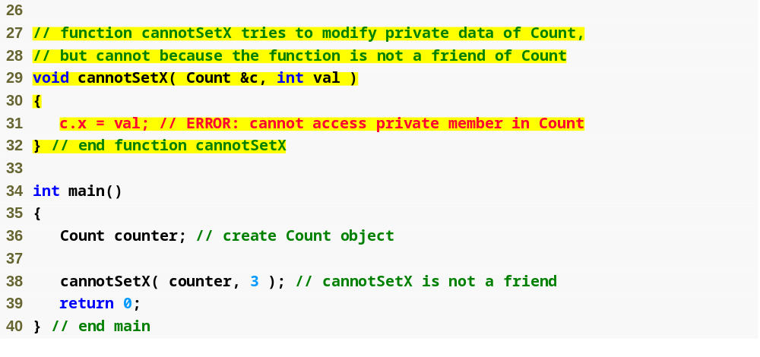
friend Function Example
Non-friend function cannot access the class’s private data
Systems Programming: Deeper into C++ Classes

Slide 41
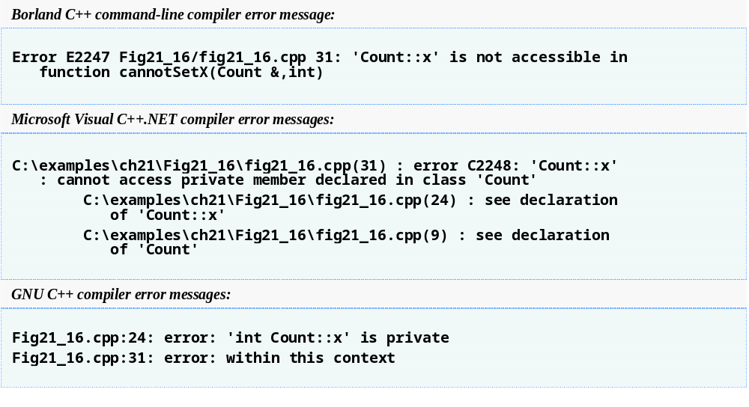
friend Function Example
Systems Programming: Deeper into C++ Classes

Slide 42
21.5 Using the this Pointer
Member functions know which object’s data members to manipulate.
  Every object has access to its own address through a pointer called this (a C++ keyword).
  An object’s this pointer is not part of the object itself.
  The this pointer is passed (by the compiler) as an implicit argument to each of the object’s non-static member functions.
Systems Programming: Deeper into C++ Classes

Slide 43
21.5 Using the this Pointer
Objects use the this pointer implicitly or explicitly.
  Used implicitly when accessing members directly.
  Used explicitly when using keyword this.
  Type of the this pointer depends on the type of the object and whether the executing member function is declared const.
Systems Programming: Deeper into C++ Classes

Slide 44
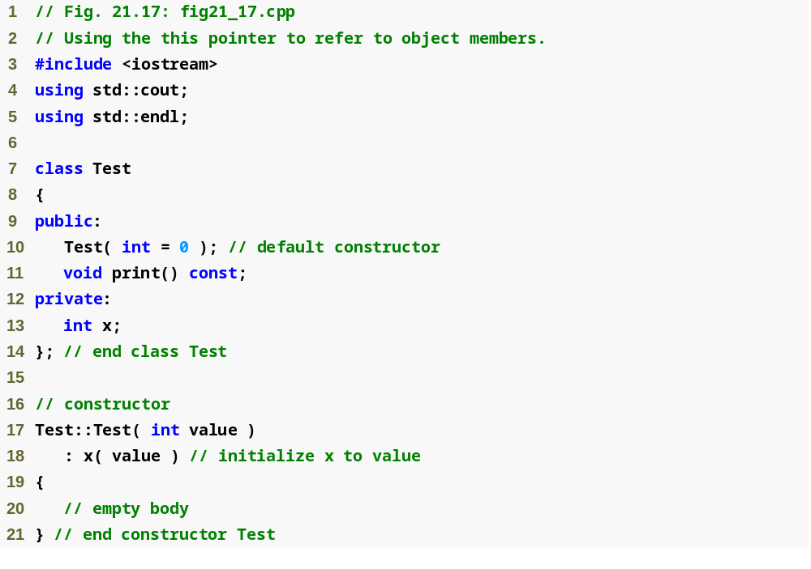
this Example
Systems Programming: Deeper into C++ Classes

Slide 45
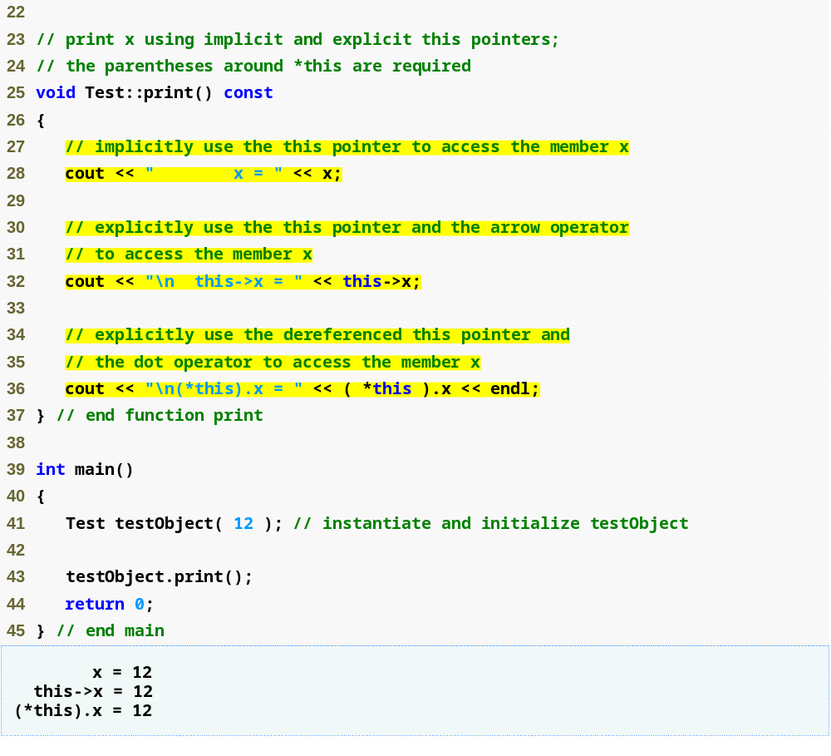
this Example
Implicitly using the this pointer to access member x
Explicitly using the this pointer to access member x
Using the dereferenced this pointer and the dot operator
Systems Programming: Deeper into C++ Classes

Slide 46
Common Programming Error 21.7
Attempting to use the member selection operator (.) with a pointer to an object is a compilation error—the dot member selection operator may be used only with an lvalue such as an object’s name, a reference to an object or a dereferenced pointer to an object.
Systems Programming: Deeper into C++ Classes

Slide 47
Using the this Pointer
Cascaded member-function calls
  Multiple functions are invoked in the same statement.
  Enabled by member functions returning the dereferenced this pointer
  Example
    t.setMinute( 30 ).setSecond( 22 );
      Calls t.setMinute( 30 );
      Then calls t.setSecond( 22 );
Systems Programming: Deeper into C++ Classes

Slide 48
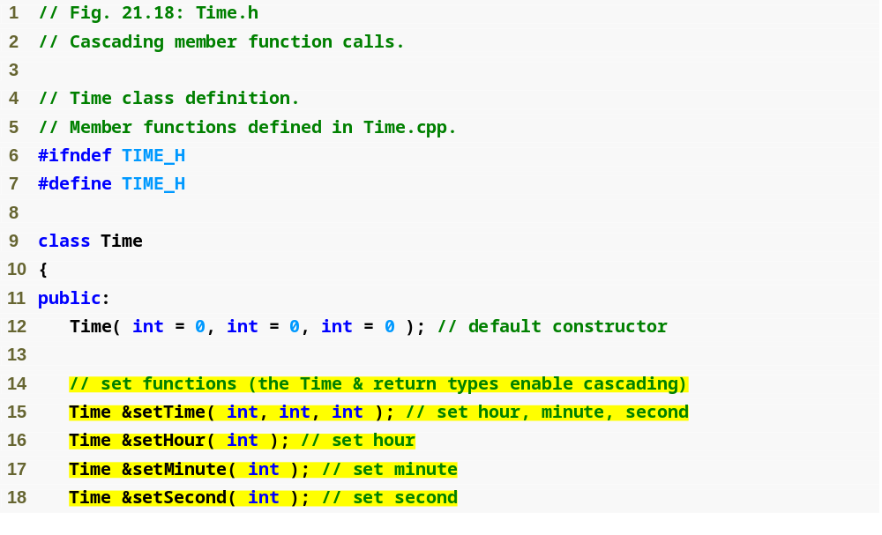
Cascading Function Calls
using this Pointer
set functions return Time & to enable cascading
Systems Programming: Deeper into C++ Classes

Slide 49
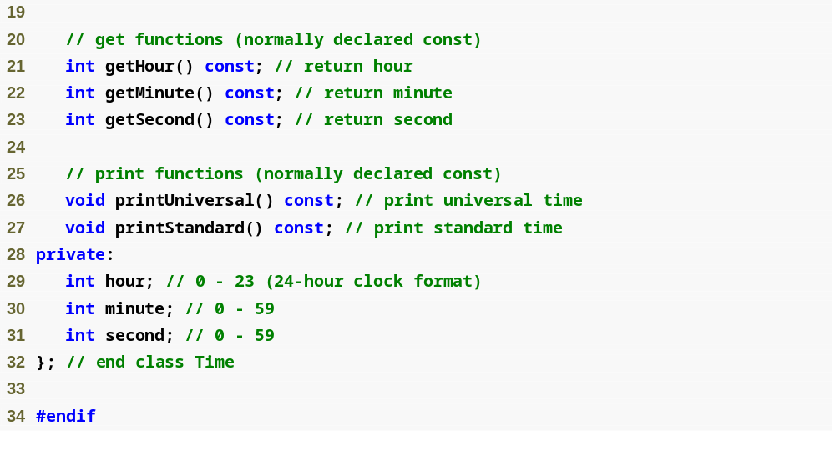
Cascading Function Calls
using this Pointer
Systems Programming: Deeper into C++ Classes

Slide 50
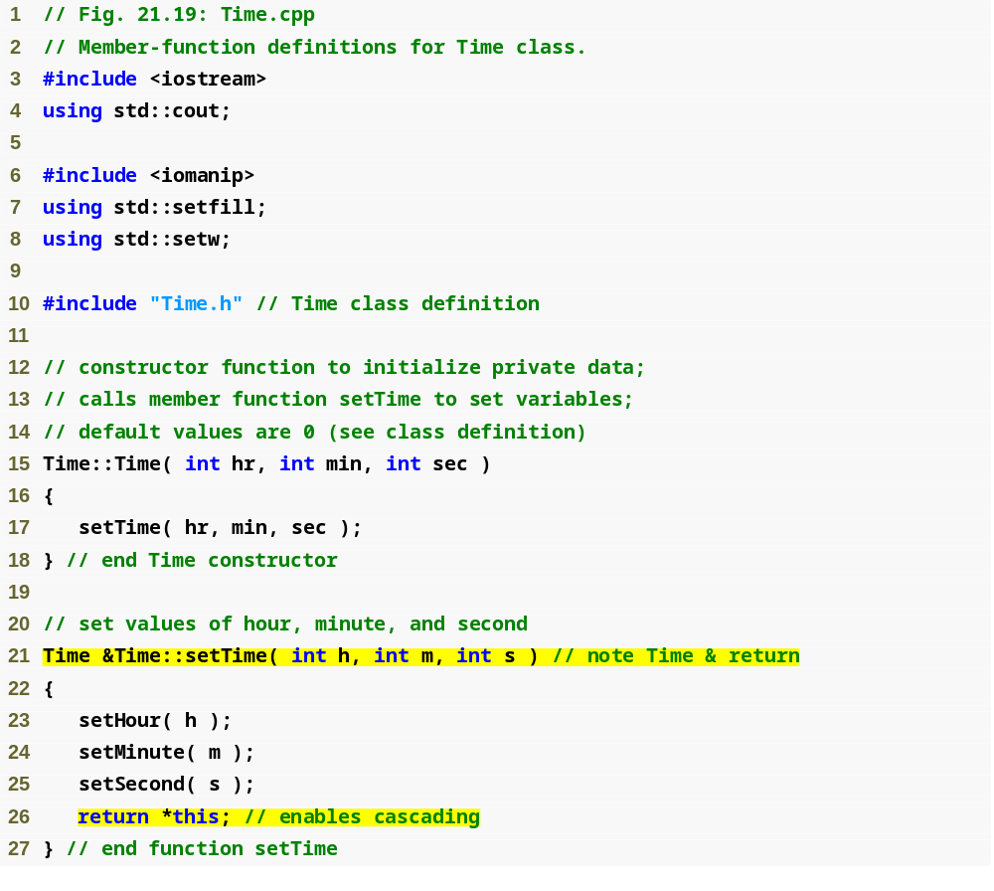
Cascading Function Calls
using this Pointer
Returning dereferenced this pointer enables cascading
Systems Programming: Deeper into C++ Classes

Slide 51
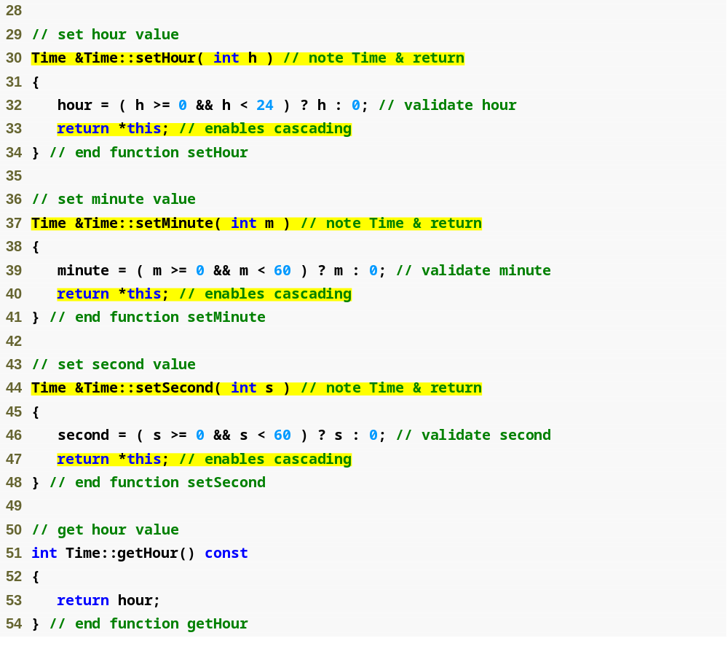
Cascading Function Calls
using this Pointer
Systems Programming: Deeper into C++ Classes

Slide 52
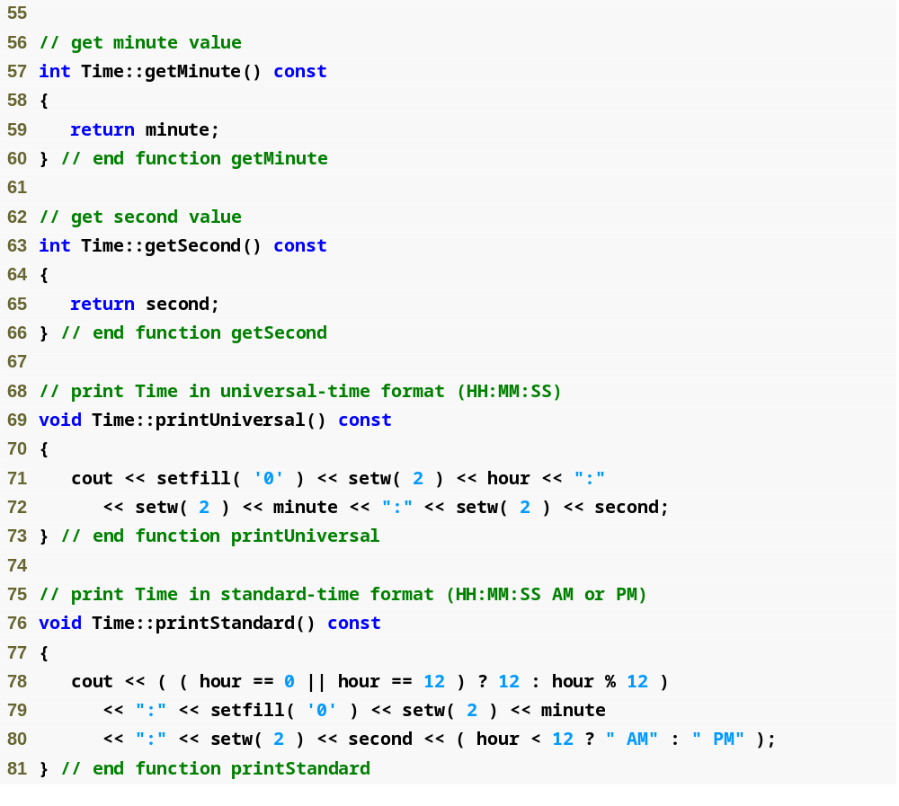
Cascading Function Calls
using this Pointer
Systems Programming: Deeper into C++ Classes

Slide 53
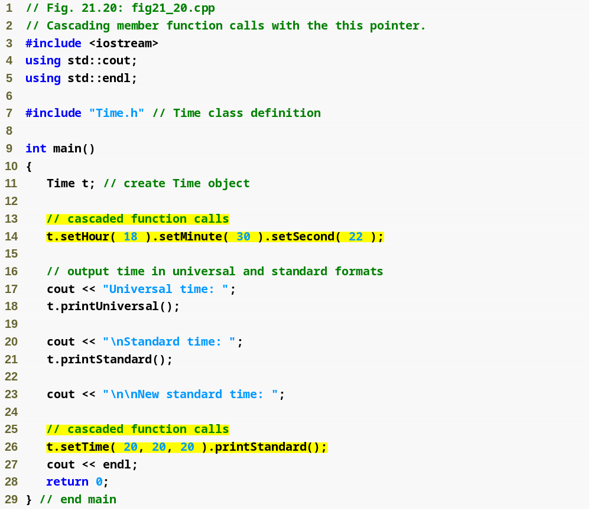
Cascading Function Calls
using this Pointer
Cascaded function calls using the reference returned by one function call to invoke the next
Note that these calls must appear in the order shown, because printStandard does not return a reference to t
Systems Programming: Deeper into C++ Classes

Slide 54
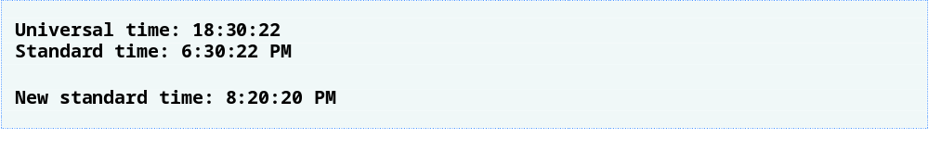
Cascading Function Calls
using this Pointer
Systems Programming: Deeper into C++ Classes

Slide 55
21.6 Dynamic Memory Management:Operators new and delete
Dynamic memory management
  Enables programmers to allocate and deallocate memory for any built-in or user-defined type.
  Performed by operators new and delete.
  For example, dynamically allocating memory for an array instead of using a fixed-size array.
Systems Programming: Deeper into C++ Classes

Slide 56
Operators new and delete
Operator new
  Allocates (i.e., reserves) storage of the proper size for an object at execution time
  Calls a constructor to initialize the object.
  Returns a pointer of the type specified to the right of new.
  Can be used to dynamically allocate any fundamental type (such as int or double) or any class type.
The Free store (referred to as the heap)
  Region of memory assigned to each program for storing objects created at execution time.
Example:
Time *timePtr
timePtr = new Time;
Systems Programming: Deeper into C++ Classes

Slide 57
Operators new and delete
Operator delete
  Destroys a dynamically allocated object.
  Calls the destructor for the object.
  Deallocates (i.e., releases) memory from the free store.
  The memory can then be reused by the system to allocate other objects.
Example:
delete timePtr;
Systems Programming: Deeper into C++ Classes

Slide 58
Operators new and delete
Initializing an object allocated by new
  Initializer for a newly created fundamental-type variable.
    Example
      double *ptr = new double( 3.14159 );
  Specify a comma-separated list of arguments to the constructor of an object.
    Example
      Time *timePtr = new Time( 12, 45, 0 );
Systems Programming: Deeper into C++ Classes

Slide 59
Operators new and delete
new operator can be used to allocate arrays dynamically.
  Dynamically allocate a 10-element integer array:
  int *gradesArray = new int[ 10 ];
  Size of a dynamically allocated array
    Specified using any integral expression that can be evaluated at execution time.
    mulePtr *Mule = new Mules[mules_in];
Systems Programming: Deeper into C++ Classes

Slide 60
Operators new and delete
Delete a dynamically allocated array:
  delete [] gradesArray;
  This deallocates the array to which gradesArray points.
  If the pointer points to an array of objects,
    It first calls the destructor for every object in the array.
    Then it deallocates the memory.
  If the statement did not include the square brackets ([]) and gradesArray pointed to an array of objects
    Only the first object in the array would have a destructor call.
Systems Programming: Deeper into C++ Classes

Slide 61
21.7 static Class Members
static data member
  Only one copy of a variable shared by all objects of a class.
    The member is “Class-wide” information.
    A property of the class shared by all instances, not a property of a specific object of the class.
  Declaration begins with keyword static
Systems Programming: Deeper into C++ Classes

Slide 62
static Class Members
Example
  Video game with Martians and other space creatures
      Each Martian needs to know the martianCount.
      martianCount should be static class-wide data.
      Every Martian can access martianCount as if it were a data member of that Martian
      Only one copy of martianCount exists.
  May seem like global variables but static has class scope.
  Can be declared public, private or protected.
Systems Programming: Deeper into C++ Classes

Slide 63
static Class Members
Fundamental-type static data members
    Initialized by default to 0.
    If you want a different initial value, a static data member can be initialized once (and only once).
const static data member of int or enum type
    Can be initialized in its declaration in the class definition.
All other static data members
    Must be defined at file scope (i.e., outside the body of the class definition)
    Can be initialized only in those definitions.
static data members of class types (i.e., static member objects) that have default constructors
    Need not be initialized because their default constructors will be called.
Systems Programming: Deeper into C++ Classes

Slide 64
static Class Members
Exists even when no objects of the class exist.
  To access a public static class member when no objects of the class exist.
    Prefix the class name and the binary scope resolution operator (::) to the name of the data member.
      Example
        Martian::martianCount
  Also accessible through any object of that class
    Use the object’s name, the dot operator and the name of the member.
      Example
        myMartian.martianCount
Systems Programming: Deeper into C++ Classes

Slide 65
static Class Members
static member function
  Is a service of the class, not of a specific object of the class.
static is applied to an item at file scope.
  That item becomes known only in that file.
  The static members of the class need to be available from any client code that accesses the file.
    So we cannot declare them static in the .cpp file—we declare them static only in the .h file.
Systems Programming: Deeper into C++ Classes

Slide 66
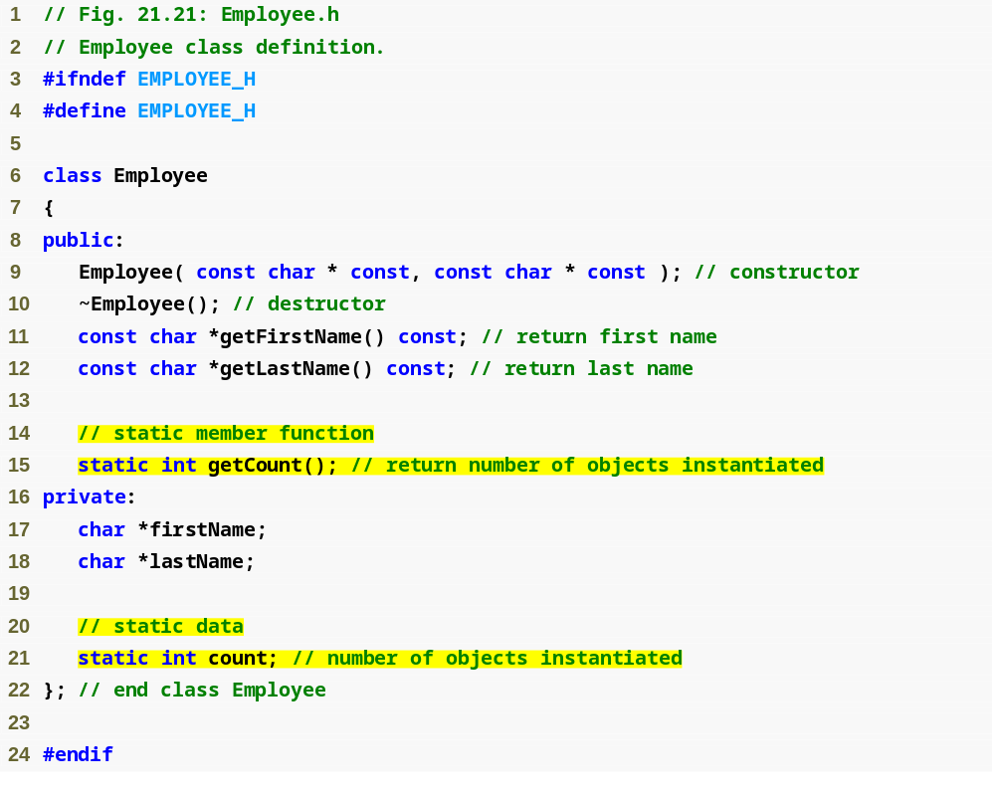
static class member Example
Function prototype for static member function
static data member keeps track of number of Employee objects that currently exist
Systems Programming: Deeper into C++ Classes

Slide 67
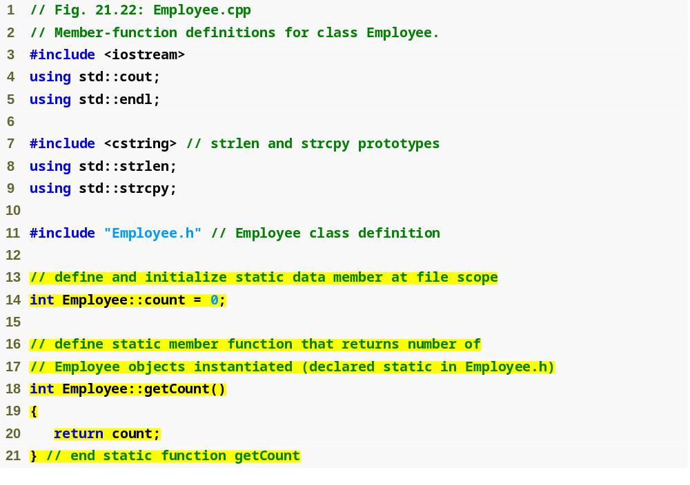
static class member Example
static data member is defined and initialized at file scope in the .cpp file
static member function can access only static data, because the function might be called when no objects exist
Systems Programming: Deeper into C++ Classes

Slide 68
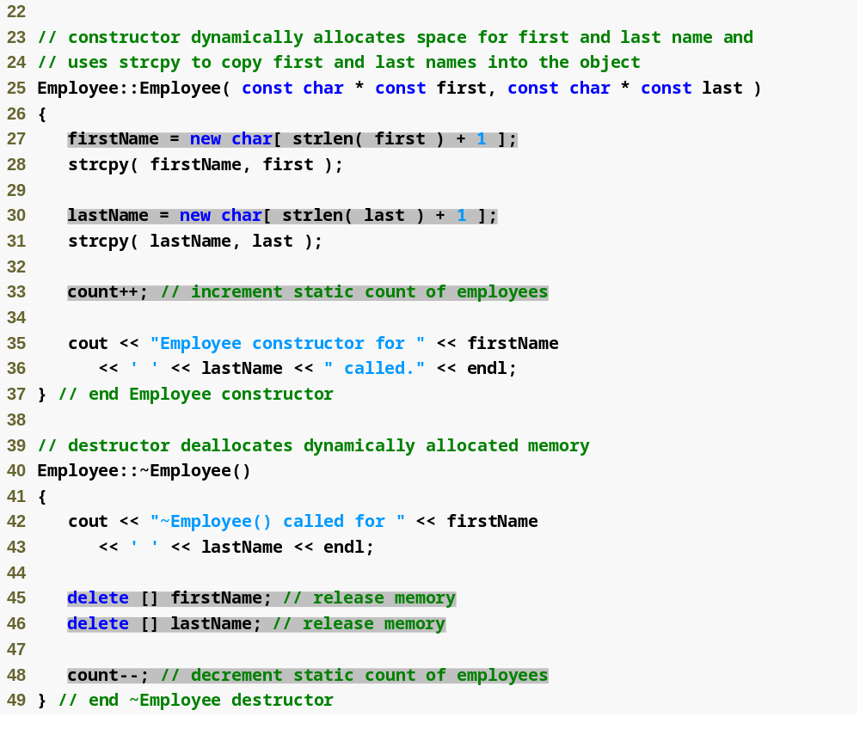
static class member Example
Dynamically allocating char arrays
Non-static member function (i.e., constructor) can modify the class’s static data members
Deallocating memory reserved for arrays
Systems Programming: Deeper into C++ Classes

Slide 69
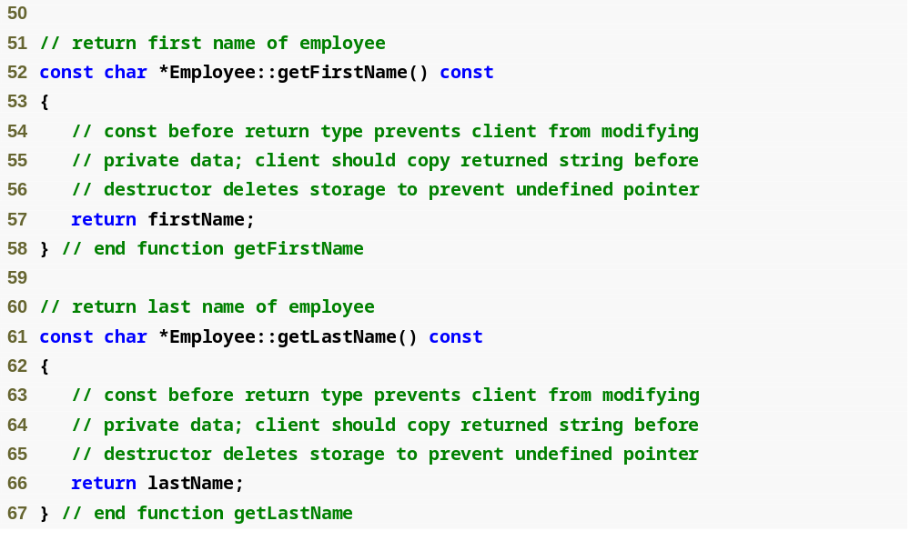
static class member Example
Systems Programming: Deeper into C++ Classes

Slide 70
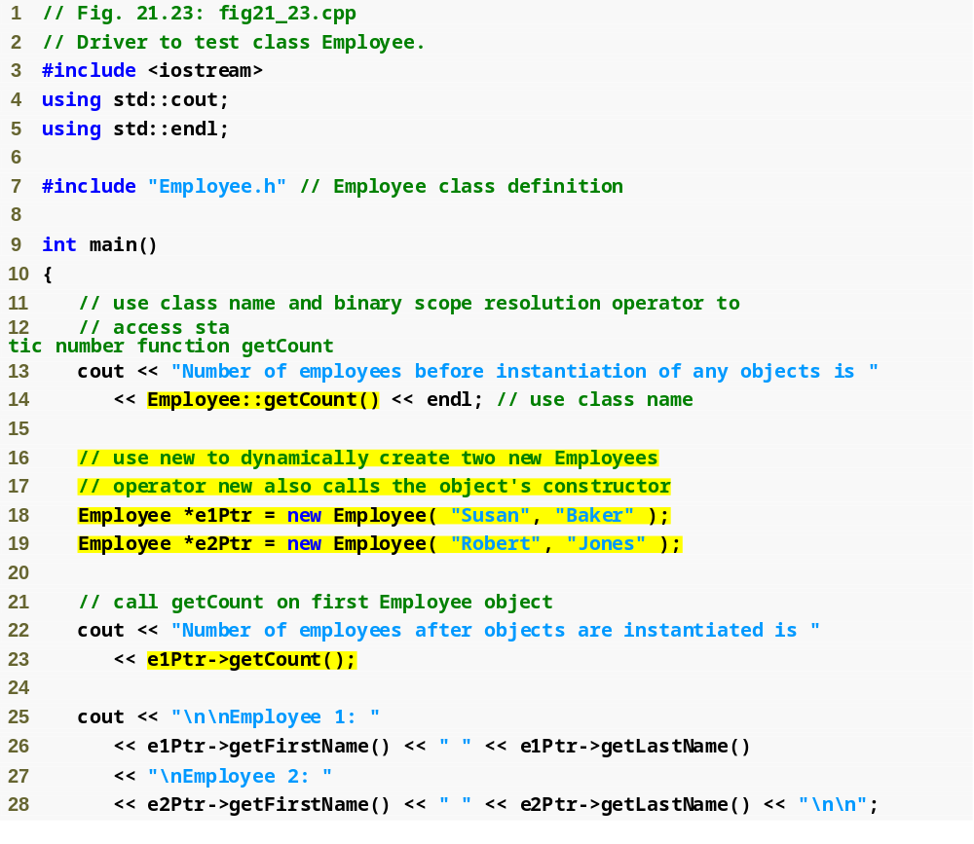
static class member Example
Calling static member function using class name and binary scope resolution operator
Dynamically creating Employees with new
Calling a static member function through a pointer to an object of the class
Systems Programming: Deeper into C++ Classes

Slide 71
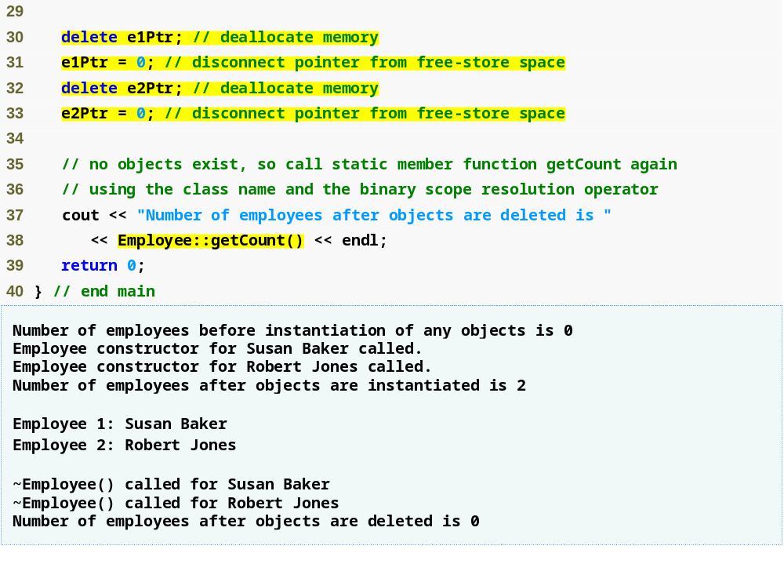
static class member Example
Releasing memory to which a pointer points
Disconnecting a pointer from any space in memory
Systems Programming: Deeper into C++ Classes

Slide 72
static Class Members
Declare a member function static
  If it does not access non-static data members or non-static member functions of the class.
A static member function does not have a this pointer.
static data members and static member functions exist independently of any objects of a class.
When a static member function is called, there might not be any objects of its class in memory.
Systems Programming: Deeper into C++ Classes

Slide 73
Abstract data types (ADTs)
  Essentially ways of representing real-world notions to some satisfactory level of precision within a computer system.
  Types like int, double, char and others are all ADTs.
    e.g., int is an abstract representation of an integer.
  Captures two notions:
    Data representation
    Operations that can be performed on the data.
  C++ classes implement ADTs and their services.
Systems Programming: Deeper into C++ Classes

Slide 74
Array Abstract Data Type
Many array operations not built into C++
  e.g., subscript range checking
Programmers can develop an array ADT as a class that is preferable to “raw” arrays
  Can provide many helpful new capabilities
C++ Standard Library class template vector.
Systems Programming: Deeper into C++ Classes

Slide 75
Summary
const objects and const member functions
Member Composition Example
Friend function Example
this pointer Example
Dynamic memory management
  new and delete operators
static class members
Abstract Data Types
Systems Programming: Deeper into C++ Classes

