Slide 1
A Heap Implementation
Chapter 18

Slide 2
Chapter Contents
Reprise: The ADT Heap
Using an Array to Represent a Heap
Adding an Entry
Removing the Root
Creating a Heap
Heapsort

Slide 3
Reprise: The ADT Heap
A complete binary tree
Nodes contain Comparable objects
In a maxheap
  Object in each node ≥ objects in descendants
Note contrast of uses of the word "heap"
  The ADT heap
  The heap of the operating system from which memory is allocated when new executes

Slide 4
Reprise: The ADT Heap
Interface used for implementation of maxheap
public interface MaxHeapInterface
{ public void add(Comparable newEntry);
public Comparable removeMax();
public Comparable getMax();
public boolean isEmpty();
public int getSize();
public void clear();
} // end MaxHeapInterface

Slide 5
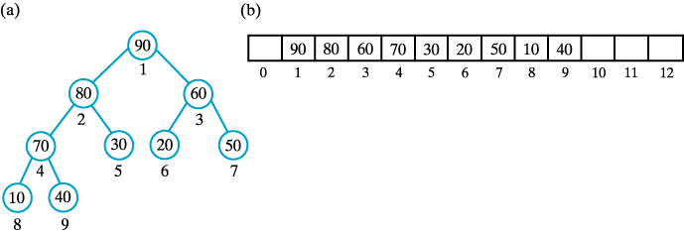
Using an Array to Represent a Heap
(a) A complete binary tree with its nodes numbered in level order; (b) its representation as an array.

Slide 6
Using an Array to Represent a Heap
When a binary tree is complete
  Can use level-order traversal to store data in consecutive locations of an array
Enables easy location of the data in a node's parent or children
  Parent of a node at i is found at i/2
  (unless i is 1)
  Children of node at i found at indices
  2i and 2i + 1

Slide 7
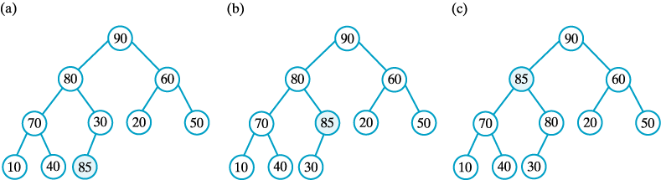
Adding an Entry
The steps in adding 85 to the maxheap of Figure 1

Slide 8
Adding an Entry
Begin at next available position for a leaf
Follow path from this leaf toward root until find correct position for new entry
As this is done
  Move entries from parent to child
  Makes room for new entry

Slide 9
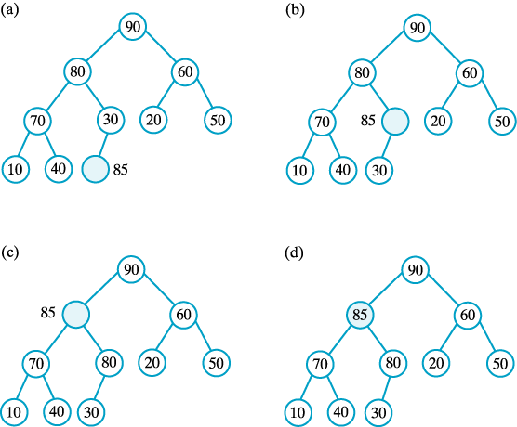
Adding an Entry
A revision of steps of addEntry to avoid swaps.

Slide 10
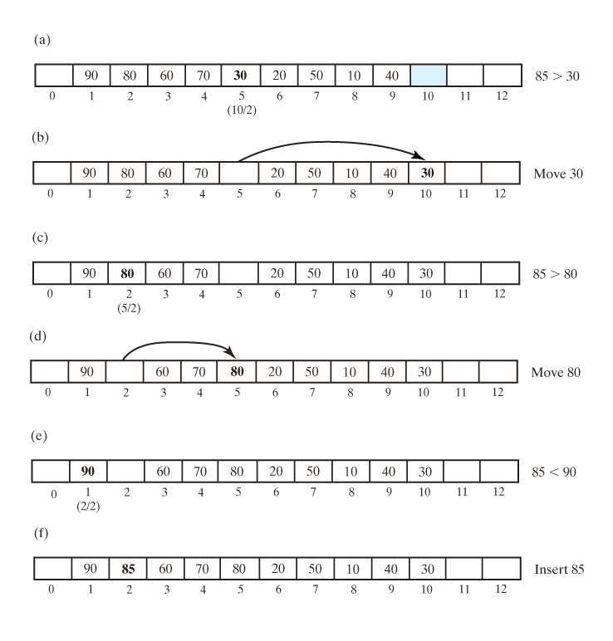
Adding an Entry
An array representation of the steps in previous slide … continued →

Slide 11
Adding an Entry
An array representation of the steps

Slide 12
Adding an Entry
Algorithm for adding new entry to a heap
Algorithm add(newEntry)
if (the array heap is full)
Double the size of the array
newIndex = index of next available array location
parentIndex = newIndex/2 // index of parent of available location
while (newEntry > heap[parentIndex])
{ heap[newIndex] = heap[parentIndex]
// move parent to available location
// update indices
newIndex = parentIndex
parentIndex = newIndex/2
} // end while

Slide 13
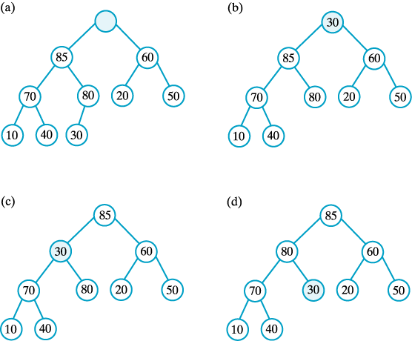
Removing the Root
The steps to remove the entry in the root of the maxheap

Slide 14
Removing the Root
To remove a heap's root
  Replace the root with heap's last child
This forms a semiheap
Then use the method reheap
  Transforms the semiheap to a heap

Slide 15
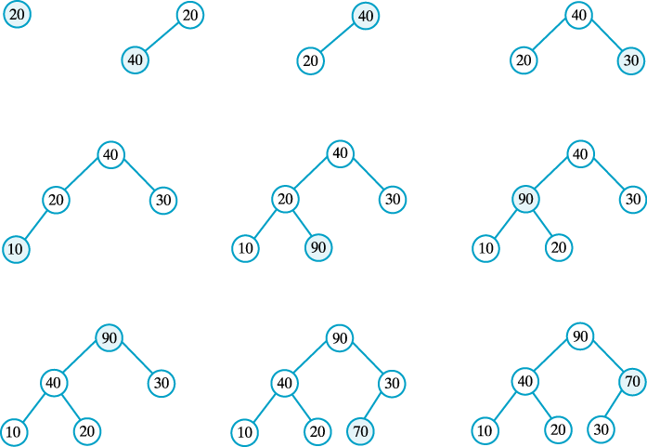
Creating a Heap
The steps in adding 20, 40, 30, 10, 90, and 70 to a heap.

Slide 16
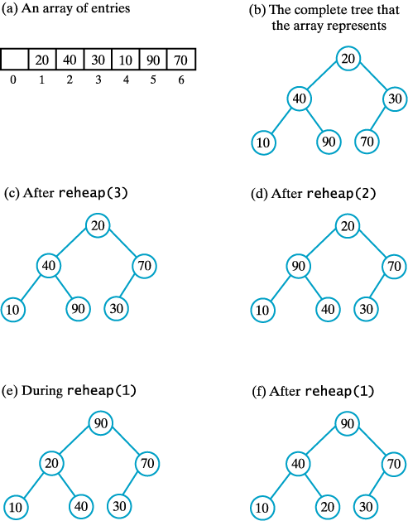
Creating a Heap
More efficient to use reheap than to use add
The steps in creating a heap by using reheap.

Slide 17
Heapsort
Possible to use a heap to sort an array
Place array items into a maxheap
Then remove them
  Items will be in descending order
  Place them back into the original array and they will be in order

Slide 18
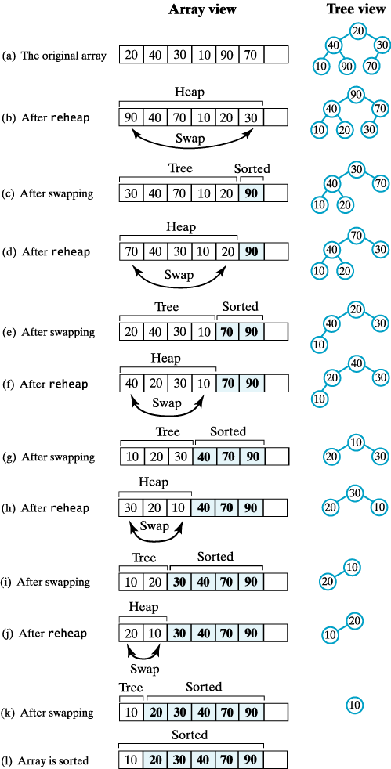
Heapsort
A trace of heapsort (a – c)

Slide 19
Heapsort
A trace of heapsort (d – f)

Slide 20
Heapsort
A trace of heapsort (g – i)

Slide 21
Heapsort
A trace of heapsort (j – l)

Slide 22
Heapsort
Implementation of heapsort
public static void heapSort(Comparable[] array, int n)
{ // create first heap
for (int index = n/2; index >= 0; index--)
reheap(array, index, n-1);
swap(array, 0, n-1);
for (int last = n-2; last > 0; last--)
{ reheap(array, 0, last);
swap(array, 0, last);
} // end for
} // end heapSor
private static void reheap(Comparable[] heap, int first, int last)
{ < replacing rootIndex with first and lastIndex with last. >
. . .
} // end reheap
Efficiency is O(n log n).

