Slide 1
Automation & Customization of OpenStack
CS-16133 | Danyal Javed Mir | 3.2
CS-16129 | Muhammad Usman Ghani | 2.9
CS-16126 | Muhammad Ammar | 3.2

Slide 2
Project Background
OpenStack based automated cloud solution that will allow users to create a private or public cloud based on the requirements of the user, without the hassle of installing and configuring the individual services and technologies needed to build a completely running cloud environment. It will also eliminates time of deployment and hefty cost of hiring professionals to build the cloud environment for the user.
The project is designed upon OpenStack which serves as the core component. The idea is to automate the process of configuring individual OpenStack component and provide users with effortless installation through our product.

Slide 3
Task Division
Ammar (CS-126)
Explore Automation Tools (Chef, Puppet & Ansible)
Danyal (CS-133)
Explore Openstack
Usman (CS-129)
Build Chef Infrastructure

Slide 4
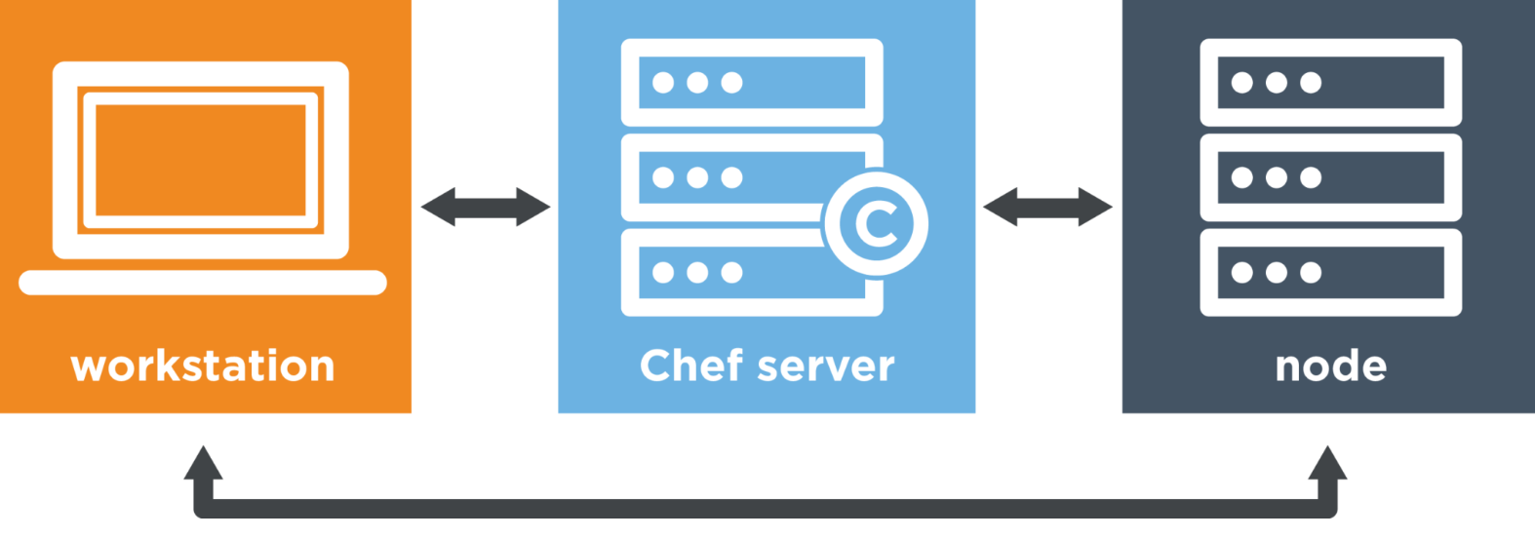
BIG PICTURE

Slide 5
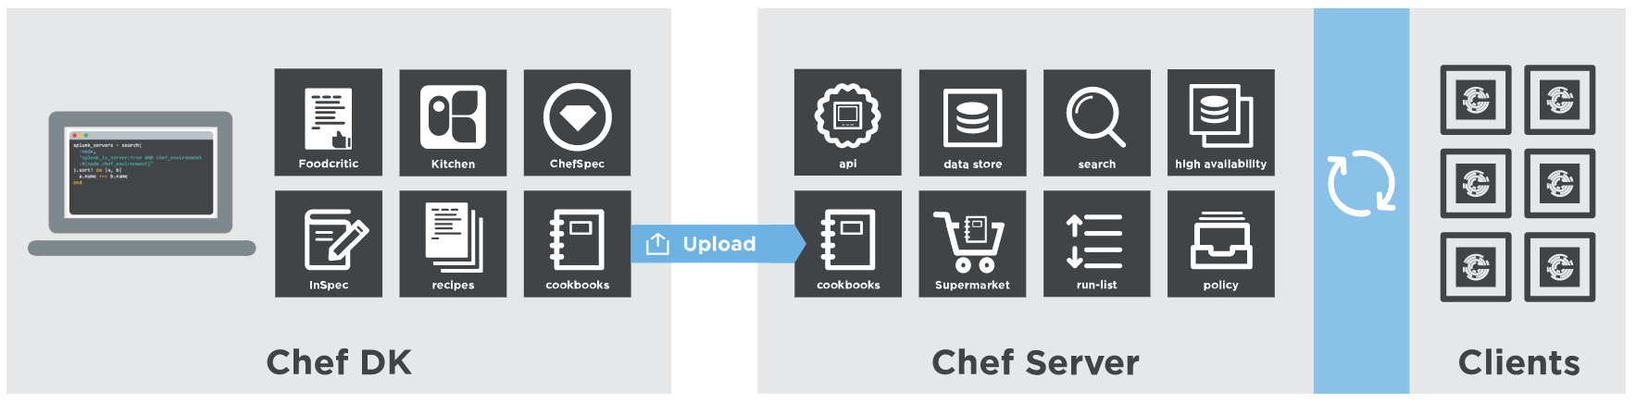
TOOLS

Slide 6
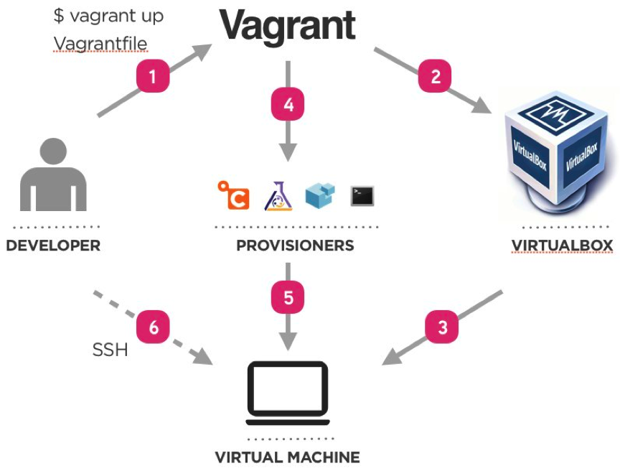
PROVISIONING

Slide 7
MILESTONES ACHIEVED
Material Review
Openstack
Chef
Cookbooks
Package Installing
Creating Environment
Configuring Network
Chef Infrastructure
Workstation
Chef-Server
Client

Slide 8
CHALLENGES
Containerizing Openstack Components
Container Nesting
Cookbook Testing
Unfamiliar with Ruby DSL

Slide 9
FUTURE ENHANCEMENTS
User Friendly WEB-UI for Installation
Deploying Architecture on Single Container
Increase Degree of Customization

