Slide 1
Automation & Customization of OpenStack
CS-16133 | Danyal Javed Mir | 3.2
CS-16129 | Muhammad Usman Ghani | 2.9
CS-16126 | Muhammad Ammar | 3.2

Slide 2
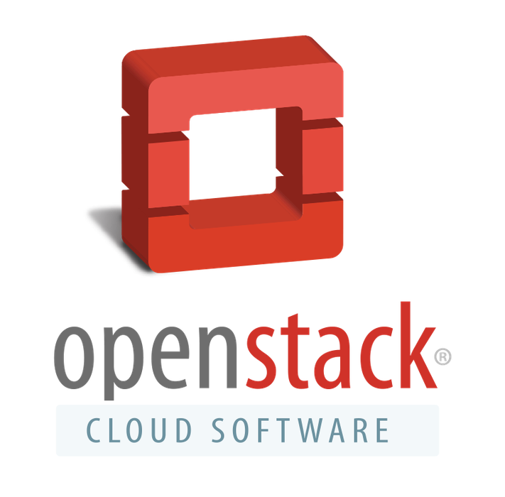
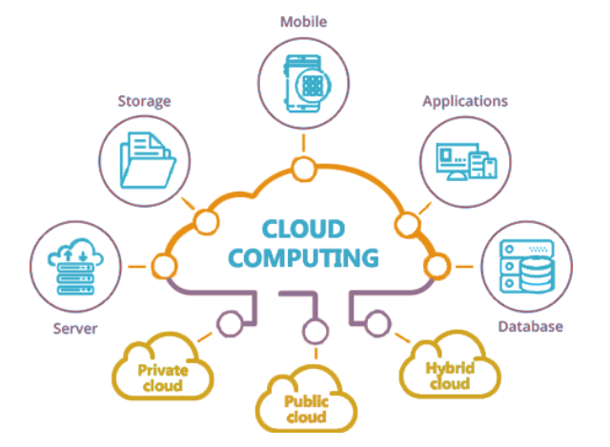
Project Background
OpenStack based automated cloud solution that will allow users to create a private or public cloud based on the requirements of the user, without the hassle of installing and configuring the individual services and technologies. It will also eliminates time of deployment and hefty cost of hiring professionals to build the cloud environment.
Our goal is provide users with few predefined solutions out of the box
Educational / Training ( Lightweight )
Research ( Integrated with Big Data Provisioning Frameworks )

Slide 3
Current Task Division
Ammar (CS-126)
Research on new tools for better workflow and developing common playbooks for system configs
Danyal (CS-133)
Working on finding best combination of services suitable for our predefined solutions and develop their scripts ( playbooks )
Usman (CS-129)
Exploring / utilizing alternative tools to deploy and test our work

Slide 4
Problems faced due to COVID-19 and Lockdowns
Limited Resources
underpowered Hardware
Accessing Remote Machines
Lack of communication / coordination

Slide 5
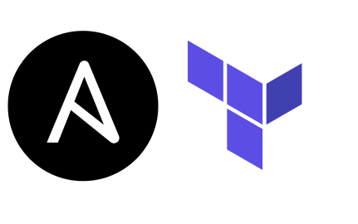

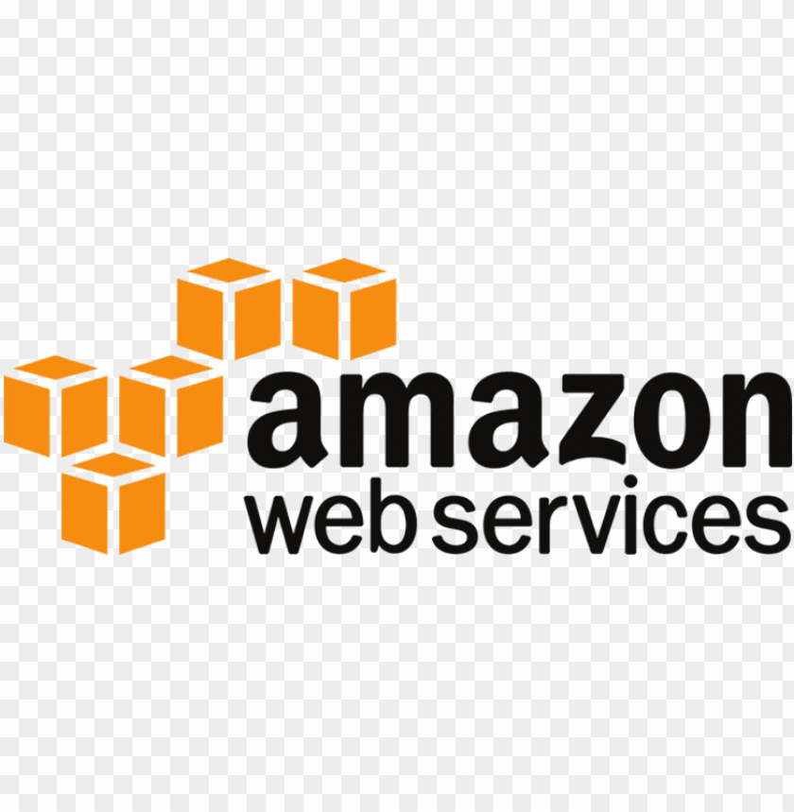
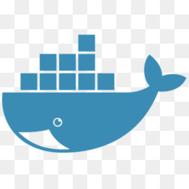
Past vs Current ( Tools )
Chef
VirtualBox
Docker
Ansible
Terraform
AWS
Azure devops

Slide 6
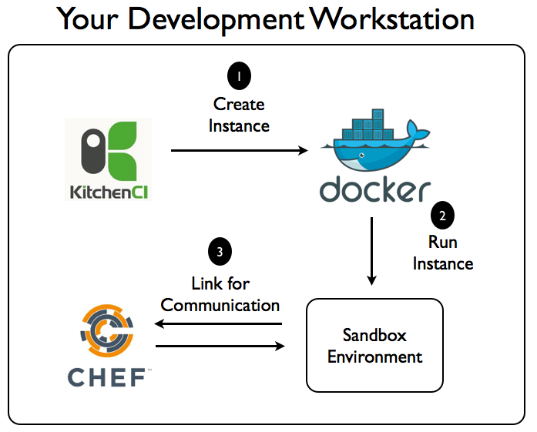
Previous Workflow

Slide 7

Past vs Current ( Tools )
VirtualBox
too much resource consumption
Docker
compute resources allocation
Chef
Separate agent server required
AWS
costly, test, deploy
Terraform
Infrastructure provisioning
Azure devops
CI/CD pipeline for terraform
Ansible
Fast and agentless

Slide 8
Why have we replaced Chef with Ansible?
Setting up the environment for Ansible is easy.
Ansible’s playbooks are much easier to create and understand.
It does not require any agents on host machine.
Ansible uses SSH by default instead of requiring agents everywhere, which avoids extra open ports and improving security.
It automates the configuration management, workflow orchestration, and even cloud provisioning all from one system.

Slide 9
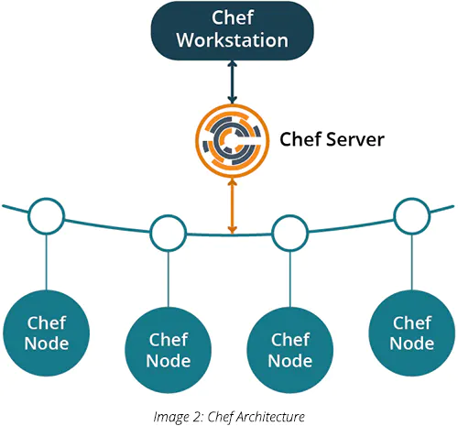
Chef Architecture

Slide 10
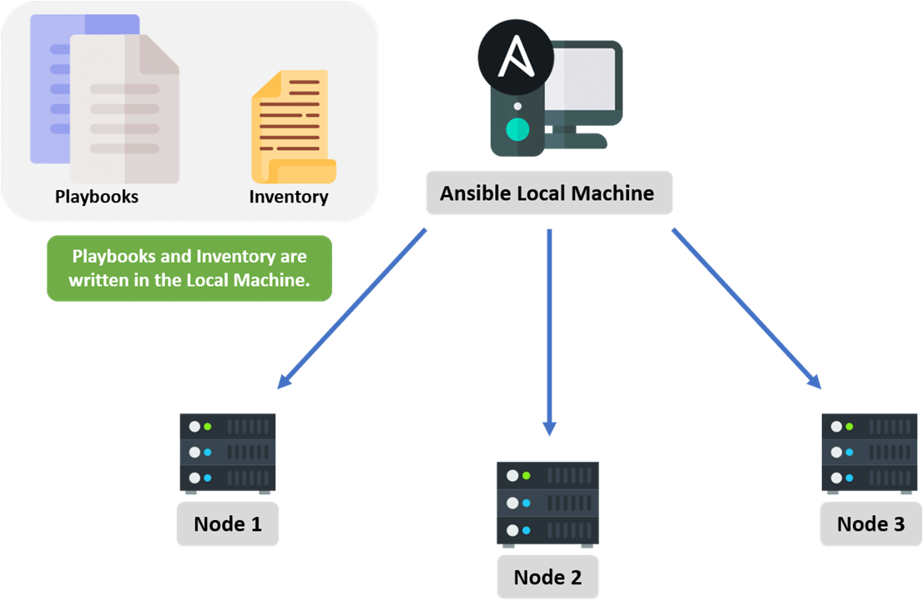
Ansible Architecture

Slide 11


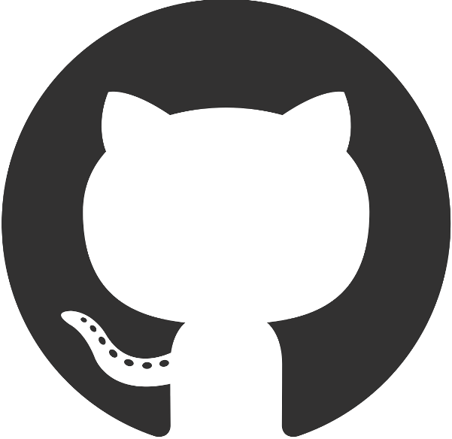
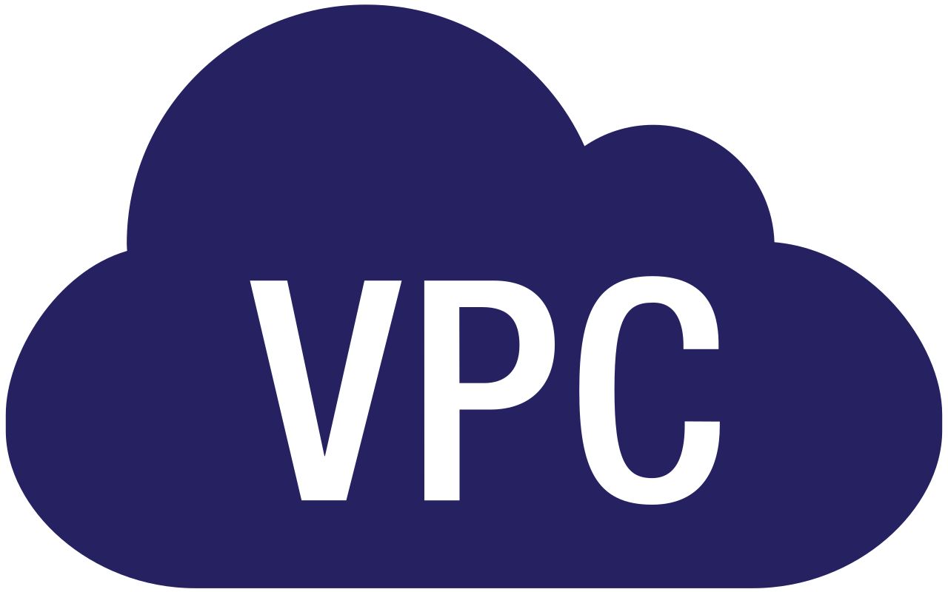


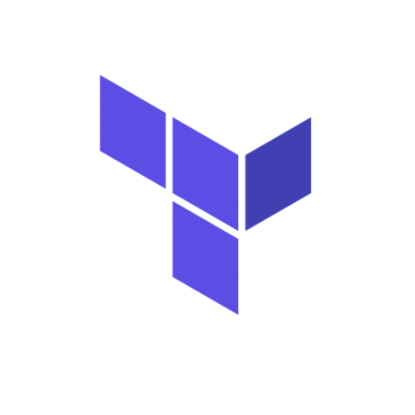
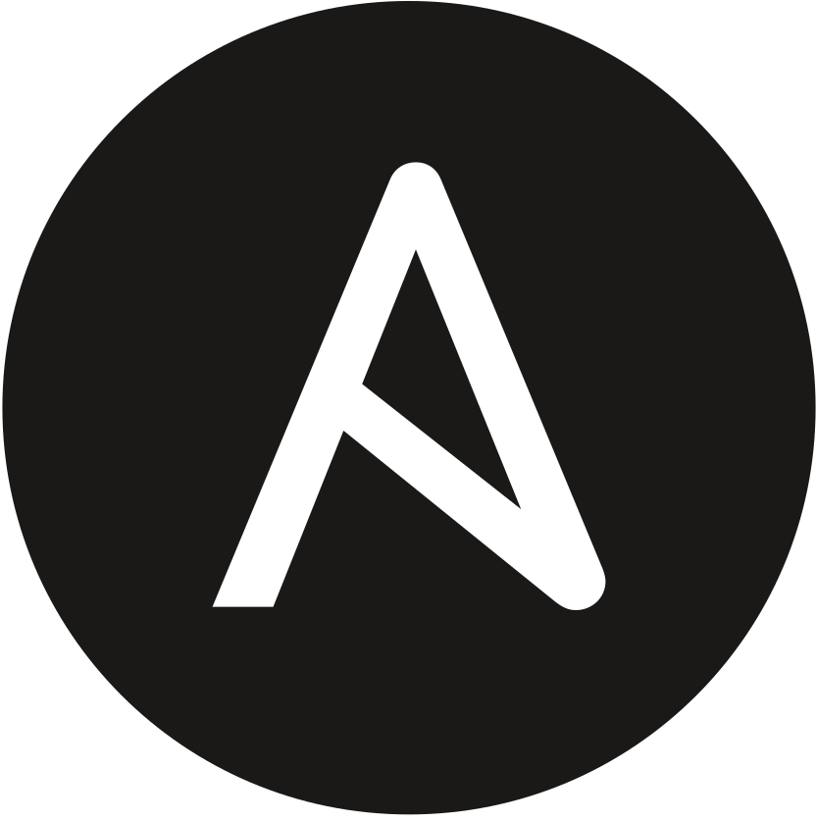
WORKFLOW
GitHub
Azure DevOps
User’s Account
Organization
Project 1
Repository 1
Terraform
Pipeline
Project 2
Repository 2
Ansible
Pipeline
EC2 Instances

Slide 12
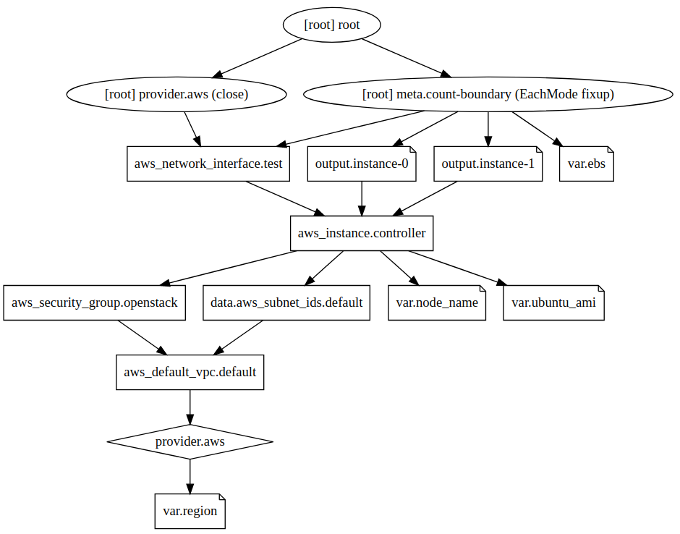

Slide 13
FUTURE ENHANCEMENTS
User Friendly WEB-UI for Installation
Cross-Platform Support
Increase Degree of Customization

