Slide 1

Automation &
Customization of OpenStack
Final Year Project

Slide 2
Group Members
CS-16133 | Danyal Javed Mir | 3.2
CS-16129 | Muhammad Usman Ghani | 2.9
CS-16126 | Muhammad Ammar | 3.2

Slide 3
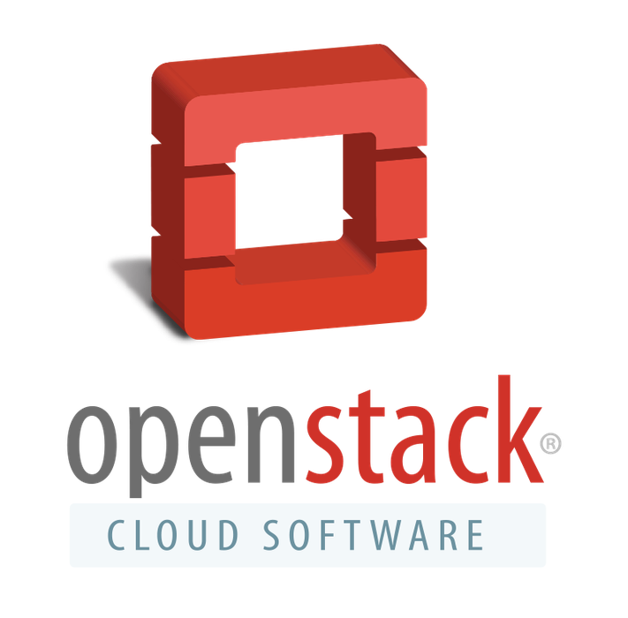
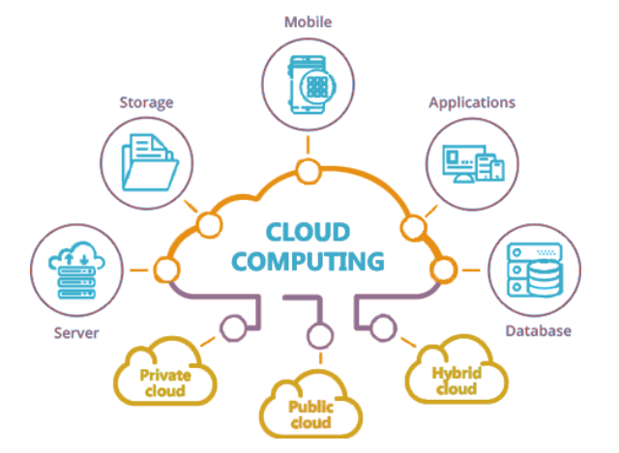
Project Introduction
Our Project is based on Openstack. It is a open source software used for developing private and public clouds. our project enables users to create their own private or public cloud, without the hassle of installing and configuring the individual technologies and services needed to build a complete running cloud environment. This solution eliminates the time of deployment and the substantial cost of hiring cloud architect professionals to build the cloud environment for you. It automates the procedure of installing Openstack.

Slide 4
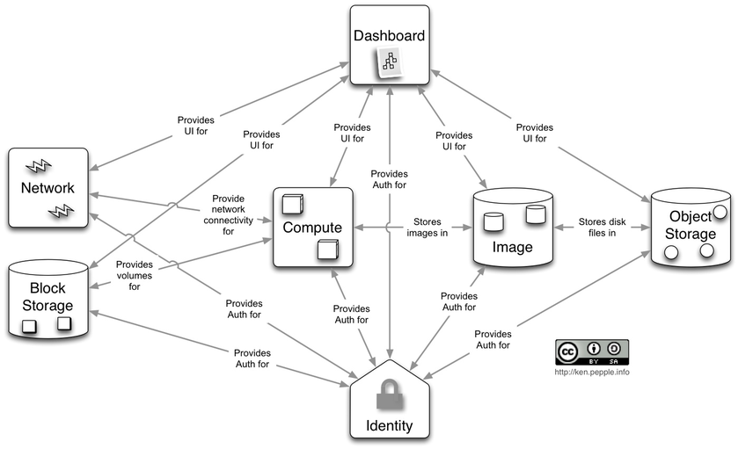
Background
Cloud Computing
Why OpenStack?
Scalable and Flexible
Used by Industry Giants
OpenStack Installation
Difficult Deciding Architecture
Installation procedures can be confusing and cumbersome
Similar Solution
DevStack
PackStack

Slide 5
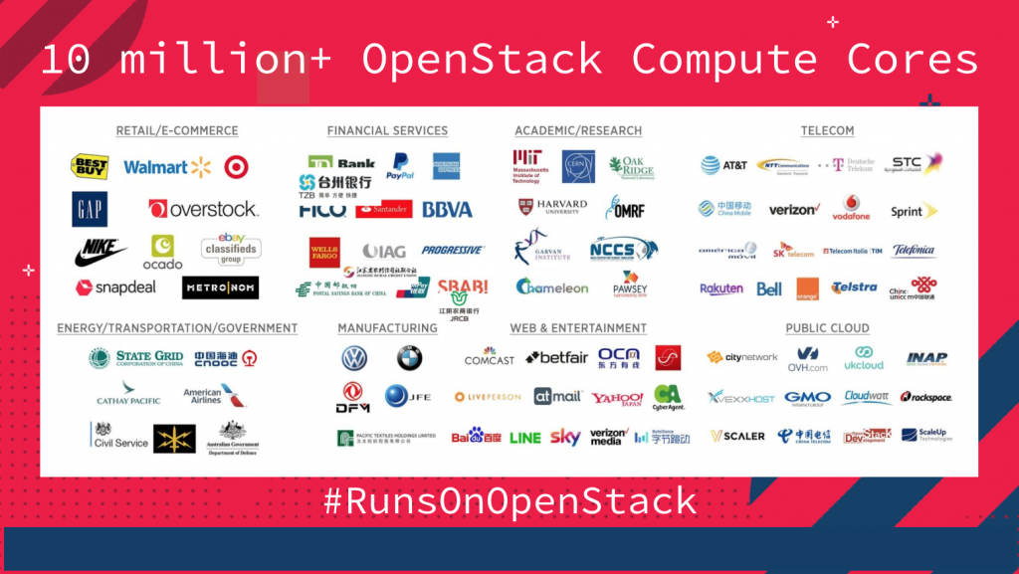

Slide 6
Objective
To develop an automated cloud installation setup through an easy cli/gui utility that can generate a cloud environment consisting of provided requirements.
Enable new users to get hands-on interaction with openstack cloud Without worrying about configuration stuff.
Provide solution to education institutes or small companies as their cloud solution.

Slide 7
Task Division
Ammar (CS-126)
Automate services installation and configurations
Centralized logging system
Danyal (CS-133)
Automate services installation and Stack Templates
Centralized logging system
Usman (CS-129)
Automate services installation and configurations
Develop command-line utility.

Slide 8
Problems faced due to COVID-19 and Lockdowns
Limited Resources
underpowered Hardware
Accessing Remote Machines
Lack of communication / coordination

Slide 9
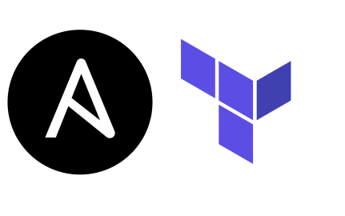


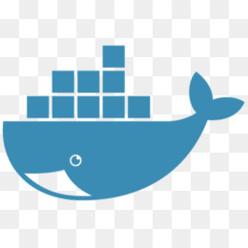
Past vs Current ( Tools )
Chef
VirtualBox
Docker
Ansible
Terraform
AWS
Azure devops

Slide 10
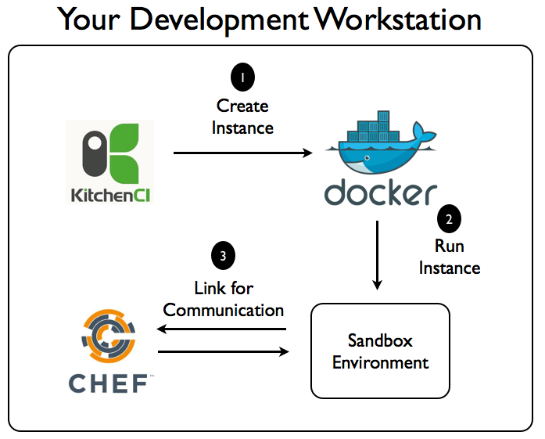
Previous Workflow

Slide 11

Past vs Current ( Tools )
VirtualBox
too much resource consumption
Docker
compute resources allocation
Chef
Separate agent server required
AWS
costly, test, deploy
Terraform
Infrastructure provisioning
Azure devops
CI/CD pipeline for terraform
Ansible
Fast and agentless

Slide 12
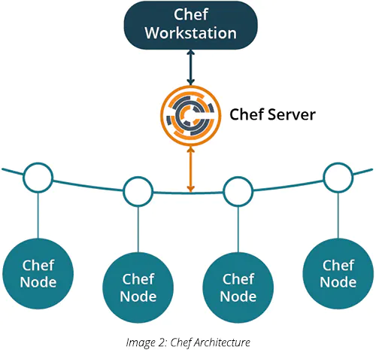
Chef Architecture

Slide 13
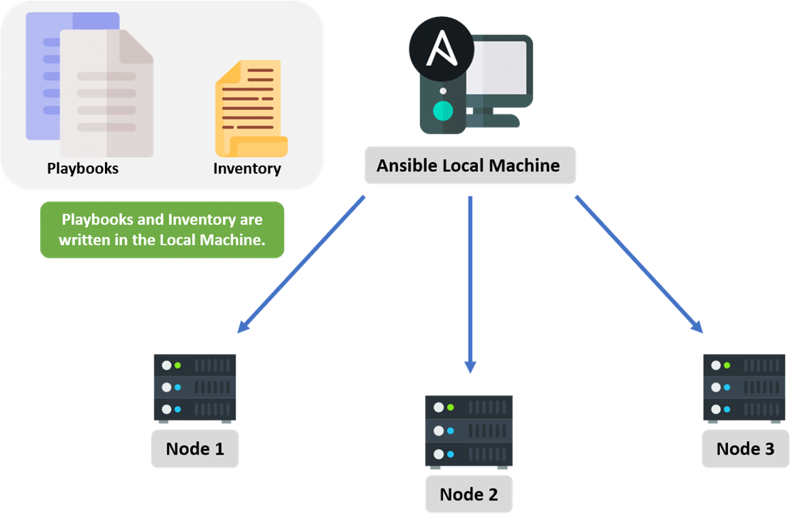
Ansible Architecture

Slide 14



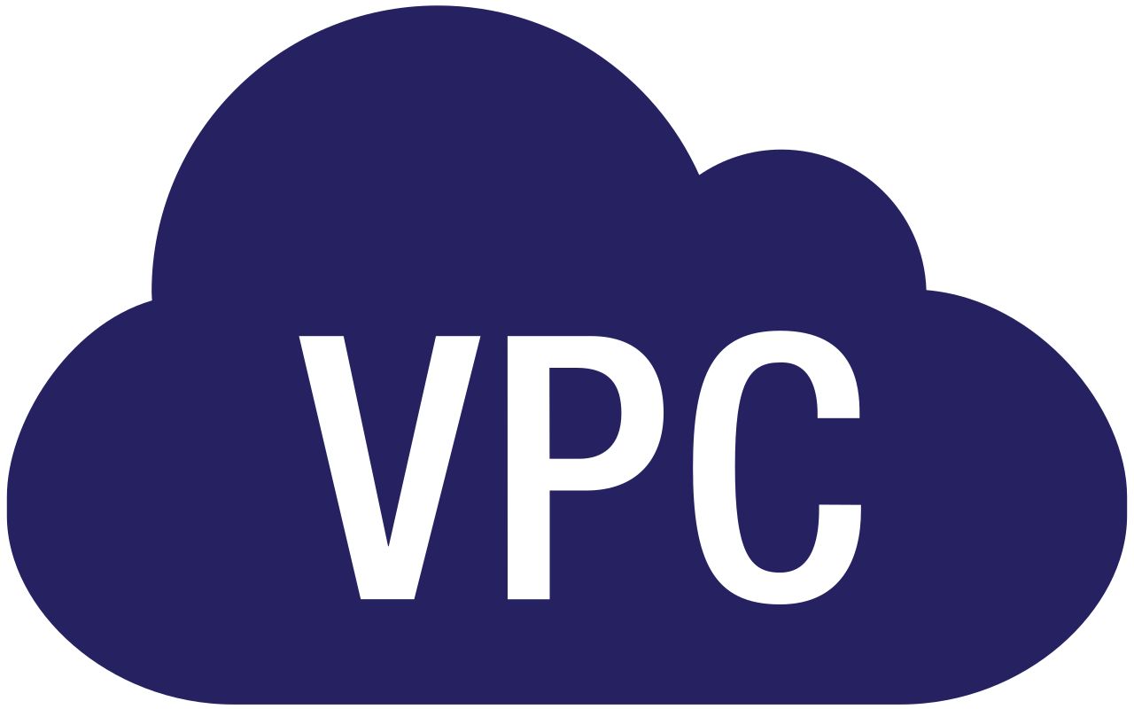



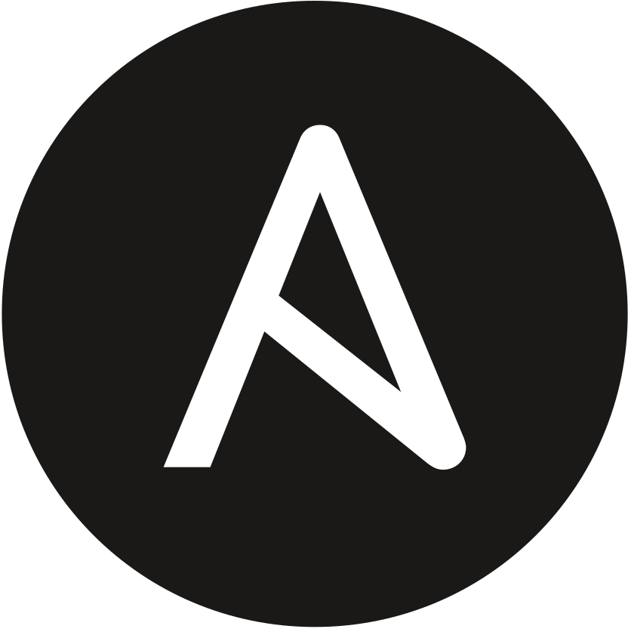
WORKFLOW
GitHub
Azure DevOps
User’s Account
Organization
Project 1
Repository 1
Terraform
Pipeline
Project 2
Repository 2
Ansible
Pipeline
EC2 Instances

Slide 15
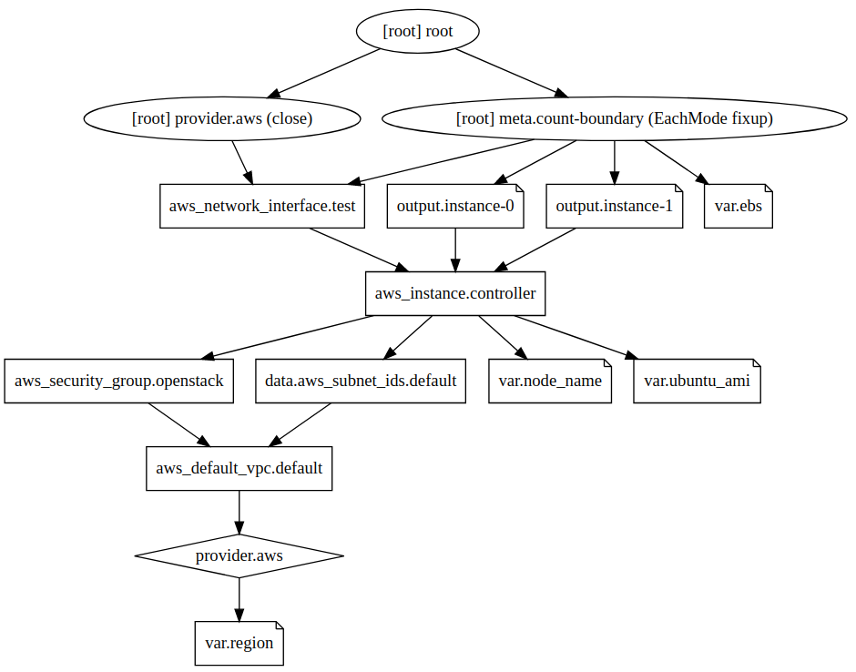

Slide 16
Configuration & Management Tool
Some most popular and reliable automation tools are; Puppet, Chef, Salt, and Ansible.
These tools use provisioning scripts to make the server reach a desirable state.
Each of these tools poses different characteristics and each works differently.

Slide 17
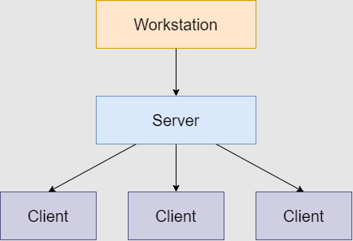
Chef

Slide 18
Why have we replaced Chef with Ansible?
Setting up the environment for Ansible is easy.
Ansible playbooks are much easier to create and understand.
It does not require any agents on host machine.
Ansible uses SSH by default instead of requiring agents everywhere, which avoids extra open ports and improving security.
It automates the configuration management, workflow orchestration, and even cloud provisioning all from one system.

Slide 19
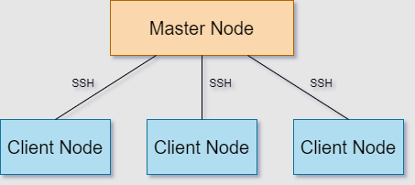
Ansible

Slide 20
Ansible
Open source
Agentless architecture
No agent required on client machine
Use SSH to configure client machines
Faster and easier to set up.
It uses a push-based synchronization approach

Slide 21
Playbook
Written in YAML
Sequential execution
Each playbook has one or more plays in it.
Each play consists of one of more roles.
These roles are nothing but another playbook.

Slide 22
ELK
A log management system known as ELK.
It is an open-source.
Most popular log analysis software
Elasticsearch - Used for storing logs
Logstash - Used for both shipping as well as processing and storing logs.
Kibana - A visualization tool, hosted through Nginx or Apache

Slide 23
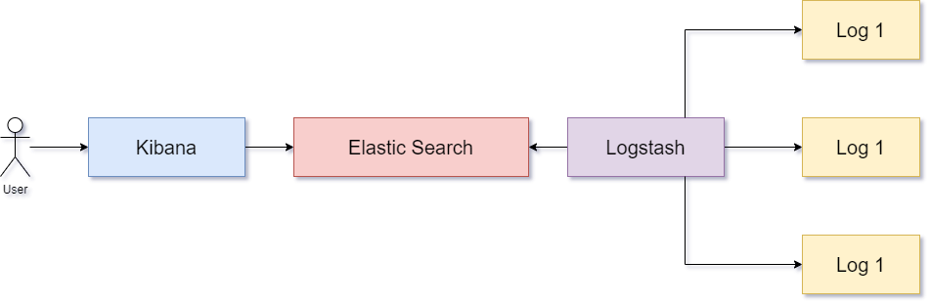
ELK

Slide 24
Filebeat
A lightweight shipper agent.
Used to fetch logs and feed them into logstash.

Slide 25
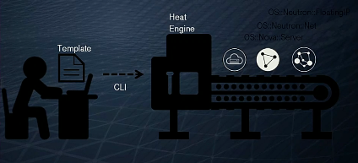
Heat
Heat is a service to orchestrate composite cloud applications using a declarative template.
The templates allow creation of most OpenStack resource types such as instances, floating ips, volumes, security groups, users, etc

Slide 26
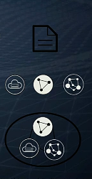
Heat
Resources
Heat will create resources like VMs, router, network, subnet, keypair etc.
Templates
HOT templates describe infrastructure of cloud application
Templates specify relation between resources
Stacks
Group of connected resources
Stacks created from templates.

Slide 27
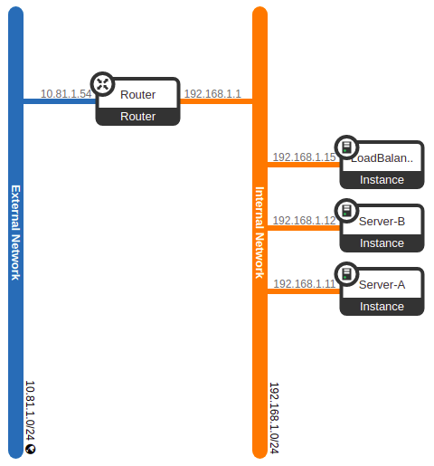
Stack Example
This stack replicates a hosting environment. It contains
3 Virtual Machines
1 Load balancer
2 server
1 Router
IP Pool

Slide 28

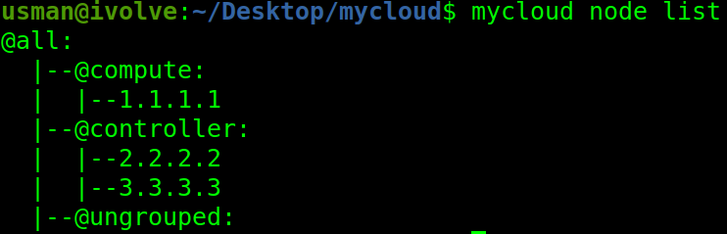
CLI Utility (mycloud)
$ mycloud node list

Slide 29
$ mycloud node add [node-name] [ip]
$ mycloud node delete [ip]

Slide 30
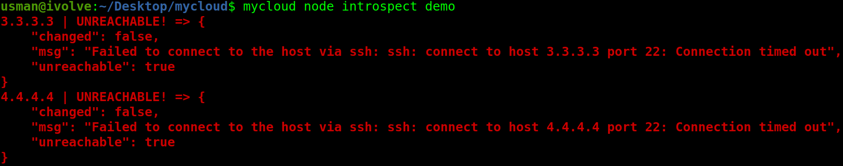
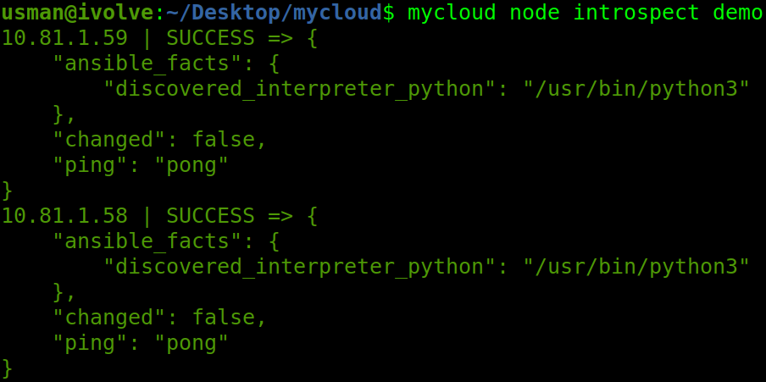
$ mycloud node introspect [username]

Slide 31
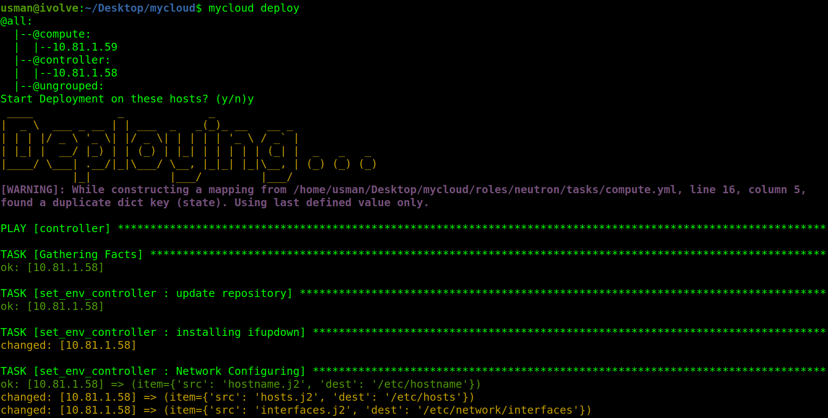
$ mycloud node deploy

Slide 32
Problems Faced
Lack of Resources
Dynamic Configuration
Logs Routing
Neutron Networking

Slide 33
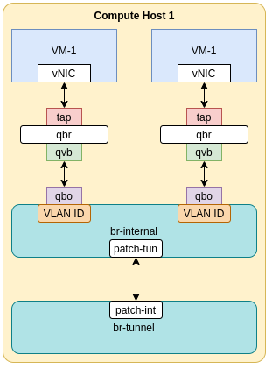
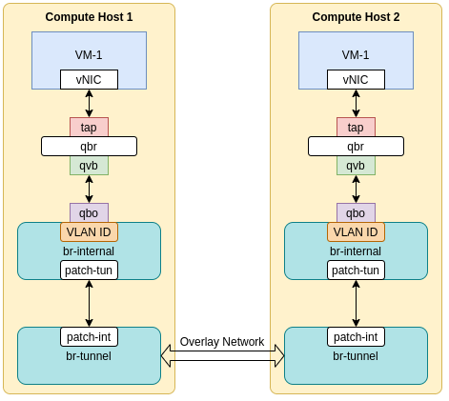
Where Packets Go ???

Slide 34
Steps to Reproduce
$ git clone https://github.com/M-Ghani97/mycloud.git
$ cd mycloud
$ ./prep.sh
$ mycloud node add <node-name> <ip-address>
$ mycloud node introspect <username>
$ mycloud deploy -y

Slide 35
Future Development
GUI utility for installation
Increase scalability
Integrate Ceph with Cinder
Integrate more services
Licenced distribution and pricing structure
Auto-Remediation, or Self-Healing
Dead process
Lack of free disk space
Overflowed rabbitmq queues
Capacity issue (by adding more hypervisors)

