Slide 1
Cost Effective:
Better Docs and More Supplies for Treating Preeclampsia in Uganda
Notes:
Looked at the entire system
Increasing # of doctors and supplies in the system

Slide 2

To strengthen health education and delivery in places facing a dire shortage of health professionals
Notes:
https://pbs.twimg.com/profile_images/560116538556940288/gvj8DhW3_400x400.png
Seed Global Health, partnerships with the Peace Corps

Slide 3

14%
14%
of maternal deaths are caused by hypertensive conditions.
Notes:
http://muettergesundheit.org/images/causes_maternal-mortality.jpg
https://encrypted-tbn0.gstatic.com/images?q=tbn:ANd9GcQBuk3pPxCw--Tg1019EAFUcM2iVKVVdfrK_mZLyyDNtrON_kmu
Even higher in the developing world

Slide 4
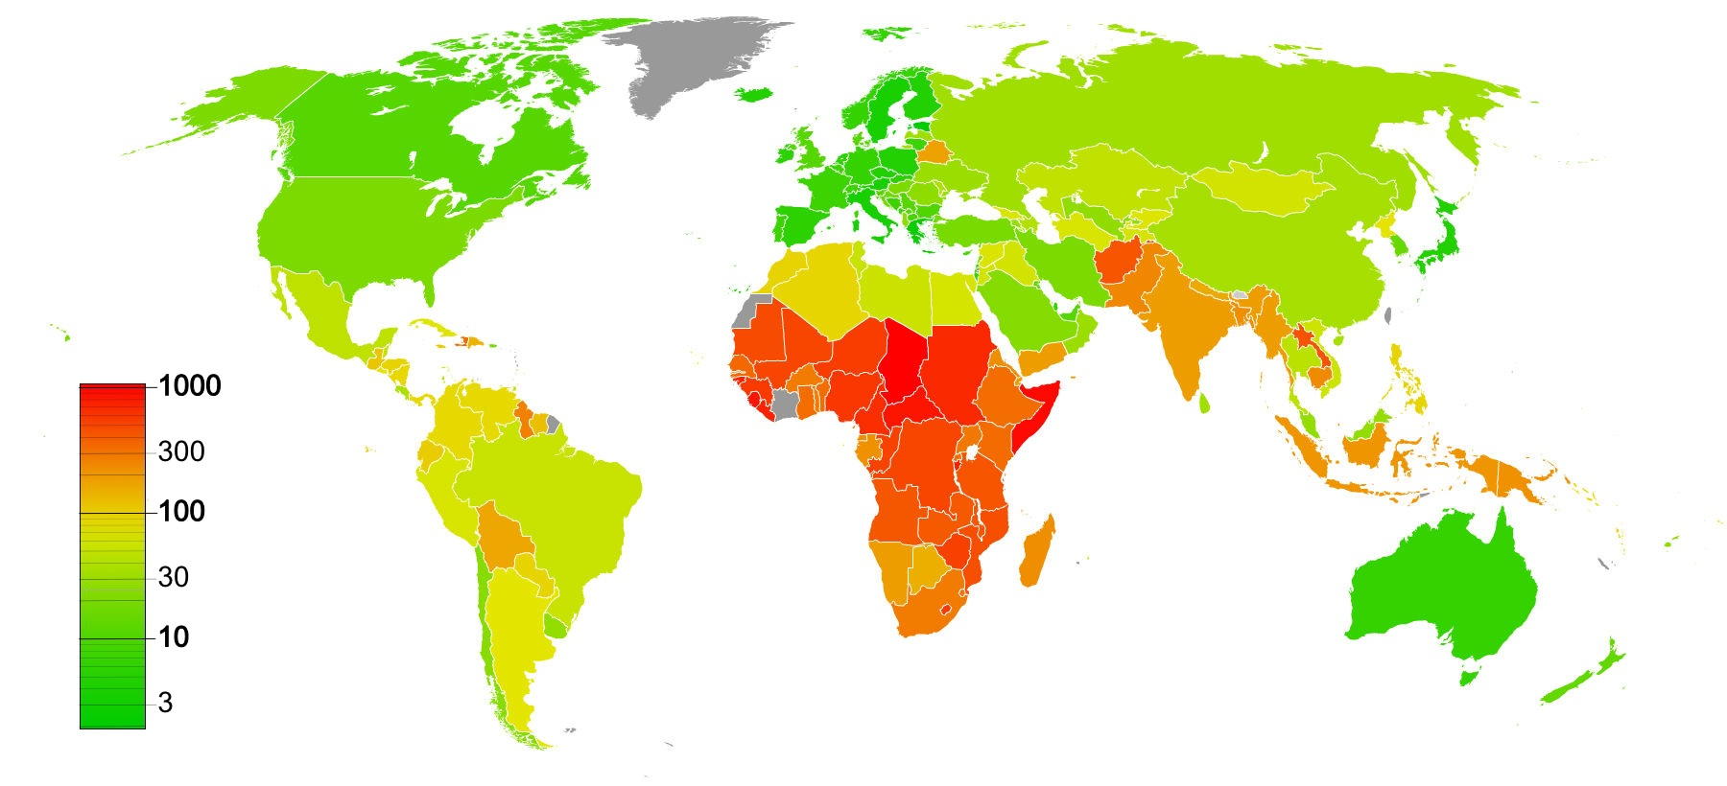
Worldwide Incidence of Maternal Mortality
Notes:
https://upload.wikimedia.org/wikipedia/commons/2/2c/Maternal_mortality_rate_worldwide.jpg
(Deaths/100,000 live births)
Specifially important in Africa, and specially in Uganda so we chose to work in the country

Slide 5

Case Study: Uganda
Clinical guidelines recommend
methyldopa for hypertension
magnesium sulfate for severe preeclampsia
Notes:
https://commons.wikimedia.org/wiki/File:Roundel_of_Uganda_-_Type_1.svg
We looked at their clinical guidelines and saw MD and MgSO4 usage

Slide 6
Case Study: Uganda
Key Factors:
testing provision
availability of medication
Notes:
https://commons.wikimedia.org/wiki/File:Roundel_of_Uganda_-_Type_1.svg
Looked at existing literature for where testing is done for HTn and PE.

Slide 7
T
T
T
T
T
T
No BP
T
MG
SO₄
UA
T
MD
T
No
MG
SO₄
T
T
BP
No
UA
T
No
MD
T
T
T
T
Severe Preeclampsia
Well
Hypertension
Eclampsia
Notes:
Talk about model approach.
Explain where the treatments end up in the model
Explain how this corresponds to the Markov Processes
The probabiliites are informed by the existing literature. 59% got a blood pressure screening and others are given by the following.
Existing literature on training methodology demonstrated 83% increase in training capacity;
Just increasing the percent

Slide 8
.31
No BP
.223
MG
SO₄
UA
.2
MD
No
MG
SO₄
.591
BP
No
UA
No
MD
Baseline
Notes:
Talk about model approach.
Explain where the treatments end up in the model
Explain how this corresponds to the Markov Processes

Slide 9
No BP
MG
SO₄
UA
↑83%
MD
No
MG
SO₄
BP
No
UA
No
MD
Training Only
Notes:
Talk about model approach.
Explain where the treatments end up in the model
Explain how this corresponds to the Markov Processes

Slide 10
No BP
↑ to .95
MG
SO₄
UA
↑ to .95
MD
No
MG
SO₄
BP
No
UA
No
MD
Supplies Only
Notes:
Talk about model approach.
Explain where the treatments end up in the model
Explain how this corresponds to the Markov Processes

Slide 11
No BP
↑83%
↑ to .95
MG
SO₄
↑ to .95
UA
↑83%
MD
No
MG
SO₄
BP
No
UA
No
MD
Both Training and Supplies
Notes:
Talk about model approach.
Explain where the treatments end up in the model
Explain how this corresponds to the Markov Processes

Slide 12
$5
No BP
$12
MG
SO₄
UA
$18
MD
No
MG
SO₄
BP
No
UA
$0
No
MD
Cost
$130
$168
$586
$1734
Well
Hypertension
Preeclampsia
Eclampsia
Notes:
Talk about model approach.
Explain where the treatments end up in the model
Explain how this corresponds to the Markov Processes
Existing literature on training methodology demonstrated 83% increase in training capacity;
Just increasing the percent

Slide 13
No BP
MG
SO₄
UA
MD
No
MG
SO₄
BP
No
UA
No
MD
Utility
1
.78
.4
.1
Well
Hypertension
Preeclampsia
Eclampsia
Notes:
Talk about model approach.
Explain where the treatments end up in the model
Explain how this corresponds to the Markov Processes

Slide 14
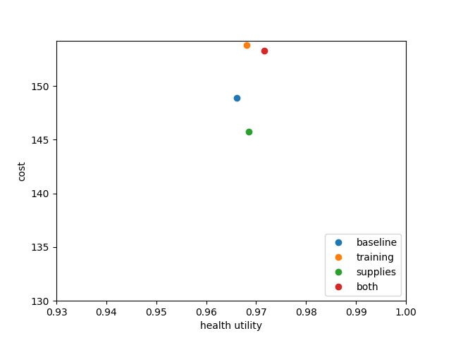
Cost-Utility Graph
Notes:
Cost-Utility Graph
A cost-utility graph was generated to examine the different costs and utilities of the different treatments. All treatments improved health utilities. The training only model improved health utility by 0.002 from baseline for an extra cost of $4.92. The supplies only model improved health utility by 0.0025 from baseline and decreased cost by $3.14. The combined or both training and supply treatment improved health utility from baseline by 0.00556 for $4.41. Raw data are also provided (Table 5).

Slide 15
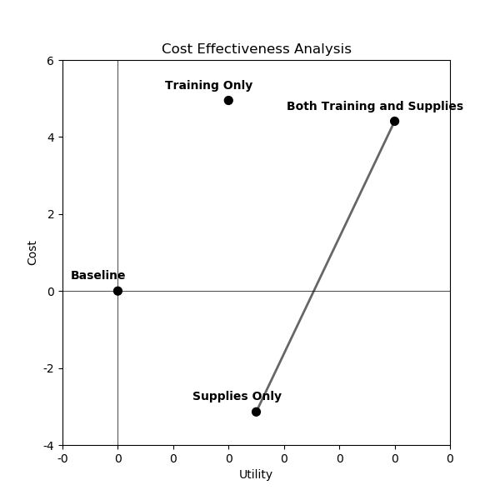
Cost-Effectiveness Analysis
Clear Frontier
Recommendation:
Increase Supplies,
Possibly Increase Training

Slide 16
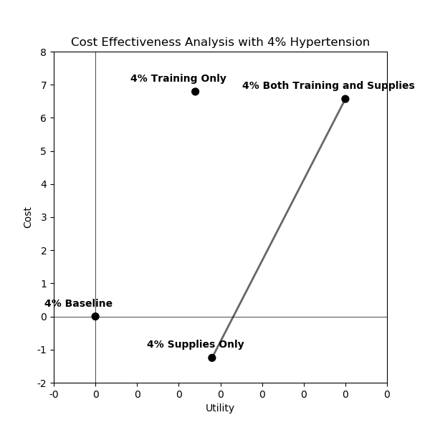
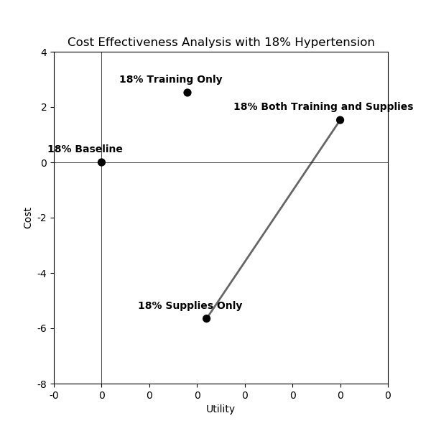
Sensitivity Analysis
Frontier is robust.

Slide 17
ICER: Supplies vs Supplies + Training
4% Hypertension: ICER = 6357.72357
10% Hypertension: ICER = 2457.682292
18% Hypertension: ICER = 1297.833935.
Notes:
Comparatively the more expensive supplies and training scenario is best where
All scenarios compared to baseline; supplies and training vs supples in the 3 different

Slide 18
Discussion
Definitely Increase Supplies. Possibly Increase Training.
Training may affect more outcomes.
Build More Integrated Model.
Pre-term births, maternal death… beyond eclampsia
Notes:
Build more integrated model = include more healthcare outcomes that it would have;

