Slide 1
Gluon CV

Slide 2
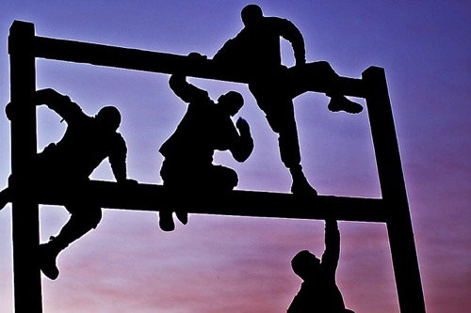
Why GluonCV?
What is the biggest challenge you have ever encountered with deep learning?

Slide 3
Why GluonCV?
What is the biggest challenge you have ever encountered with deep learning?
“reproducing the best claimed results”

Slide 4
Real-world Stories
Back to a period in 2016, the same ImageNet models trained by MXNet achieves on average 1% worse accuracy compared to Torch.
Tried almost everything to debug, even developed a plugin to run Torch code inside MXNet so that it is easier to compare the results.
Transcoding training images using 95 JPEG quality rather than 85 solved the problem.

Slide 5
Real-world Stories
Using another open source DL framework, a similar problem happened: trained model accuracies cannot match previous internal version.
Spent months to figure out why, with no clue.
The order of data augmentation is different from previous version.

Slide 6
Starting from scratch can be hard
Even the most talented researchers will get blocked by trivial things.
Experiences and instincts might be your enemies in certain circumstances.
Training is time-consuming, initialization and augmentation is randomized, and tons of implementation details need to be taken care of. Debugging deep models is extremely difficult.

Slide 7
It’s not easy to embrace open-source implementations
Qualities of open-source implementations vary.
Languages, code styles, project structures, DL frameworks are mixed.
Personal projects tend to focusing on a specific task with specific datasets. It requires significant engineering efforts to adapt to your use case.
Community projects can be abandoned frequently.

Slide 8


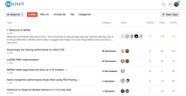
What does GluonCV provide
Reproduction of important papers in recent years
Training scripts (as well as tuned hyper-parameters) to reproduce the results
Considerate APIs and modules that are easy to follow and understand, so that re-invent based on existing algorithms are less frustrating
Community support, feel free to ask and discuss

Slide 9
Enough talk, show me something!
Demo notebook

Slide 10
What’s in GluonCV
Image Classification
More than 20+ pre-trained ImageNet models(ResNet, MobileNet…)
We achieved the best accuracy using some of the most popular models(e.g., ResNet), compared with other frameworks

Slide 11
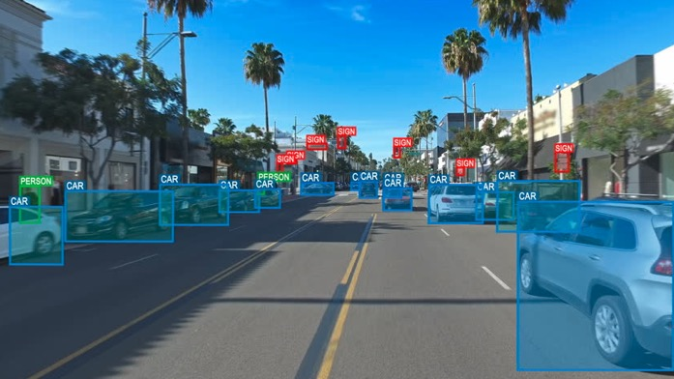
What’s in GluonCV
Object Detection
SSD and YOLOv3: fastest solution
Faster-RCNN, RFCN and FPN: slower but more accurate, especially for tiny objects
Mask-RCNN: simultaneous object detection and semantic segmentation

Slide 12
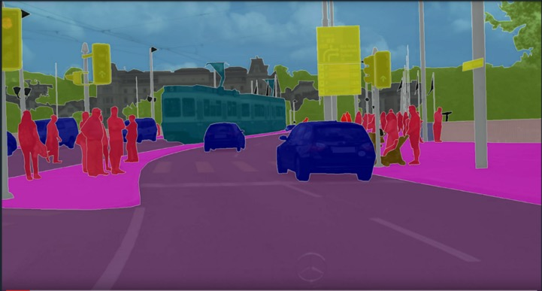
What’s in GluonCV
Semantic Segmentation
FCN
PSPNet
Mask-RCNN
DeepLab

Slide 13
What’s in GluonCV
Style Transfer
MSGNet

Slide 14
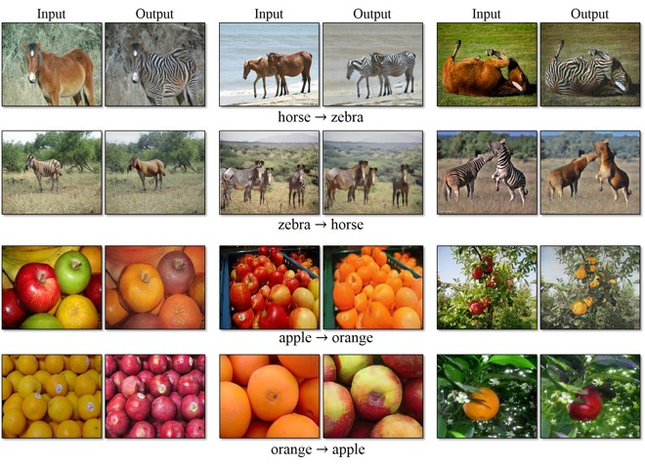
What’s in GluonCV
Generative Adversarial Networks (GAN)
CycleGAN

Slide 15
What’s in GluonCV
Distributed training
Take hours rather than days/weeks to train your own model on large datasets.

Slide 16
What’s in GluonCV
Deployment
Deploy your models to laptops, smartphones, IoT devices
Unleash the performance potentials

Slide 17



Like GluonCV?
https://github.com/dmlc/gluon-cv
https://gluon-cv.mxnet.io

