Slide 1
Multivariate Time Series
Cyrus Vahid - Principal Architect – AWS Deep Learning
Amazon Web Services

Slide 2
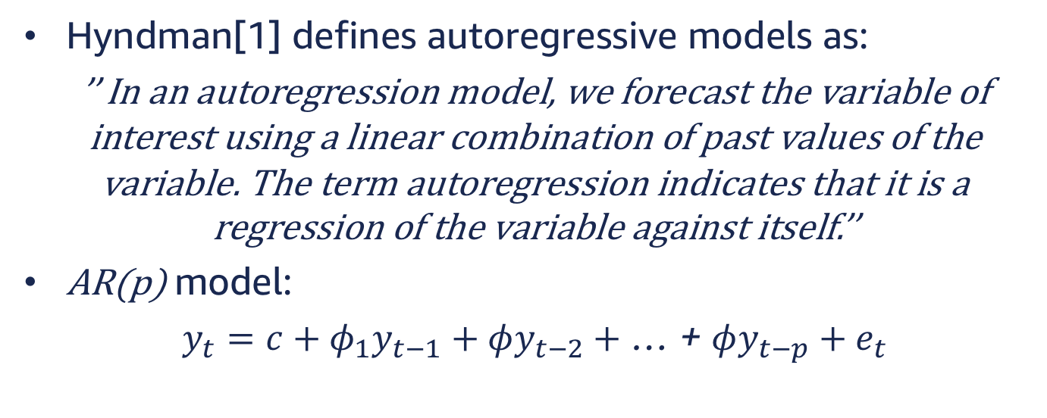
Autoregressive Models
Hyndman[1] defines autoregressive models as:
’’ In an autoregression model, we forecast the variable of interest using a linear combination of past values of the variable. The term autoregression indicates that it is a regression of the variable against itself.’’
AR(p) model:
$y_{t}=c+φ_{1}y_{t−1}+φy_{t−2}+$ … + $φy_{t−p}+e_{t}$

Slide 3



Auto Regressive Models
Autoregressive models are remarkably flexible at handling a wide range of different time series patterns.
$$y_{t}=18−0.8y_{t−1}+e_{t}$$
$$y_{t}=8+1.3y_{t}−1 −0.7 y_{t−2 }−2+e_{t}$$
$$ref:Hyndman [1]$$

Slide 4
Challenges faced by existing models
Most methods are designed to forecasting individual series or small groups. New set of problems have emerged that require to predict series.
In recent years problem of forecasting a large number of individual or grouped time series.
Trying to learn a global model facing the difficulty of dealing with scale of different time-series that would otherwise be related.
Many older models cannot account for environmental inputs.

Slide 5
Goal
Ability to learn and generalized from similar series provides us with the ability to learn more complex models without overfitting.

Slide 6
DeepAR

Slide 7
Solution
DeepAR is a forecasting model based on autoregressive RNNs, which learns a global model from historical data of all time series in all datasets.[2]

Slide 8
DeepAR Advantages
Minimal manual feature engineering
Ability to provide forecast for series with little or no history.
Ability to incorporate a wide range of likelihood models.
Provides consistent estimates for subgroups.

Slide 9
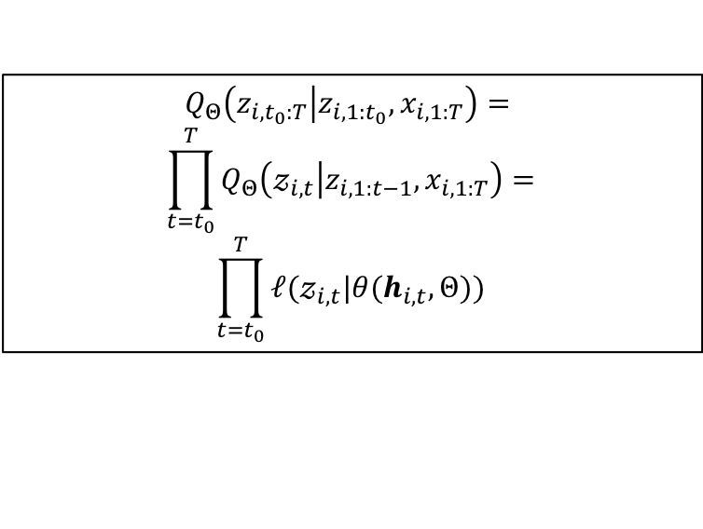

DeepAR Model
Goal: Given observed values of a series $i$ for $t$ time-steps, estimating probability distribution of next $T$ steps; more formally, modeling the below conditional distribution is the goal: $P\left(z_{i,t_{0}:T} | z_{i,{1:t}_{0}}, x_{i, 1:T}\right)$
Parameterized by output of an AR RNN.
$$Q_{Θ}\left(z_{i,t_{0}:T} | z_{i,{1:t}_{0}}, x_{i, 1:T}\right)=$$
$$\prod_{t=t_{0}}^{T}{Q_{Θ}\left(𝓏_{i,t} | z_{i,1:t−1}, x_{i,1:T}\right)=}$$
$$\prod_{t=t_{0}}^{T}{ℓ(𝓏_{i,t}|θ(h_{i,t}, Θ))}$$
$$h_{i,t}=h(h_{i,t−1},𝓏_{i,t−1},x_{i,t},Θ)$$

Slide 10
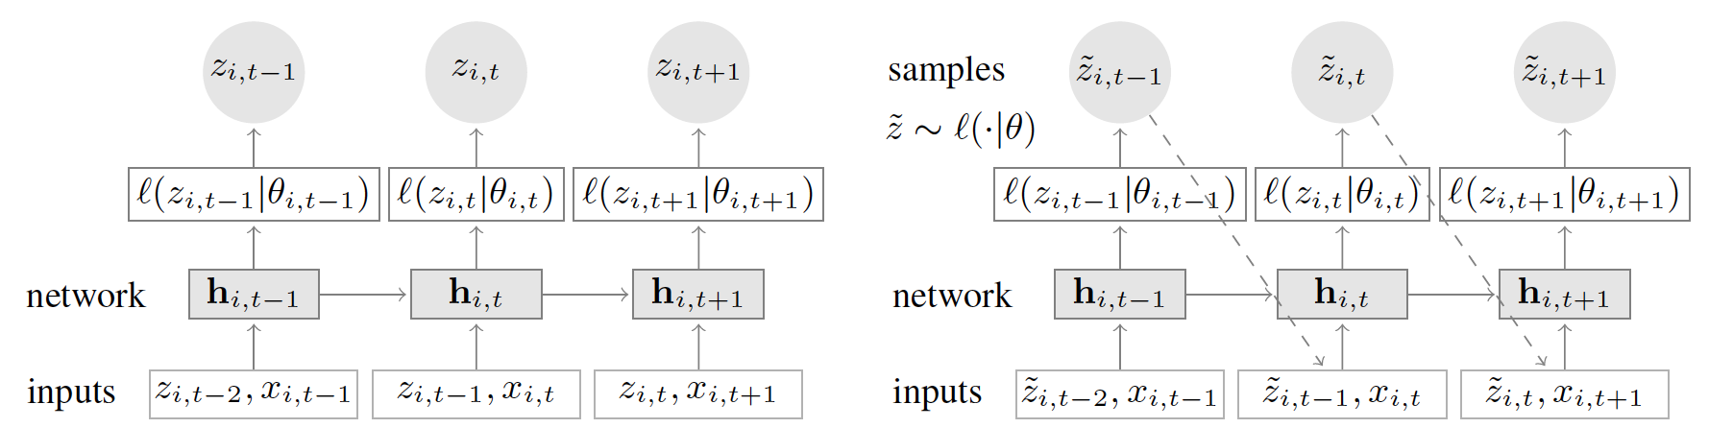
DeepAR Architecture
DeepAR is an encoder decode architecture, taking a number of input steps, output from encoder, and covariates, and predicts for the number of steps indicated as horizon.

Slide 11

Likelihood Model – Gaussian
Gaussian likelihood for real-valued Data
$$ℓ_{G}\left(𝓏 | μ,σ\right)={\left(2πσ^{2}\right)}^{−\frac{1}{2}}e^{\left(−\frac{{\left(𝓏−μ\right)}^{2}}{2σ^{2}}\right)}$$
$$μ\left(h_{i,t}\right)=w_{μ}^{T}h_{i,t}+b_{μ}$$
$$σ\left(h_{i,t}\right)=\log\left(1+e^{\left(w_{μ}^{T}h_{i,t}+b_{σ}\right)}\right)$$
Network output
Softplus activation

Slide 12
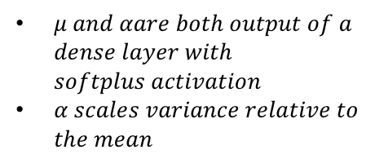

Likelihood Model – Negative Bionomial
Negative-binomial likelihood for positive count data. The Negative Binomial distribution is the distribution that underlies the stochasticity in over-dispersed count data.[3]
$$ℓ_{NB}\left(𝓏 | μ,α\right)=\frac{Γ\left(𝓏+\frac{1}{α}\right)}{Γ\left(𝓏+1\right)Γ\left(\frac{1}{α}\right)}{\left(\frac{1}{1+αμ}\right)}^{\frac{1}{α}}{\left(\frac{αμ}{1+αμ}\right)}^{𝓏}$$
$$μ\left(h_{i,t}\right)=\log\left(1+e^{\left(w_{μ}^{T}h_{i,t}+b_{μ}\right)}\right)$$
$$α\left(h_{i,t}\right)=\log\left(1+e^{\left(w_{α}^{T}h_{i,t}+b_{α}\right)}\right)$$
$μ and αare both output of a$ $dense layer with$ $softplus activation$
$α scales variance relative to$ $the mean$

Slide 13
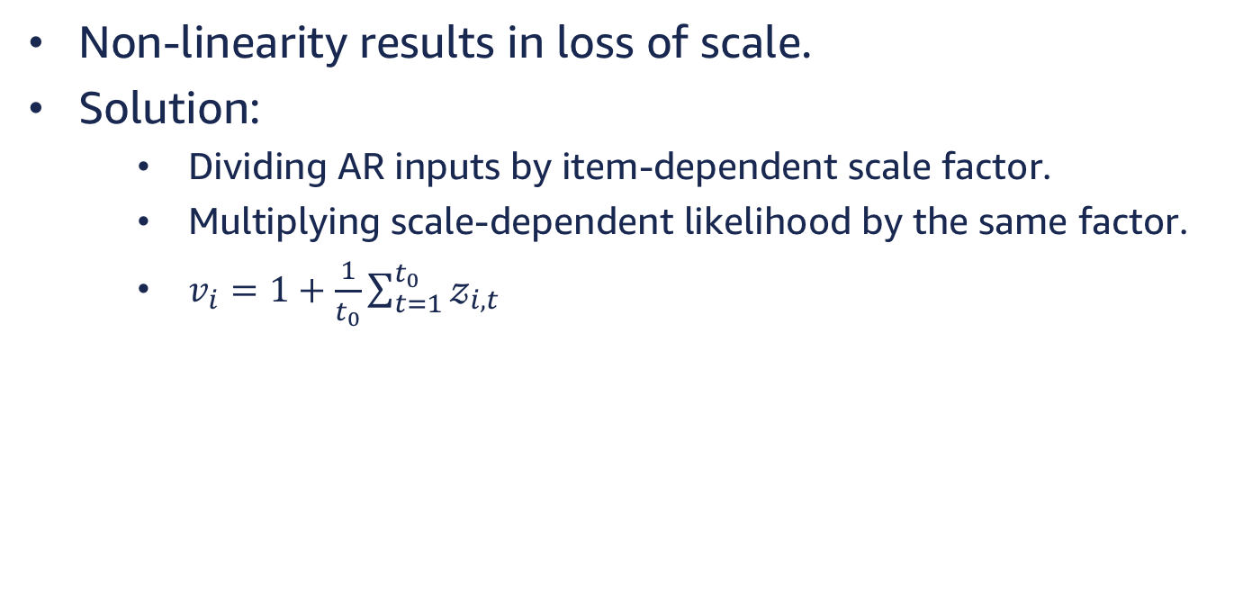
Scaling
Non-linearity results in loss of scale.
Solution:
Dividing AR inputs by item-dependent scale factor.
Multiplying scale-dependent likelihood by the same factor.
$v_{i}=1+\frac{1}{t_{0}}\sum_{t=1}^{t_{0}}{𝓏_{i,t}}$

Slide 14
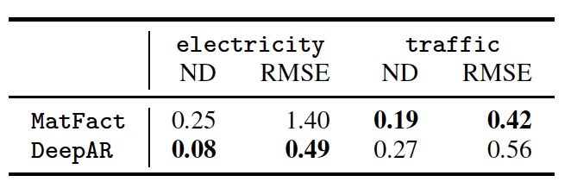
Comparison

Slide 15
LSTNet

Slide 16
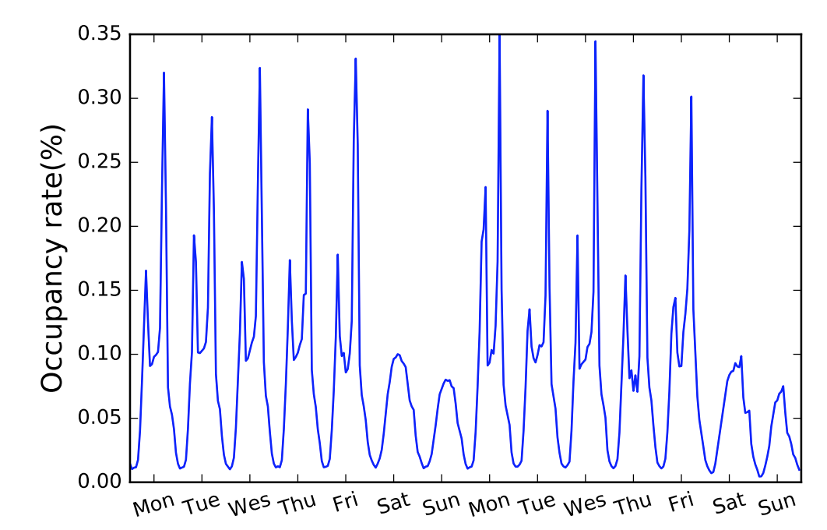
Challenge
Autoregressive models may fail to capture mixture of long and short term patterns.

Slide 17
Solution – LSTNet[4]
Long and Short Terms Time-series Networks is designed to capture mix long- and short-term patterns in data for multivariate time-series.

Slide 18
Concept
Using CNN to discover local dependencies
RNNs to capture long-term dependencies
Autoregressive model to handle scale.

Slide 19
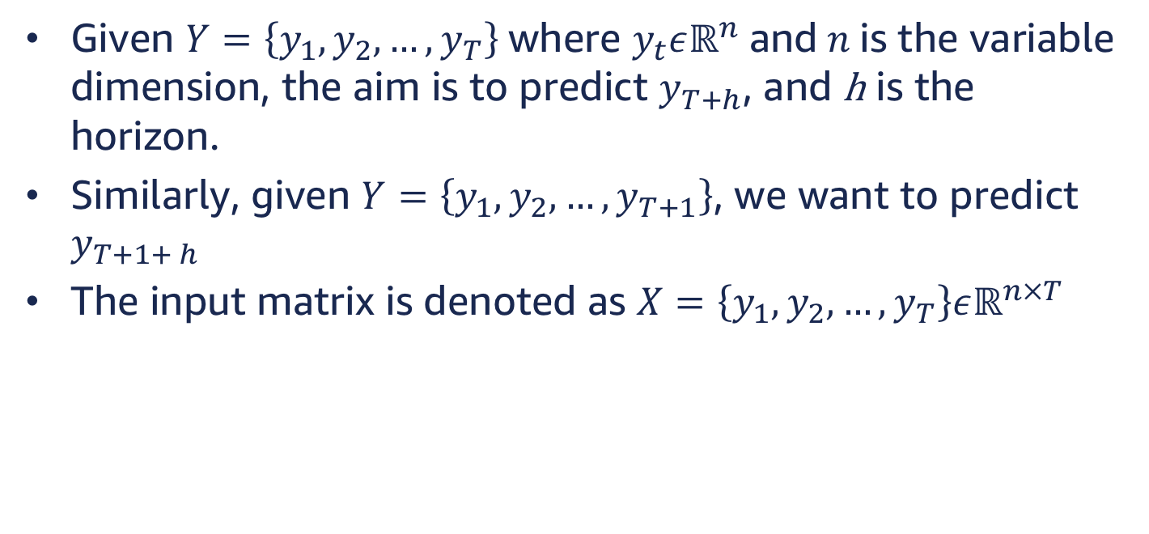
Problem Formulation
Given $Y=\left\{y_{1}, y_{2},…, y_{T}\right\}$where $y_{t}εℝ^{n}$ and $n$ is the variable dimension, the aim is to predict $y_{T+h}$, and h is the horizon.
Similarly, given $Y=\left\{y_{1}, y_{2},…, y_{T+1}\right\}$, we want to predict $y_{T+1+ h}$
The input matrix is denoted as $X=\left\{y_{1}, y_{2},…, y_{T}\right\}εℝ^{n×T}$

Slide 20
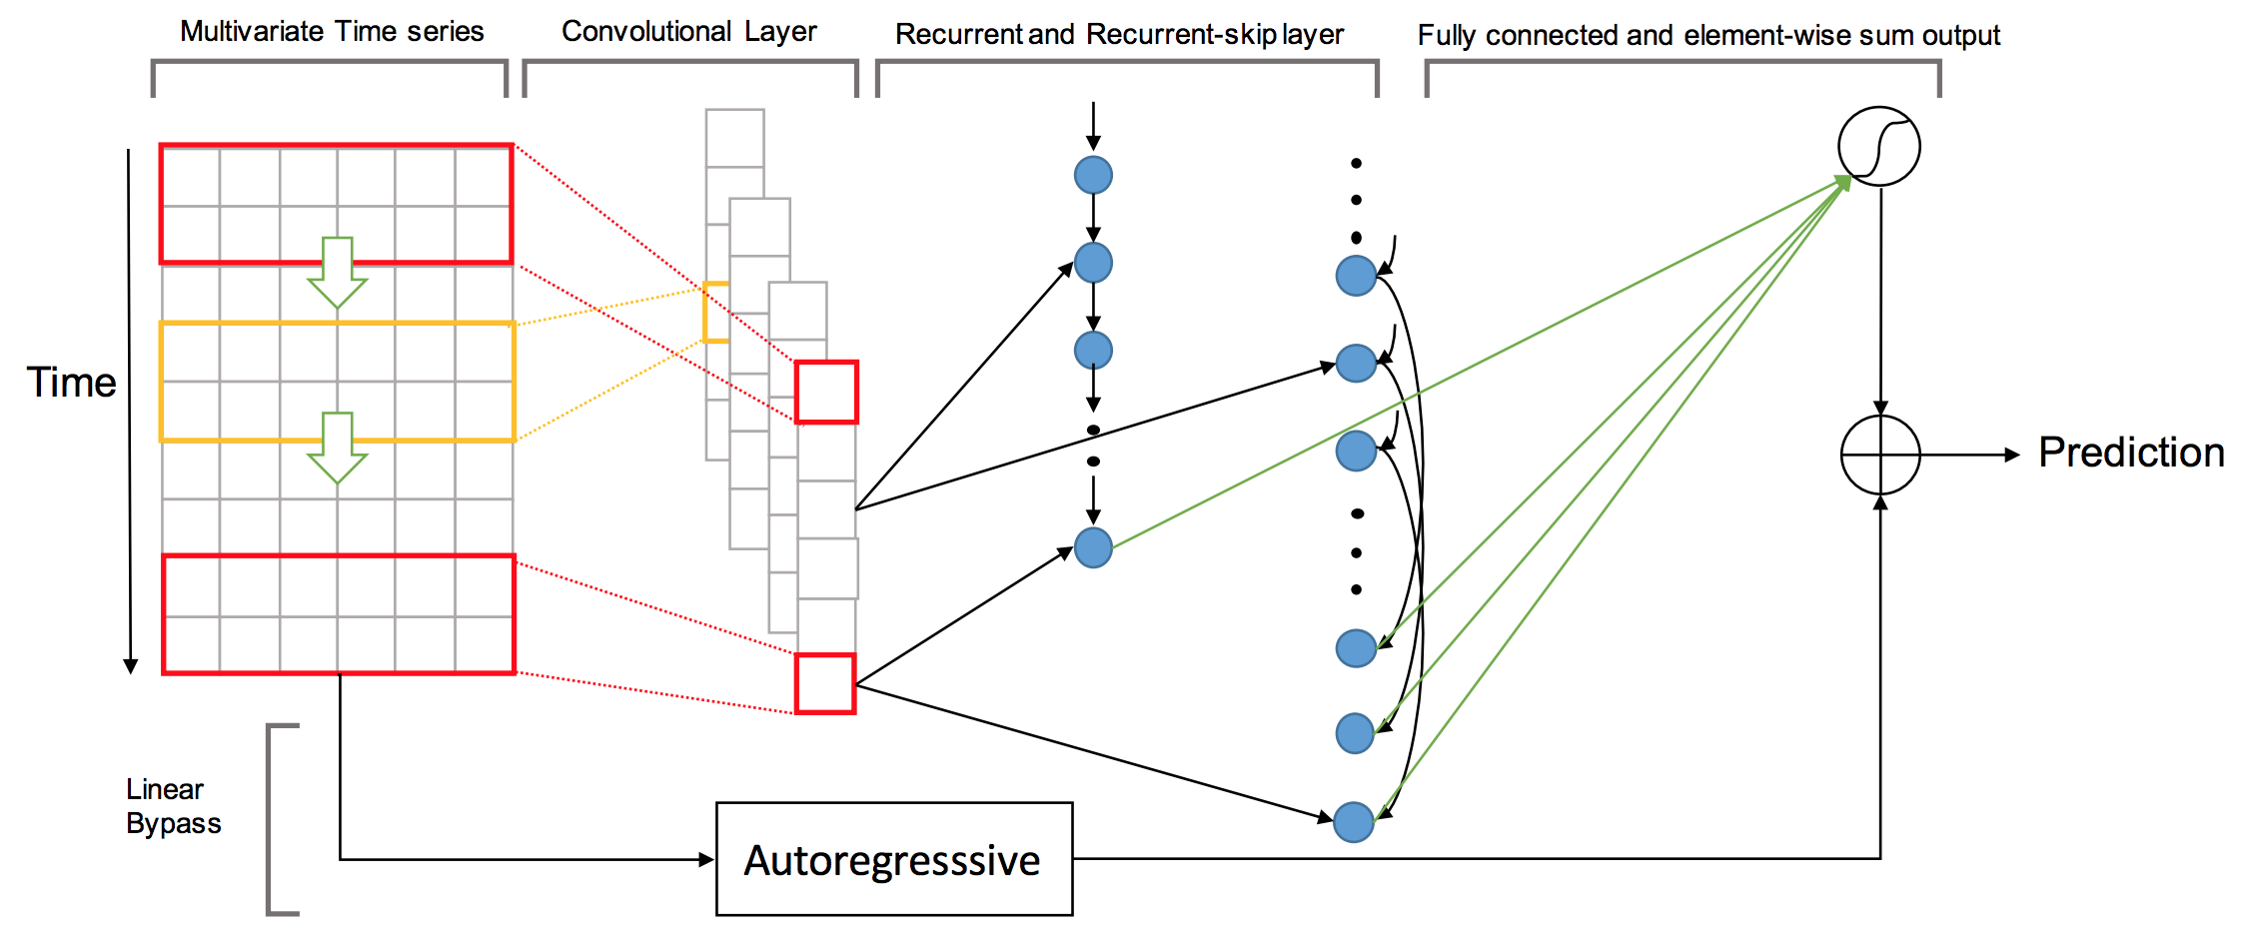
Architecture

Slide 21

Convolutional Component
Extract short-term patterns in the time dimension as well as local dependencies between variables.
Multiple filters of width $ω$ and height $n=num_var$
$h_{k}=RELU(W_{k}∗X+b_{k})$

Slide 22
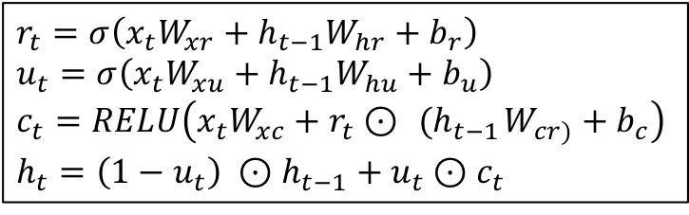
Recurrent Component
The output of the Conv layer is simultaneously fed to Recurrent and Recurrent-skip layers (next slide).
RNN component is GRU layer with RELU activation.
$$r_{t}=σ\left(x_{t}W_{xr}+h_{t−1}W_{hr}+b_{r}\right)$$
$$u_{t}=σ\left(x_{t}W_{xu}+h_{t−1}W_{hu}+b_{u}\right)$$
$$c_{t}=RELU\left(x_{t}W_{xc}+r_{t}⊙{ (h}_{t−1}W_{cr)}+b_{c}\right)$$
$$h_{t}=\left(1−u_{t}\right) ⊙h_{t−1}+u_{t}⊙c_{t}$$

Slide 23
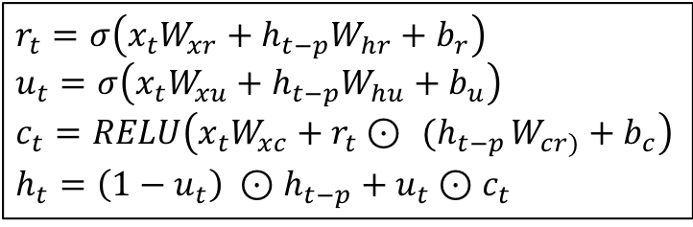
Recurrent-skip Component
Recurrent skip component is a recurrent layer that captures lagged long-term dependencies according to the appropriate lag. For instance hourly electricity consumption would have a lag of 24 time steps.
$$r_{t}=σ\left(x_{t}W_{xr}+h_{t−p}W_{hr}+b_{r}\right)$$
$$u_{t}=σ\left(x_{t}W_{xu}+h_{t−p}W_{hu}+b_{u}\right)$$
$$c_{t}=RELU\left(x_{t}W_{xc}+r_{t}⊙{ (h}_{t−p}W_{cr)}+b_{c}\right)$$
$$h_{t}=\left(1−u_{t}\right) ⊙h_{t−p}+u_{t}⊙c_{t}$$

Slide 24
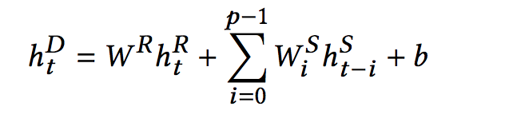
Combining Recurrent and Recurrent-skip Outputs
A Dense layer combines the output from recurrent layers.

Slide 25
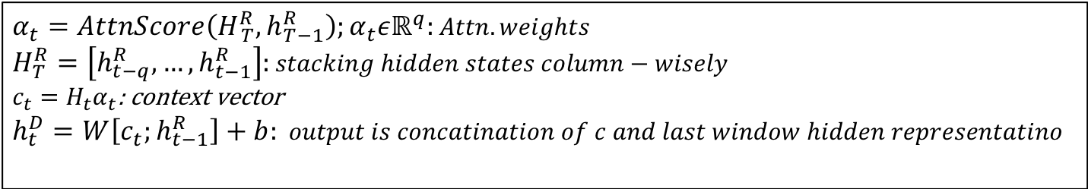
Temporal Attention Layer
In case of non-seasonal data skip step p is not useful.
In such cases an attention mechanism is used, which learns the weighted combination of hidden representations at each window position of the input matrix.
$$α_{t}=AttnScore\left(H_{ T}^{R}, h_{T−1}^{R}\right);α_{t}εℝ^{q}:Attn. weights$$
$$H_{T}^{R}=\left[h_{t−q}^{R}, …,h_{t−1}^{R}\right]:stacking hidden states column−wisely$$
$c_{t}=H_{t}α_{t}$: context vector
$$h_{t}^{D}=W\left[c_{t};h_{t−1}^{R}\right]+b: output is concatination of c and last window hidden representatino$$

Slide 26
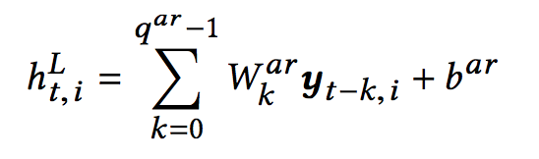
Autoregressive Component
ARC overcomes loss of scale, cased by DNN non-linearity.
ARC is a linear AR.

Slide 27

Final Output
Final output is obtained by integrating AR and DNN outputs.
$${\hat{Y}}_{t}=h_{t}^{D}+h_{t}^{L}$$

Slide 28
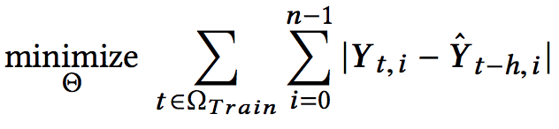
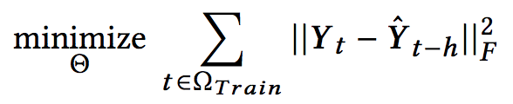
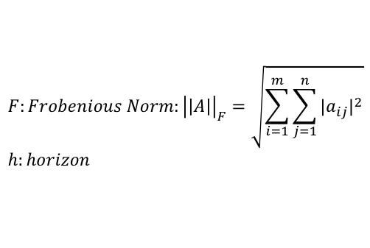
Objective Function
The paper suggests using either L1 or L2 loss function.
$$F:Frobenious Norm:{\left|\left|A\right|\right|}_{F}=\sqrt{\sum_{i=1}^{m}{\sum_{j=1}^{n}{{|a_{ij}|}^{2}}}}$$
$$h:horizon$$

Slide 29
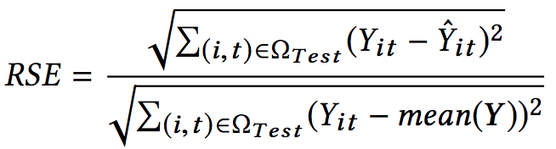
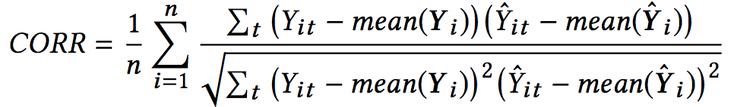
Metrics
Root Relative Squared Error (RSE): We want lower error.
Empirical Correlation Coefficient (CORR): We want higher correlation.

Slide 30
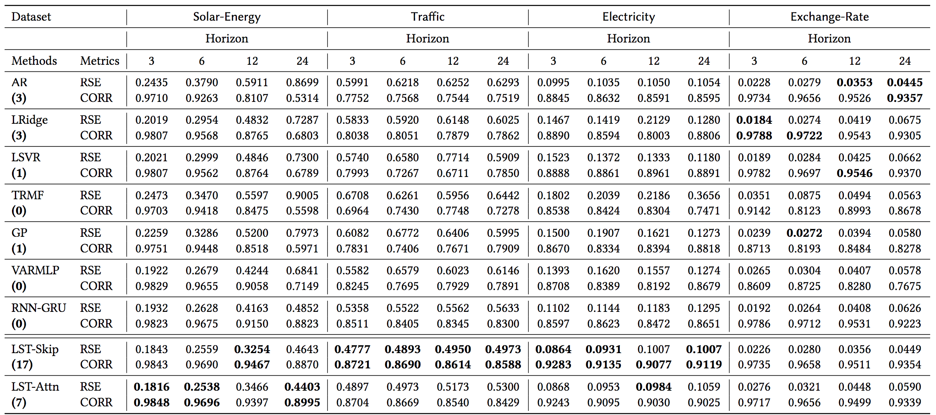
Comparison

Slide 31
References
Forecasting: Principles and Practice – Rob J Hyndman, George Athana­sopou­los https://www.otexts.org/fpp/8/3
DeepAR: Probabilistic Forecasting with Autoregressive Recurrent Networks - Valentin Flunkert , David Salinas , Jan Gasthaus. https://arxiv.org/abs/1704.04110
http://sherrytowers.com/2014/07/11/negative-binomial-likelihood/
Modeling Long- and Short-Term Temporal Patterns with Deep Neural Networks, Guokun Lai et. Al https://arxiv.org/pdf/1703.07015.pdf

