Slide 1
GluonNLP:
A Deep Learning Toolkit for NLP Practitioners

Slide 2
GluonNLP

Slide 3
GluonNLP
A deep learning framework designed for fast data processing/loading, and model building

Slide 4
GluonNLP APIs
gluonnlp.data
Build efficient data pipelines for NLP tasks
gluonnlp.vocab
text data numericalization and the subword functionality provided in
gluonnlp.model
Train or load state-of-the-arts models for common NLP tasks
gluonnlp.embedding
Train or load state-of-the-arts embeddings for common NLP tasks

Slide 5
GluonNLP Community
Main contributors:
Sheng Zha, Chenguang Wang, Aston Zhang, Mu Li, Shuai Zheng, Leonard Lausen, Xingjian Shi
Code&docs:
https://github.com/dmlc/gluon-nlp
http://gluon-nlp.mxnet.io/
Forums:
https://discuss.gluon.ai/
https://discuss.mxnet.io/

Slide 6
GluonNLP Cool Examples

Slide 7
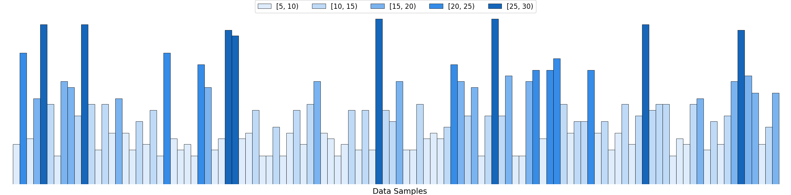
Data Bucketing
How to generate the mini-batches?

Slide 8
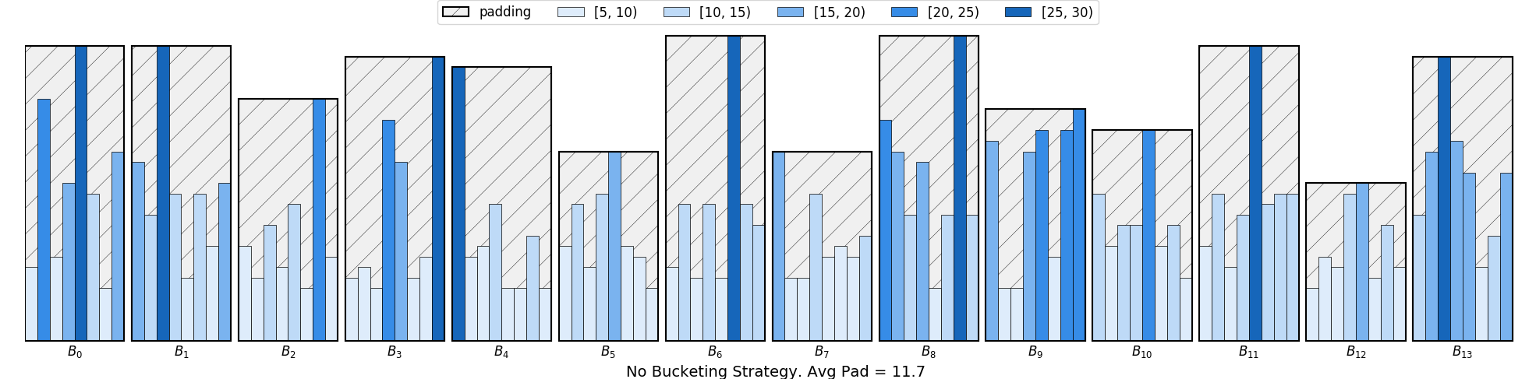
No Bucketing
Average Padding = 11.7
Data loading
slow and memory inefficient

Slide 9
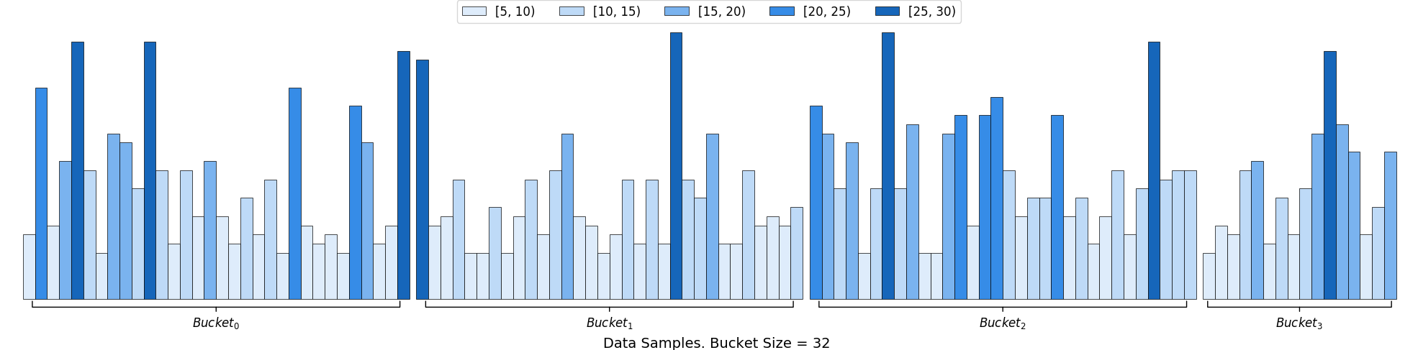
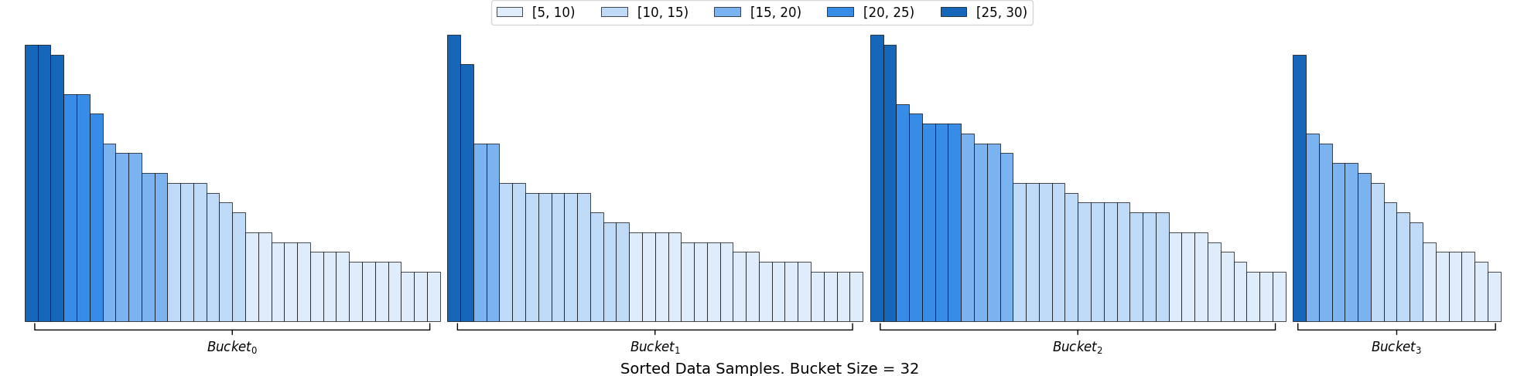
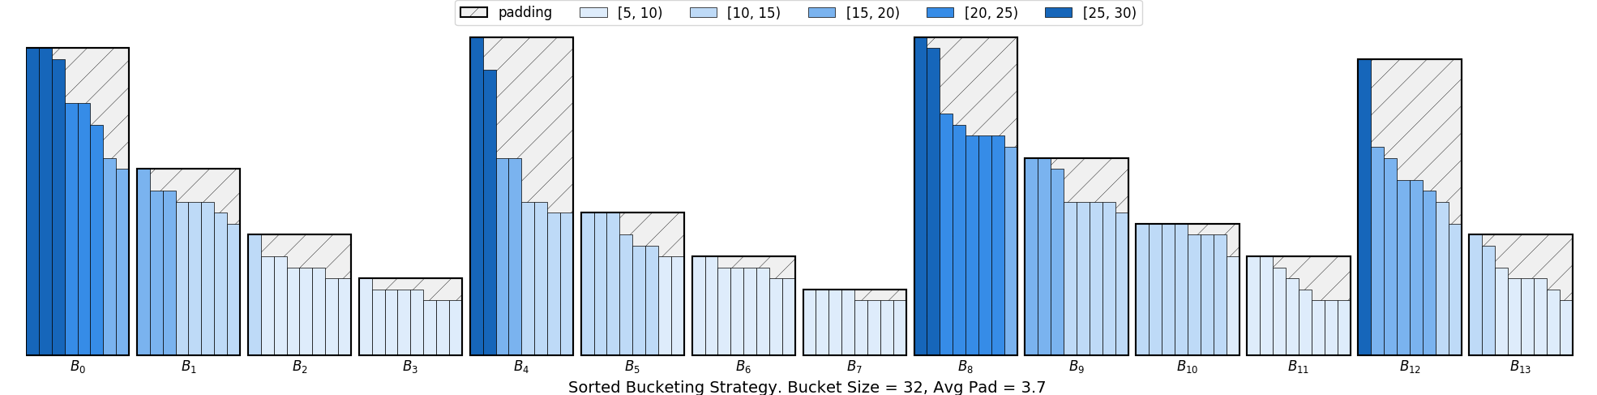
Sorted Bucketing
Average Padding = 3.7
GluonNLP data bucketing
fast and memory efficient

Slide 10
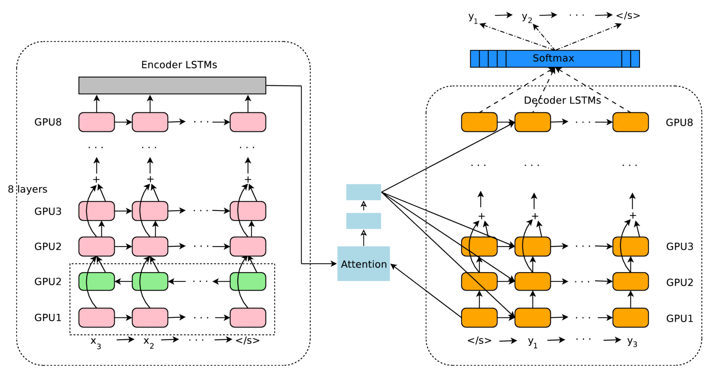
Google Neural Machine Translation
Our implementation:
BLEU 26.22 on IWSLT2015, 10 epochs, Beam Size=10
Tensorflow/nmt:
BLEU 26.10 on IWSLT2015, Beam Size=10
Encoder: Bidireciontal LSTM + LSTM + Residual
Decoder: LSTM + Residual + MLP Attention
Wu, Yonghui, et al. "Google's neural machine translation system: Bridging the gap between human and machine translation." arXiv preprint arXiv:1609.08144 (2016).

Slide 11
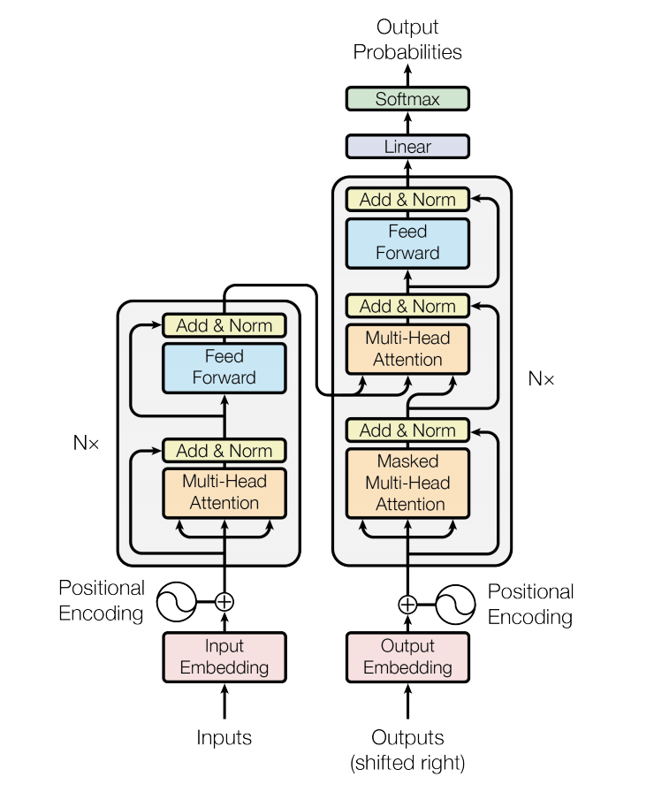
Transformer
Encoder
6 layers of self-attention+ffn
Decoder
6 layers of masked self-attention and
output of encoder + ffn
Our implementation:
BLEU 26.81 on WMT2014en_de, 40 epochs
Tensorflow/t2t:
BLEU 26.55 on WMT2014en_de
Vaswani, Ashish, et al. "Attention is all you need." Advances in Neural Information Processing Systems. 2017.

Slide 12
GluonNLP Step-by-step
-A language model example

Slide 13
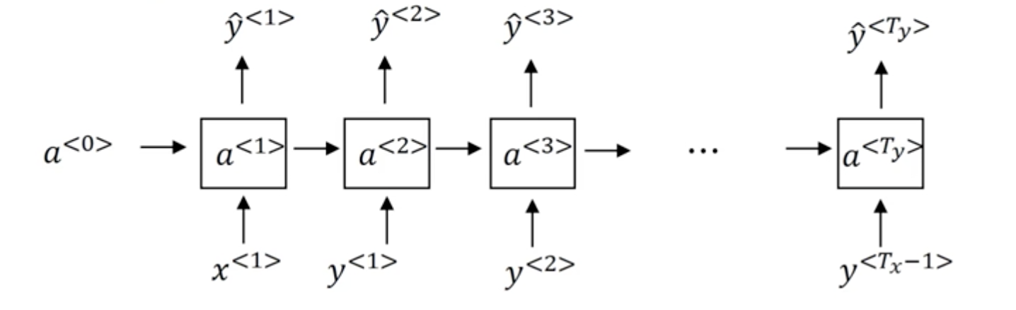
Language Model
Language model is trying to predict the next word based on the previous ones

Slide 14
Steps to Write Language Model
1. Collect a dataset <-most of the work
2. Build the model <-a few lines of code
3. Train <-a few lines of code
4. Evaluate <-one line
5. Inference <-one line
http://gluon-nlp.mxnet.io/examples/language_model/language_model.html

Slide 15
Step #1: Collect a dataset
import gluonnlp as nlp
dataset_name = 'wikitext-2'
train_dataset, val_dataset, test_dataset = [nlp.data.WikiText2(segment=segment,
bos=None, eos='<eos>',
skip_empty=False)
for segment in ['train', 'val', 'test']]
vocab = nlp.Vocab(nlp.data.Counter(train_dataset[0]), padding_token=None, bos_token=None)
train_data, val_data, test_data = [x.bptt_batchify(vocab, bptt, batch_size,
last_batch='discard')
for x in [train_dataset, val_dataset, test_dataset]]

Slide 16
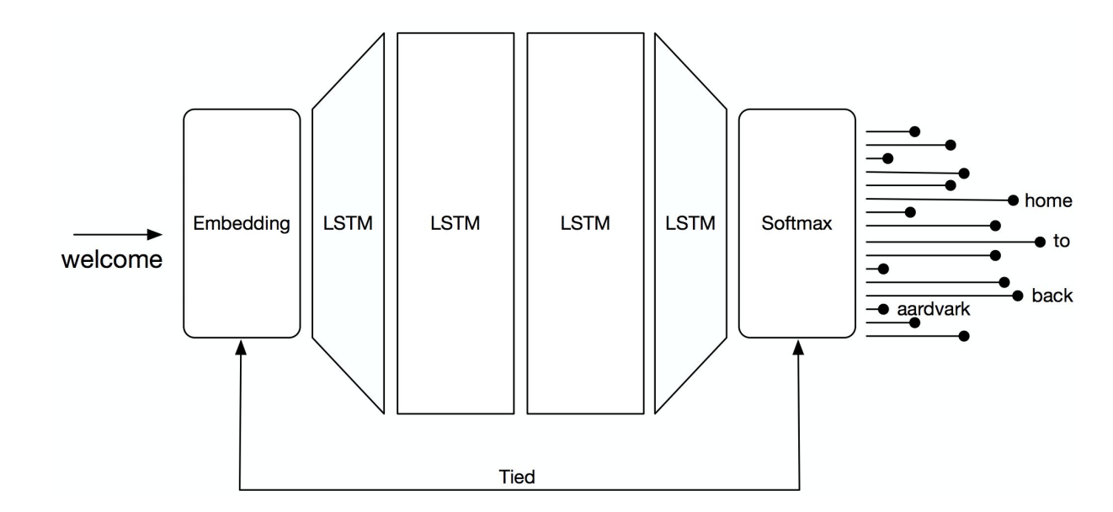
Step #2: Build the model
with self.name_scope():
self.embedding = self._get_embedding()
self.encoder = self._get_encoder()
self.decoder = self._get_decoder()
model = nlp.model.train.StandardRNN(args.model, len(vocab), args.emsize,
args.nhid, args.nlayers, args.dropout, args.tied)
self.embedding
self.encoder
self.decoder

Slide 17
Step #3: Train
model.initialize(mx.init.Xavier(), ctx=context)
trainer = gluon.Trainer(model.collect_params(), 'sgd',
{'learning_rate': lr,
'momentum': 0,
'wd': 0})
loss = gluon.loss.SoftmaxCrossEntropyLoss()
train(model, train_data, val_data, test_data, epochs, lr)

Slide 18
Step #4: Evaluate
test_L = evaluate(model, test_data, batch_size)

Slide 19
Step #5: Inference
model, _ = nlp.model.get_model('standard_lstm_lm_200', vocab=vocab)
test_L = evaluate(model, test_data, batch_size)

Slide 20
GluonNLP Embedding
http://gluon-nlp.mxnet.io/api/embedding.html

Slide 21
Embedding is Powerful!
Recommendation
Information Retrieval
Advertising, etc.
Language model,
machine translation,
QA, Dialog System, etc.
Graph mining
etc.
Image classification,
Image detection,
SSD, etc
LINE, Deepwalk,
CNN embedding
…
Faster R-CNN, etc.
…
Word2vec, Fasttext, Glove, etc
…
Word Embedding, Sentence Embedding,
Paragraph embedding etc.
Network embedding,
Subgraph embedding
CNN embedding
Language Embedding
Graph Embedding
Image Embedding
Embedding

Slide 22
Word Embedding
Map words or phrases from the vocabulary to vectors of real numbers.

Slide 23
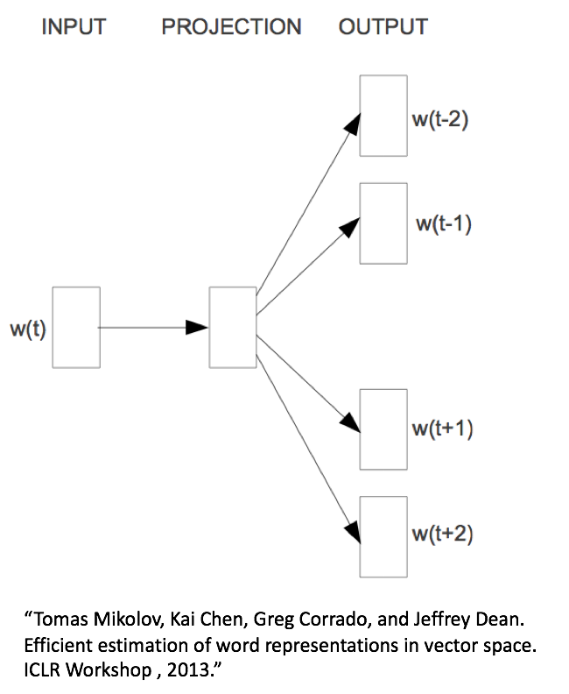
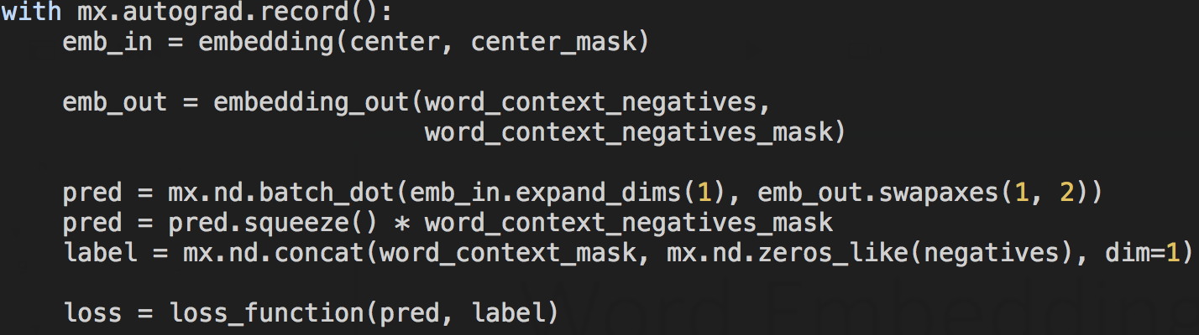
Word2vec
Skip-gram
Given a center word, predict surrounding words

Slide 24
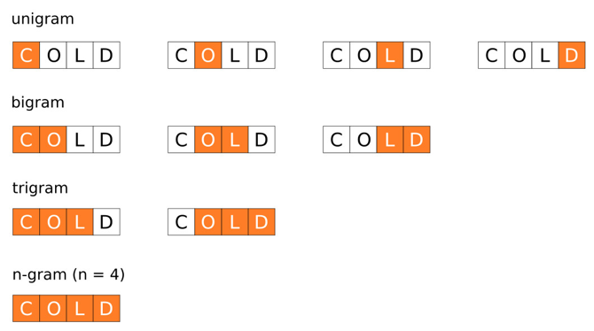
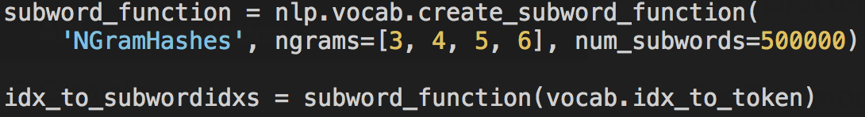
FastText
(Unknown) word:
the sum of char-n-gram.
Bojanowski, Piotr, et al. "Enriching word vectors with subword information." arXiv preprint arXiv:1607.04606 (2016).

Slide 25
Embedding Evaluation
Similarity
See the example: http://gluon-nlp.mxnet.io/index.html
Analogy
See the example: http://gluon-nlp.mxnet.io/examples/word_embedding/word_embedding.html

Slide 26
GluonNLP Status
Dataset
Many public datasets.
Streaming for very large datasets.
Text data processing
Vocabulary
Tokenization
Bucketing
Modeling
Attention
Beam Search
Weight Drop
Embedding
Pretrained Embedding
Embedding Training
State-of-the-art models
Embedding, LM, MT, SA
Examples friendly to users that are new to the task
Reproducible training scripts
More is coming soon!

Slide 27
Summary
In GluonNLP, we provide
High-level APIs
gluonnlp.data, gluonnlp.model, gluonnlp.embedding
Low-Level APIs
gluonnlp.data.batchify, gluonnlp.model.StandardRNN
Designed for practitioners: researchers and engineers

Slide 28
Thanks && QA
gluon-nlp.mxnet.io

