Slide 1
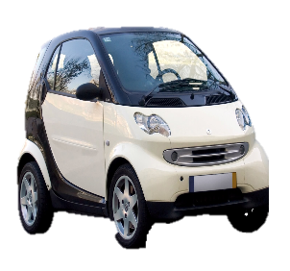
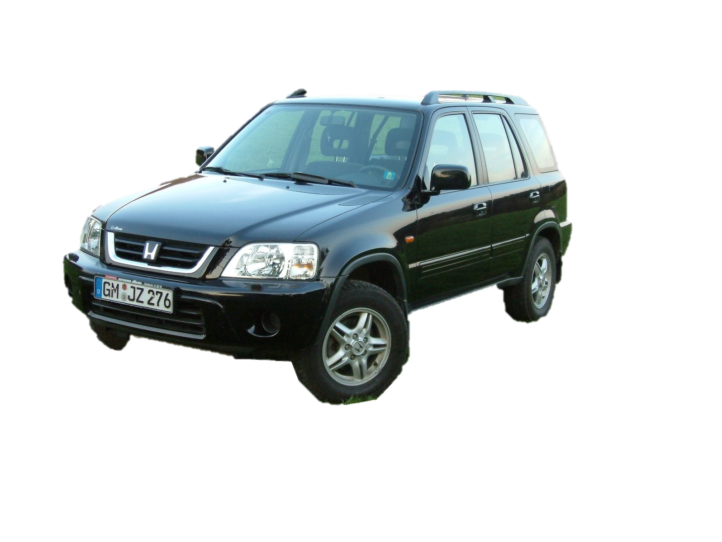
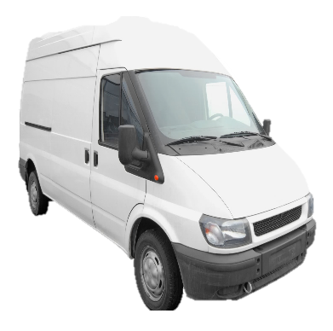
Car Rental Company User Stories
BLINK 192

Slide 2
System Roles
Customer – Persons who book or rent vehicles from CRC.
Employee – Acts on behalf of CRC and communicates with customers.
Manager – Responsible for employees and store performance.
Board Member – Responsible for CRC, its managers, employees, and the direction and progression of the business.
User stories have been prioritised according to the MoSCoW system.

Slide 3
Release 1 – Sprint 1

Slide 4
Employee Login
Story ID: S01
Priority:
M
Story Points: 2
As an employee, I want to be able to access a landing page, so that I can login to a system and perform my employee duties.
Acceptance Criteria:
On the Car Rental Company (CRC) website, an ‘Employee Login’ link will be displayed. Clicking the link will allow employees to enter their employee ID and password, in order to access the database and client information.
Upon logging in, the employee will be presented with a dashboard of information that can be filtered and drilled down into to retrieve more specific information when required. This will be achieved through the use of tabs with titles such as reports and vehicle information. A search box will also be included for the employee to search the database at large.
This login will also serve as a way to discern between employees, managers, and board members. This will in turn dictate what a person will be displayed upon logging in, based on their role at CRC.
Assumptions: It is assumed that the database will be converted to SQL and connected to the web application in order for employees to login and for information and statistics to be retrieved and displayed on the dashboard.

Slide 5
Vehicle Recommendations
Story ID: S02
Priority:
M
Story Points: 4
As an employee, I want to view the history of customers rentals and returns, so that I can make vehicle recommendations.
Acceptance Criteria:
Upon successfully logging in, the employee will be able to search the customer’s name and find their profile/previous bookings with information of their previous vehicles’ type, model, city retrieved from, and month booked.
This will primarily be used by employees at the service desk where customers are picking up their car, so that possible upgrades/recommendations can be made, based on what cars are available at the store. This will also require a search of all vehicles that can be filtered by type and model, as city will be the location of the store the customer is in, and month will be irrelevant due to the fact that the possible upgrade/recommendation must be available at the store at the time that the customer is there. The database will store the customer information, car information, store information and time.
Assumptions: N/A

Slide 6
Generate Reports
Story ID: S03
Priority:
M
Story Points: 4
As a board member, I want to view detailed reports, so that I can make decisions regarding future car purchases.
Acceptance Criteria:
After a board member has successfully logged in they will be able to select a ‘Reports’ tab that will direct them to a data visualisation tool that they can filter and customise.
The tool will have drop down boxes with choices of year, month, location, and popular vehicles with a search button to quickly create a new search. There will also be a generate report button, which when pressed will submit a database query based on the drop down box fields, and it will return a report containing the desired information. The report will be presented on the web page in a table/chart format and will be downloadable as a .CSV file.
Assumptions: N/A

Slide 7
Customer Vehicle Search
Story ID: S04
Priority:
M
Story Points: 2
As a customer, I want to be able to view which vehicles are available, so that I can reserve a vehicle with my preferences considered.
Acceptance Criteria:
The CRC web page will contain a calendar icon/field, to select dates manually, and a location search bar. Customers can choose to enter one or both entry fields to create a search. The customer can navigate the calendar to their desired dates and select a start and end date.
Customers can make a search based on a specific location. In the location search bar, the word ‘location’ will appear in grey and disappear when typing begins. Depending on the search, customers will select the exact location from a specified list of locations. The field will be predictive based on what the customer enters. A future option may allow the customer to choose their nearest store, based on their current location.
After the search, the customer will be directed to a list of vehicles available. A customer will be able to reserve a vehicle by clicking on the vehicle they would like, then clicking ‘Book Now’ on the following page. The customer will then be prompted to enter their details and click the ‘Confirm’ button to submit their reservation request. The reservation will be confirmed via email.
Assumptions: N/A

Slide 8
Update Vehicles – Not Inspected
Story ID: S05
Priority:
M
Story Points: 2
As an employee, I want to be able to indicate when cars have been delivered to a store, but not inspected, so that I can obtain an accurate value for the number of cars being held by the business.
Acceptance Criteria:
After an employee has logged in, a ‘Vehicle Information’, tab pertaining to a comprehensive list of vehicles and their current ‘rental status’, will be displayed on the dashboard. This status will vary between: available, booked, rented, delivered, and completed. Where: available means the car is available at the specific store; booked means the vehicle has been reserved; rented means the car is currently out of store and in use by a customer; delivered means the vehicle has been delivered but not inspected; and completed means the vehicle has been completed but not inspected; once the inspection has been completed, the ‘rental status’ will return to available and its store location will be updated by the employee.
Should a vehicle be deemed to have suffered damage, the process will divert after the ‘delivered’ rental status to damaged, quoted, repaired, re-inspected, and available. Where: damaged indicates that the car has been damaged and requires repairs; quoted indicates that the cost of repairs quote has been received; repaired will indicate [continue on next page]

Slide 9
Update Vehicles – Not Inspected
Story ID: S05
Priority:
M
Story Points: 2
Continued: that the vehicle is being repaired; re-inspected will mean that the vehicle has been repaired and is currently being evaluated at CRC again; after these steps, the rental status will return to available.
Should a car not be returned, it’s rental status will be able to be updated to not returned, and a follow up process will need to be executed by CRC to retrieve the vehicle.
Assumptions: It is assumed that a vehicle delivered to a different store will remain at that store until rented again, or a manual stocktake/retrieval is conducted by the company.

Slide 10
Update Vehicles – Inspected
Story ID: S06
Priority:
M
Story Points: 2
As an employee, I want to be able to update cars as ‘returned’ after they have been inspected, so that I can make them available to hire.
Acceptance Criteria:
Once the employee has logged in, they will be able to select the ‘Vehicle Information’ tab and view the cars that have been returned by using the drop down filter for ‘rental status’. This will enable them to view the cars hired, which will display the date hired, return date, car details, customer details, and rental status.
A button will be added to this page to enable the employee to edit the rental status of the vehicle, which will unlock the fields for editing. Whilst editing the button will turn into a ‘Save’ button to complete the changes, update the fields, and re-lock them.
Assumptions: N/A

Slide 11
Release 1 – Sprint 2

Slide 12
Employee Customer Search
Story ID: S07
Priority:
M
Story Points: 2
As an employee, I want to be able to search for a customer, so that I can decide whether or not I need to create a new customer entry.
Acceptance Criteria:
The employee dashboard will contain a search field. An employee can enter either a customer’s name, address, phone number, or DOB in the search field. This will search the entire database and display the customers matching the criteria. If the entry is invalid, either the information entered was incorrect or there are no entries for that customer, meaning they have not previously booked with CRC.
To create an account for a customer, the employee then selects the ‘new customer’ button which is present on every page (including the homepage). The employee then enters the customer’s information into each relevant search field. The information recorded includes, first name, last name, address, DOB and phone number. Once the information is entered and the employee selects the ‘complete’ button at the bottom of the last entry field, a customer ID is generated, and that customer is now added to the CRC database.
Assumptions: In order to accommodate for the inconsistencies in the data, this search will return a list of customers, it is assumed that the employee searching for a customer will have [continue on next page]

Slide 13
Employee Customer Search
Story ID: S07
Priority:
M
Story Points: 2
Continued: enough information to be able to discern which customer they are looking for. This is because there are multiple entries for some customers, and some of the entries’ dates of birth and phone numbers are inconsistent with other entries that are clearly the same customer. Although the multiple entries for the same customer issue will be consolidated before the development of the web interface, the information the customer provides to the employee, may be slightly incorrect when they search for the customer and will need to be updated.

Slide 14
Online Payment
Story ID: S08
Priority:
S
Story Points: 4
As a customer, I want to be able to securely book and pay for a vehicle online, so that I can confirm my booking is verified.
Acceptance Criteria:
The customer will be able to search for a vehicle from the CRC web page by inputting just the location and date range. They will then be able to select a vehicle they would like, with the option to filter results further, and book and pay for the vehicle or select pay in store.
This feature will require a secure payment button, secure connection, and SSL certificate in order to verify the security of the transaction. After completing the transaction, the customer will be emailed a receipt and letter of confirmation for their booking.
Assumptions: N/A

Slide 15
In-Store Payment
Story ID: S09
Priority:
S
Story Points: 4
As a customer, I want to be able to book and pay for a vehicle in person, so that I can confirm my booking is verified.
Acceptance Criteria:
If the vehicle has only been booked and the customer would like to pay in store, only a booking confirmation will be issued, with an amount owing. When the customer arrives to collect their car they will be required to pay before they are given the car.
Assumptions: N/A

Slide 16
View Vehicle Reports
Story ID: S10
Priority:
S
Story Points: 4
As a manager, I want to view the list of vehicles hired per month, so that I can plan for future growth and allocation of business resources.
Acceptance Criteria:
Upon a manager successfully logging in, a tab titled ‘Vehicle Information’ will allow the manager to view information about CRC’s vehicles. This will show custom tables that the manager can view for business use. Dropdown filters for date, month, location, vehicle type, and rental status, will allow the manager to view customised information for the vehicles.
Assumptions: N/A

Slide 17
Access Customer Details
Story ID: S11
Priority:
S
Story Points: 2
As an employee, I want to be able to access each customers’ details, so that I can inform them when the car has been ‘returned’ and if further costs will be incurred.
Acceptance Criteria:
After successfully logging in, an employee will be presented with a dashboard. This dashboard will contain a search box to enable the employee to search for a customer by name, phone number, address, or date of birth. Once searched, results will be displayed in a listed table format, and the employee will be able to see the details of each customer here.
The employee will also be able to click on the customer and view their current, previous, and future bookings with the company. From here, the employee will be able to click an ‘Edit’ button, which will unlock the customer fields, and allow them to be updated or edited. Whilst editing, the button will change to ‘Save’ and can be clicked again to confirm changes and re-lock the fields.
When clicking on a vehicle or searching for a vehicle, the employee will be presented with the rental history of the vehicle, and its current rental status. This will allow employees to monitor the process for damaged cars and inform the customer of any further costs.
Assumptions: N/A

Slide 18
Release 2 – Sprint 3

Slide 19
View Stock
Story ID: S12
Priority:
S
Story Points: 2
As a manager, I want to be able to view the number of stock at each location, so that I can organise the transportation of vehicles to and from other locations.
Acceptance Criteria:
On the manager dashboard, a ‘Stock’ tab/link, which when clicked, will display stock levels based on the location of the manager. Stock levels at other stores will be able to be viewed by changing the field in the location drop down box.
A ‘Show Stock Levels’ button will be present on the page that, when clicked with a location selected, will generate a report that displays a table/chart of the location of the store and number of vehicles available at the store.
A display all button will be included, to allow managers to determine which stores they will request cars from.
Assumptions: N/A

Slide 20
Update Customer Information
Story ID: S13
Priority:
S
Story Points: 1
As an employee, I want to be able to update customer information, so that I can keep all the information in the database up to date and accurate.
Acceptance Criteria:
After successfully logging in, an employee will be able to search a customer name from the search box in the employee dashboard page. Results will be displayed on a new page and the employee can choose which client they are wanting to update. Information displayed will include: rentals, returns, order ID, vehicle information, name, contact details, address and date of birth.
Once a customer has been clicked on, a new page with customer information, previous bookings, current bookings, and future bookings, will be displayed. On the right side of the information is an ‘Edit’ button. If clicked, the fields will unlock and the employee can update customer information. The edit button will change into a ‘Save’ button which, when selected, will update the information stored in the database and the fields will become locked again.
Assumptions: When a car is rented or returned, the customers information will be gathered.

Slide 21
FAQs
Story ID: S14
Priority:
C
Story Points: 2
As a customer, I want to view a Frequently Asked Questions (FAQ) page, so that I can have my queries answered.
Acceptance Criteria:
The website will require a Frequently Asked Questions (FAQ) page, where customers can view FAQs that may provide an answer to their questions. This page will have a list of FAQs and a search box. If the customer search does not match any sentence in any of the listed FAQs, the page will display a contact us page/form. Otherwise, the customer will be directed to a question on the FAQ page that matches their search.
Assumptions: N/A

Slide 22
Detailed Specifications Search
Story ID: S15
Priority:
C
Story Points: 1
As a customer, I want to search the detailed specifications of each vehicle, so that I can book a vehicle that meets my requirements.
Acceptance Criteria:
On the landing page, an ‘Our Vehicles’ link will be included that, when clicked, will display a list of all vehicles the company has. Next to each vehicle will be a link that will display further specifications about each vehicle. Furthermore, when a customer submits a booking search, each vehicle will have a ‘Specifications’ link that will display more information about the specific vehicle.
Assumptions: N/A

Slide 23
View Vehicle by Model
Story ID: S16
Priority:
C
Story Points: 1
As a customer, I want to be able to view available vehicles by model, so that I can see if my preferred brand is available near the location I have selected.
Acceptance Criteria:
On the landing page, the customer will have the option of searching by location and date, with various other filters. One such filter will be model, which will allow the customer to search by their preferred model.
Once an original search has been carried out, the results page will have a ‘Refine Results’ button that will allow the customer to further filter the results with the use of drop down boxes.
Assumptions: N/A

Slide 24
Customer Sign-up
Story ID: S17
Priority:
C
Story Points: 1
As a customer, I want to be able to create an account, so that I can view my previous bookings and make changes to my future bookings.
Acceptance Criteria:
On the landing page, a ‘Create Account’ button will be accessible for the customer. This will allow them to enter their details and create an account, through which they can view their previous, current, and future bookings. This will allow customers to edit their contact information, future rental plans, current rental plans, and see which cars they have rented previously. They will be able to monitor the ‘Rental Status’ of vehicles they have rented. Customers will also be able to view recommendations based on their previous usage.
Assumptions: N/A

Slide 25
Total Story Points
There are 40 story points (for the 17 user stories) in total.

