Slide 1

SHARE YOUR DAY
CHEEKY HONG

Slide 2

CONTENTS
01. ONE
02. TWO
03. THREE
04. FOUR
05. FIVE
06. SIX

Slide 3
01
KOREAN
FORSYTHIA
KOREAN
FORSYTHIA

Slide 4
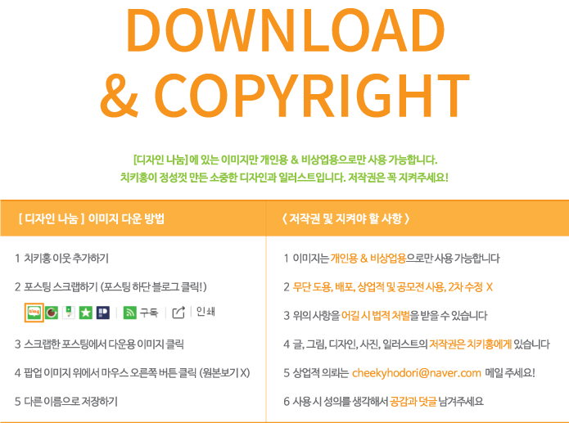
02
이미지
다운방법
및 저작권

Slide 5
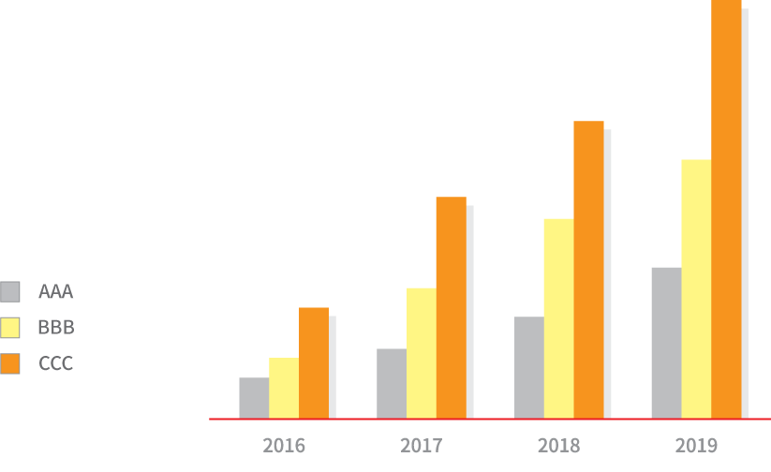
03
GRAPH

Slide 6
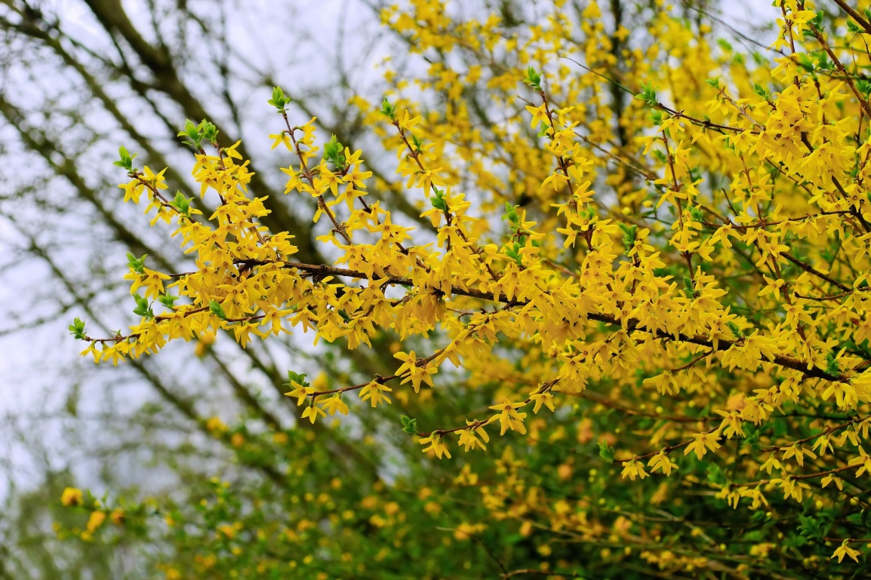
04
IMAGE

Slide 7
THANK YOU

