Slide 1
Domain Oriented Conversational Agent
Internal Guide – Dr. Gorthi R. K. S. S. Manyam
External Guide – Pavan Kumar Reddy Sannadi
Submitted by – Vamshi Kumar Kurva
SC15M045

Slide 2
Introduction
Artificial conversational entity.
Responds to domain-oriented user questions.
Assists the user just like humans.
A kind of customer care service.
Technically, the task is to predict the next sentence given the context ( previous sentences in the conversation)

Slide 3
Challenges in building such an agent:
Conversations have time-dependencies.
Agent should be able to understand and reply even if the question asked is a bit different from the trained conversations
Agent should be able to capture the long-term temporal dependencies.
Agent has a limited vocabulary.

Slide 4
Literature survey
NNs can learn to generalize given the huge dataset.
DNNs can only be applied to problems whose inputs and targets can be sensibly encoded with vectors of fixed dimensionality
It is a significant limitation, since many important problems are best expressed with sequences whose lengths are not known a-priori.
Question-answering, machine translation are sequential problems.
Question-answering can also be seen as mapping a sequence of words representing the question to a sequence of words representing the answer

Slide 5
RNN
RNN, in principle can map entire history of inputs to each output.
RNN with a sufficient number of hidden units can approximate any measurable sequence-to-sequence mapping to arbitrary accuracy
RNNs allow a ‘memory’ of previous inputs to persist in the network’s internal state, thereby influence the network output.
RNN can be thought of as a FFNN unfolded in time space
Forward pass is same as that of a FFNN, except for the fact that activations arrive the hidden layer from both current external input and the hidden layer activations from the previous time step.

Slide 6
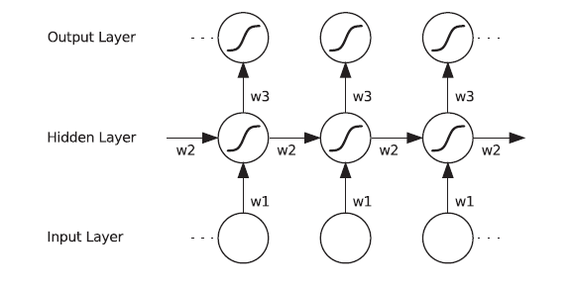






Let I --- i/p neurons, H --- hidden,
K --- o/p neurons
L ---- Loss function
$δ_{j}$ = $\frac{∂L}{∂a_{j}}$ , $a_{j}$ = $\sum_{i}{w_{ij}b_{i}}$
$$a_{h}$$
$b_{h}$ = f($a_{h}$)
f
Using Backpropagation
$δ_{h}$ = f’($a_{h}$) $\sum_{h^{′}εH_{l+1}}{δ_{h′} }w_{hh′}$
$\frac{∂L}{∂w_{ij}}$ = $\frac{∂L}{∂a_{j}} \frac{∂a_{j}}{∂w_{ij}}$ = $δ_{j}$ $b_{i}$

Slide 7

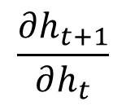


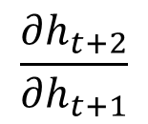
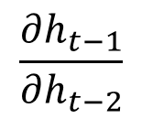

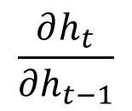

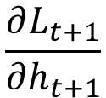

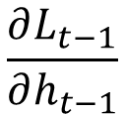




$$L_{t−1}$$
$$L_{t}$$
$$L_{t+1}$$
$$\frac{∂L_{t−1}}{∂h_{t−1}}$$
$$\frac{∂L_{t}}{∂h_{t}}$$
$$\frac{∂L_{t+1}}{∂h_{t+1}}$$
$$h_{t−1}$$
$$h_{t}$$
$$h_{t+1}$$
$$\frac{∂h_{t−1}}{∂h_{t−2}}$$
$$\frac{∂h_{t}}{∂h_{t−1}}$$
$$\frac{∂h_{t+1}}{∂h_{t}}$$
$$\frac{∂h_{t+2}}{∂h_{t+1}}$$
$$x_{t−1}$$
$$x_{t}$$
$$x_{t+1}$$

Slide 8
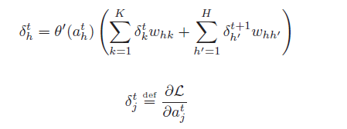

Let $W_{IH}$ ---- input to hidden weight matrix
${ W}_{HH}$ ---- hidden to hidden weight matrix
$x_{t}$ ---- input vector at time ‘t’, then
$h_{t}$ = $W_{IH}$ $x_{t}$ + $W_{HH}$ $h_{t−1}$ ---------------(1)
if T is the length of input sequence, then by applying (1) repeatedly from t=1 to T, we can get the hidden state activations ($h_{0}$ = 0)
Backward pass:
Using BPTT, start at t = T till t=1
$\frac{∂L}{∂w_{ij}}$ = $\sum_{t=1}^{T}{\frac{∂L}{∂{a_{j}}^{t}} \frac{∂{a_{j}}^{t}}{∂w_{ij}}}$ = $\sum_{t=1}^{T}{{{ δ}_{j}}^{t} {b_{i}}^{t}}$

Slide 9

Problem with RNN
Since the network is unfolded for many no’of time steps, when using BPTT, the gradients either explodes or vanishes. This problem is known as “Vanishing and exploding gradients problem”
Because of this training difficulty, RNNs are not suited for learning long-range temporal dependencies.
$h_{t}$ = $W_{IH}$ $x_{t}$ + $W_{HH}$ $h_{t−1}$
$h_{t}$ = $W_{IH}$ $x_{t}$ + $W_{HH}$ $(W_{IH} x_{t−1}\text{ + }W_{HH} h_{t−2})$
$h_{t}$ = $W_{IH}$ $x_{t}$ + $W_{HH}$ $(W_{IH} x_{t−1}\text{ + }W_{HH}(W_{IH} x_{t−2}\text{ + }W_{HH} h_{t−3}))$
$\frac{∂h_{t}}{∂h_{k}}$ = $\prod_{t≻i>k}{{ (W}_{HH})}$ = ${{ (W}_{HH})}^{t−k}$
Just like for a real number ‘a’ ; $a^{k}$ → $∞$ if a > 1 and $a^{k}$ → $0$ for a < 1 as k → $∞$

Slide 10

The term ${{ (W}_{HH})}^{t−k}$ → 0 as (t-k)→ large, if $ρ$ < 1 where $ρ$ is the spectral radius of the matrix ${ W}_{HH}$
Similarly ${{ (W}_{HH})}^{t−k}$ → $∞$ as (t-k)→ large, if $ρ$ > 1
$ρ\left(A\right)= \max_{λ}{\{\left|λ_{1}\right|,\left|λ_{2}\right|…\left|λ_{n}\right|\}}$ where A is an n x n matrix, $λ$ s are the eigen values
Gradient of weight $Θ$ , w.r.to loss function L is given by,
$\frac{∂L}{∂Θ}$ = $\sum_{t=1}^{T}{\frac{∂L_{t}}{∂Θ}}$
$\frac{∂L_{t}}{∂Θ}=\sum_{1≤k≤t}{\frac{∂L_{t}}{∂h_{t}}\frac{∂h_{t}}{∂h_{k}}}$ $\frac{∂h_{k}}{∂Θ}$
The only term through which error flows backward in time is $\frac{∂h_{t}}{∂h_{k}}$ and
$\frac{∂h_{t}}{∂h_{k}}={{ (W}_{HH})}^{t−k}$

Slide 11

So, the gradients either vanishes to 0 or explodes to $∞$ based on the spectral radius $ρ$
Even though all weights are initialized between -1 and 1, it doesn’t guarantee that the gradients will not explode
For e.g. Consider, A = $\left[\begin{matrix}2/3 & 2/3 \\ 2/3 & 2/3\end{matrix}\right]$ ; $A^{2}$ = $\left[\begin{matrix}8/9 & 8/9 \\ 8/9 & 8/9\end{matrix}\right]$
$A^{3}$ = $\left[\begin{matrix}128/81 & 128/81 \\ 128/81 & 128/81\end{matrix}\right]$ i.e $A^{k}$→ $∞$ as k → $∞$ because its eigen values are 4/3 > 1 with multiplicity 2
Since $\frac{∂h_{t}}{∂h_{k}}={{ (W}_{HH})}^{t−k}$ ; the problem occurs only for long-term components. i.e. terms for which (t-k) is large.

Slide 12
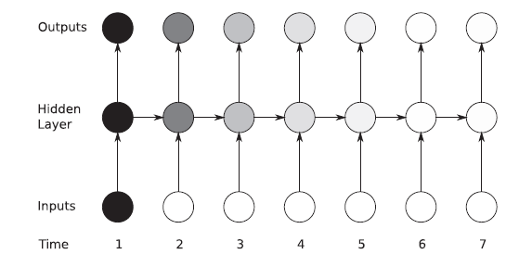
Sensitivity of inputs over time (RNN)

Slide 13

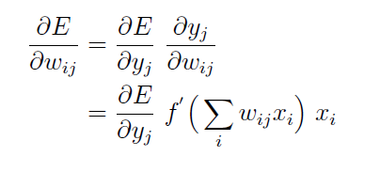

Change the activation function
Consider a simple NN, where Error ‘E’ depends on weights {$w_{ij}$} only through $y_{j}$
If we use sigmoid as an activation function, the max value of f’ is 0.25 and it’s almost zero for very small and very large inputs.

Slide 14
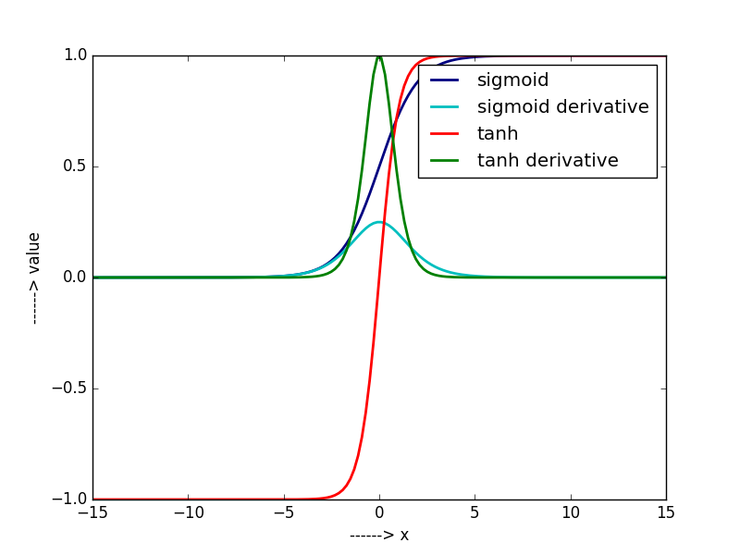

Slide 15

Hence, when the output of the cell is near to zero or one, gradients don’t propagate well back. This is called the saturation problem.
Because of this, it is much more difficult to train the below layers when compared to the outer ones.(gradients keep on decrease in size)
We can use other activations like tanh, which is better than sigmoid
One solution is to use ReLU activation function, which has the constant derivative of 1 for positive inputs. Hence the gradients won’t diminish over the layers
ReLU activation function

Slide 16
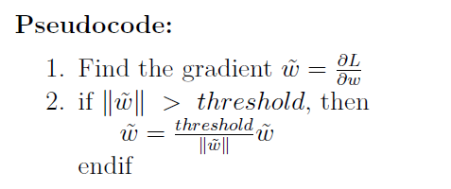
Scale the gradients
A simple way to manage exploding gradients problem is to rescale the gradients if the norm exceeds a particular value.

Slide 17
LSTM
LSTM(Long Short Term Memory)s motivated by the problem of capturing long-term dependencies in RNN
LSTMs are a version of RNN, with specific architecture proved to be effective in learning long-range time dependencies.
The LSTM architecture consists of a set of recurrently connected subnets, known as memory blocks.
Each block contains one or more self-connected memory cells and three multiplicative units—the input, output and forget gates
continuous analogues of write, read and reset

Slide 18
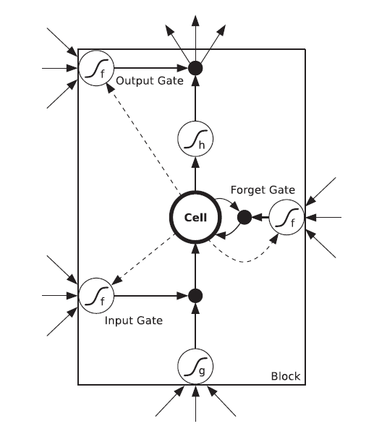
The multiplicative gates allow LSTM memory cells to store and access information over long periods of time, thereby mitigating the vanishing gradient problem.
For example, as long as the input gate remains closed the activation of the cell will not be overwritten by the new inputs arriving in the network, and can therefore be made available to the net much later in the sequence, by opening the output gate.
Total no’of parameters
I*H*4 + H*H*4 + H*K + H*3

Slide 19
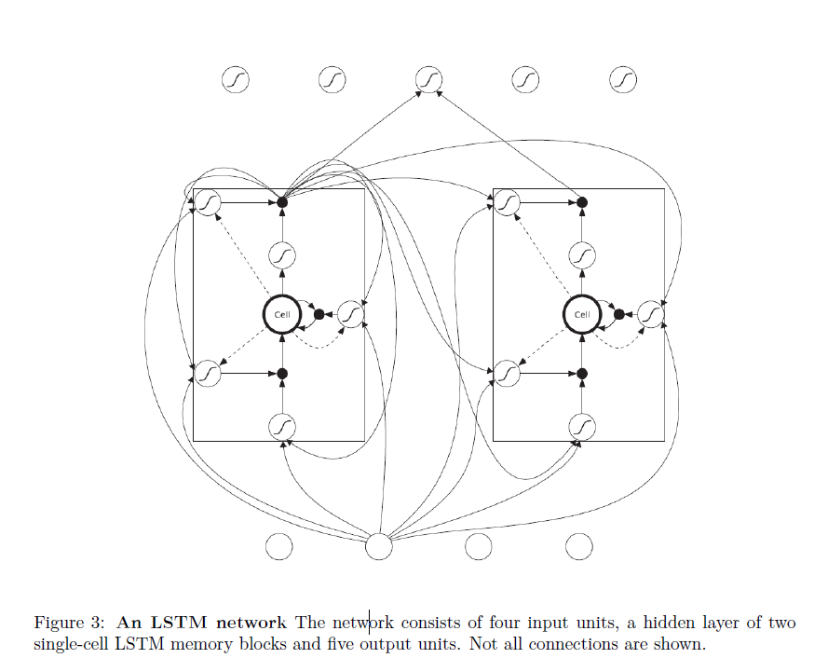

Slide 20
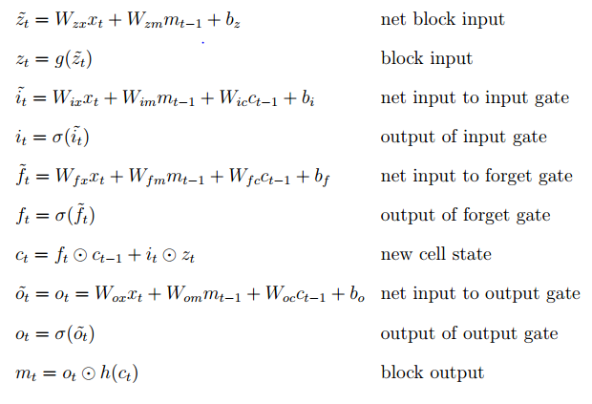
LSTM Equations

Slide 21

The only term through which error flows backward in time is $\frac{∂c_{t}}{∂c_{k}}$ , $k<t$and
$\frac{∂c_{t}}{∂c_{t−1}}$ = $\frac{∂(f_{t} ⨀{c_{t−1}})}{∂c_{t−1}}$ = $diag(f_{t})$ = $diag(σ(\tilde{f_{t}}))$
$\frac{∂c_{t}}{∂c_{k}}$ = $\prod_{t≥i>k}{diag(σ(\tilde{f_{i}})) }$
While this term can approach zero, there is no specific factor in it (i.e. some weight) which will drive the derivative to zero for very large time lags, i.e. for t >> k
This part is also safe from exploding, since each of the factors is it is bounded by 1 due to the activation function sigmoid.

Slide 22
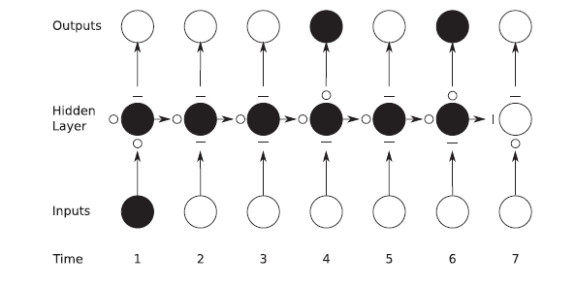
Sensitivity with time(LSTM)

Slide 23


Word embedding
Since we can’t directly input the words into the networks, we have to represent them in vector format
First form a vocabulary of words in the training set
Let V is the size of the vocabulary
Represent each word as using 1-of-V encoding
Let N be the size of embedding. Then project the V dimensional vector onto N dimensions using V x N weight matrix
So, the representation of the${ i}^{th}$ word is given by the ${ i}^{th}$ row of the matrix

Slide 24

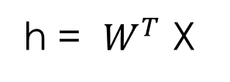










$$x_{1}$$
$$x_{2}$$
$$h_{1}$$
ENCODER
$$x_{3}$$
$$h_{2}$$
$$x_{k}$$
$$h_{i}$$
$$W_{V×N }=\{w_{ki}\}$$
h = $W^{T}$ X
$$h_{N}$$
$$x_{V}$$

Slide 25

Architecture
A simple strategy for general sequence learning is to map the input sequence to a fixed-sized vector using one RNN, and then to map the vector to the target sequence with another RNN
Input ($x_{1}$, $x_{2}$, $x_{3}$….. $x_{T}$), output ($y_{1}$, $y_{2}$, $y_{3}$….. $y_{T^{′}}$)
P($y_{1}$, $y_{2}$, $y_{3}$….. $y_{T^{′}}$ / $x_{1}$, $x_{2}$, $x_{3}$….. $x_{T}$ ) = P($y_{1}$, $y_{2}$, $y_{3}$….. $y_{T^{′}}$ / $θ$)
= $\prod_{t=1}^{T^{′}}{\text{P}\text{(}y_{t} \text{/ }θ,y_{1}\text{, }y_{2}\text{….. }y_{t−1}\text{) }}$
Encoder ($x_{1}$, $x_{2}$, $x_{3}$….. $x_{T}$) -------- $θ$
Decoder -------- predicts $\text{P}\text{(}y_{t} \text{/ }θ,y_{1}\text{, }y_{2}\text{….. }y_{t−1}\text{)}$

Slide 26
GO
Question
Thought
Vector
Tokenizer
words
Encoder
(RNN)
Decoder
(RNN)
logits
Output projection
probabilities
Feed_previous
While training, Feed_previous = False
While testing, Feed_previous = True

Slide 27


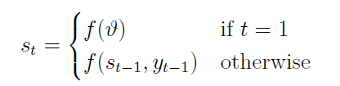

Basic Model
Encoder is modelled using an RNN/LSTM, such that ($x_{1}$, $x_{2}$….. $x_{T}$) --------- > $θ$
Here $θ$ = q($h_{1}$, $h_{2}$……$h_{T}$) = $h_{T}$
With decoder RNN/LSTM, this conditional probability distribution can be modeled as
where g is a nonlinear, potentially multi-layered, function that outputs the probability of $y_{t}$ , $s_{t}$ is the hidden state of decoder at time ’t’, given by

Slide 28




Model with attention
Includes the attention mechanism.
Allows the decoder to peek at input at every time step while decoding.
Here the conditional probability is modeled as
where $s_{t}$ is the hidden state of the decoder at time t, given by
where $c_{t}$ is the context vector for symbol $y_{t}$. Unlike the basic model, here the probability is conditioned on different context vector for each symbol.
Context vector depends on the sequence of encoder hidden states ($h_{1}$, $h_{2}$……$h_{T}$)

Slide 29

















$$y_{t−1}$$
$$y_{t}$$
$$s_{t−1}$$
$$s_{t}$$
$$c_{t}$$
$${α }_{t1}$$
$${α }_{t2}$$
$${α }_{tT}$$
$${α }_{t3}$$
$$h_{1}$$
$$h_{2}$$
$$h_{3}$$
$$h_{T}$$
$$x_{1}$$
$$x_{2}$$
$$x_{3}$$
$$x_{T}$$

Slide 30




weights $α_{tj}$ is given by
where
$e_{tj}$ is a score of how well the input at position ’j’ and output at position ’t’ match.
Alignment model a can be modeled as a feed forward neural network.
The vector v, matrices W1, W2 are the learn-able parameters of the model.

Slide 31
Scheduled sampling
While training, we provide the current token to the decoder to predict the next token
While inference, current token is considered to be the one generated by the model itself.
So, if the model makes a mistake early in the sequence, there is a chance that the error is propagated to the next time steps and it gets accumulated.
This happens mainly because of the discrepancy between training and testing methods.
To make the model robust to its errors, proposed a strategy which is scheduled sampling.

Slide 32
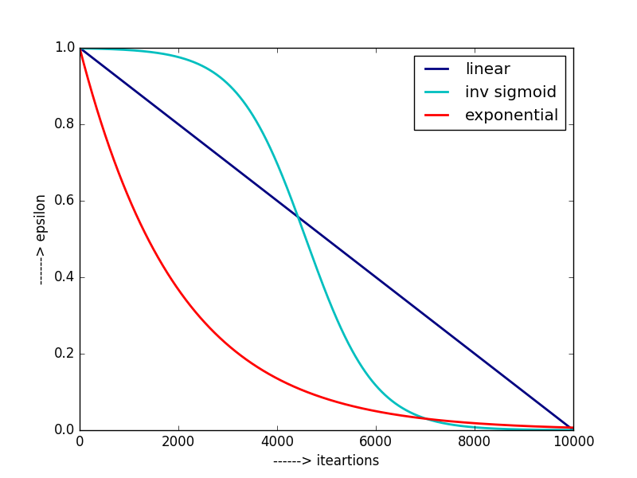

Slide 33

According to this strategy, choose the true token at the $i^{th}$ iteration with probability $ε_{i}$, and the estimate coming out of model with probability (1-$ε_{i}$)
Where estimate at time t-1 is
arg $\max_{s}{P\left(y_{t−1}=s ;s_{t−1}\right)}$
And the strategy is to reduce it as ‘i’ increases. In this way, we can sample more from the estimates as the training progresses, which makes the model ready for the inference.
Some of the strategies are
Linear $ε_{i}$ = max ($ε,$k- c.i) ; $0≤ε$ < 1; k, c decides the rate of convergence
Exponential $ε_{i}$ = $k^{i}$; k < 1

Slide 34
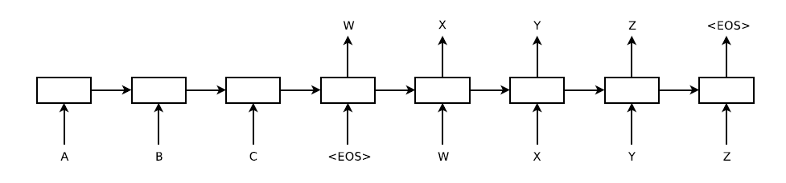
Dataset
The training data consists of source sentence and the corresponding response.
answer ------- ‘GO’ + answer + ‘EOS’
Each question and answer lengths are limited to certain length. for e.g. (20,20)
Since, it allows us for batch processing and we can use matrix operations.

Slide 35
Training
Consider the translation ABC → WXYZ.
The encoder inputs would be A, B, C in sequence.
Decoder inputs would be GO, W, X, Y, Z.
Outputs of the decoder expected at each time step would be W, X, Y, Z, EOS.
The output of the decoder at time ’t’ is fed back to the decoder, to predict the word at time ’t+1’.
provide the correct input to the decoder at every time-step, even if the decoder made a mistake before.
Prepare the vocabulary of most frequent words from both the source and target files.
Embed the words before feeding into encoder.

Slide 36

Generate the ‘thought vector’ (final encoder state).
Thought vector is considered as the initial hidden state of the decoder.
Now, feed the decoder inputs one after the other.
Decoder generates an array of V’ values, each corresponds to the logits of the vocabulary on the target side.
Output of the decoder gives logits (range (-$∞,$ $∞$))
After output projection
probabilities = softmax( logits*W + b)
Cross entropy error (Perplexity) = -$\sum_{ k ∈V}{(z_{k} \log{y_{k}})}$
Back propagate the error to jointly make changes in the encoder and decoder parameters

Slide 37

During testing, start with ‘GO’ until we generate ‘EOS’
Encoder and decoder jointly work together to maximize the probability of output sequence given the input sequence
Training objective is to maximize
$\frac{1}{\left|S\right|}$ $\sum_{\left(t,s\right) € S }{\log{P(t/s)}}$
P($y_{1}$, $y_{2}$, $y_{3}$….. $y_{T^{′}}$ / $x_{1}$, $x_{2}$, $x_{3}$….. $x_{T}$ ) = P($y_{1}$, $y_{2}$, $y_{3}$….. $y_{T^{′}}$ / $θ$)
= $\prod_{t=1}^{T^{′}}{\text{P}\text{(}y_{t} \text{/ }θ,y_{1}\text{, }y_{2}\text{…}\text{.. }y_{t−1}\text{) }}$
log P($y_{1}$, $y_{2}$, $y_{3}$….. $y_{T^{′}}$ / $x_{1}$, $x_{2}$, $x_{3}$….. $x_{T}$ ) = $\sum_{t=1}^{T′}{\log{\text{P}\text{(}y_{t} \text{/ }θ,y_{1}\text{…}\text{.. }y_{t−1}\text{)}}}$
Most likely o/p sequence = $\underset{t}{arg max}{\log{P(t/s)}}$

Slide 38


Evaluation measures
Perplexity
Let N be the length of sequence, then
Where, ${target}_{i}$is the target word at the $i^{th}$ position.
It is nothing but the average of cross entropy loss over the sequence
Perplexity = exp(loss)

Slide 39
Experiments with cornell movie dataset
Has conversations from 617 movies.
Conversational exchanges between 10,292 movie characters.
After pre-processing, able to extract 1,30,000 one-to-one (Q,A) pairs.
For simplicity, (Q,A) pair length is limited to (10, 15)

Slide 40
Here are the model parameters used
vocabulary side --------------------> 25,000 (both source and target sides)
word embedding size ------------> 32
num of layers -----------------------> 2
num of cells in each layer -----> 512
batch size ----------------------------> 10
num of iterations -------------------> 47,500
learning rate (initial) --------------> 0.5

Slide 41
Sample conversation
human: hello
machine: hello
human: how are you?
machine: i 'm fine
human: who made you?
machine: you
human: are you human?
machine: no
human: are you a robot?
machine: yes
human: are you male?
machine: no
human: are you female?
machine: yes
human: will you come to movie with me?
machine: i will
human: what time is okay with you?
machine: eight
human: where do you live?
machine: i do n't know
human: what's your age?
machine: you know
human: how old are you?
machine: i 'm fine
human: are you woman?
machine: no
human: are you man?
machine: yes

Slide 42
Not much change in perplexity is observed using the attention mechanism.
The conversation above suggests that the model can converse with a human fluently.
Since the model is trained for one-to-one mapping, it is unable to take into account the previous sentences while conversing. Hence, the model is not good at maintaining the context.
It can also be seen from the conversation that the model lacks the personality and its responses are inconsistent.
This is because of using the noisy, open-domain dataset that is used to train the model.
This lack of consistent personality makes it difficult to pass the Turing test.

Slide 43
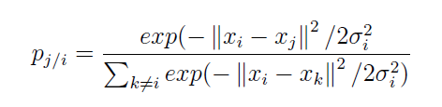

SNE
Stochastic Neighbor Embedding
Dimensionality Reduction Technique
Objective is to model similar objects by nearby points and dissimilar objects by distant points.
X = {${\text{x}}_{1}$, ${\text{x}}_{2}$ … ${\text{x}}_{n}\}$ are high dimensional data points and Y = {${\text{y}}_{1}$, ${\text{y}}_{2}$ … ${\text{y}}_{n}\}$ are low-dimensional data points
It first coverts the distances between data points in high dimensional space to joint probabilities
Where ${\text{σ}}_{i}$ is the variance of the Gaussian centered at ${\text{x}}_{i}$, ${\text{p}}_{j/i}$ is the probability of ${\text{x}}_{i}$ picking ${\text{x}}_{j}$ as neighbor.

Slide 44
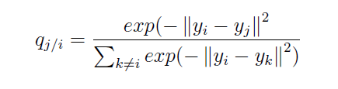
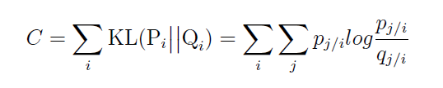

${\text{σ}}_{i}$ will vary according to the density of data points around ${\text{x}}_{i}$(if the region around ${\text{x}}_{i}$ is dense ${\text{σ}}_{i}$ will be low and vice versa).
We are only interested in modelling pairwise similarity, so set ${\text{p}}_{i/i}$ = ${\text{q}}_{i/i}$ = 0
Our aim is to make the conditional probabilities ${\text{p}}_{j/i}$, ${\text{q}}_{j/i}$ similar. i.e. we have to reduce the difference between them, using KL divergence.
Where ${\text{P}}_{i}$ is the conditional probability distribution over all data points given ${\text{x}}_{i}$

Slide 45
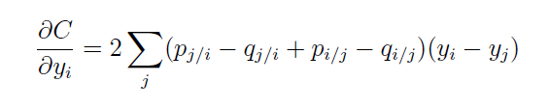

The gradient is computed to be
Gradient is proportional to the mismatch of the similarities between data points and map points.
Using Gradient descent, we can compute ${\text{y}}_{i}$over iterations.
This technique was used to project 128 dimensional vectors that are obtained out of encoder RNN, onto a 2 dimensional space.
Similar sentences are supposed to be clustered on the 2d space because their vector similarity is more

Slide 46
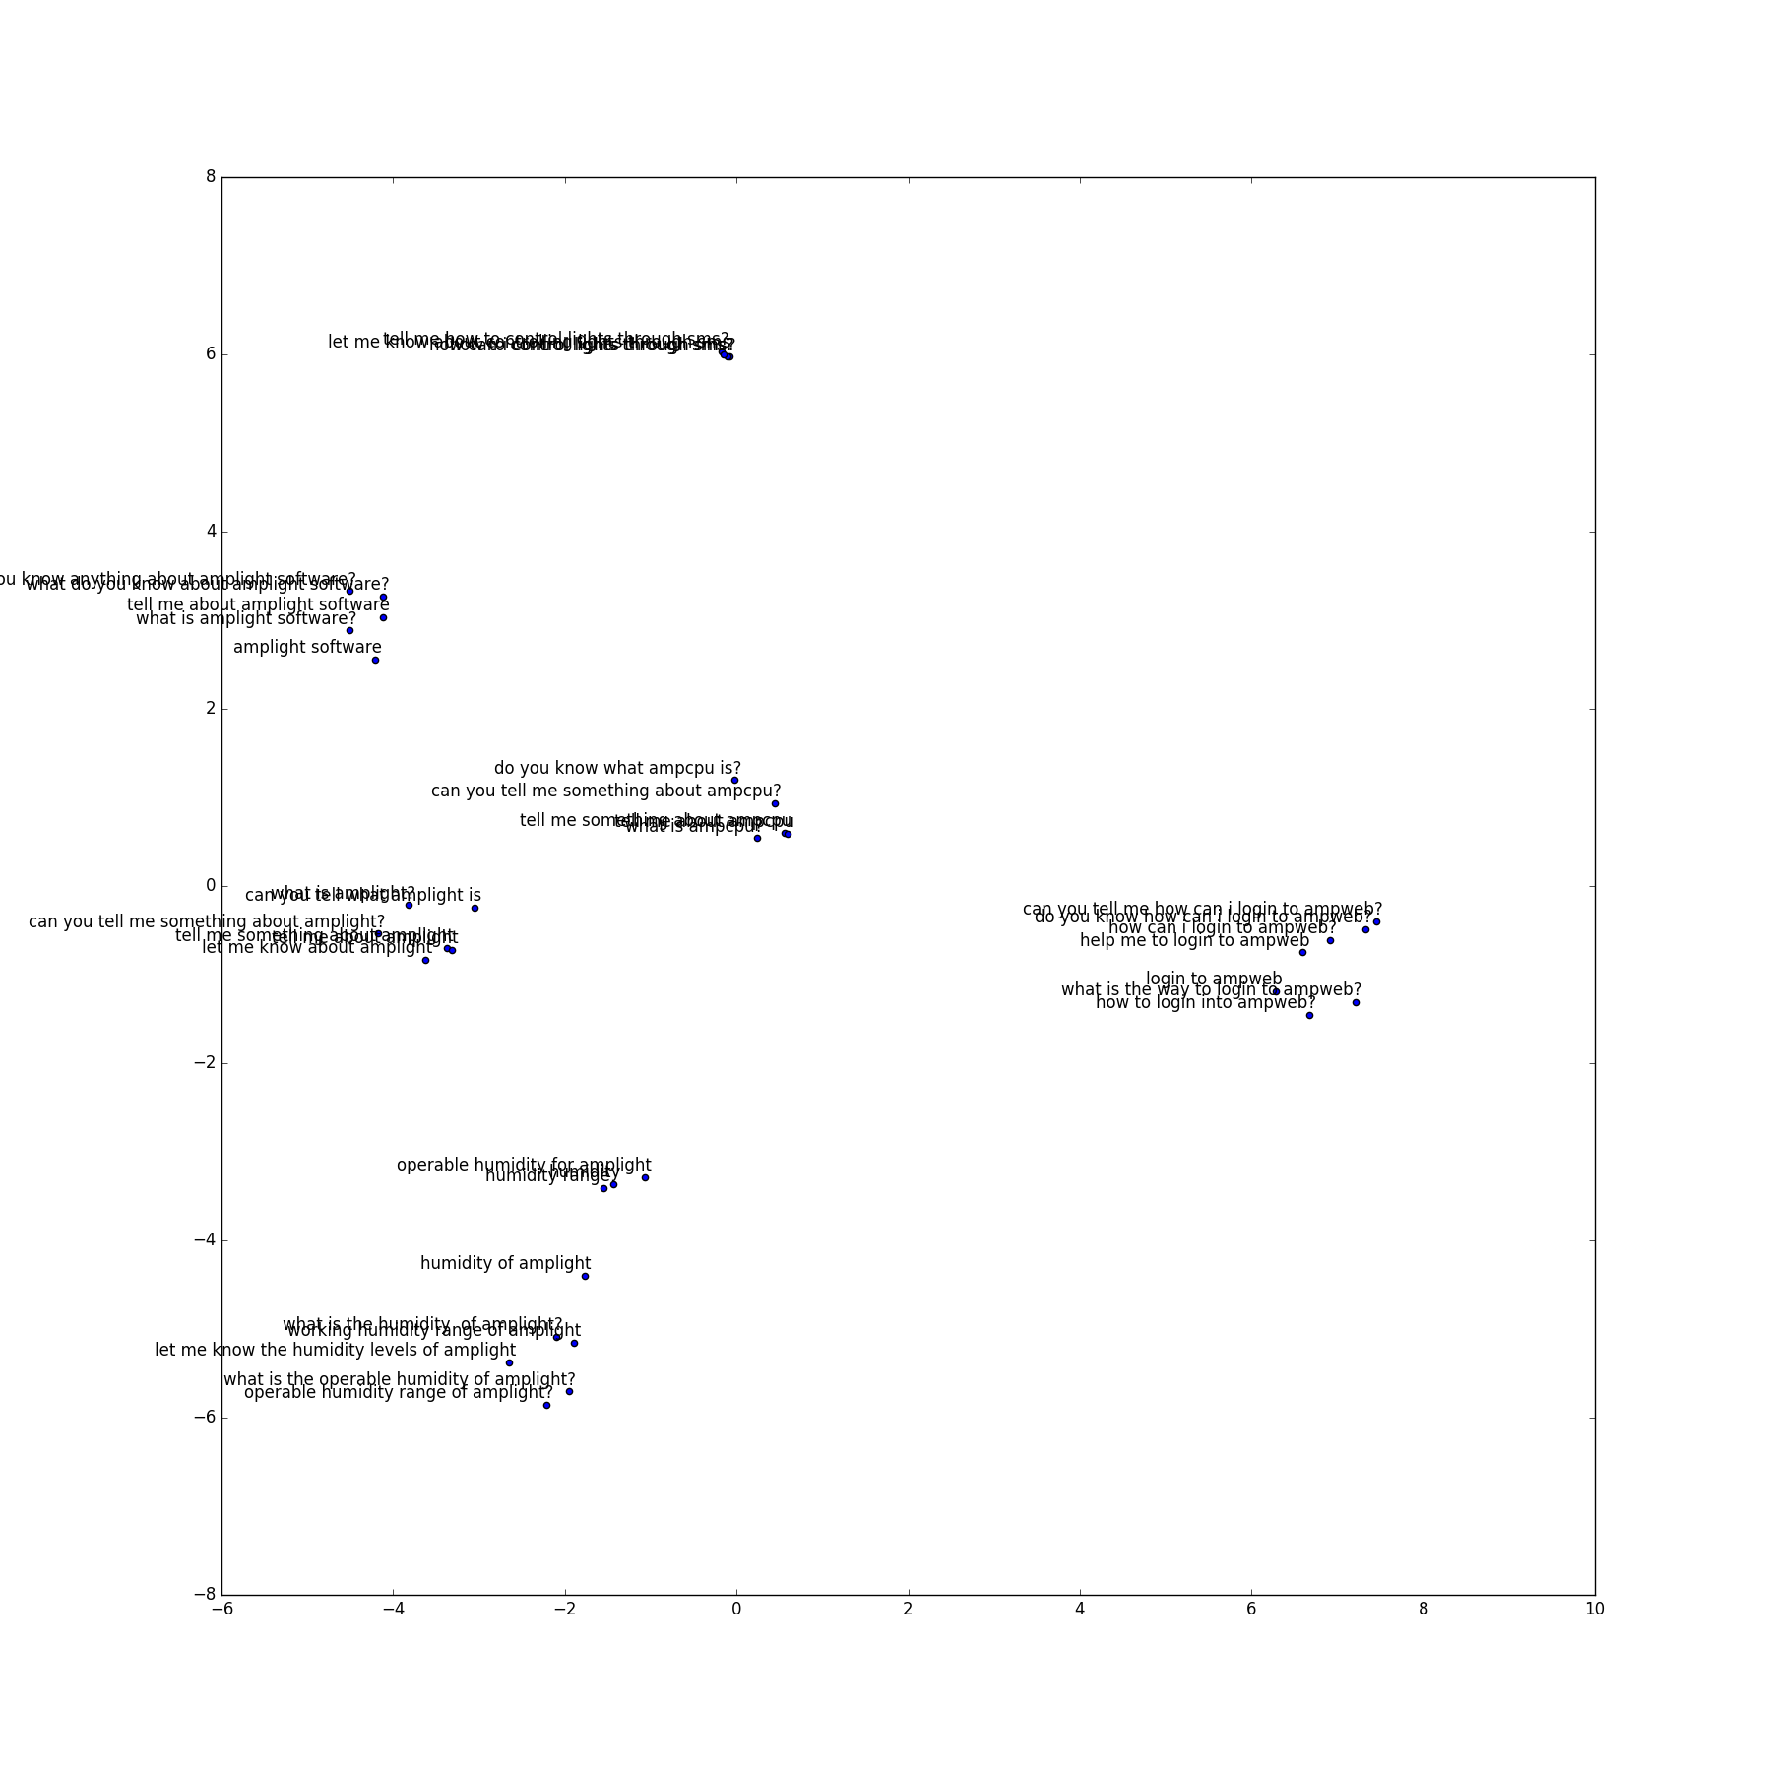

Slide 47
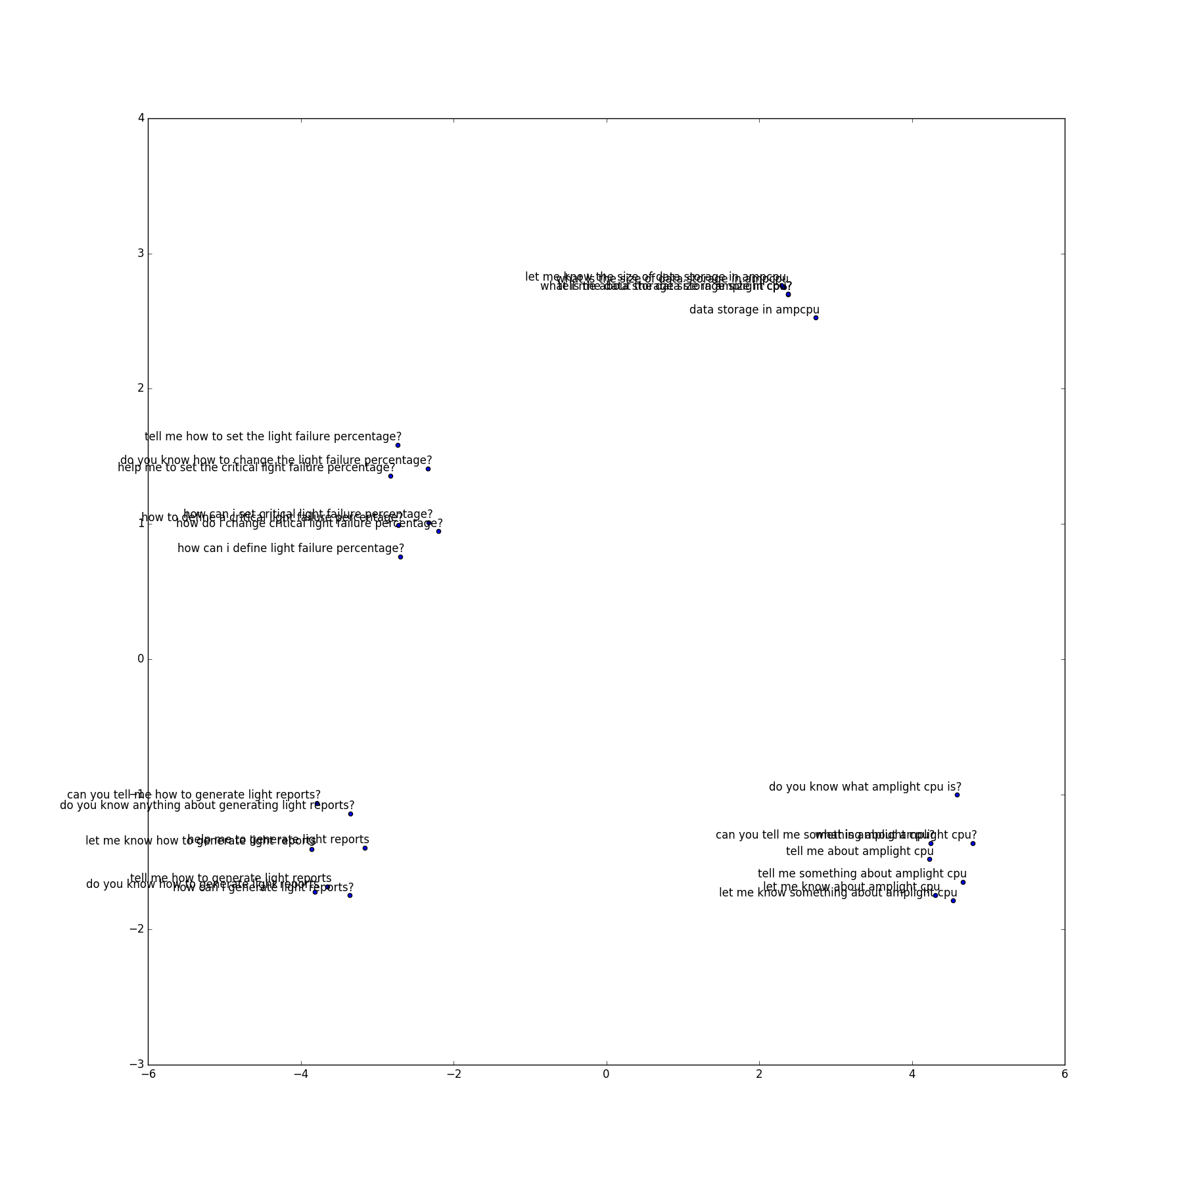

Slide 48


BLEU Score
Bi Lingual Evaluation Understudy
Evaluation metric for Machine translation.
Based on modified n-gram precision.
Language independent,
Operate on local level , doesn’t take grammatical correctness into account
Where

Slide 49
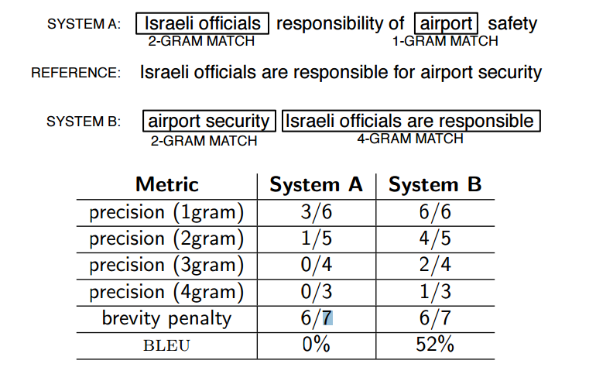

$p_{n}$ is the modified n-gram precision, which is the number of n-grams in the candidate translation that occur in any of the reference translations, out of total number of n-grams in the candidate translation.
For N=4, the score is found to be in much correlation with the human judgement.

Slide 50
TIDES-IIIT Eng-Hin parallel corpus
DARPA-TIDES released in 2002 for SMT
Later refined by (Venkatapathy, 2008) for NLP tools Contest.
“ the translations are not faithful. They are paraphrased in such a way that they convey the meaning in the best possible way. i.e they are not the exact translations ”
50k training, 1k validation
Limited the length to 30
33k used for training, 716 for validation

Slide 51
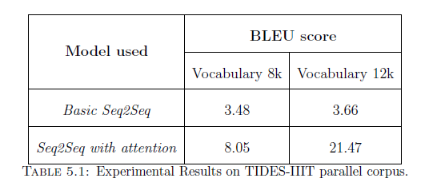
Number of layers 2
Number of cells(LSTM) 512
Batch size 32
Scheduled sampling with exponential decay after 50k iterations resulted a BLEU score of 23.13 on training set

Slide 52
Seqseq model with attention mechanism has boosted the performance of the translation model.
Even though scheduled sampling achieved an improvement in the model performance, the choice of decay schedule has proved to be crucial.
Using the scheduled sampling from the beginning of the training has deteriorated the performance of the model.
Hence it is suggested to use a decay schedule which decreases slowly and is better to use it after certain number of iterations.

Slide 53
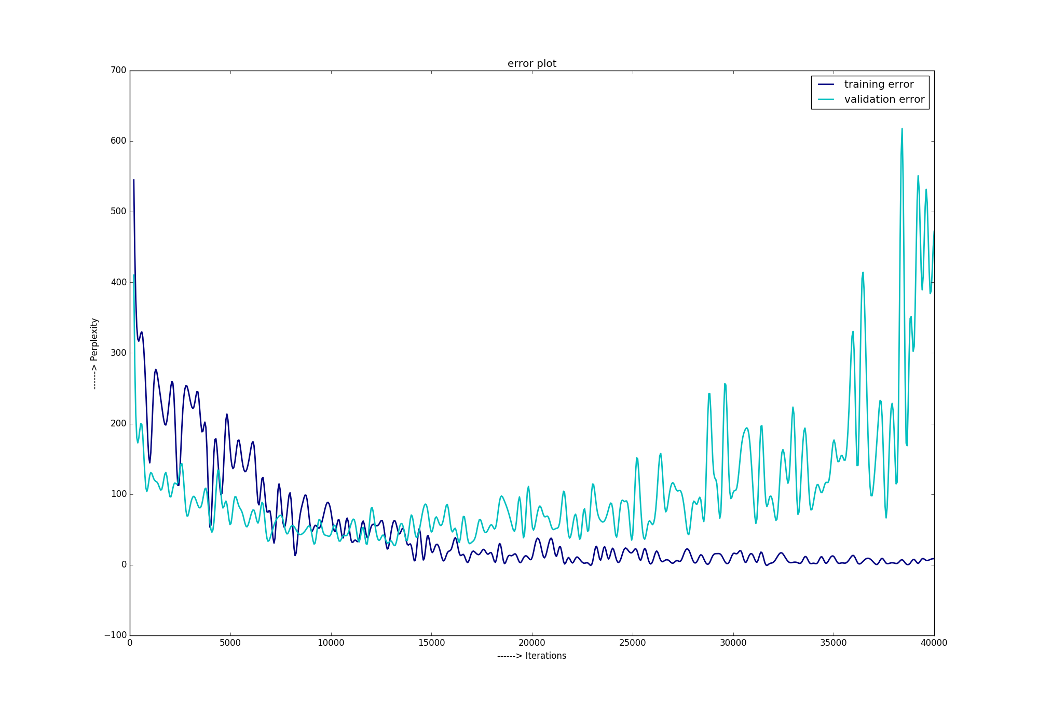
Overfitting of the model to the training data

Slide 54
Conclusions
Seq2Seq models learn the semantic and syntactic relations between the source and target sentence pairs by maximizing the likelihood of the target sentence given the source.
Attention mechanism is useful in learning the alignment between the source and target words in MT task rather than on a mere question-answering task.
Scheduled sampling has resulted in the performance improvement of the model, but one should choose a proper decay schedule, otherwise it could lead to a bad model.
The projections of the thought vectors from an encoder network onto 2D space indicates that the model generates similar thought vectors for similar questions

Slide 55
Future works
Instead of modelling only uni-directional source-to-target dependency P(Y/X), we can model source-to-target dependency P(X/Y).
We can use Bi-directional RNN or Bi-directional LSTMs.
Evaluation metrics doesn’t take grammatical correctness into account. Doesn’t correlate much with human judgement. New evaluation metrics can be explored.
Instead of using the random word embeddings, we can use the word vectors obtained from a language model so that it can speed-up the training process.
Multi-tasking can be mixed with Seq2Seq models like using a shared encoder to translate into multiple languages from the source language.

Slide 56
THANK YOU

