Slide 1
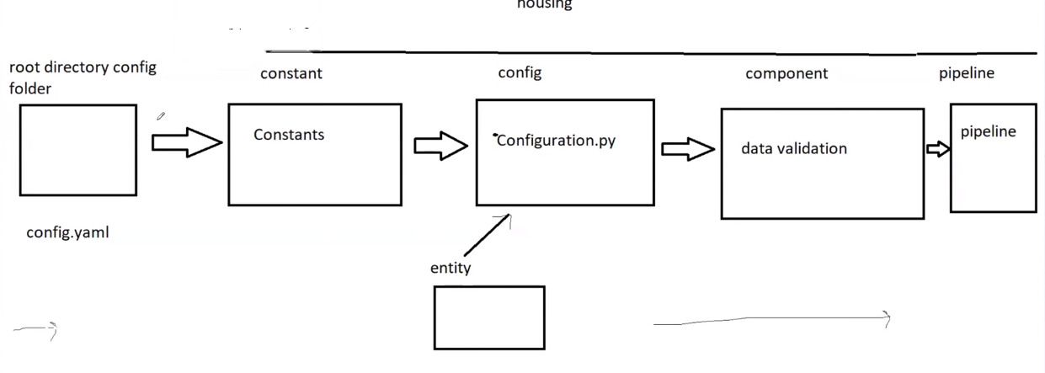

Slide 3
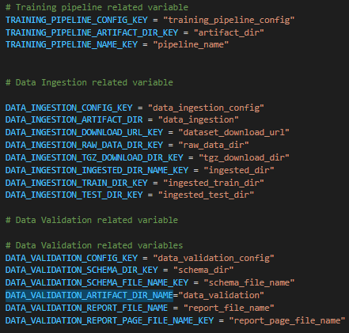
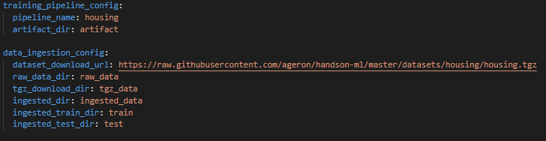
Root Directory
Config folder
config.yaml → This file contains all file names , path names, pipe line name.
Also this file name is linked with Housing>Constant>_init_.py file.
All the keys of config.yaml is defined against variable in Housing>Constant>_init_.py
This structure is followed so that we do not need to hardcode file name , path, random state , ML algo. Parameter etc. We just need to update config.yaml file if we want to change any file name or path.
Housing>Constant>_init_.py
Config.yaml

Slide 4
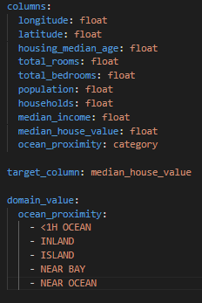
Root Directory
Config folder
schema.yaml → This file contains data set schema.
We can use this schema for data validation , data ingestion
In schema all the column names are mentioned. Also all Categorical variable are mentioned.
We can also add name of additional column to be created in dataset for EDA, Data Validation ,Feature engineering
Housing>Constant>_init_.py

Slide 5
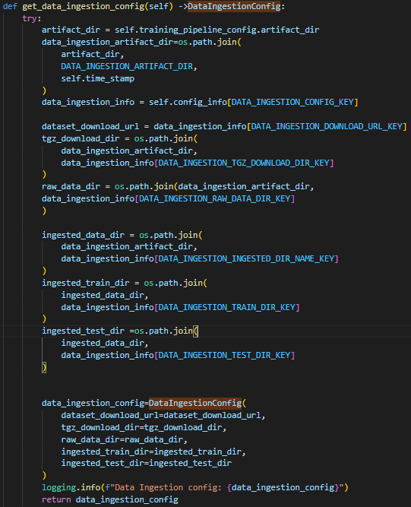
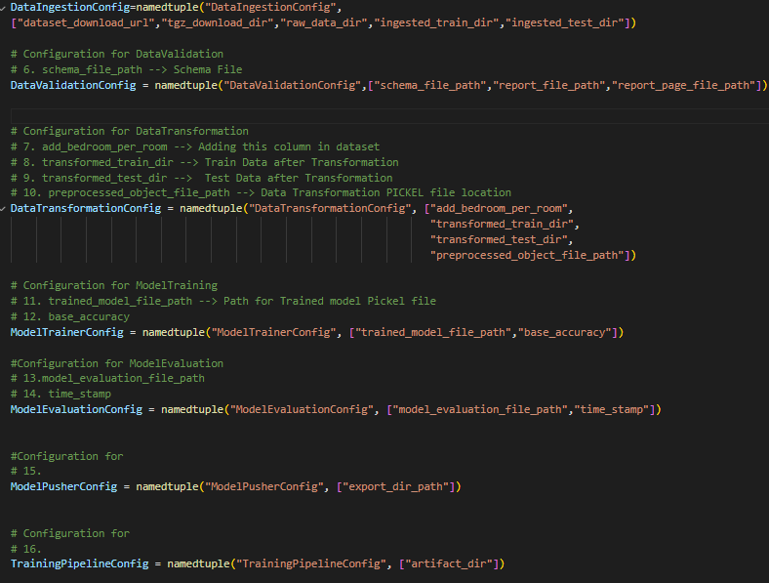
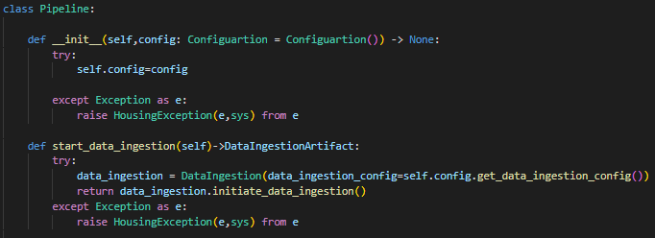
Root Directory
Housing (Project Folder)
Entity Folder
Config_entity.py → In this file we defined data structure of various configuration.
Here we are creating blank structure using NamedTuple .
i.e. For DataIngestionConfig we need following thins : 1. dataset_download_url 2. tgz_download_dir 3. ingested_train_dir 4.ingested_test_dir
DataIngestionConfig is just a structure now we can create variable and push above mentioned details in newly created variable
Housing>config>configuration.py
Housing>Entity>config_entity.py
Creating Variable which follow structure of DataIngestionConfig mentioned in Entity>config_entity.py
This variable is created using reading config.yaml with the use of constant defined in constant.py
Now whenever we call
get_data_ingestion_config() function
from data ingestion pipe line
in return we are sending back
data_ingestion_config data
with defined structure
Here we are using
structure created in
config_entity.py to
create new variable in
config>configuration.py
Housing>pipeline>pipeline.py

Slide 6
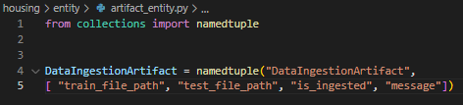
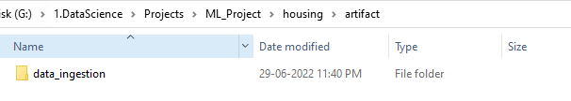
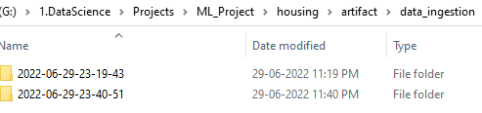
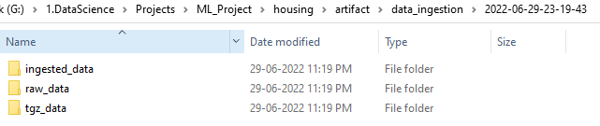
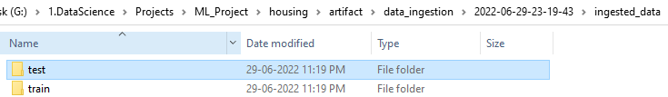
Root Directory
Housing (Project Folder)
Entity Folder
artifact_entity.py → Similar to config_entity.py but this file is for structure of artifact
Artifact is output of pipeline. i.e. test_data,train_data,EDA graphs etc
Housing>Entity>artifact_entity.py

