Slide 1
Airflow + Data Pipeline
A workshop by
Dinesh Kumar Subramanian
Founder, DTeam

Slide 2
About DTeam
AI Company
JS, Python
Based in Chennai
Enlightenment

Slide 3
About Me
Founder DTeam
AI & Fullstack
Twitter: @ortist
Apps: Wizhi, Ortist, Ship Mining
Founder@ Dreampp, Dreamcards, Dreamstudio

Slide 4
Getting Started with Airflow

Slide 5
Airflow
What is Airflow
Why Airflow
What is DAG
Tasks
Operators
Sensors
Plugins
Airflow UI walkthrough

Slide 6
What is Airflow
Apache Airflow is an open-source tool for orchestrating complex computational workflows and data processing pipelines.
Created by Airbnb in 2015 now accepted as part of Apache

Slide 7
Why Airflow
Dynamic: Airflow pipelines are configuration as code (Python), allowing for dynamic pipeline generation. This allows for writing code that instantiates pipelines dynamically.
Extensible: Easily define your own operators, executors and extend the library so that it fits the level of abstraction that suits your environment.
Elegant: Airflow pipelines are lean and explicit. Parameterizing your scripts is built into the core of Airflow using the powerful Jinja templating engine.
Scalable: Airflow has a modular architecture and uses a message queue to orchestrate an arbitrary number of workers. Airflow is ready to scale to infinity.

Slide 8
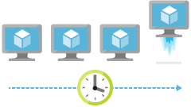
When to use Airflow

Slide 9
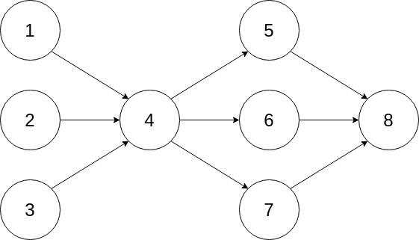
DAGs or Pipelines

Slide 10
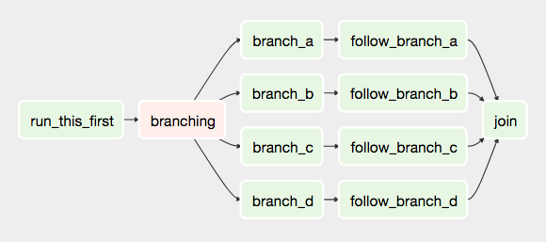
Airflow Pipeline DAG
Apache Airflow is an open-source tool for orchestrating complex computational workflows and data processing pipelines.
Created by Airbnb in 2015 now accepted as part of Apache

Slide 11
Airflow Architecture
Airflow DAGs are composed of Tasks.
Each Task is created by instantiating an Operator class. A configured instance of an Operator becomes a Task, as in: my_task = MyOperator(...).
When a DAG is started, Airflow creates a DAG Run entry in its database.
When a Task is executed in the context of a particular DAG Run, then a Task Instance is created.
AIRFLOW_HOME is the directory where you store your DAG definition files and Airflow plugins.

Slide 12
Installing Airflow
pip install apache-airflow
mkdir airflow_home
export AIRFLOW_HOME=`pwd`/airflow_home
Can also installed with additional packages
pip install "apache-airflow[s3, postgres]"

Slide 13
Airflow UI Walkthrough

Slide 14
Your first Airflow DAG
from datetime import datetime from airflow import DAG from airflow.operators.dummy_operator import DummyOperator from airflow.operators.python_operator import PythonOperator def print_hello(): return 'Hello world!' dag = DAG('hello_world', description='Simple tutorial DAG', schedule_interval='0 12 * * *', start_date=datetime(2017, 3, 20), catchup=False) dummy_operator = DummyOperator(task_id='dummy_task', retries=3, dag=dag) hello_operator = PythonOperator(task_id='hello_task', python_callable=print_hello, dag=dag) dummy_operator >> hello_operator

Slide 15
Airflow Operator
An Operator is an atomic block of workflow logic, which performs a single action.
Operators are written as Python classes (subclasses of BaseOperator)
Where the __init__ function can be used to configure settings for the task
A method named execute is called when the task instance is executed.

Slide 16
Airflow Operator
We’ll create your first operator in an Airflow plugin file named plugins/my_operators.py.
First create the airflow_home/plugins directory, then add the my_operators.py

Slide 17
Airflow Operator
import logging from airflow.models import BaseOperator from airflow.plugins_manager import AirflowPlugin from airflow.utils.decorators import apply_defaults log = logging.getLogger(__name__) class MyFirstOperator(BaseOperator): @apply_defaults def __init__(self, my_operator_param, *args, **kwargs): self.operator_param = my_operator_param super(MyFirstOperator, self).__init__(*args, **kwargs) def execute(self, context): log.info("Hello World!") log.info('operator_param: %s', self.operator_param) class MyFirstPlugin(AirflowPlugin): name = "my_first_plugin" operators = [MyFirstOperator]

Slide 18
Testing Operator
Now, we’ll need to create a new DAG to test our operator.
Create a dags/test_operators.py file

Slide 19
Testing Operator
from datetime import datetime from airflow import DAG from airflow.operators.dummy_operator import DummyOperator from airflow.operators import MyFirstOperator dag = DAG('my_test_dag', description='Another tutorial DAG', schedule_interval='0 12 * * *', start_date=datetime(2017, 3, 20), catchup=False) dummy_task = DummyOperator(task_id='dummy_task', dag=dag) operator_task = MyFirstOperator(my_operator_param='This is a test.', task_id='my_first_operator_task', dag=dag) dummy_task >> operator_task

Slide 20
Debugging Airflow Operator
Debugging would quickly get tedious if you had to trigger a DAG run and wait for all upstream tasks to finish before you could retry your new operator.
Airflow has the airflow test command, which you can use to manually start a single operator in the context of a specific DAG run.
The command takes 3 arguments: the name of the dag, the name of a task and a date associated with a particular DAG Run.

Slide 21
Testing Airflow Operator
name of the dag
name of the task
Date Associated with particular DAG Run
airflow test my_test_dag my_first_operator_task 2017-03-18T18:00:00.0

Slide 22
More on Airflow
Airflow Sensor
An Airflow Sensor is a special type of Operator, typically used to monitor a long running task on another system.
Communicating between operators with Xcom

Slide 23
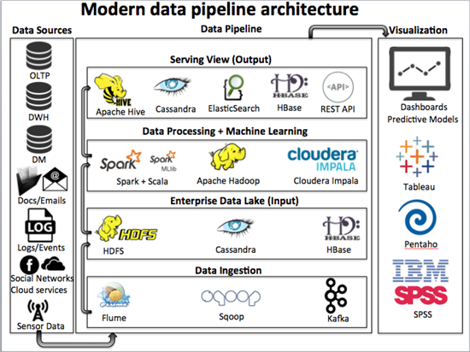

Slide 24
Data Ingestion
Flume Sqoop kafka

Slide 25
Distributed File Systems
Hbase:
Distributed column oriented db built on top of HDFS designed to perform an Data lake not suitable for web, mobile
Cassandra:
Distributed NOSQL Database

Slide 26
Workflow Management tools
Airflow lugi azkaban oozie

Slide 27
SQL Engines / Hadoop engines
Redshift:
Hive:
Great amount of stability
Impala:
Many concurrent users
Spark:
Billions and billions of rows with more joins
Presto:
Many concurrent users

Slide 28
HDFS Data Storage Formats
Parquet:
Column based storage format
Avro:
Row based storage format
Avro is a RPC and Data stabilization framework

Slide 29
Cluster Managers
Yarn:
Created as a necessity to move hadoop Map reduce API to next iteration and life cycle
Zookeeper:
Mesos:

Slide 30
Container Orchestration
Mesos Docker kubernetes

Slide 31
HIVEQL PIG
---> High level platform for creating programs that run on hadoop
---> Can do all required data manipulation in Hadoop
---> Pig can execute hadoop jobs in mapreduce, Apache tez or Apache spark
---> Enables data workers to write complex data transformations

Slide 32
Questions?

Slide 33
AI Workshop

Slide 34
AI - 2 Day Workshop
Introduction to python
Intro to Jupyter Notebooks
Numpy Essentials
Data Visualisation
Exploring Data with Pandas
Data Accusation
Cleaning and preparing Data
Introduction to ML
Getting started with Math for ML
ML with Scikit Learn
Introduction to DL
Understanding Perceptron
Decoding Back Propagation
DL with Tensorflow

Slide 35
Introduction to Python
Data types
Control structures
Code organization
File I/O read/write
Overview of OOP
list comprehensions
Generator expressions

Slide 36
Introduction to jupyter Notebook
ipython shell/jupyter notebook
Latex
Inserting videos
Magic tool

Slide 37
Numpy Essentials
Numpy Array
N-dimensional Array
Memory mapped Files

Slide 38
Data Visualization(matplotlib)
2D plotting with matplotlib
Advanced data Visualization with seaborn/d3.js

Slide 39
Exploring Data with Pandas
Data Manipulation
Statistical Analysis
Time series Analysis
I/O operation
1D and 2D Data structures(series and data frame)
Data alignment, aggregation and summarization
Computation and analysis
Dealing with dates and times/Visualization

Slide 40
Exploring Data with Pandas(contd)
DB-AP12 and SQL Alchemy
Execute sql commands from pandas
Loading DB data into a data frame
Combining and manipulating data frames
Merge, join and concatenate

Slide 41
Data Accusation
Accessing Data from multiple sources
Local Files/All file types
Remote files
Web scrapped data
Many powerful read-table method

Slide 42
Cleaning and preparing Data
Indexing, slicing, fancy indexing and boolean indexing
Data wrangling, dealing with missing data
Adding, dropping, selecting, creating and combining rows and columns

Slide 43
Introduction to ML
Linear and non linear models
Constant and variable learning rates
Cost functions, regularization methods and other constants
Fitting, transforming and predicting

Slide 44
Calculus
Linear Algebra
Probability and Statistics
Hypothesis Testing
Optimization
Mean and STD norm
Theta
Conditional probability
Getting started with Math for ML

Slide 45
ML with SciKit Learn
Data Pipeline
Pre Processing data
Regression
Classification
Model Selection

Slide 46
Questions?

Slide 47
Academy for AI

Slide 48
Thank You

