Slide 1
Machine Learning & Deep Learning
Getting Started
Dinesh Kumar Subramanian
Founder, DTeam

Slide 2
About DTeam
AI Company
JS, Python
Based in Chennai
Enlightenment

Slide 3
About Me
B-Tech IT (2004) - VIT, Vellore
MS - HCI and Data Mining - U of I, Chicago
Founder DTeam
AI & Full-Stack
Twitter: @ortist
Apps: Wizhi, Ortist, Ship Mining, IPC Notes
Founder@ DreamApp, DreamCards, DreamStudio

Slide 5
Machine Learning
The art of finding patterns

Slide 6
Its All About
Data

Slide 7
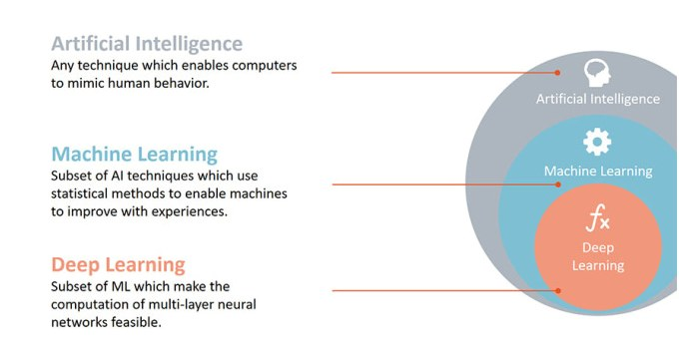

Slide 8
What is Machine Learning
The field of study that gives computers the ability to learn
without being explicitly programmed

Slide 9
1. Email Spam Detection
2. Face recognition
3. Speech recognition
4. Computer Vision and Image classification
5. Self-Driving cars/Driverless cars
6. Advertisements (Google Ad sense, sponsored ads)/Recommendations engines
7. Anti-virus
8. Healthcare (detecting disease on the early stages)
9. Weather forecast
Applications of Machine Learning

Slide 10
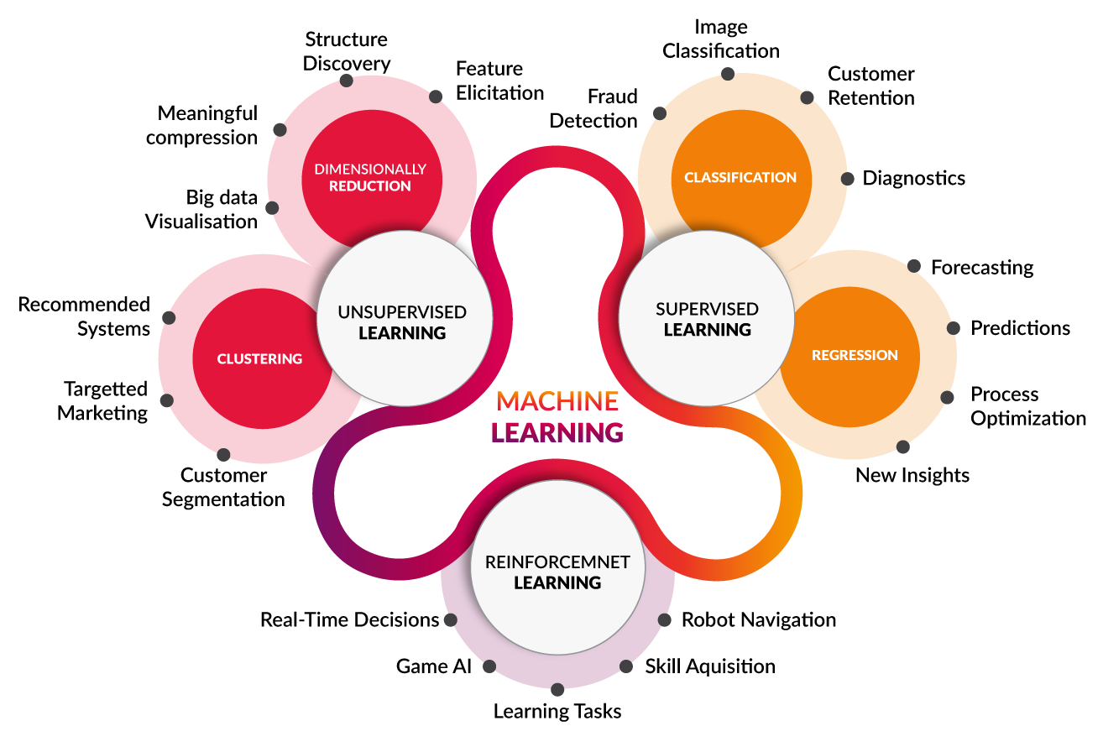

Slide 11
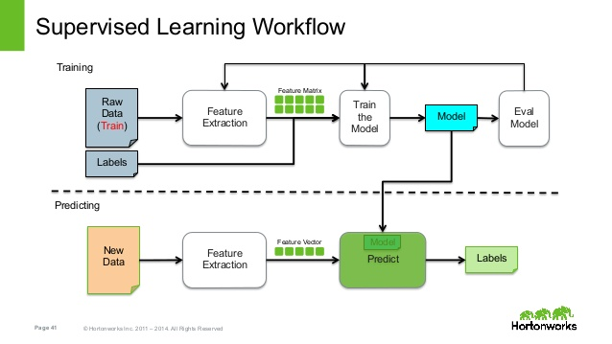

Slide 12
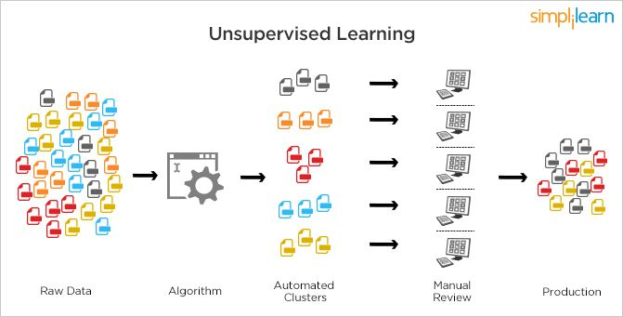

Slide 13
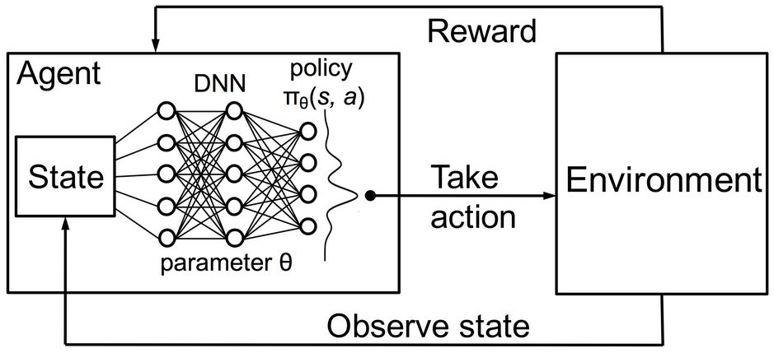
Reinforcement Learning

Slide 14
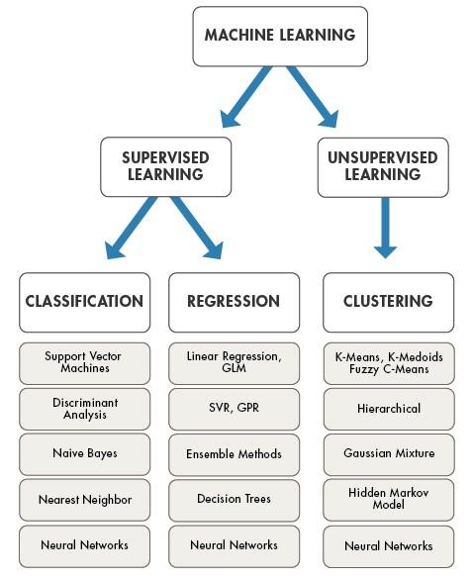

Slide 15
What is
Deep Learning/ Deep Neural Network

Slide 16
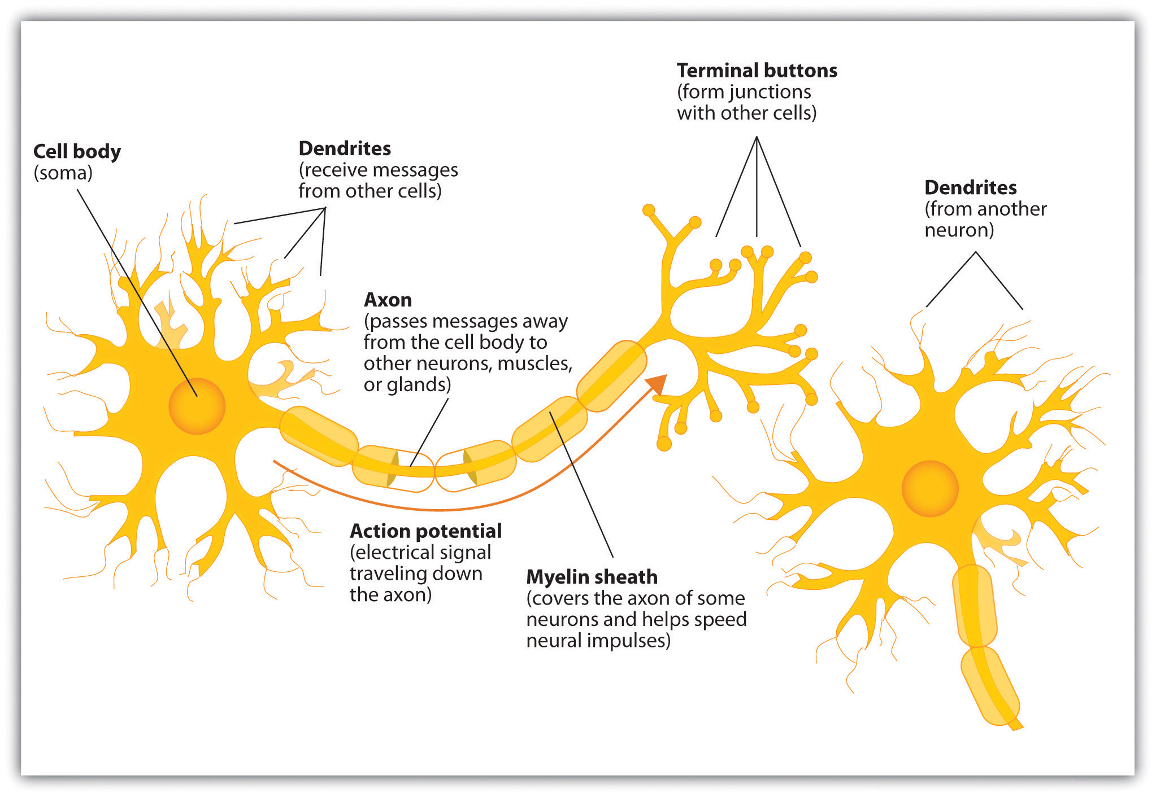
Neuron
/ Synapse

Slide 17
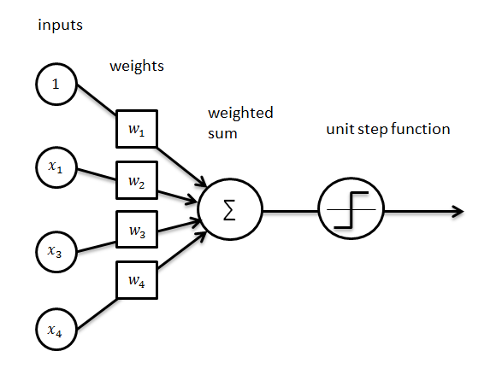
Perceptron

Slide 18
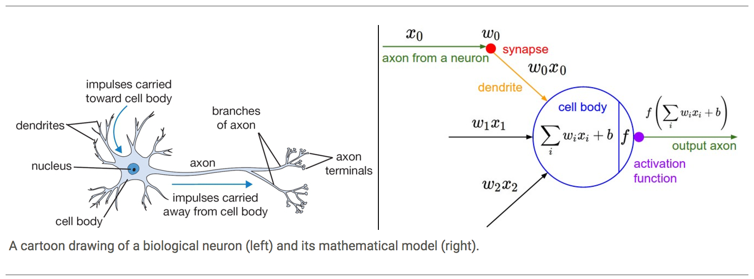
Neuron vs Perceptron

Slide 19
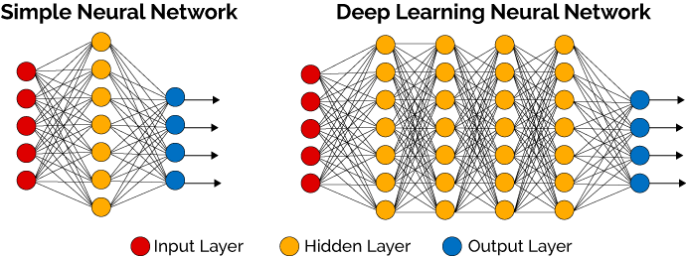

Slide 20
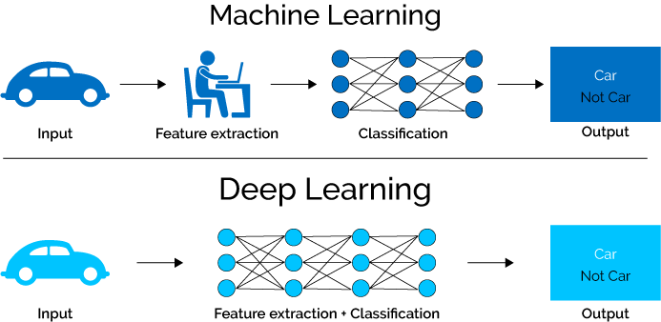

Slide 21
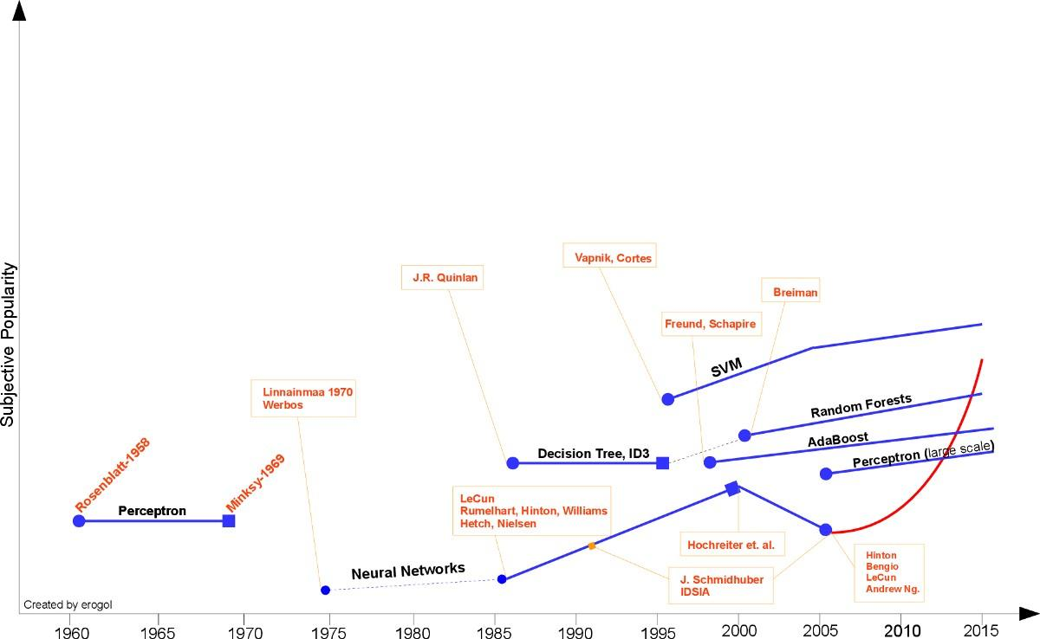

Slide 22
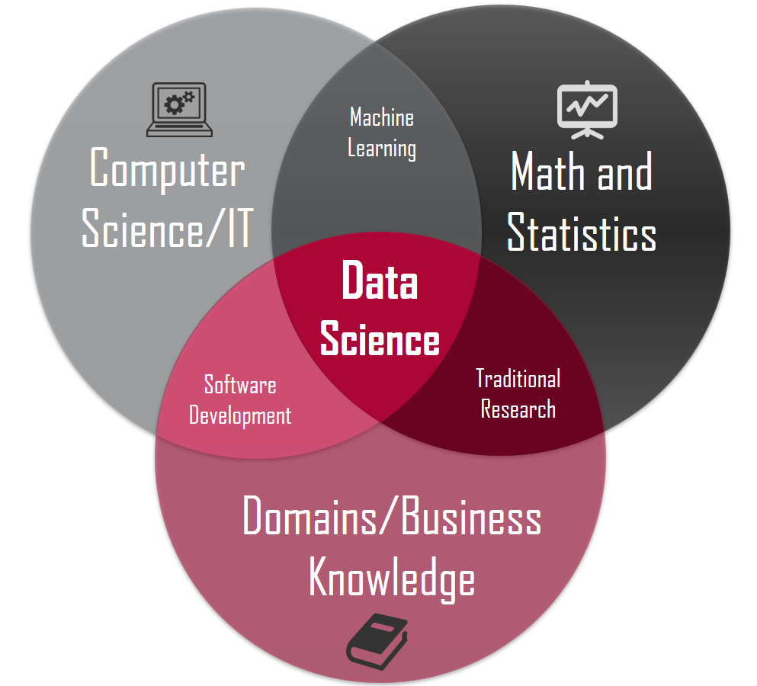

Slide 23
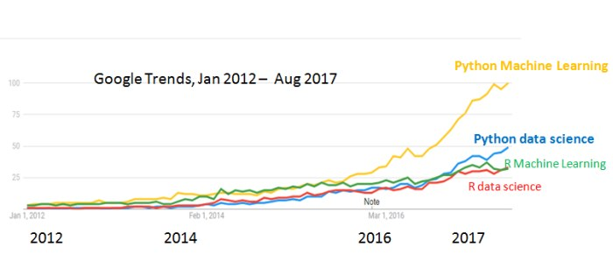

Slide 24
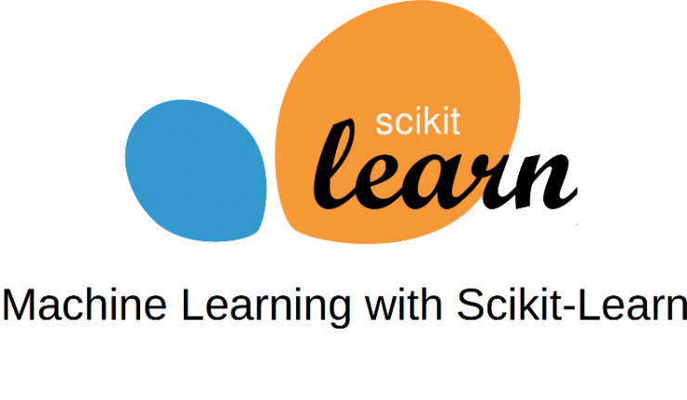

Slide 25
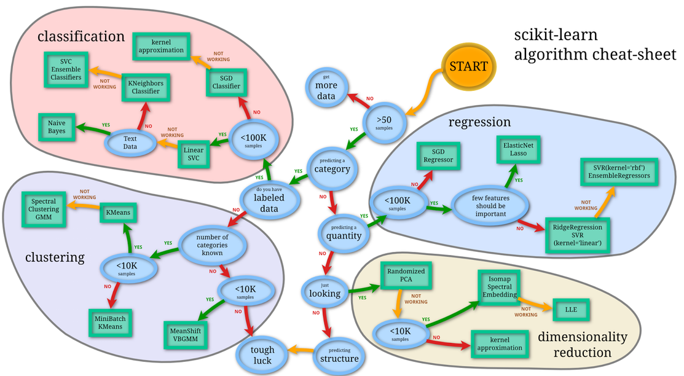

Slide 26
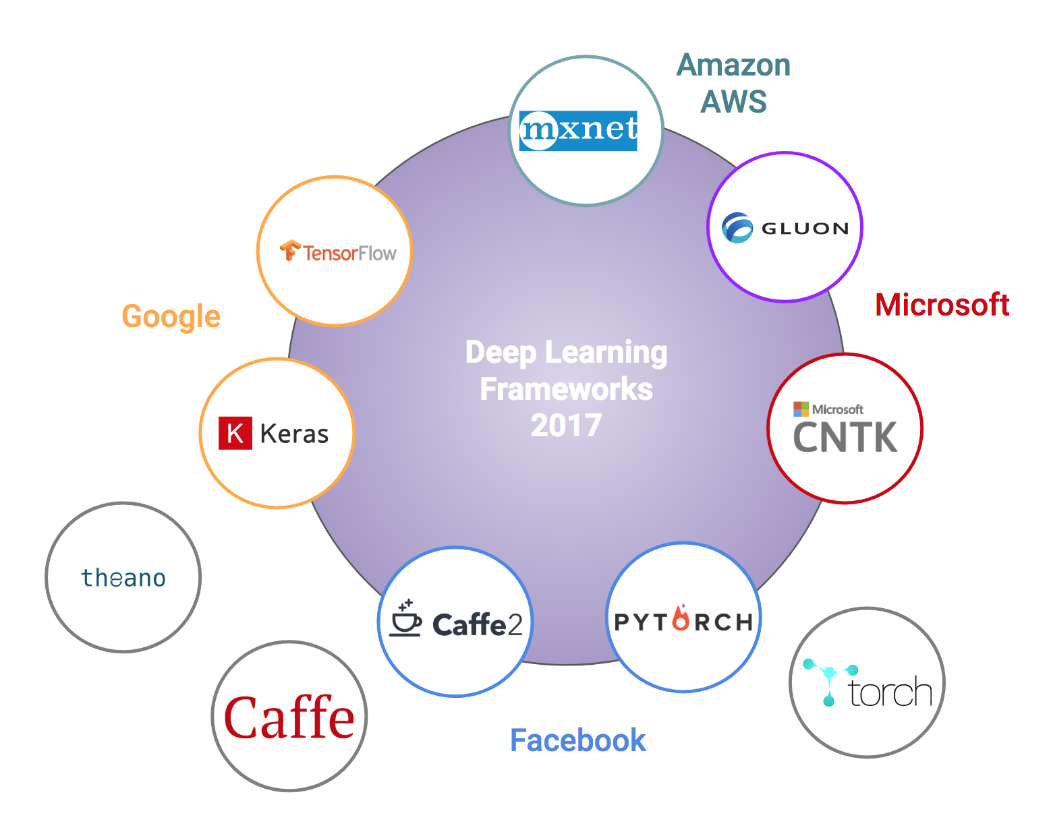

Slide 27
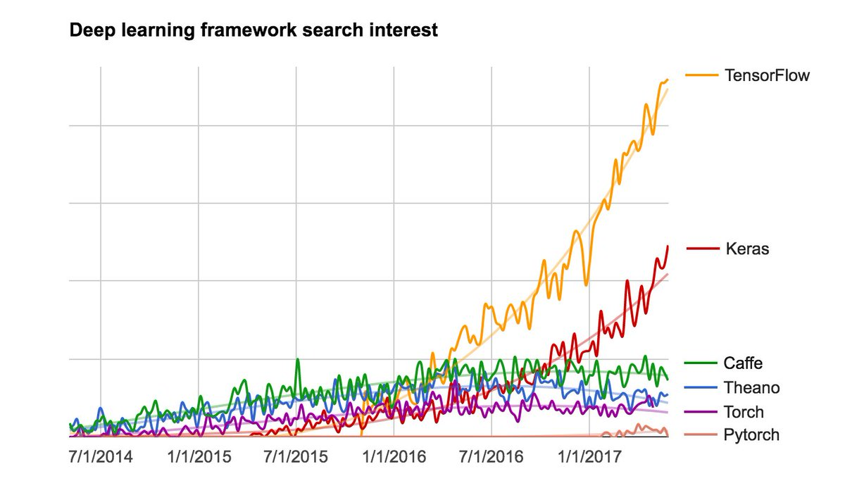

Slide 28


Slide 29
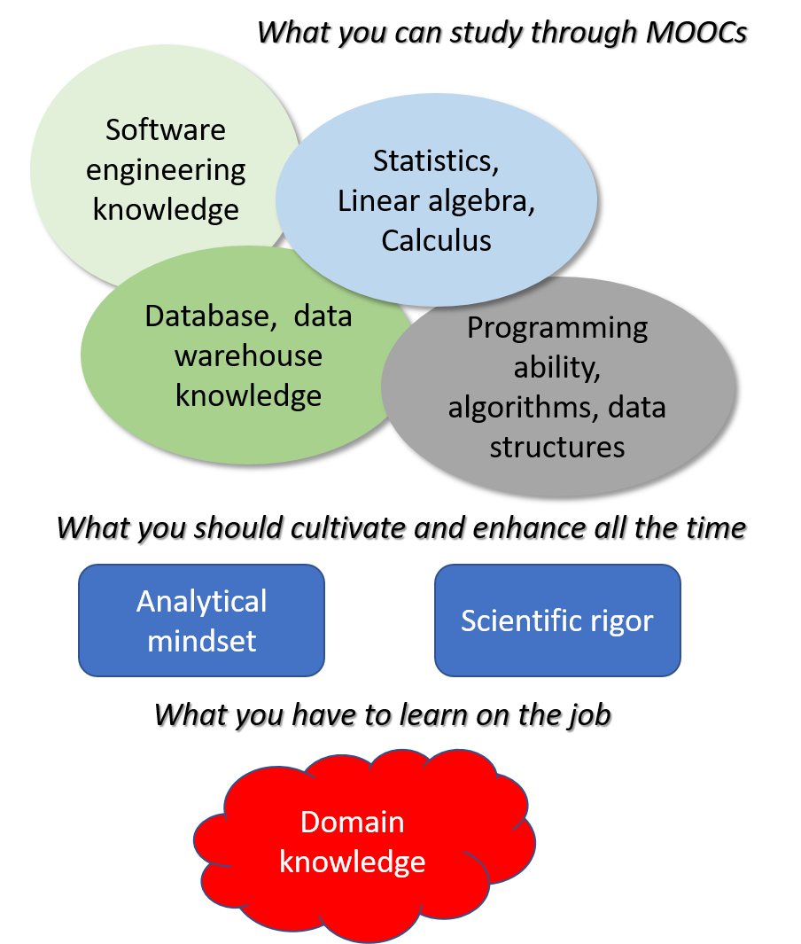

Slide 30
AI Experiments
Math Books
https://experiments.withgoogle.com/ai
Calculus Made Easy - Silvanus P. Thompson
Coding the Matrix - Philip N. Klein
Elements of Statistical Learning - Trevor Hastie and Rob Tibshirani

Slide 31
Best courses :
Machine Learning - Andrew Ng, Stanford University
Machine Learning for Undergraduates - Nando de Freitas, University of British Columbia
Machine Learning - Tom Mitchell, CMU
Learning from Data - Abu Mostafa, EdX and Caltech

Slide 32
Meetups
Workshops
https://www.meetup.com/Dteams-Chennais-3D-printing-IoT-AI-AR-VR/
2 Day Workshop that will cover the basics of
Python
Math ( Linear Algebra, Calculus, Probability & statistics)
Machine Learning
Deep Learning

Slide 33
Academy for AI

Slide 34
Thank you

