Slide 1
Machine Learning & Deep Learning
Process & Linear Regression
A workshop by
Dinesh Kumar Subramanian
Founder, Dteam

Slide 2
Its All About
Data

Slide 3
Machine Learning
The art of finding patterns

Slide 4
Ask Yourself
Does Your Business needs ML/DL
Data Science hierarchy of needs

Slide 5
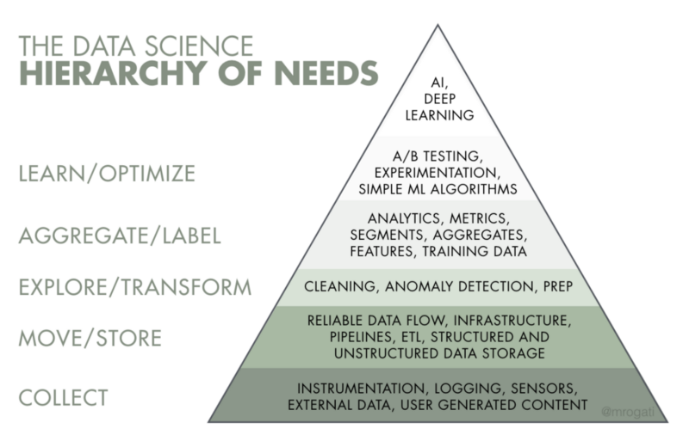

Slide 6
Real Problem in Learning
Training programs, academic or professional, tend to focus on the top of the pyramid knowledge
Modern courses that encourage students to scrape, prepare, or access raw data through public APIs, most of them do not teach students how to properly design table schemas or build data pipelines
As a result, some of the critical elements of real-life data science projects were lost in translation.

Slide 7
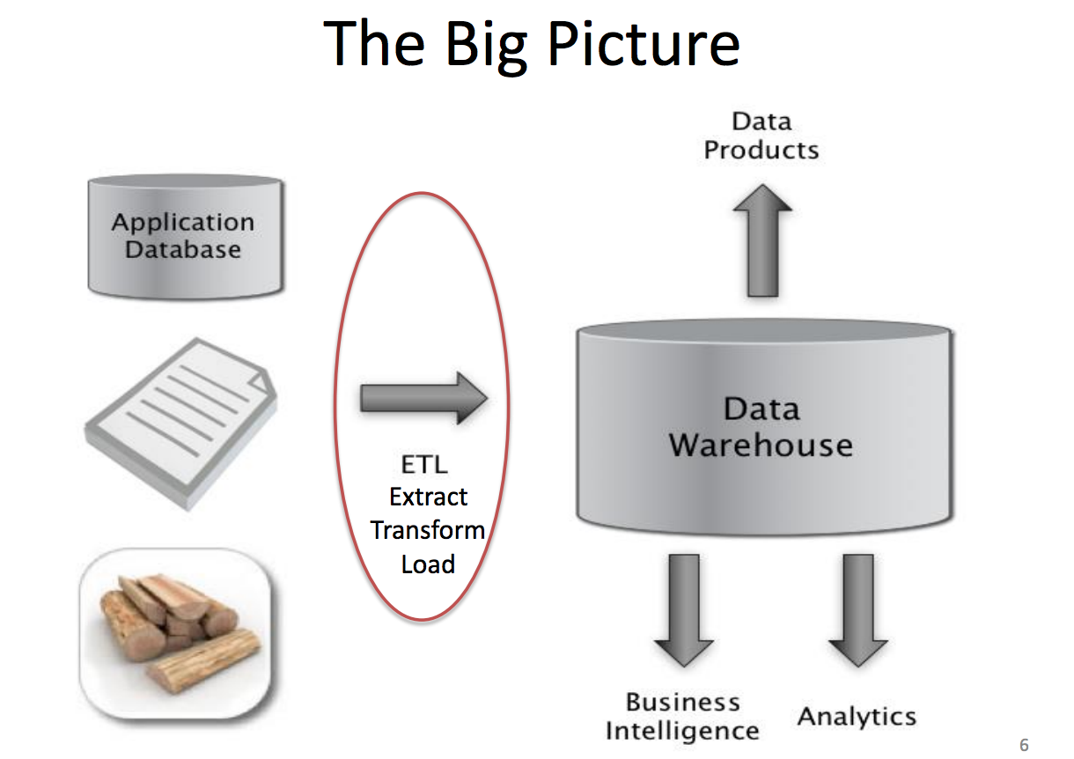

Slide 8
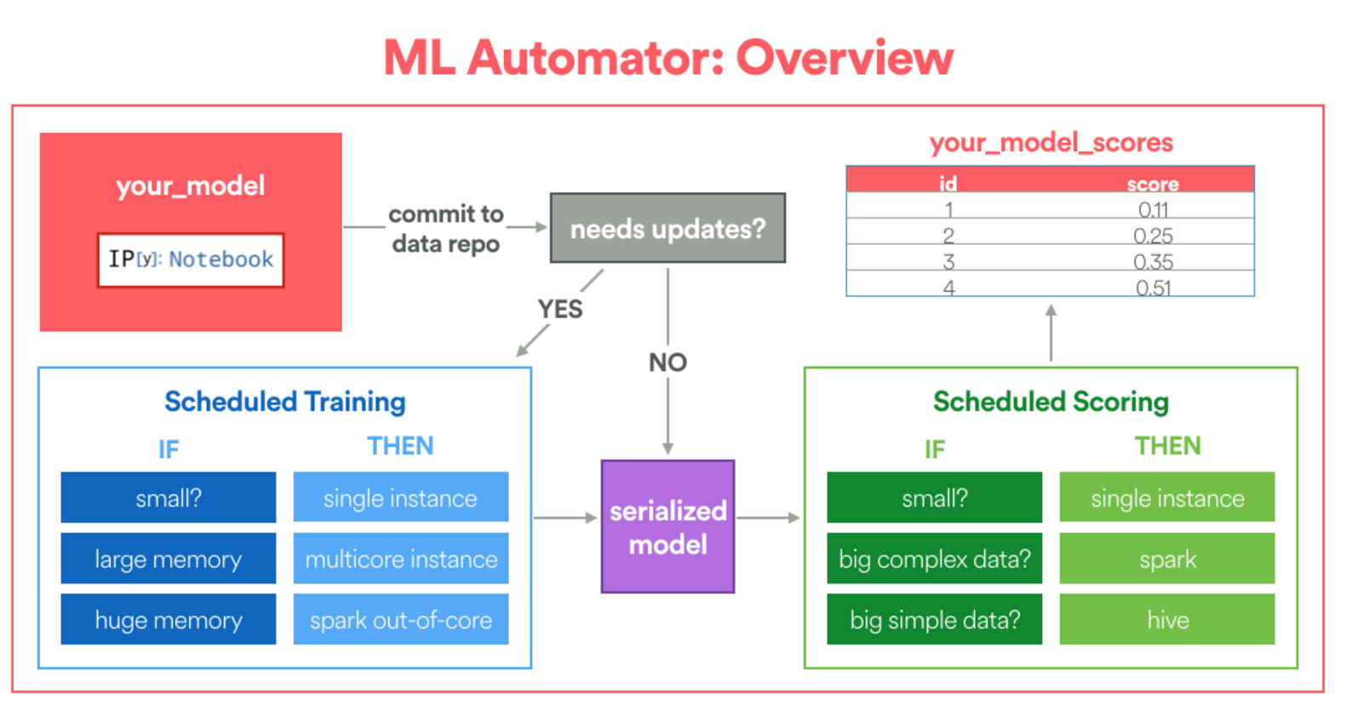

Slide 9
Data Engineering
Data Pipeline
Machine Learning Process
Machine Learning Models

Slide 10
Machine Learning Data processing
The art of finding patterns

Slide 11
Data Engineering
Data Structures
Databases
Data Warehousing
ETL

Slide 12
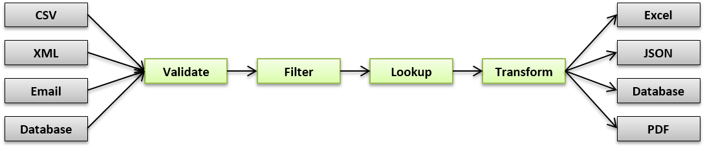
Data Pipeline

Slide 13
ML Process
Define the Problem
Prepare Data
Experiement with Variety of Algorithms
Improvise

Slide 14
Learning About the Problem
Familiarize with the domain
Understand why u are building the solution

Slide 15
Ask yourself
What is the problem
Describe
List Assumptions
Need to Solve
Motivation to Solve
Benefits of Solution and how it will be used and impact it will create
How will a real human/expert solve the problem manually

Slide 16
Experiment with different algorithms

Slide 17
Improve Results
Hyper parameter tuning
Ensemble Methods/models
Feature Engineering

Slide 18
Linear Regression

Slide 19
y = B0 + B1 * x
x is the input variable and
y is the output variable that we are trying to predict
x y
1 1
2 3
4 3
3 2
5 5

Slide 20
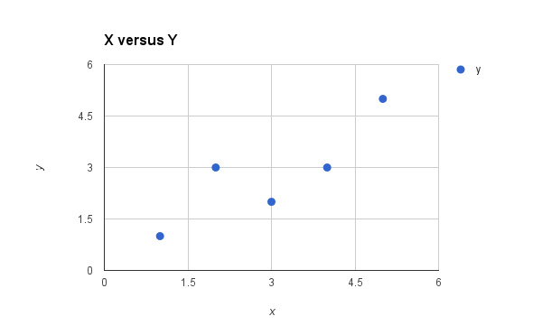
x y
1 1
2 3
4 3
3 2
5 5

Slide 21
We can start off by estimating the value for B1 as:
B1 = sum((xi-mean(x)) * (yi-mean(y))) / sum((xi – mean(x))^2)
We can calculate B0 using B1 and some statistics from our dataset, as follows:
B0 = mean(y) – B1 * mean(x)

Slide 22
B1 = 0.8
B0 = mean(y) – B1 * mean(x)
B0 = 2.8 – 0.8 * 3 or B0 = 0.4
We now have the coefficients for our simple linear regression equation.
y = B0 + B1 * x Or y = 0.4 + 0.8 * x

Slide 23
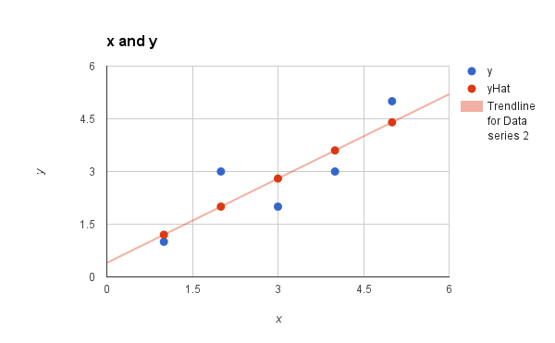
x y predicted y
1 1 1.2
2 3 2
4 3 3.6
3 2 2.8
5 5 4.4

Slide 24
Linear Regression using Gradient Descent

Slide 25
Gradient Descent
Gradient Descent is the process of minimizing a function by following the gradients of the cost function.
This involves knowing the form of the cost as well as the derivative so that from a given point you know the gradient and can move in that direction, e.g. downhill towards the minimum value.

Slide 26
This procedure can be used to find the set of coefficients in a model that result in the smallest error for the model on the training data. Each iteration the coefficients, called weights (w) in machine learning language are updated using the equation:
w = w – alpha * delta
Where w is the coefficient or weight being optimized, alpha is a learning rate that you must configure (e.g. 0.1) and gradient is the error for the model on the training data attributed to the weight.

Slide 27
We can calculate the error for a prediction as follows:
error = p(i) – y(i)
p(i) is the prediction for the i’th instance in our dataset and
y(i) is the i’th output variable for the instance in the dataset.
x=1, y=1 p(i) = 0.0 + 0.0 * 1 p(i) = 0
Now we can calculate our error: error = 0 – 1 error = -1

Slide 28
We can calculate the update for the B0 coefficient as follows:
B0(t+1) = B0(t) – alpha * error
B0(t+1) is the updated version of the coefficient we will use on the next training instance,
B0(t) is the current value for B0
alpha is our learning rate and
error is the error we calculate for the training instance.
Let alpha == 0.01
B0(t+1) = 0.0 – 0.01 * -1.0 ⇒ B0(t+1) = 0.01

Slide 29
We can update B1 using the equation:
B1(t+1) = B1(t) – alpha * error * x
B1(t+1) -> update coefficient,
B1(t) -> current version of the coefficient,
alpha -> same learning rate described above
error -> same error calculated before and
x is the input value.

Slide 30
We can plug in our numbers into the equation and calculate the updated value for B1:
B1(t+1) = 0.0 – 0.01 * -1 * 1
B1(t+1) = 0.01
We have just finished the first iteration of gradient descent and we have updated our weights to be B0=0.01 and B1=0.01.
This process must be repeated for the remaining 4 instances from our dataset.
One Epoch → This process of updating weight for the entire Set once.

Slide 32
∂ ∂θj J(θ) = ∂ ∂θj 1 2 (hθ(x) − y) 2 = 2 · 1 2 (hθ(x) − y) · ∂ ∂θj (hθ(x) − y) = (hθ(x) − y) · ∂ ∂θj Xn i=0 θixi − y ! = (hθ(x) − y) xj

