Slide 1
Machine Learning & Deep Learning
Data Pipeline
A workshop by
Dinesh Kumar Subramanian
Founder, Dteam

Slide 2
Data Pipelines are Everywhere

Slide 3
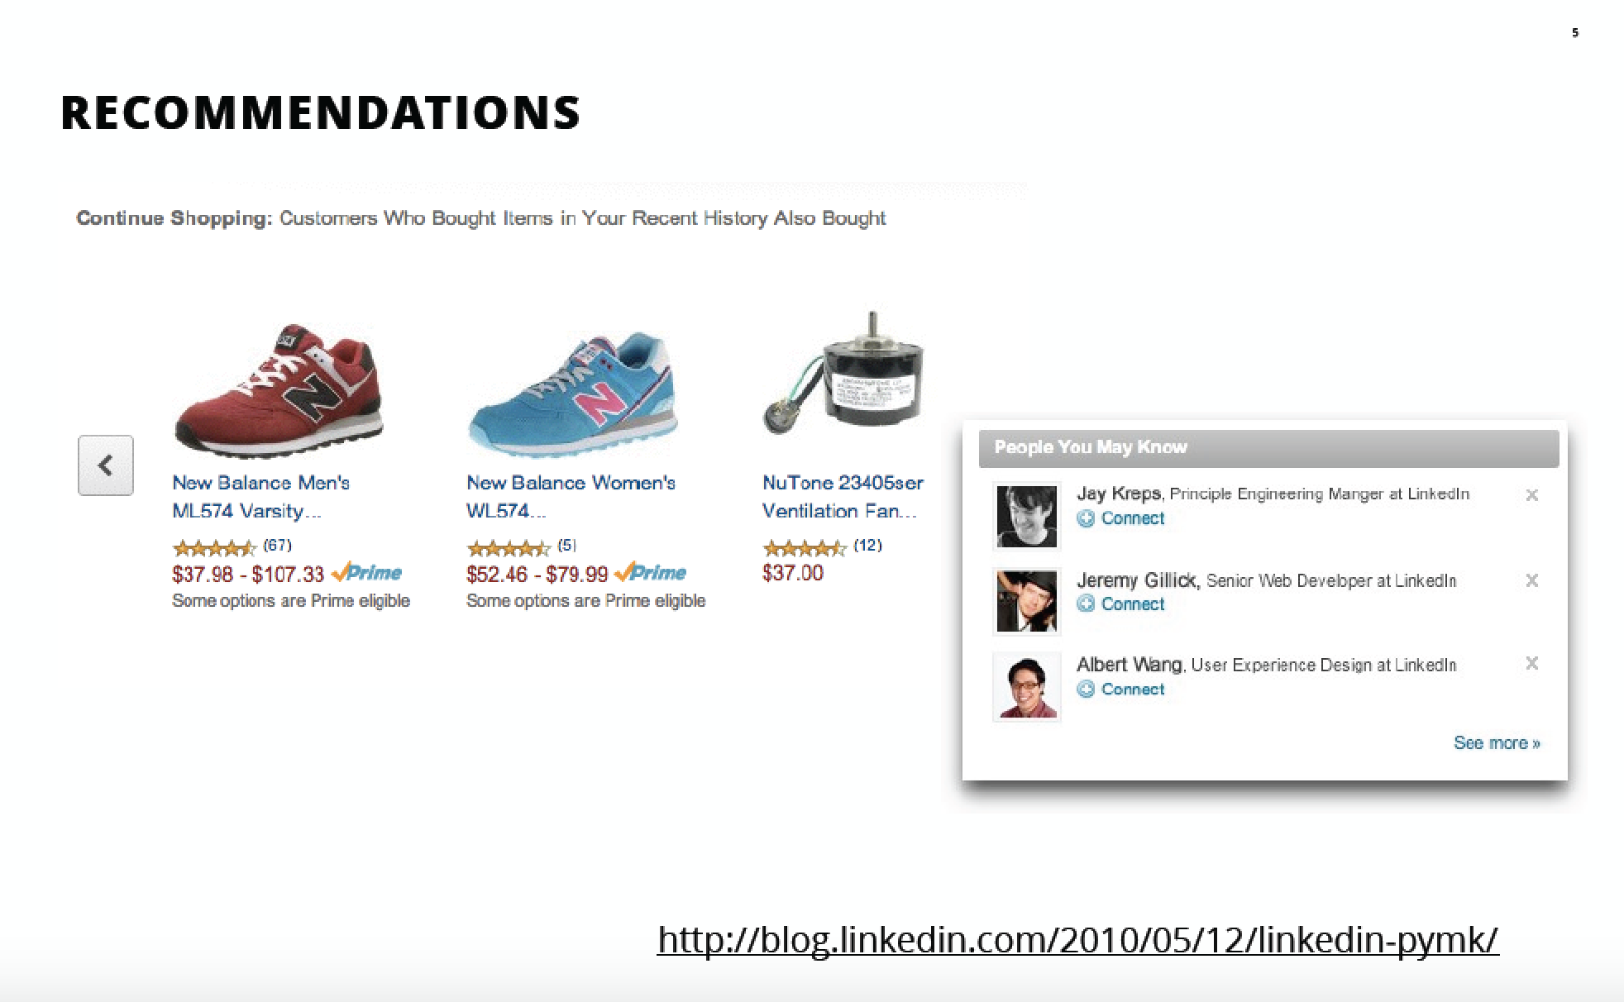
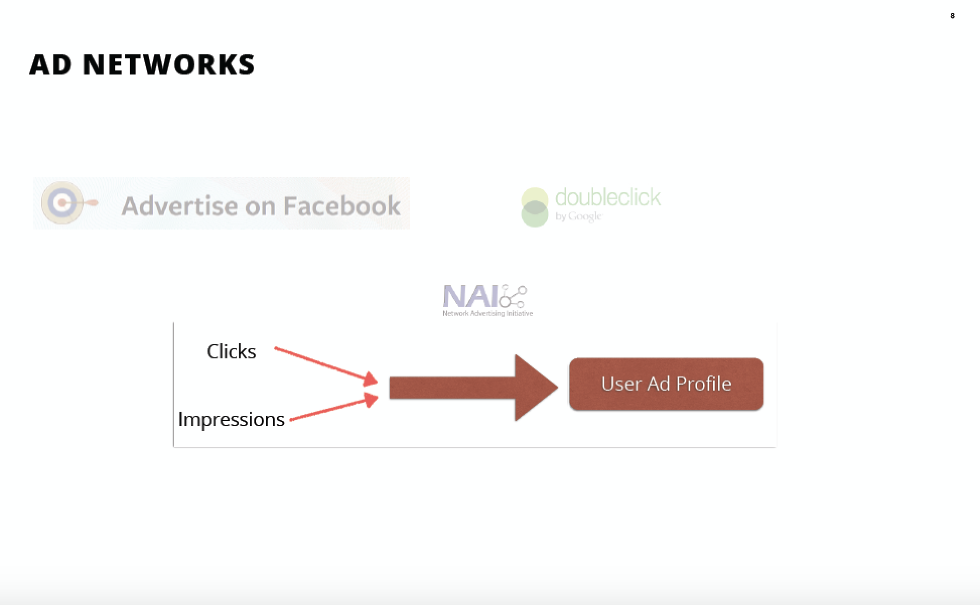
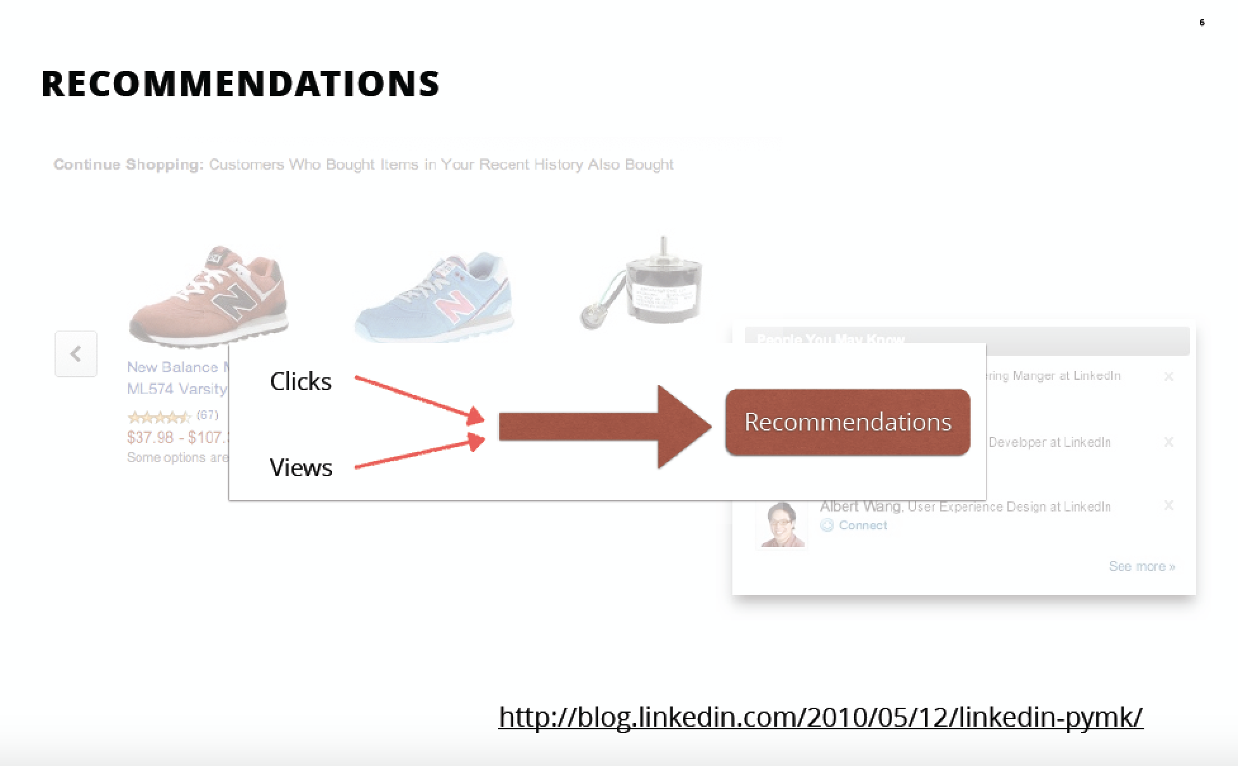

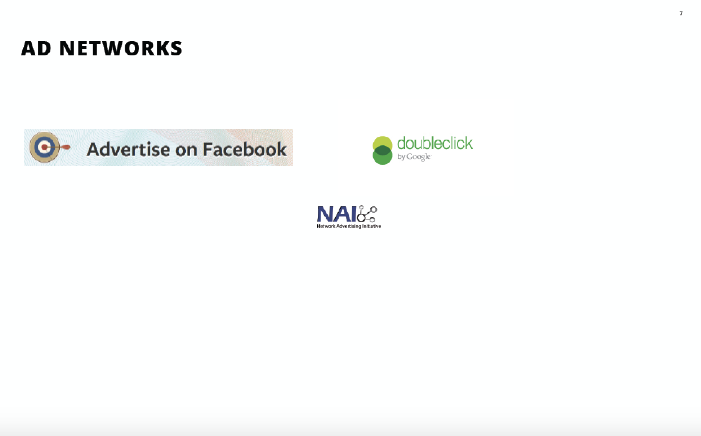

Slide 8
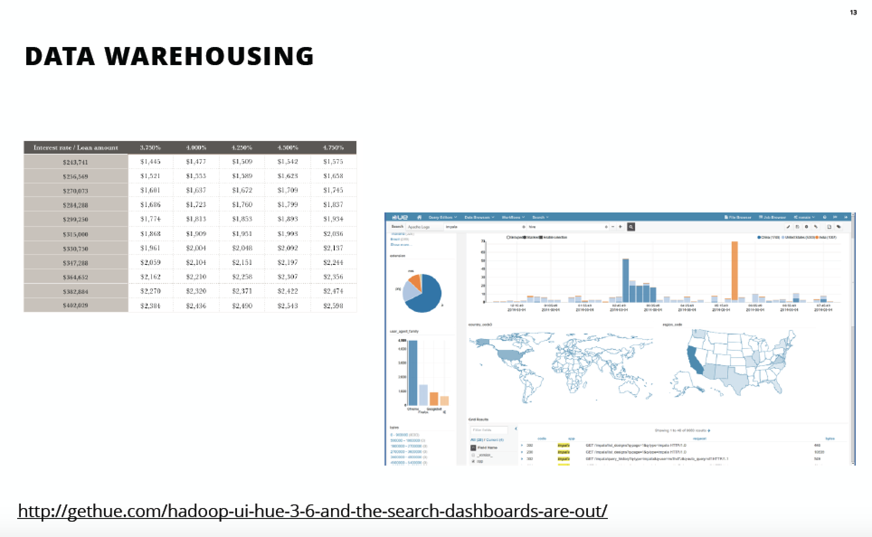
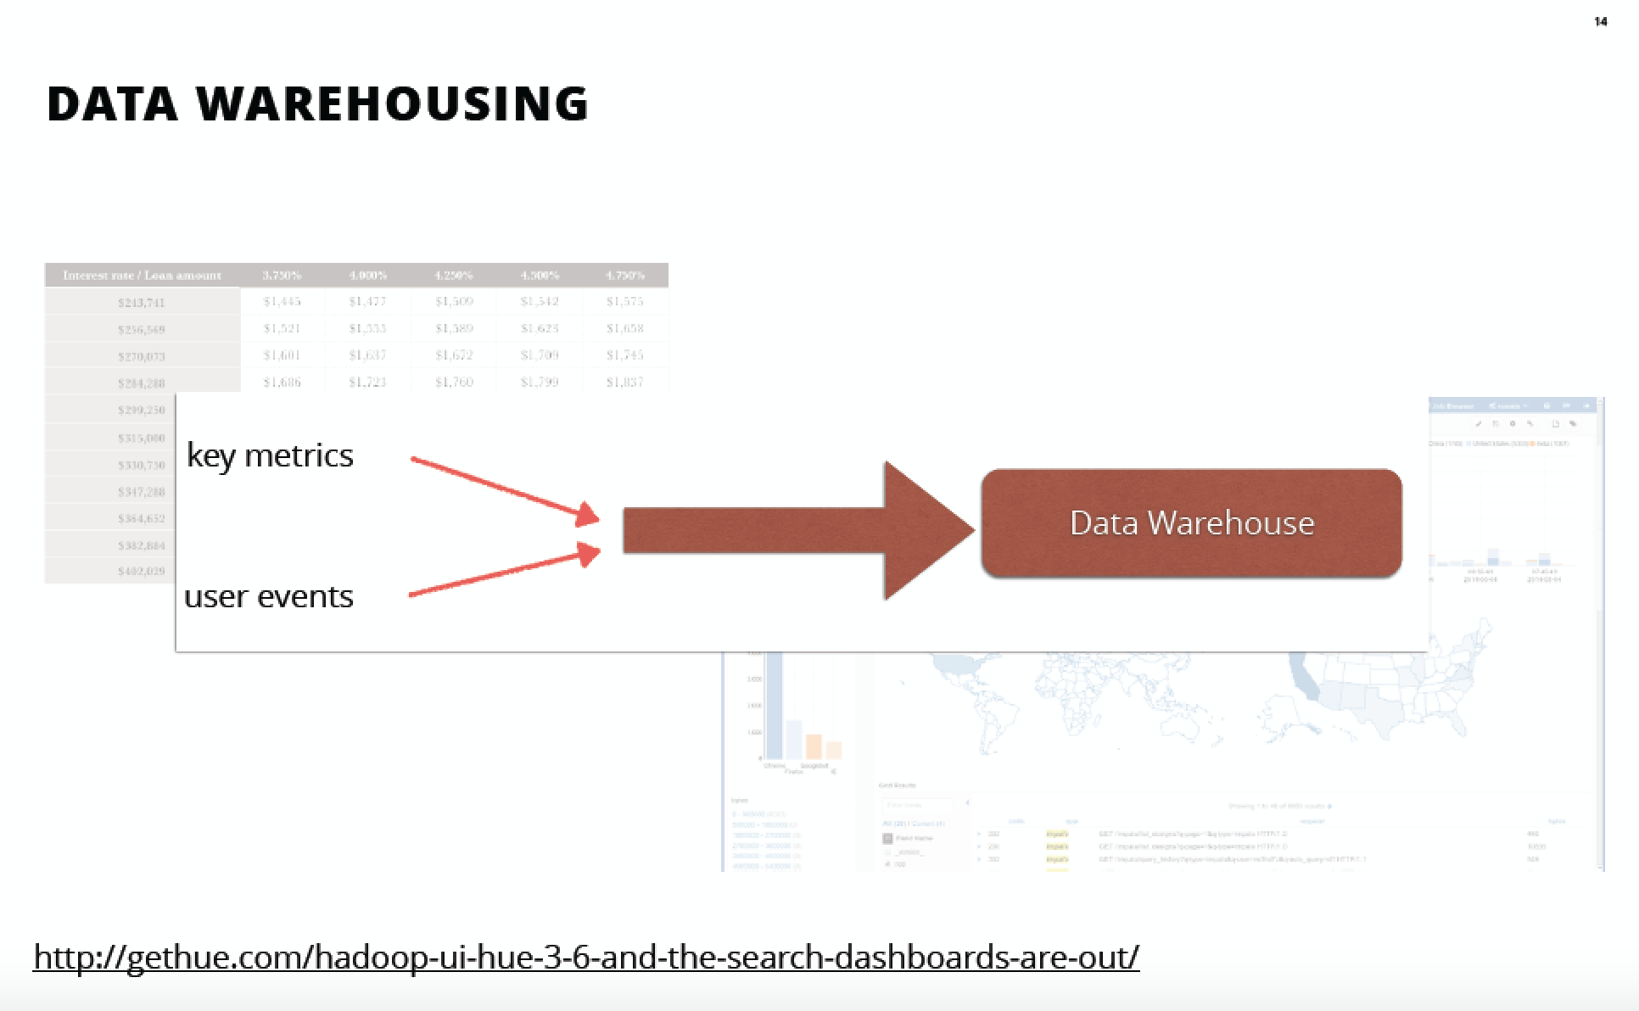
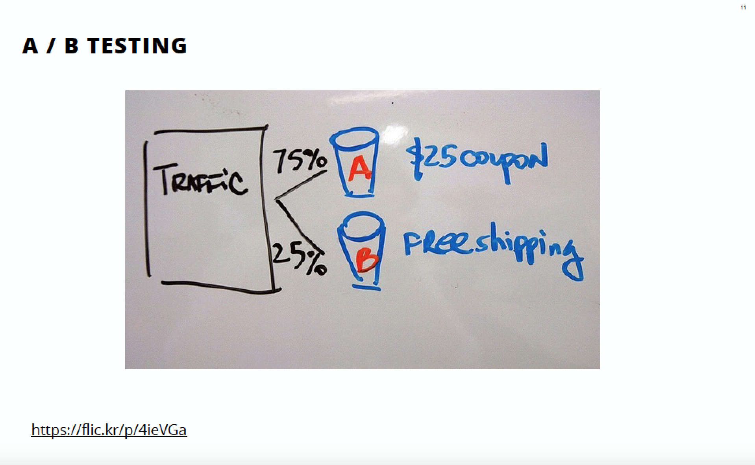
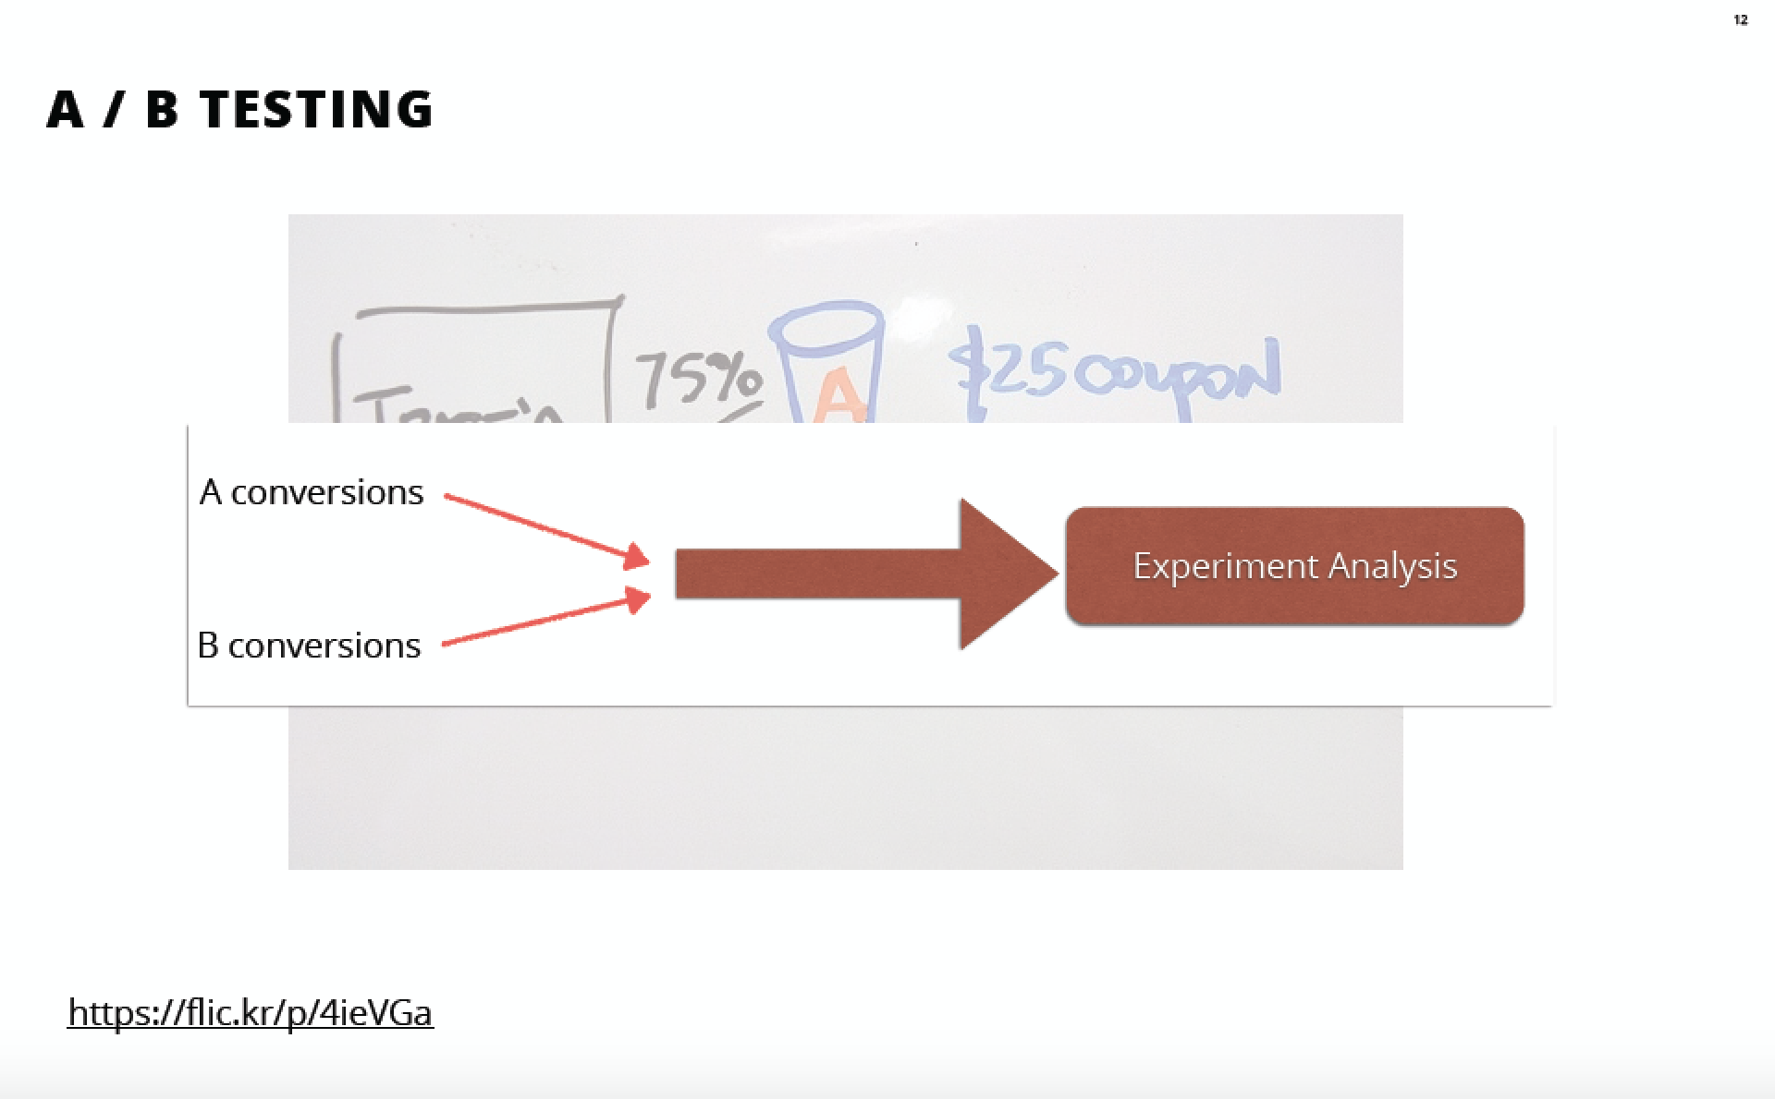
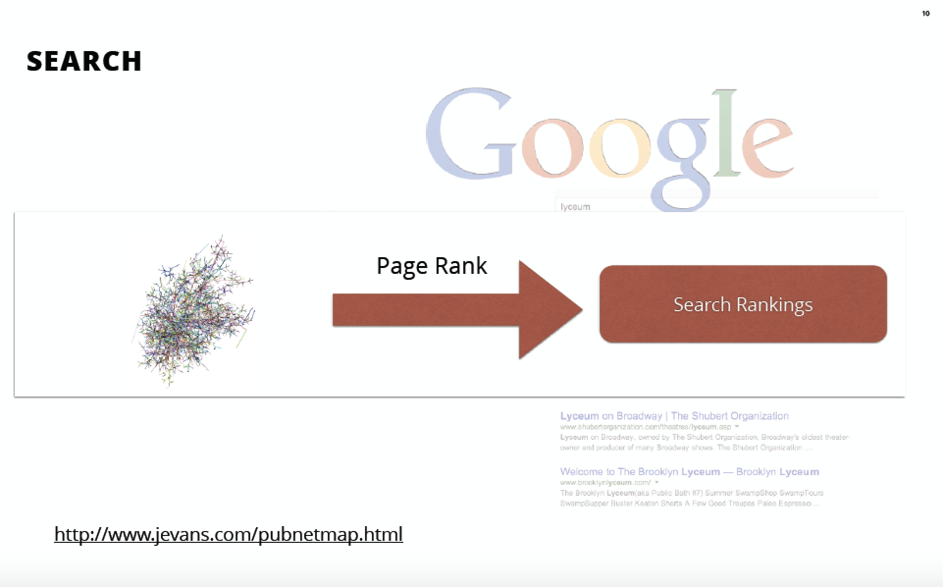

Slide 13
What is Data Pipeline
A Data Pipeline is a unified system for capturing events for analysis and building products.

Slide 14
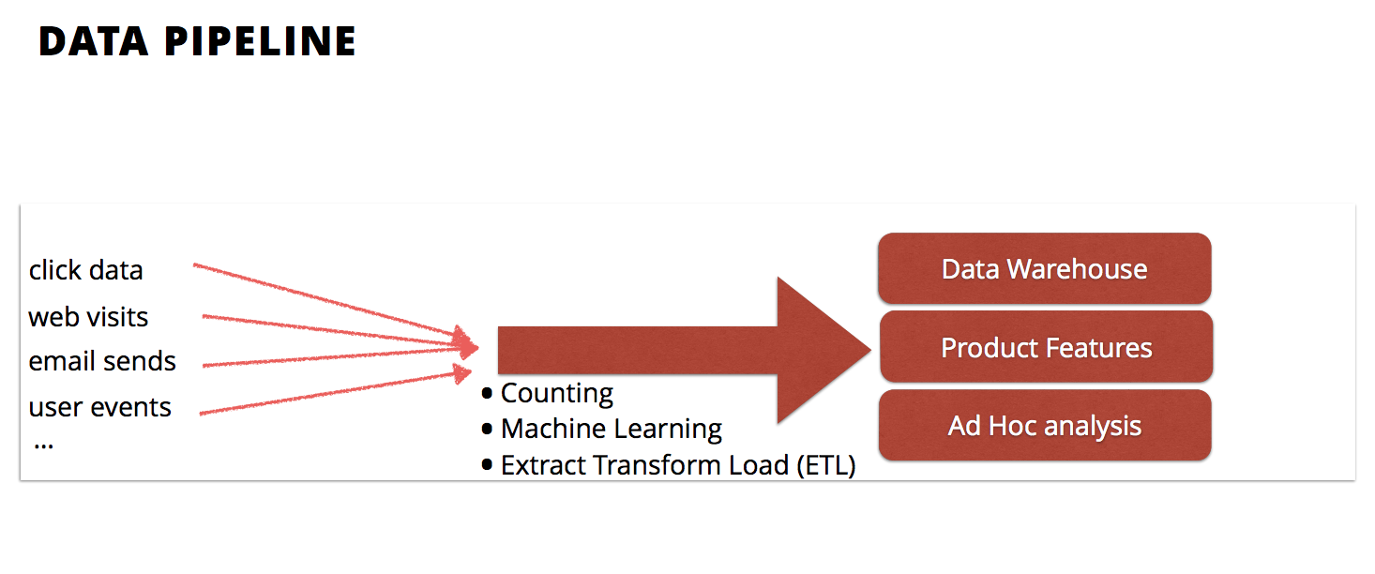

Slide 15
Events

Slide 16
Events
Each of the Actions can be thought of as events
Coarse Grained Events
Fine Grained Events

Slide 17
Coarse Grained Events
• Events are captured as a by-product.
• Stored in text logs used primarily for debugging and secondarily for analysis.
127.0.0.1 - - [17/Jun/2014:01:53:16 UTC] "GET / HTTP/1.1" 200 3969 IP Address Timestamp Action Status

Slide 18
Fine Grained Events
Record events like:
app opened
auto refresh
user pull down refresh
Rather than:
GET /newsfeed
Annotate events with contextual information like:
view the user was on
which button was clicked

Slide 19
Schema
Used to describe data, providing a contract about fields and their types.
Two schemas are compatible if you can read data written in schema 1 with schema 2.
Facilities automated analytics—summary statistics, session/funnel analysis, a/b testing.

Slide 20
Key Components
Event Framework
Big Message Bus (Scribe, Flume, Kafka)
Data Persistence (Amazon S3, Hadoop HDFS)
Workflow Management (Airflow, Lugi, oozie)
Serialization Framework (Apache Arvo, thrift)
Batch Processing and Adhoc Analysis (Apache Hadoop, Hive, Spark)

Slide 21
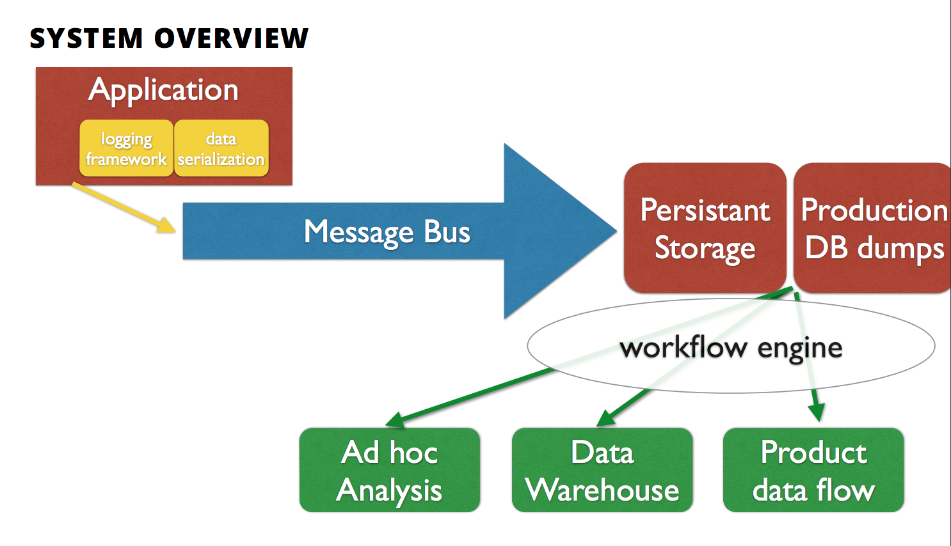
KeyComponents

Slide 22
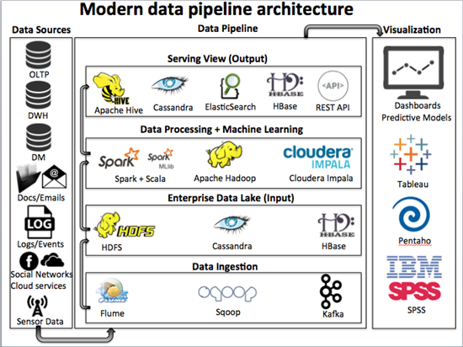

Slide 23
Building Data Pipeline From Scratch

Slide 24
Webserver Log Analysis

Slide 25
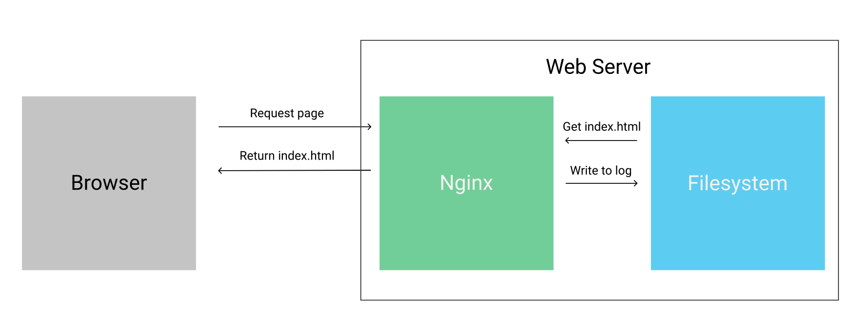
Webserver Log Analysis

Slide 26
Example Log Entry
X.X.X.X - - [09/Mar/2017:01:15:59 +0000] "GET /blog/assets/js/jquery-1.11.1.min.js HTTP/1.1" 200 95786 "http://www.dataquest.io/blog/" "Mozilla/5.0 (X11; Linux x86_64) AppleWebKit/537.36 (KHTML, like Gecko) Ubuntu Chromium/53.0.2785.143 Chrome/53.0.2785.143 Safari/537.36 PingdomPageSpeed/1.0 (pingbot/2.0; +http://www.pingdom.com/)"

Slide 27
Example Log Entry
X.X.X.X - - [09/Mar/2017:01:15:59 +0000] "GET /blog/assets/js/jquery-1.11.1.min.js HTTP/1.1" 200 95786 "http://www.dataquest.io/blog/" "Mozilla/5.0 (X11; Linux x86_64) AppleWebKit/537.36 (KHTML, like Gecko) Ubuntu Chromium/53.0.2785.143 Chrome/53.0.2785.143 Safari/537.36 PingdomPageSpeed/1.0 (pingbot/2.0; +http://www.pingdom.com/)"
$remote_addr - $remote_user [$time_local] "$request" $status $body_bytes_sent "$http_referer" "$http_user_agent"

Slide 28
Webserver Log Creation
The web server continuously adds lines to the log file as more requests are made to it.
Occasionally, a web server will rotate a log file that gets too large, and archive the old data.

Slide 29
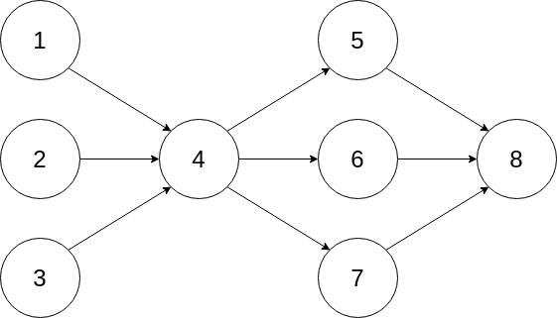
What is DAG

Slide 30
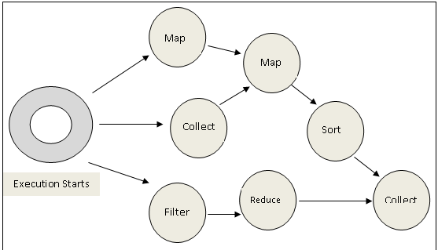
What is DAG

Slide 31
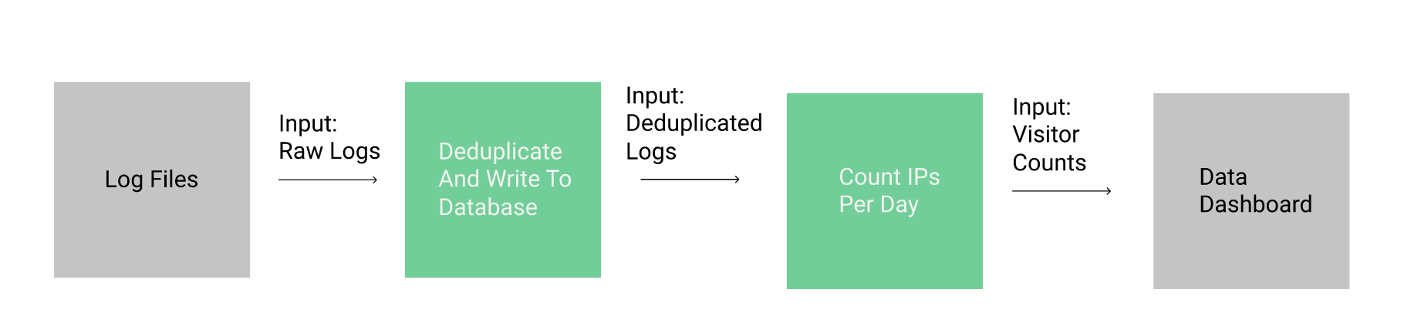
Simple Data Pipeline to get Visitor Count

Slide 32
Visitor Count Pipeline details
Each pipeline component is separated from the others, and takes in a defined input, and returns a defined output.
We store the raw log data to a database.
We remove duplicate records.
Each pipeline component feeds data into another component.
keep each component as small as possible, so that we can individually scale pipeline components up, or use the outputs for a different type of analysis.

Slide 33
Generate Logs
new entries being written to log_a.txt in the same folder.
After 100 lines are written to log_a.txt, the script will rotate to log_b.txt.
It will keep switching back and forth between files every 100 lines.

Slide 34
Logs to DB
Open the log files and read from them line by line.
Parse each line into fields.
Write each line and the parsed fields to a database.
Ensure that duplicate lines aren't written to the database. (de-duplicate)

Slide 35
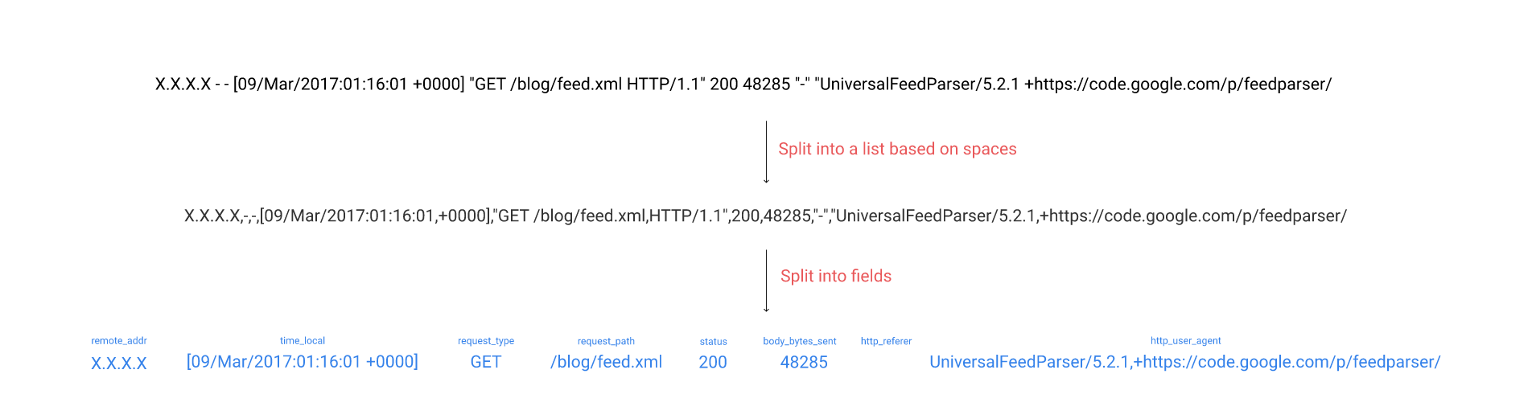
Parsing Logs to Structured Fields

Slide 36
Counting Visitors With A Data Pipeline
We can use a few different mechanisms for sharing data between pipeline steps:
Files
Databases
Queues

Slide 37
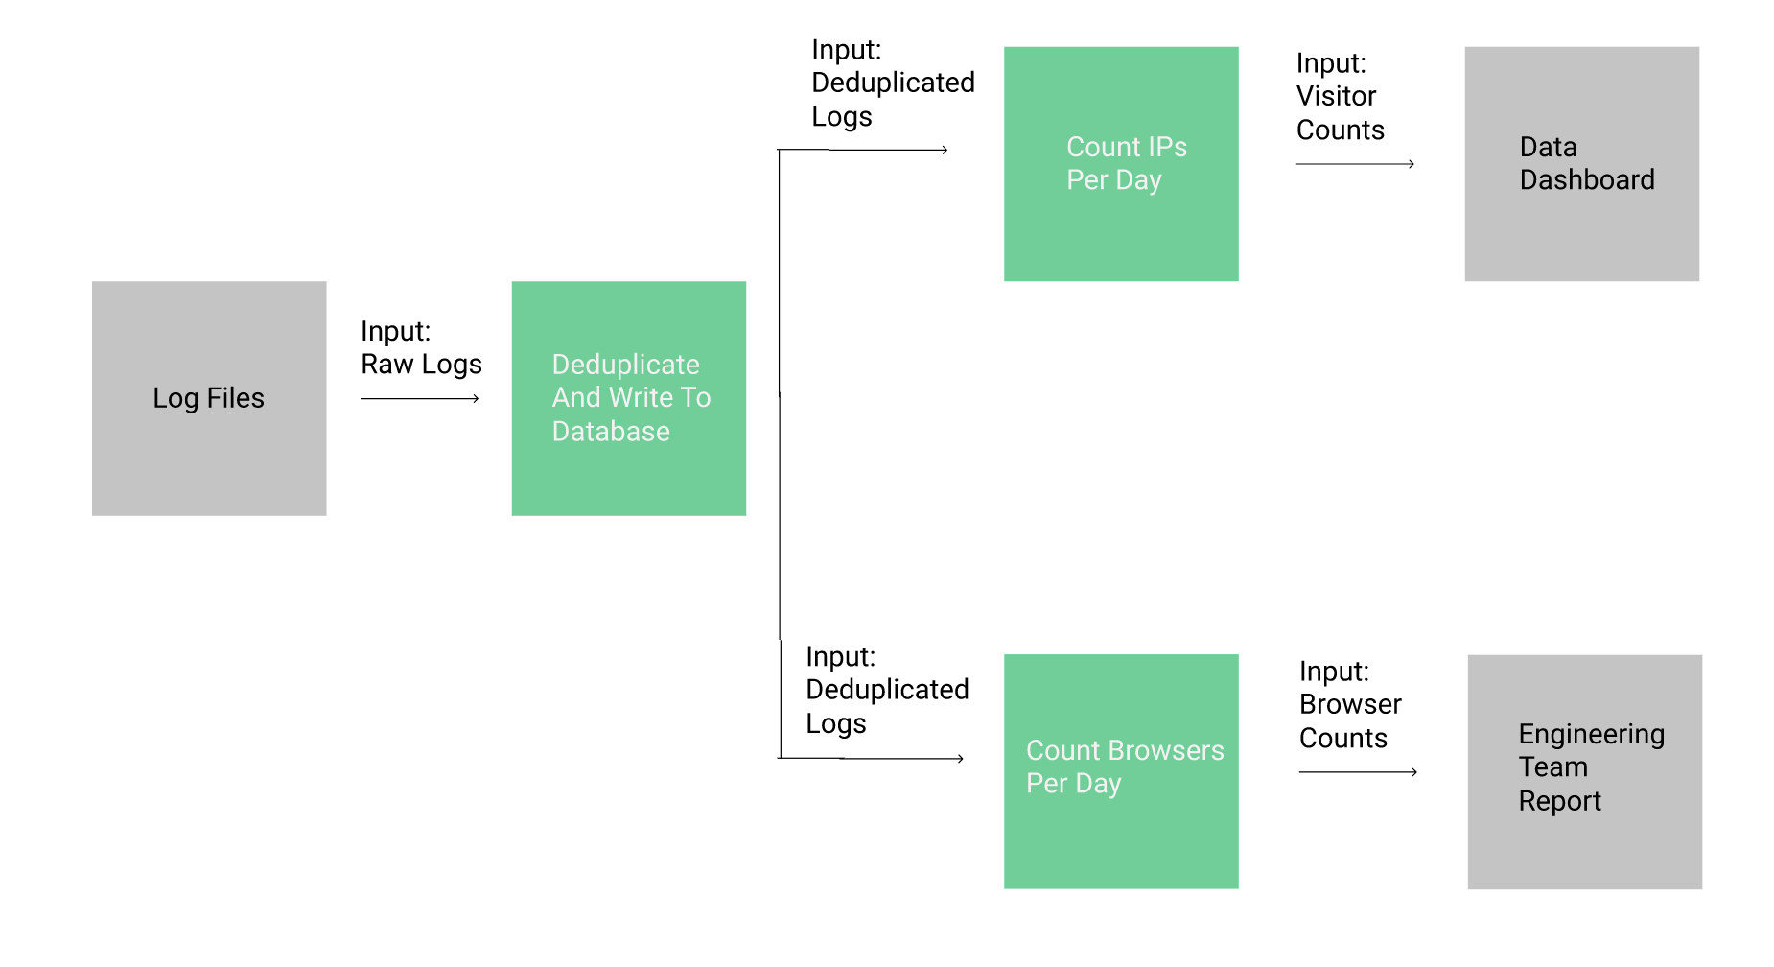
Adding Another Step To The Data Pipeline

Slide 38
Keypoint to take
We've now created two basic data pipelines, and demonstrated some of the key principles of data pipelines:
Making each step fairly small.
Passing data between pipelines with defined interfaces.
Storing all of the raw data for later analysis.

Slide 39
More pipeline to explore
Handling errors
Creating redundancy
Scaling components
Increasing throughput
Adding more complex steps
Can you geolocate the IPs to figure out where visitors are?
Can you figure out what pages are most commonly hit?

Slide 40
More pipeline to explore
Can you geolocate the IPs to figure out where visitors are?
Can you figure out what pages are most commonly hit?

Slide 41
What’s Next?

Slide 42
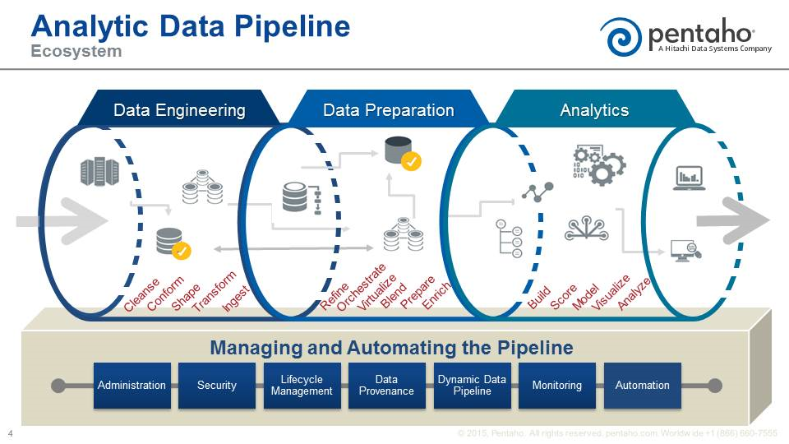

Slide 43
What’s Next?

Slide 44
Airflow + Amazon EMR

Slide 45
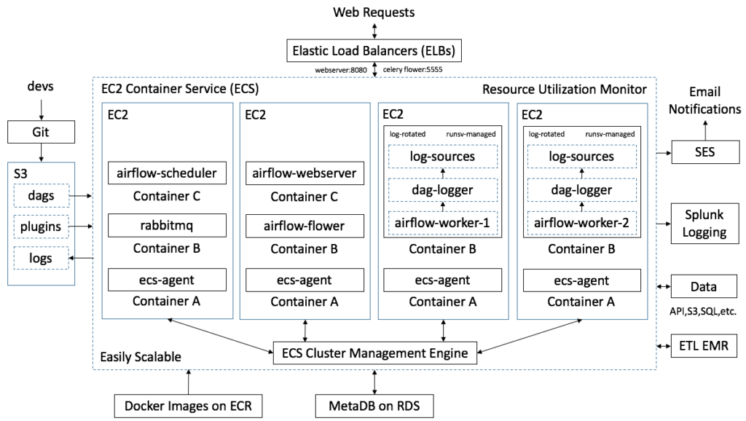
Airflow + Amazon EMR

Slide 46
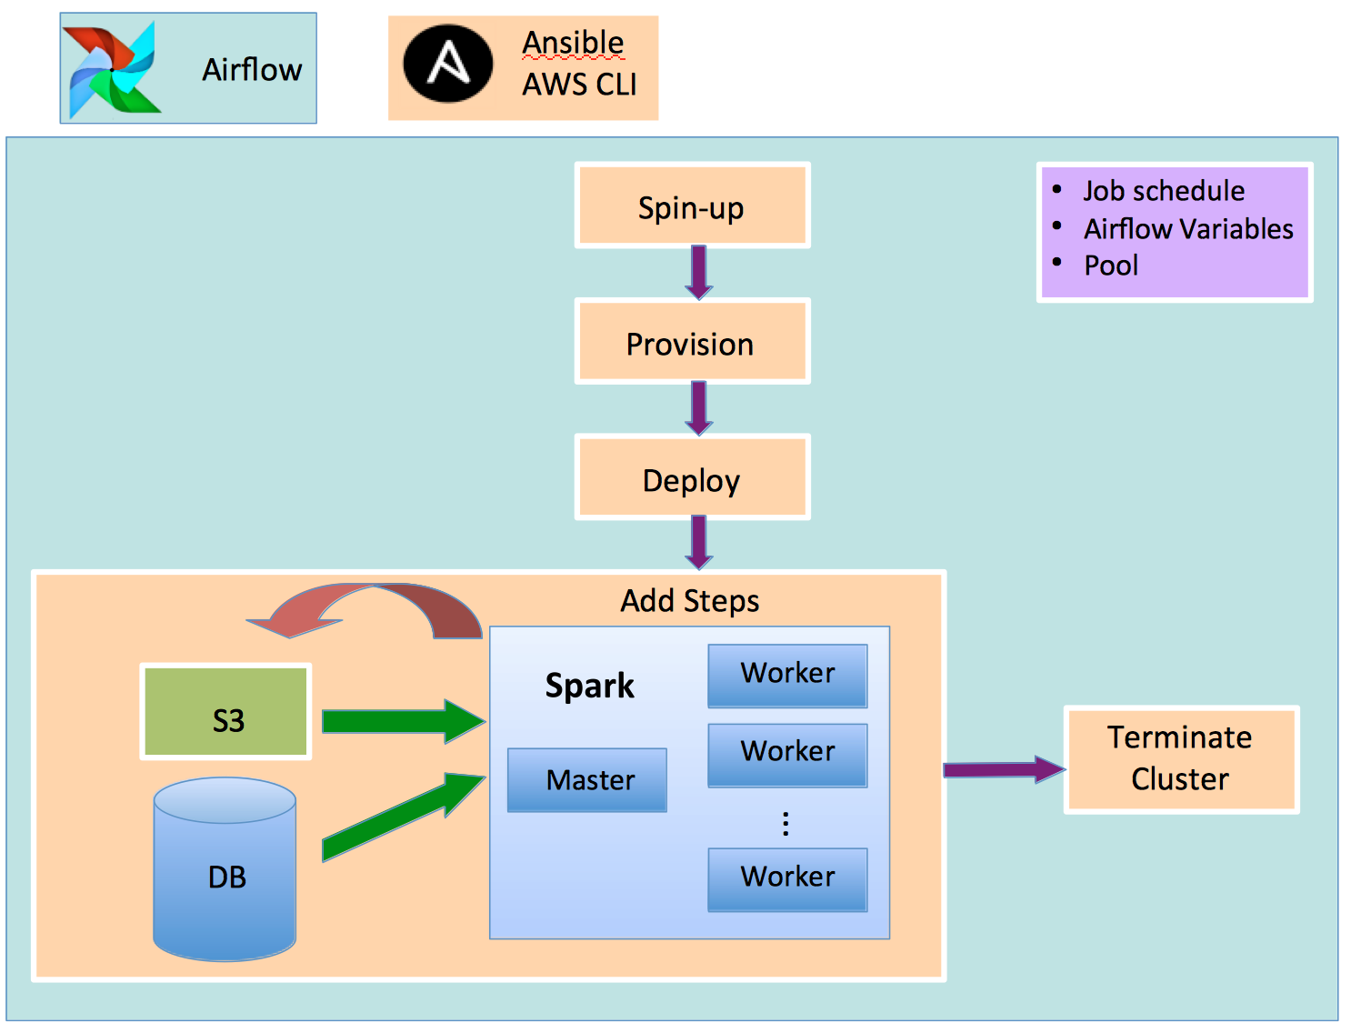
Airflow + Amazon EMR

Slide 47
Thank You. Questions?

Slide 48
*All references are taken from internet

