Slide 1
Machine Learning & Deep Learning
Kafka, Spark, HBase
Dinesh Kumar Subramanian
Founder, DTeam

Slide 2
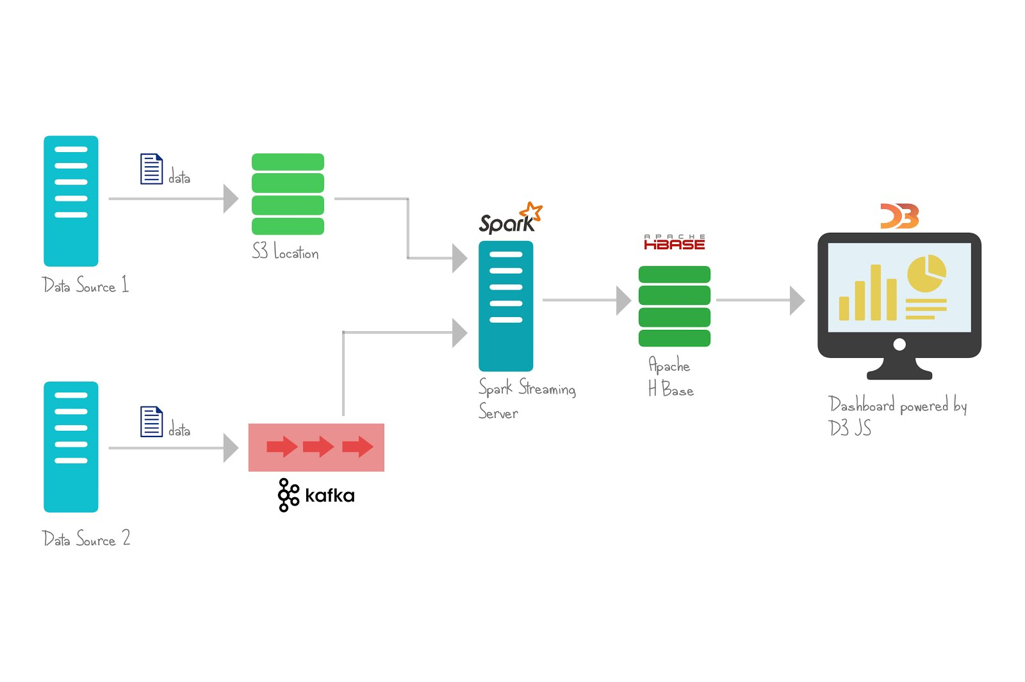

Slide 3
Today’s Agenda
Apache Kafka - 80%
What it is?
Architecture
Role in Pipeline
Apache Spark - 10%
What it is?
Architecture
Role in Pipeline
HBase - 10%
What it is?
Architecture
Role in Pipeline

Slide 4
What is Kafka

Slide 5
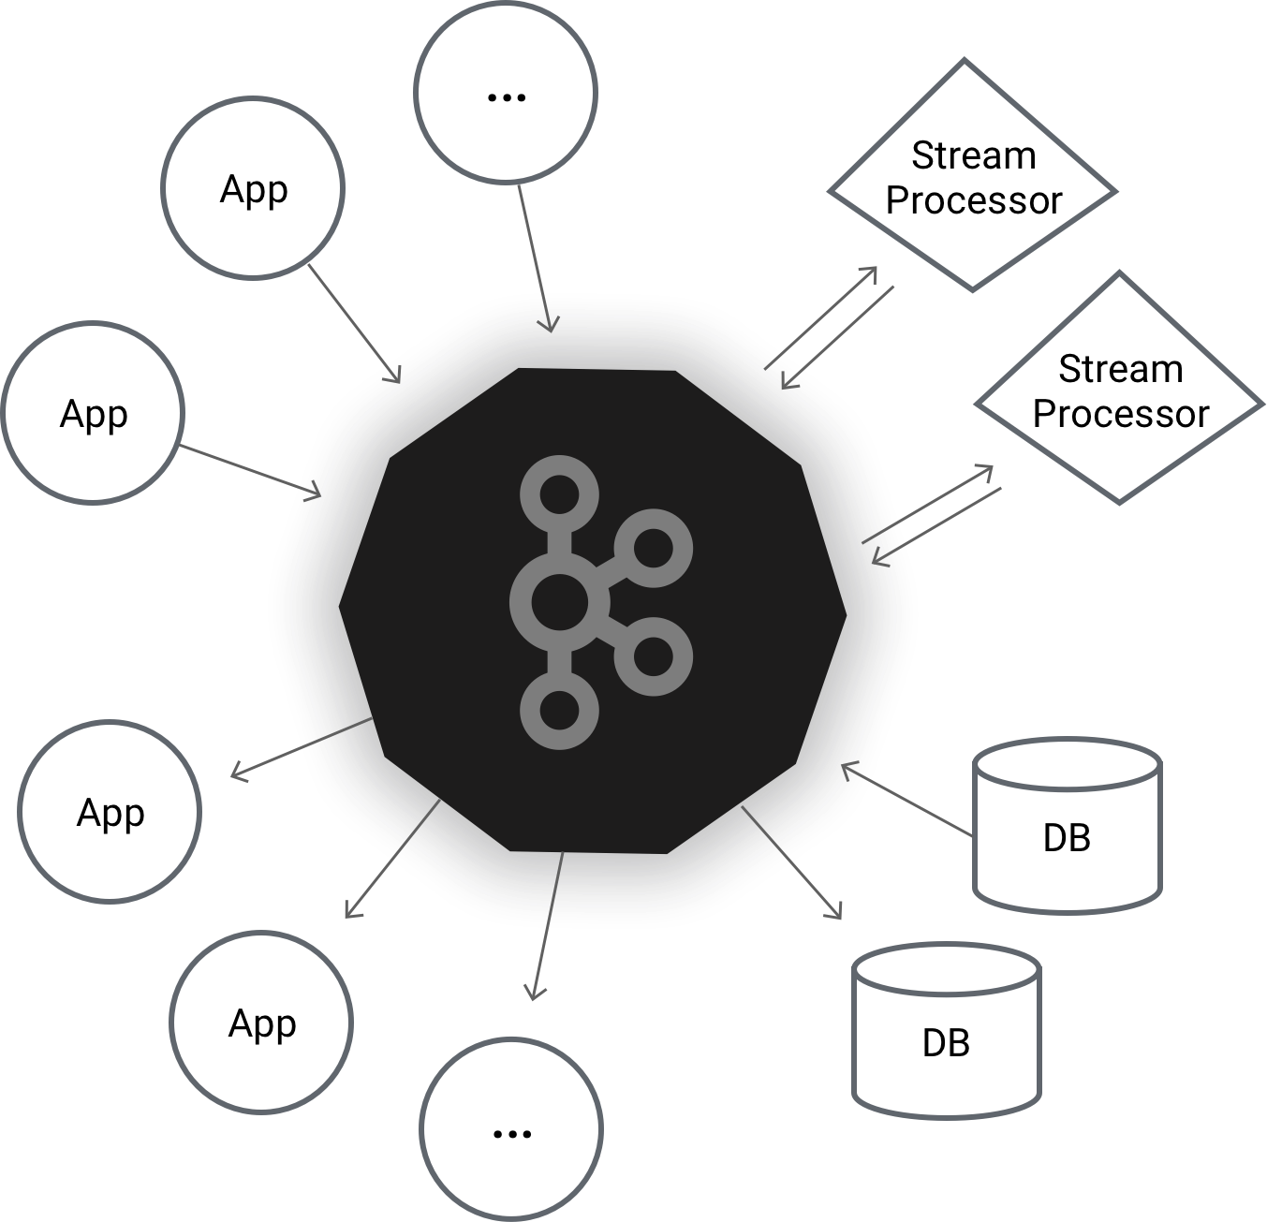

Slide 6
What is Kafka
Distributed Streaming Platform

Slide 7
Streaming Platform ?
Publish and subscribe to streams of records, similar to a message queue or enterprise messaging system.
Store streams of records in a fault-tolerant durable way.
Process streams of records as they occur.

Slide 8
Kafka Use Cases
Building real-time streaming data pipelines that reliably get data between systems or applications
Building real-time streaming applications that transform or react to the streams of data

Slide 9
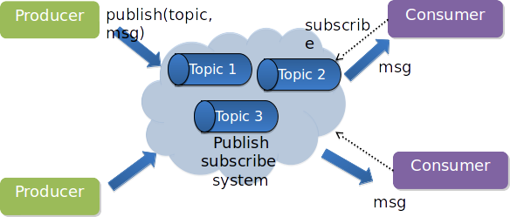
Publish-Subscribe

Slide 10
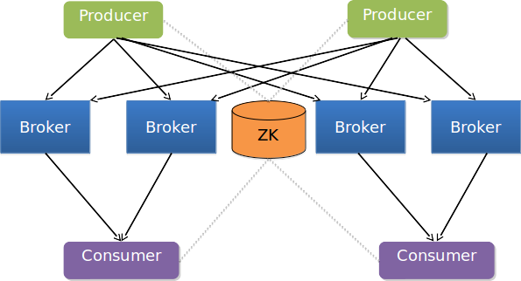
Architecture of Kafka

Slide 11
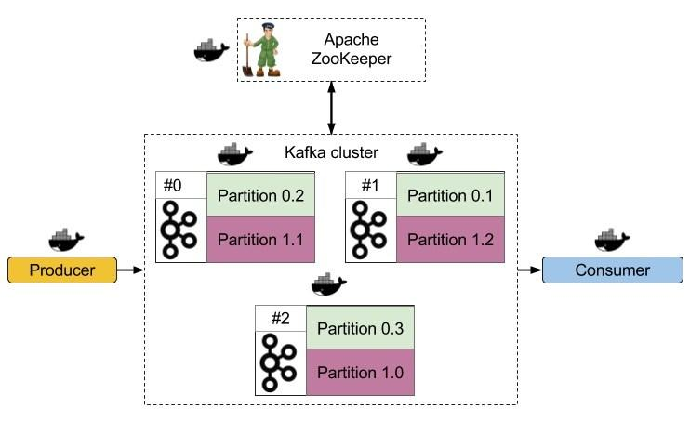
Kafka Architecture
Co-ordinator of Kafka Cluster and Consumer Groups
Broker : One node of Kafka Cluster

Slide 12
Why Apache kafka?
Kafka is a unified platform for handling all the real-time data feeds
Supports low latency message delivery and gives guarantee for fault tolerance in the presence of machine failures
Has the ability to handle a large number of diverse consumers
Is very fast, performs 2 million writes/sec
Kafka persists all data to the disk, which essentially means that all the writes go to the page cache of the OS (RAM)
This makes it very efficient to transfer data from page cache to a network socket

Slide 13
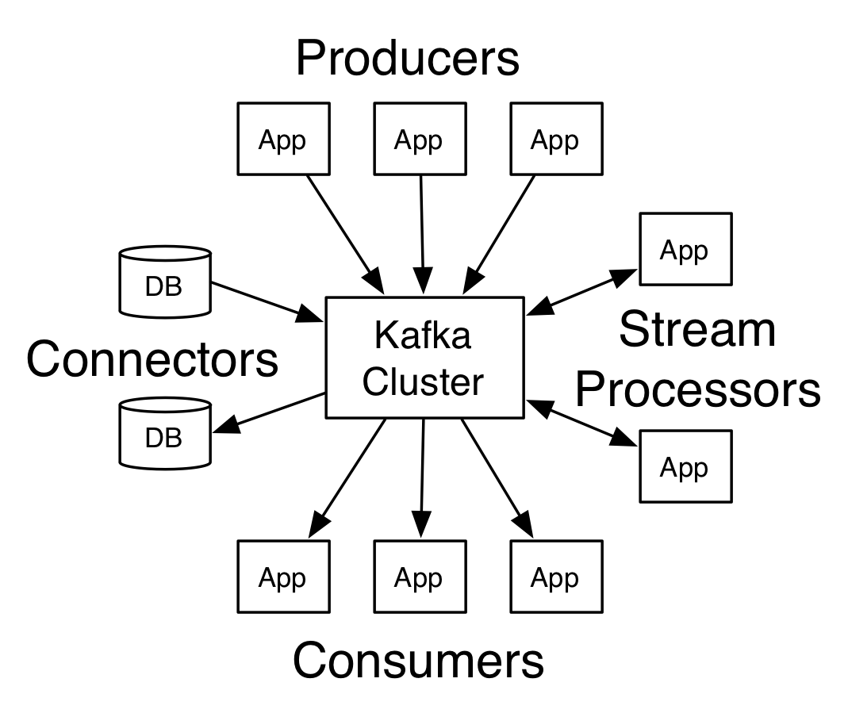
Kafka Four Core APIs
Producer API
Consumer API
Streams API
Connector API

Slide 14
Overview
Topic: A Topic is a category/feed name to which messages are stored and published.
Topic partition: Kafka topics are divided into a number of partitions, which allows you to split data across multiple brokers.
Replicas: A replica of a partition is a "backup" of a partition. Replicas never read or write data. They are used to prevent data loss.
Offset: The offset is a unique identifier of a record within a partition. It denotes the position of the consumer in the partition.
Node: A node is a single computer in the Apache Kafka cluster.
Cluster: A cluster is a group of nodes i.e., a group of computers.

Slide 15
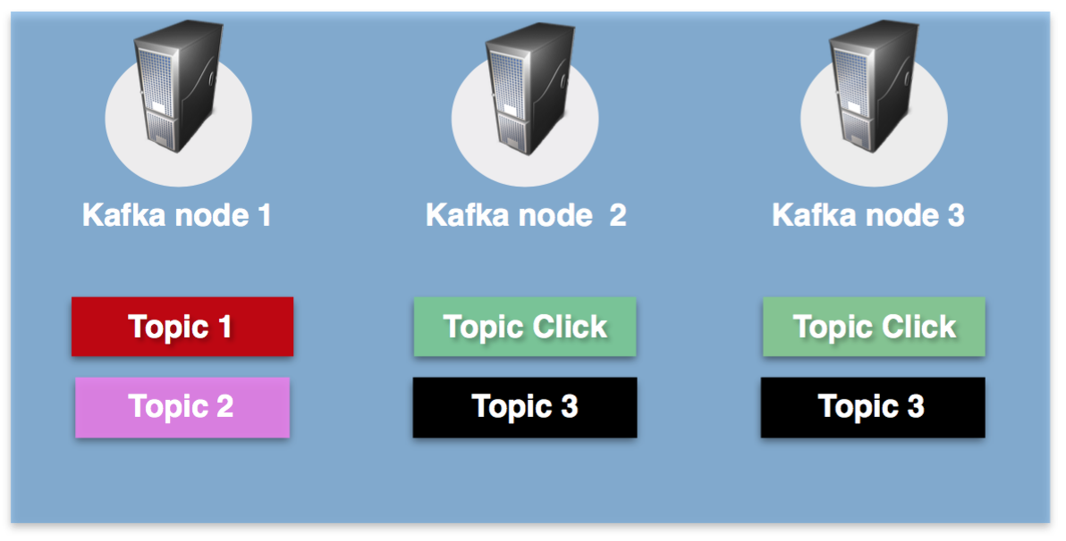
Kafka Topic?
A Topic is a category/feed name to which messages are stored and published.
Messages are byte arrays that can store any object in any format.
Producer applications write data to topics and consumer applications read from topics.
Messages published to the cluster will stay in the cluster until a configurable retention period has passed by.
Kafka retains all messages for a set amount of time, and therefore, consumers are responsible to track their location.

Slide 16
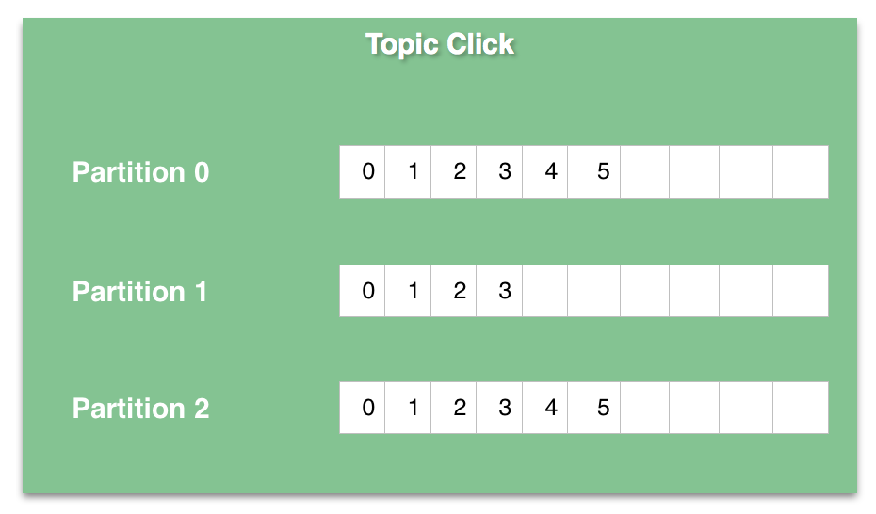
Topic Partition?
Kafka topics are divided into a number of partitions, which contains messages in an unchangeable sequence.
Each message in a partition is assigned and identified by its unique offset.
A topic can also have multiple partition logs like the click-topic has in the image to the right.
Partitions allow you to parallelize a topic by splitting the data in a particular topic across multiple brokers.

Slide 17
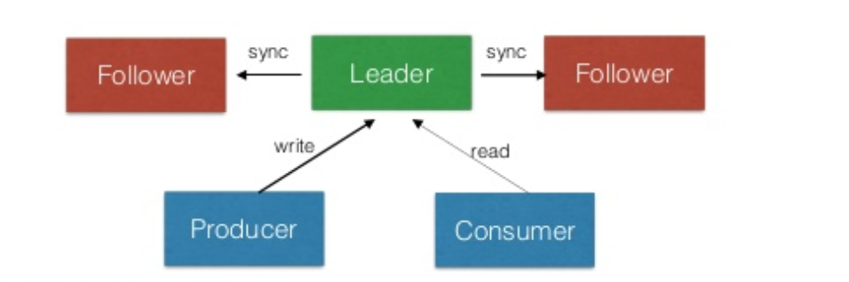
Kafka Replicas
The redundant unit of a topic partition is called a replica.
Every partition (replica) has one server acting as a leader and the rest of them as followers.
All Reads and Writes go through the leader of the partition

Slide 18
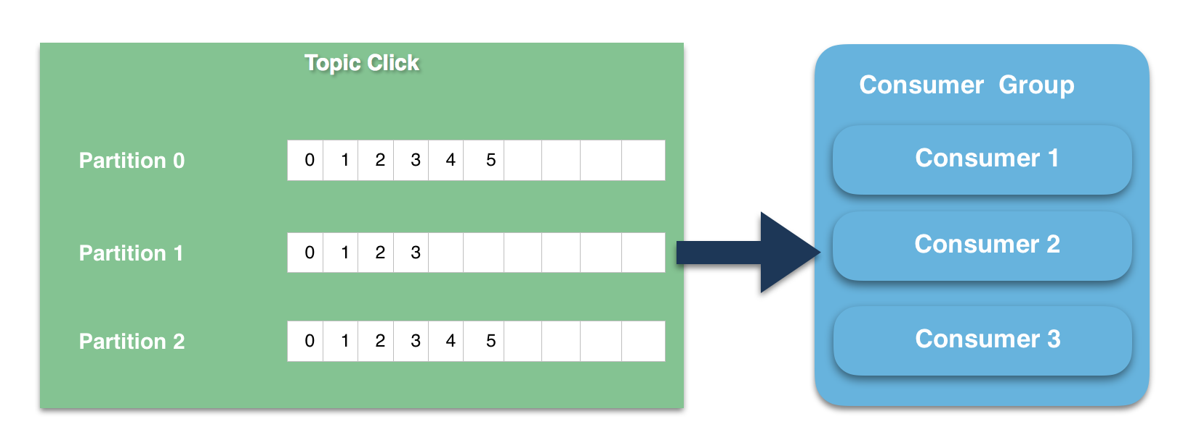
Consumer & Consumer Groups
Consumers can read messages starting from a specific offset and are allowed to read from any offset point they choose.
Consumers can join a group called a consumer group. A consumer group includes the set of consumer processes that are subscribing to a specific topic.
By using consumer groups, consumers can be parallelised so that multiple consumers can read from multiple partitions on a topic

Slide 19
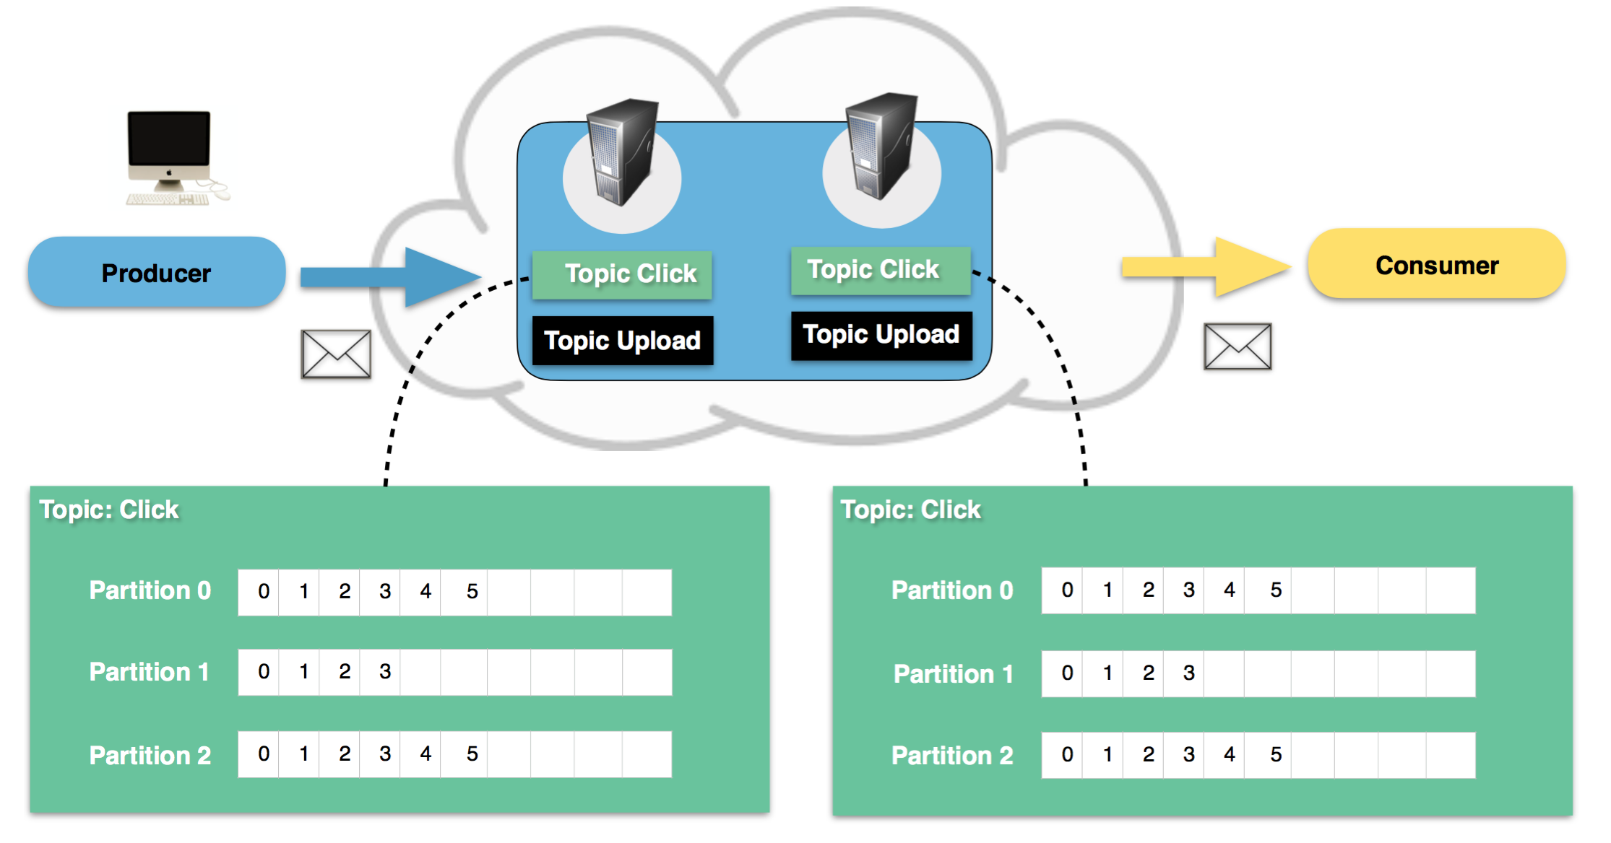
Example - Website Activity Tracking
A user with user-id 0 clicks on a button on the website.
The web application publishes a message to partition 0 in topic "click".
The message is appended to its commit log and the message offset is incremented.
The consumer can pull messages from the click-topic and show monitoring usage in real-time, or it can replay previously consumed messages by setting the offset to an earlier one.

Slide 20
What is Zookeeper?
An open source, High performance distributed coordination service.
Service used by a cluster (group of nodes) to coordinate between themselves and maintain shared data with robust synchronization techniques
Kafka uses Zookeeper to store meta information about Kafka Cluster and Consumer client
ZooKeeper service is mainly used to notify producer and consumer about the presence of any new broker in the Kafka system or failure of the broker in the Kafka system.
For zookeeper to run, Java is essential.

Slide 21
Set up an Apache Kafka instance
download and install Apache Kafka and Zookeeper

Slide 22
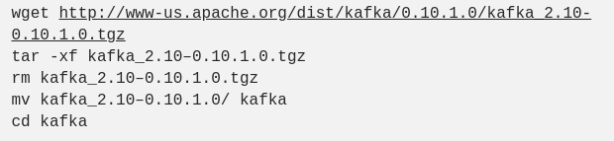
Installing and running kafka
To start Zookeeper:
bin/zookeeper-server-start.sh config/zookeeper.properties
To start Kafka:
bin/kafka-server-start.sh config/server.properties

Slide 23
Installing and running kafka
Creating a Kafka Topic:
List of Topics:
Start Producer to Send Messages
The producer will wait on input from stdin and publishes to the Kafka cluster. By default, every new line is published as a new message

Slide 24

Installing and running kafka
Start Consumer to Receive Messages
Python Integration for kafka:

Slide 25
Apache Kafka Demo

Slide 26
What is Apache Spark?
A general-purpose computing engine, in memory framework
It lets you execute real-time and batch work in a scripting manner in a variety of languages with powerful fault tolerance
Spark is designed to work with an external cluster manager or its own standalone manager
Spark also relies on a distributed storage system to function from which it calls the data it is meant to use

Slide 27
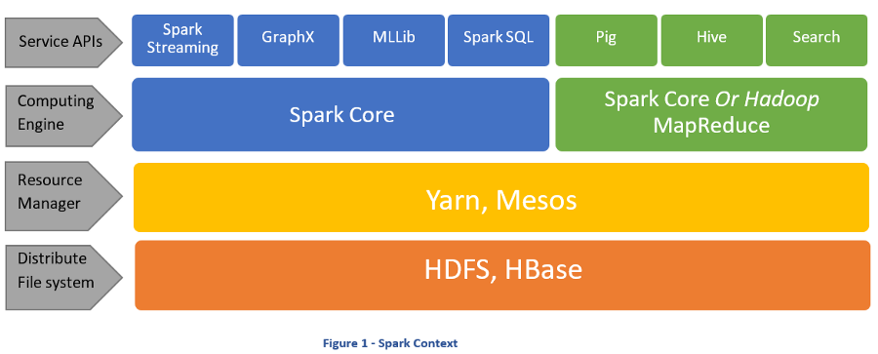
Spark Context

Slide 28
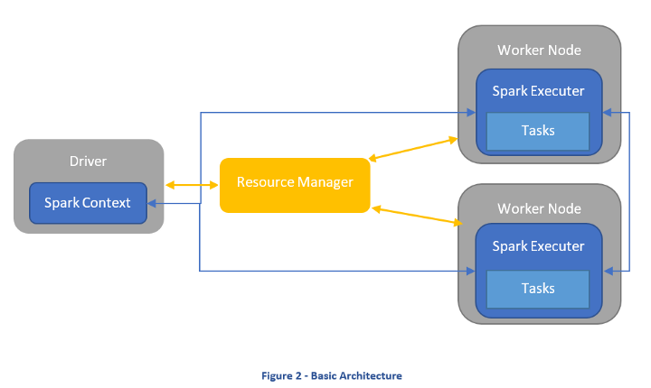
Basic Architecture

Slide 29
Why Apache Spark?
To put it bluntly, it has addressed many of the shortcomings Hadoop MapReduce has.
Is roughly 10 to 100-fold faster than Hadoop MapReduce.
Spark is a big deal in Data Science
Some notable organisations that use Spark are:
Amazon,
NASA Jet Propulsion Labs,
IBM
Hitachi

Slide 30
Supported Systems of Apache Spark
Cluster Managers:
Spark Standalone Manager
Hadoop YARN
Apache Mesos
Distributed Storage Systems:
Hadoop Distributed File System (HDFS)
MapR File System (MapR-FS)
Cassandra
OpenStack Swift
Amazon S3
Kudu

Slide 31

Installing and Running Spark
Check to see if Java is already installed by typing:
Go to https://spark.apache.org/downloads.html and download a pre-built for Hadoop 2.7 version of Spark
Then Extract it and enter the spark directory:

Slide 32
Installing and Running Spark
For kafka streaming integration, one need to use jar file of spark-kafka-streaming.
Download the jar file from:
http://search.maven.org/remotecontent?filepath=org/apache/spark/spark-streaming-kafka-0-8-assembly_2.11/2.2.0/spark-streaming-kafka-0-8-assembly_2.11-2.2.0.jar
And move the file to jars directory inside spark folder.
There are two approaches for integrating Spark with Kafka:
Receiver-based and
Direct (No Receivers)
Here we will try Direct method.
Following code is the direct method to receive the kafka stream.

Slide 33
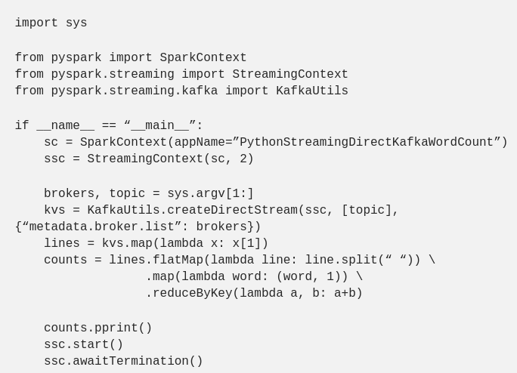
Installing and Running Spark

Slide 34
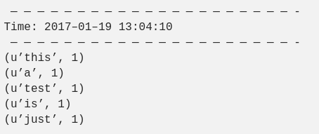
Installing and Running Spark
To start the streaming, execute the Following command:
bin/spark-submit --jars jars/spark-streaming-kafka-0-8-assembly_2.11-2.2.0.jar spark_test.py localhost:9092 new_topic
If you produce message from kafka, you could see it in the Spark output:

Slide 35
Demo
Twitter (#twitter) → Kafka → Hbase → Spark → Hive/HBase

