Slide 1
Python
By
Vignesh Ram

Slide 2

PYTHON
CODE SMART

Slide 3
ABOUT PYTHON
→ Python is powerful… and fast plays well with others.
→ Runs everywhere.
→ Is friendly & easy to learn.
→ Is Open.

Slide 4
---> Simple syntax:
Some programming languages will make irritate with parentheses, brackets,commas and colons
With python you spend less time debugging syntax and more time programming
---->Dynamically typed
Java : int x = 2
x = (int)x/2
Python: x = 2
X = x/2

Slide 5
----> One liners
Elegant 1-line solutions to what takes a whole block of code in other languages.
One example swap x and y
Java: int temp = x;
>> x = y;
>> y = temp;
Python: x,y = y,x
----> English like commands
Python: name = ‘bob’
print(name)

Slide 6
----> Intuitive data structure
List, tuples, dictionaries
Powerful yet simple and intuitive to use flexible(mixed data types)

Slide 7
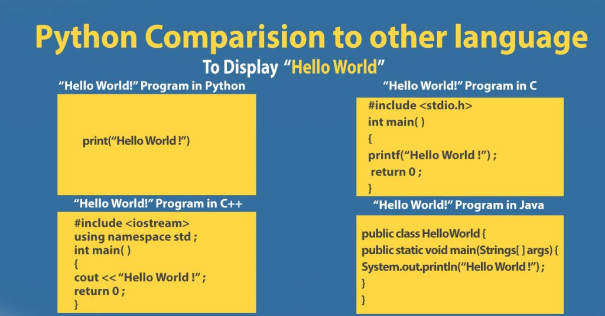

Slide 8
REFERENCES FOR COMPARISON
https://www.python.org/doc/essays/comparisons/

Slide 9
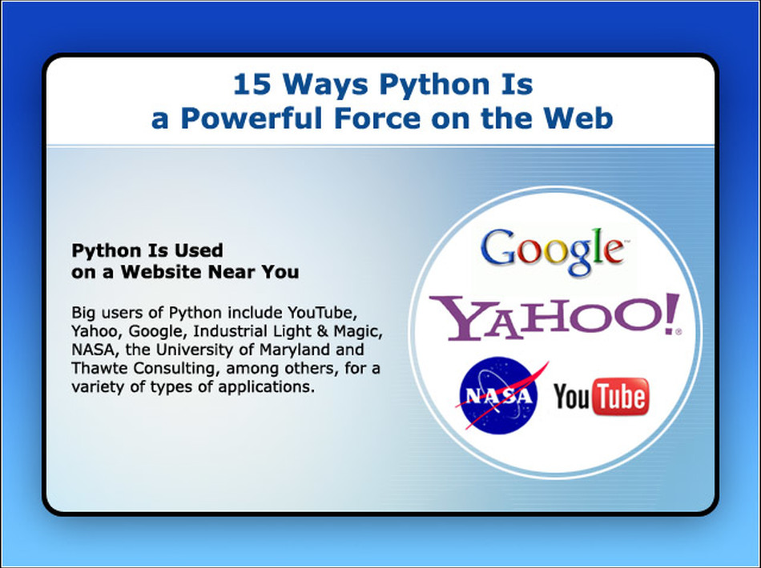

Slide 10
What’s different about python’s Variables,Expressions and Statements

Slide 11
ASSIGNMENT STATEMENTS
→ IT CREATES A NEW VARIABLE AND GIVES IT A VALUE
Examples:
> message = ‘And now for something completely different’
> n = 17
> pi = 3.141867592637
---The first assigns string to a variable named message
---Second assigns integer 17 to the variable named n
---Third assigns assigns approximate value of π to pi

Slide 12
VARIABLE NAMES
-->Variable name can be as long as you like
-->Can contain both letters and numbers, but can’t begin with number
-->Also keywords cannot be used as a variable, as usual in all the
-->Underscore character can appear in a name
EXPRESSIONS AND STATEMENTS
-->Expression is combination of values, variables and operators
Examples: look to jupyter notebook

Slide 13
STATEMENTS:
-->Statement has an effect like creating a variable or displaying a value
Example
n = 17
print(n)
First line is an assignment statement, that gives values to n, Second line is a print statement it displays the value of n
When we type a statement, the interpreter executes it, which means that it does whatever the statement says

Slide 14
ORDER OF OPERATION
When an expression contains more than one operator, the order of evaluation depends on order of operation
For mathematical operators python follows mathematical conventions.
The acronym PEMDAS is useful way to remember the rules:

Slide 15
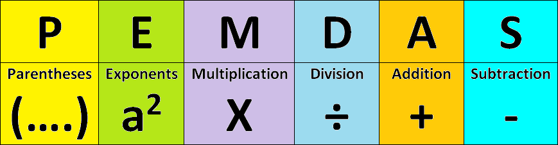

Slide 16
→ Parentheses have the highest precedence and can be used to force an expression to evaluate in the order you want.
→ You can also use parentheses to make an expression easier to read, as in (minute * 100) / 60, even if it doesn’t change the result.
→Exponentiation has the next highest precedence so 1 + 2**3 is 9, not 27, and 2 * 3**2 is 18, not 36
→ Multiplication and Division have higher precedence than Addition and Subtraction. So 2*3-1 is 5, not 4, and 6+4/2 is 8, not 5
→ Operators with the same precedence are evaluated from left to right (except exponentiation). So in the expression degrees / 2* pi , the division happens first and the result is multiplied by pi .To divide by 2 π, you can use parentheses or write degrees/ 2 / pi

Slide 17
FUNCTIONS
A function is a named sequence of statements that performs a computation. When you define a function, you specify the name and the sequence of statements. Later, you can “call” the function by name

Slide 18
Why functions?
Creating a new function gives you an opportunity to name a group of statements, which makes your program easier to read and debug.
Functions can make a program smaller by eliminating repetitive code. Later, if you make a change, you only have to make it in one place.
Dividing a long program into functions allows you to debug the parts one at a time and then assemble them into a working whole.
Well-designed functions are often useful for many programs. Once you write and debug one, you can reuse it.

Slide 19
>>> type(42)
<class 'int'>
The name of the function is type.
The expression in parentheses is called the argument of the function.
The result, for this function, is the type of the argument.

Slide 20
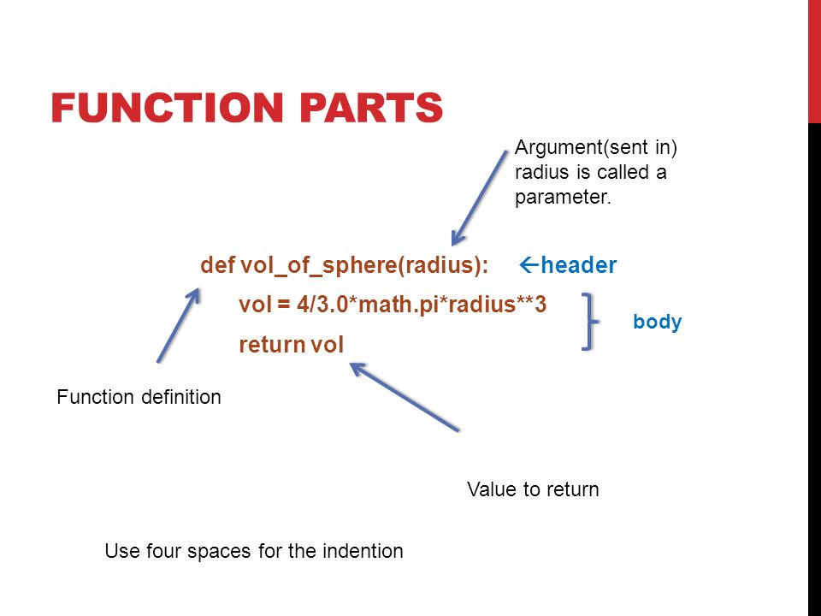

Slide 21
ADDING A NEW FUNCTION
So far, we have only been using the functions that come with Python, but it is also possible to add new functions.
A function definition specifies the name of a new function and the sequence of statements that run when the function is called.
Here is an example:
-----> jupyter-notebook

Slide 22
Rules for defining a function
The rules for function names are the same as for variable names: letters, numbers and underscore are legal, but the first character can’t be a number.
You can’t use a keyword as the name of a function, and you should avoid having a variable and a function with the same name.
The empty parentheses after the name indicate that this function doesn’t take any arguments
The first line of the function definition is called the header ; the rest is called the body . The header has to end with a colon and the body has to be indented. By convention, indentation is always four spaces. The body can contain any number of statements.

Slide 23
The strings in the print statements are enclosed in double quotes. Single quotes and double quotes do the same thing; most people use single quotes except in cases like this where a single quote (which is also an apostrophe) appears in the string.
if you type a function definition in interactive mode, the interpreter prints dots (...) to let you know that the definition isn’t complete:
Defining a function creates a function object, which has type function:
---> jupyter-notebook

Slide 24
PARAMETERS AND ARGUMENTS
Some of the functions we have seen require arguments. For example, when you call math.sin you pass a number as an argument. Some functions take more than one argument: math.pow takes two, the base and the exponent.
Inside the function, the arguments are assigned to variables called parameters. Here is a definition for a function that takes an argument:
---> JUPYTER NOTEBOOK
This function assigns the argument to a parameter named bruce. When the function is called, it prints the value of the parameter (whatever it is) twice.

Slide 25
Variables and parameters are local
When you create a variable inside a function, it is local, which means that it only exists inside the function. For example:
----> jupyter-notebook
Parameters are also local. For example, outside print_twice, there is no such thing as bruce

Slide 26
Fruitful functions and void functions
Some of the functions we have used, such as the math functions, return results; for lack of a better name, I call them fruitful functions.
Other functions, like print_twice, perform an action but don’t return a value. They are called void functions.
When you call a fruitful function, you almost always want to do something with the result; for example, you might assign it to a variable or use it as part of an expression:
----> JUPYTER-NOTEBOOK Void functions might display something on the screen or have some other effect, but they don’t have a return value. If you assign the result to a variable, you get a special value called None
.

Slide 27
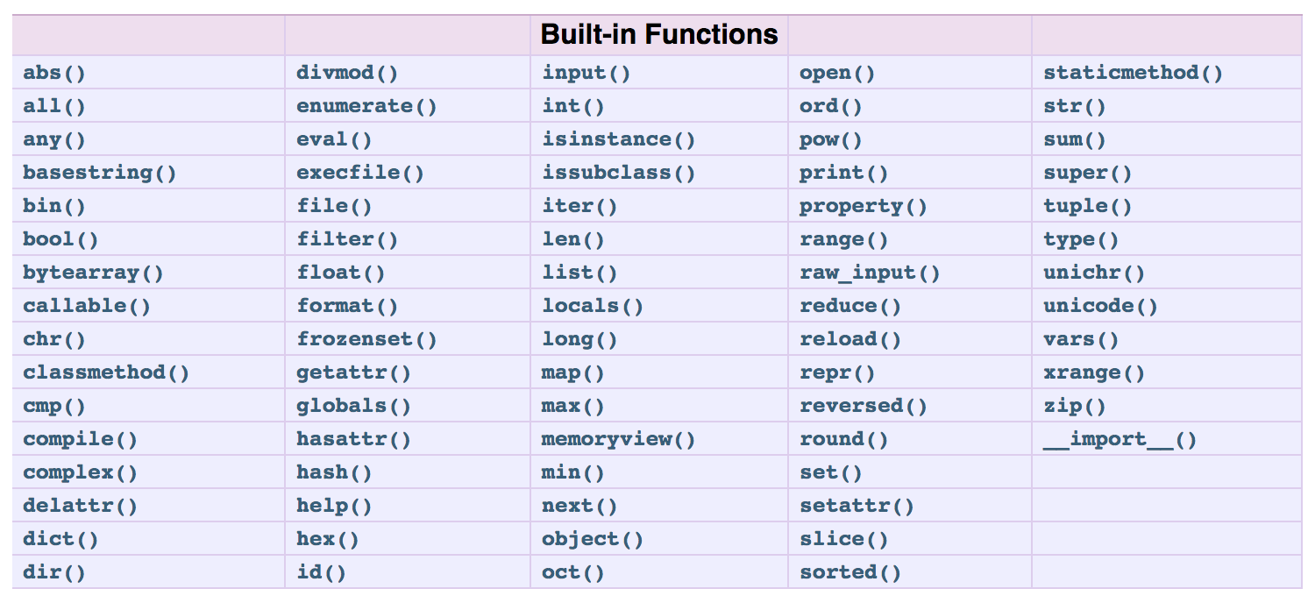

Slide 28
CONDITIONS AND RECURSION
In order to write useful programs, we almost always need the ability to check conditions and change the behavior of the program accordingly. Conditional statements give us this ability.
The simplest form is the if statement:
Example:
>>>> if x > 0:
print(‘x is positive’)

Slide 29
The boolean expression after if is called the condition. If it is true, the indented statement runs. If not, nothing happens.
If statements have the same structure as function definitions: a header followed by an indented body. Statements like this are called compound statements.
There is no limit on the number of statements that can appear in the body, but there has to be at least one

Slide 30
Alternative execution
A second form of the if statement is “alternative execution”, in which there are two possibilities and the condition determines which one runs.
------> JUPYTER-NOTEBOOK

Slide 31
Chained conditionals
Sometimes there are more than two possibilities and we need more than two branches. One way to express a computation like that is a chained conditional:
----> jupyter-notebook
elif is an abbreviation of “else if”. Again, exactly one branch will run. There is no limit on the number of elif statements. If there is an else clause, it has to be at the end, but there doesn’t have to be one.
----->jupyter-notebook

Slide 32
Contd ..,
Each condition is checked in order. If the first is false, the next is checked, and so on. If one of them is true, the corresponding branch runs and the statement ends. Even if more than one condition is true, only the first true branch runs.

Slide 33
Nested conditionals
One conditional can also be nested within another.
--------> jupyter -notebook
The outer conditional contains two branches.
The first branch contains a simple statement.
The second branch contains another if statement, which has two branches of its own.
Those two branches are both simple statements, although they could have been conditional statements as well.

Slide 34
Contd ..,
Although the indentation of the statements makes the structure apparent, nested conditionals become difficult to read very quickly. It is a good idea to avoid them when you can.

Slide 35
Keyboard input
The programs we have written so far accept no input from the user. They just do the same thing every time.
Python provides a built-in function called input that stops the program and waits for the user to type something.
When the user presses Return or Enter, the program resumes and input returns what the user typed as a string. In Python 2, the same function is called raw_input.
------> jupyter-notebook
Before getting input from the user, it is a good idea to print a prompt telling the user what to type. Input can take a prompt as an argument:

Slide 36
Exercise 1.
If you are given three sticks, you may or may not be able to arrange them in a triangle. For example, if one of the sticks is 12 inches long and the other two are one inch long, you will not be able to get the short sticks to meet in the middle. For any three lengths, there is a simple test to see if it is possible to form a triangle: If any of the three lengths is greater than the sum of the other two, then you cannot form a triangle. Otherwise, you can. (If the sum of two lengths equals the third, they form what is called a “degenerate” triangle.)
1. Write a function named is_triangle that takes three integers as arguments, and that prints either “Yes” or “No”, depending on whether you can or cannot form a triangle from sticks with the given lengths.
2. Write a function that prompts the user to input three stick lengths, converts them to integers, and uses is_triangle to check whether sticks with the given lengths can form a triangle.
------> jupyter - notebook

Slide 37
ITERATIONS
Computers are often used to automate repetitive tasks.
Repeating identical or similar tasks without making errors is something that computers do well and people do poorly.
In a computer program, repetition is also called iteration.
While statement
---> jupyter -notebook

Slide 38
You can almost read the while statement as if it were English. It means, “While n is greater than 0, display the value of n and then decrement n. When you get to 0, display the word Blastoff!”
the flow of execution for a while statement:
1. Determine whether the condition is true or false.
2. If false, exit the while statement and continue execution at the next statement.
3. If the condition is true, run the body and then go back to step 1.
This type of flow is called a loop because the third step loops back around to the loop

Slide 39
The body of the loop should change the value of one or more variables so that the condition becomes false eventually and the loop terminates. Otherwise the loop will repeat forever, which is called an infinite loop.
BREAK:
Sometimes you don’t know it’s time to end a loop until you get half way through the body. In that case you can use the break statement to jump out of the loop.

Slide 40
Strings
Strings are not like integers, floats, and booleans. A string is a sequence, which means it is an ordered collection of other values.
In this chapter you’ll see how to access the characters that make up a string, and you’ll learn about some of the methods strings provide

Slide 41
A string is a sequence
A string is a sequence of characters. You can access the characters one at a time with the bracket operator:
-----> JUPYTER - NOTEBOOK
The second statement selects character number 1 from fruit and assigns it to letter.
The expression in brackets is called an index. The index indicates which character in the sequence you want (hence the name).
-----> jupyter-notebook
But you might not get what you expect:

Slide 42
String operations
In general, you can’t perform mathematical operations on strings, even if the strings look like numbers, so the following are illegal:
----->jupyter - notebook
But there are two exceptions,+and * .
The + operator performs string concatenation, which means it joins the strings by linking them end-to-end.
------> jupyter-notebook
The * operator also works on strings; it performs repetition. For example, 'Spam '*3 is 'Spam Spam Spam'. If one of the values is a string, the other has to be an integer.

Slide 43
For most people, the first letter of ' banana ' is b, not a. But for computer scientists, the index is an offset from the beginning of the string, and the offset of the first letter is zero.
LEN(Length):
Len is a built-in function that returns the number of characters in a string:
----> jupyter - notebook
To get the last letter of a string, you might be tempted to try something like this:
----> jupyter - notebook
The reason for the IndexError is that there is no letter in 'banana' with the index 6. Since we started counting at zero, the six letters are numbered 0 to 5. To get the last character, you have to subtract 1 from length:

Slide 44
FOR LOOP
The following example shows how to use concatenation (string addition) and a for loop to generate an abecedarian series (that is, in alphabetical order). In Robert McCloskey’s book Make Way for Ducklings, the names of the ducklings are Jack, Kack, Lack, Mack, Nack, Ouack, Pack, and Quack. This loop outputs these names in order:
prefixes ='JKLMNOP'
suffix ='ack’
----> jupyter-notebook

Slide 45
String slices
A segment of a string is called a slice. Selecting a slice is similar to selecting a character:
----> jupyter-notebook
The operator [n:m] returns the part of the string from the “n-eth” character to the “m-eth” character, including the first but excluding the last.
This behavior is counterintuitive, but it might help to imagine the indices pointing between the characters
If you omit the first index (before the colon), the slice starts at the beginning of the string.
If you omit the second index, the slice goes to the end of the string:

Slide 46
Contd ..,
If the first index is greater than or equal to the second the result is an empty string, represented by two quotation marks:
Strings are immutable
Immutable which means you can’t change an existing string.
he best you can do is create a new string that is a variation on the original:

Slide 47
Searching:
-----> jupyter - notebook
In a sense, find is the inverse of the [] operator. Instead of taking an index and extracting the corresponding character, it takes a character and finds the index where that character appears. If the character is not found, the function returns -1.
This is the first example we have seen of a return statement inside a loop. If word[index] == letter , the function breaks out of the loop and returns immediately.
if the character doesn’t appear in the string, the program exits the loop normally and returns -1

Slide 48
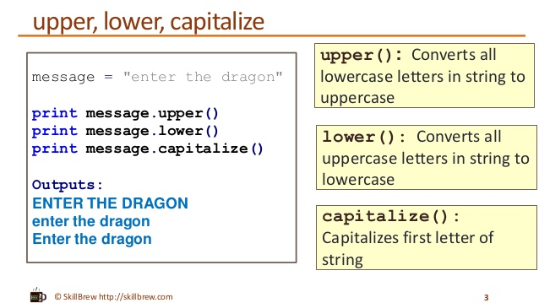
String methods

Slide 49
REFERENCE
https://docs.python.org/3/library/string.html
For more string methods

Slide 50
The in operator
The word in is a boolean operator that takes two strings and returns True if the first appears as a substring in the second:
-------> jupyter-notebook

Slide 51
LISTS
This chapter presents one of Python’s most useful built-in types, lists
Like a string, a list is a sequence of values. In a string, the values are characters; in a list, they can be any type. The values in a list are called elements or sometimes items.
A list within another list is nested .
A list that contains no elements is called an empty list; you can create one with empty brackets, [ ].

Slide 52
Lists are mutable
The syntax for accessing the elements of a list is the same as for accessing the characters of a string—the bracket operator. The expression inside the brackets specifies the index. Remember that the indices start at 0.
Unlike strings, lists are mutable. When the bracket operator appears on the left side of an assignment, it identifies the element of the list that will be assigned:
List indices work the same way as string indices:
• Any integer expression can be used as an index.
• If you try to read or write an element that does not exist, you get an IndexError.
• If an index has a negative value, it counts backward from the end of the list.

Slide 53
Contd..,
The in operator also works on lists:
---> jupyter-notebook
Traversing a list
The most common way to traverse the elements of a list is with a for loop. The syntax is the same as for strings:
----> jupyter-notebook
This works well if you only need to read the elements of the list. But if you want to write or update the elements, you need the indices.

Slide 54
List operations
The + operator concatenates lists:
The * operator repeats a list a given number of times:
-----> jupyter -notebook
List slices
The slice operator also works on lists:
Since lists are mutable, it is often useful to make a copy before performing operations that modify lists.

Slide 55
List methods
Python provides methods that operate on lists. For example, append adds a new element to the end of a list:
----> jupyter notebook
Extend takes a list as an argument and appends all of the elements:
----> jupyter notebook
Sort arranges the elements of the list from low to high:
----> jupyter notebook

Slide 56
contd..,
Most list methods are void; they modify the list and return None. If you accidentally write
t = t.sort(), you will be disappointed with the result.
Deleting elements
There are several ways to delete elements from a list. If you know the index of the element you want, you can use pop :
Pop modifies the list and returns the element that was removed. If you don’t provide an index, it deletes and returns the last element.

Slide 57
If you don’t need the removed value, you can use the del operator:
If you know the element you want to remove (but not the index), you can use remove :
Lists and strings
A string is a sequence of characters and a list is a sequence of values, but a list of characters is not the same as a string.
To convert from a string to a list of characters, you can use list
-----> jupyter notebook

Slide 58
Dictionaries
This chapter presents another built-in type called a dictionary.
Dictionaries are one of Python’s best features; they are the building blocks of many efficient and elegant algorithms.
A dictionary is a mapping
A dictionary is like a list, but more general. In a list, the indices have to be integers; in a dictionary they can be (almost) any type.

Slide 59
Contd..,
A dictionary contains a collection of indices, which are called keys, and a collection of values. Each key is associated with a single value. The association of a key and a value is called a key-value pair or sometimes an item.
In mathematical language, a dictionary represents a mapping from keys to values, so you can also say that each key “maps to” a value. As an example, we’ll build a dictionary that maps from English to Spanish words, so the keys and the values are all strings.
The function dict creates a new dictionary with no items. Because dict is the name of a built-in function, you should avoid using it as a variable name.
-------> jupyter -notebook

Slide 60
The squiggly-brackets,{} represent an empty dictionary.
To add items to the dictionary, you can use square brackets:
The order of the key-value pairs might not be the same. If you type the same example on your computer, you might get a different result. In general, the order of items in a dictionary is unpredictable
But that’s not a problem because the elements of a dictionary are never indexed with integer indices. Instead, you use the keys to look up the corresponding values.

Slide 61
Exercise 2
Write a function called nested_sum that takes a list of lists of integers and adds up the elements from all of the nested lists. For example:
t = [[1, 2], [3], [4, 5, 6]]

Slide 62
Tuples
This chapter presents one more built-in type, the tuple, and then shows how lists, dictionaries, and tuples work together.
Tuples are immutable
A tuple is a sequence of values. The values can be any type, and they are indexed by integers, so in that respect tuples are a lot like lists. The important difference is that tuples are immutable.

Slide 63
Syntactically, a tuple is a comma-separated list of values:
>> t = ‘a’, ’b’, ’c’, ’d’, ’e’, ’f’
Although it is not necessary, it is common to enclose tuples in parentheses:
>> t = (‘a’, ’b’, ’c’, ’d’, ’e’, ’f’)
To create a tuple with a single element, you have to include a final comma:
T1 = ‘a’,
A value in parentheses is not a tuple:
T2 = (‘a’)

Slide 64
Contd..,
Another way to create a tuple is the built-in function tuple. With no argument, it creates an empty tuple:
>> t = tuple()
>>t
()
----> jupyter-notebook

Slide 65
Contd..,
If the argument is a sequence (string, list or tuple), the result is a tuple with the elements of the sequence
-----> jupyter -notebook
Most list operators also work on tuples. The bracket operator indexes an element
----->jupyter-notebook

Slide 66
Lists and tuples
Zip is a built-in function that takes two or more sequences and returns a list of tuples where each tuple contains one element from each sequence. The name of the function refers to a zipper, which joins and interleaves two rows of teeth.

Slide 67
THANK YOU

