Slide 1
Python from Scratch to getting started
By
Arjun v
(Ai Engineer)
DTEAM

Slide 2
Writing modules
Any file that contains Python code can be imported as a module
A Module is a file which consists of Python Definitions and Statements
Python comes with a library of standard set of modules
For example:
Math Module
Os Module
Modules can import another modules
What is Python Path?
How to set Python path?

Slide 3
Object Oriented Programming
In
Python

Slide 4
What is a Class?
The class is the fundamental building block in python
It is a Programmer-Defined data type
Understanding what classes are, when to use them, and how they can be useful is essential, and the goal of this part of session
In the process, we will also explore what the term Object-Oriented Programming means and how it ties together with Python classes.

Slide 5

Defining Class and Instantiation
A class definition looks like this:
You can define variables and methods inside a class definition
Defining a class named Point creates a class object
Creating a new object is called instantiation, and the object is an instance of the class
Instantiation of an object is not possible.

Slide 6

Class Attributes
You can assign values to an instance using dot notation
This syntax is similar to the syntax for selecting a variable from a module, such as math.pi or string.whitespace
In this case, though, we are assigning values to named elements of an object. These elements are called attributes.

Slide 7

Objects are mutable
You can change the state of an object by making an assignment to one of its attributes
For example, to change the size of a rectangle without changing its position, you can modify the values of width and height :

Slide 8

Classes and Functions
Now that we know how to create new types, the next step is to write functions that take programmer-defined objects as parameters and return them as results
As another example of a programmer-defined type, we’ll define a class called Time that records the time of day

Slide 9
Pure functions
The Pure function creates a new object of a class, and initializes its attributes, and returns a reference to the new object.
For Example: Consider creating Add_time function.
It does not modify any of the objects passed to it as arguments and it has no effect, like displaying a value or getting user input, other than returning a value.

Slide 10
Modifiers
Sometimes it is useful for a function to modify the objects it gets as parameters
In that case, the changes are visible to the caller
Functions that work this way are called modifiers
In general, recommend practice is that you write pure functions, and resort to modifiers only if there is a compelling advantage.
This approach might be called a functional programming style.

Slide 11
Classes and methods
A method is a function that is associated with a particular class
We have seen methods for strings, lists, dictionaries and tuples
For example: In ‘string’.lower() statement, lower() is a method.
Methods are semantically the same as functions, but there are two syntactic differences:
Methods are defined inside a class definition in order to make the relationship between the class and the method explicit.
The syntax for invoking a method is different from the syntax for calling a function

Slide 12
The init method
The init method (short for “initialization”) is a special method that gets invoked when an object is instantiated.
Its full name is __init__
It is common for the parameters of __init__ to have the same names as the attributes.
The parameters are optional, so if you call class with no arguments, you get the default values.

Slide 13
The __str__ method
__str__ is a special method, like __init__ , that is supposed to return a string representation of an object
Whenever we write a new class, It is always a good to start by writing __init__ , which makes it easier to instantiate objects, and __str__ , which is useful for debugging.

Slide 14
Operator overloading
By defining other special methods, you can specify the behavior of operators on programmer-defined types
For example, if you define a method named __add__ for the Time class, you can use the + operator on Time objects
Changing the behavior of an operator so that it works with programmer-defined types is called operator overloading
For every operator in Python there is a corresponding special method, like __add__

Slide 15
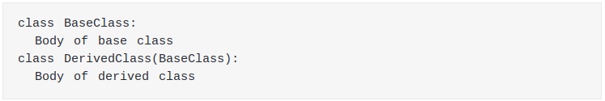
Inheritance
Inheritance is the ability to define a new class that is a modified version of an existing class
How Python uses inheritance?
Derived class inherits features from the base class, adding new features to it
This results into re-usability of code.

Slide 16
The Goodies
Python provides a number of features that are not really necessary
You can write good code without them
But with them you can sometimes write code that’s more concise, readable or efficient, and sometimes all three.
The Following are some of them:
Conditional expressions
List comprehensions
Generator expressions

Slide 17

Conditional Expressions
We saw conditional statements in previous session.
Conditional statements are often used to choose one of two values
For example:
We can write this statement more concisely using a conditional expression:

Slide 18
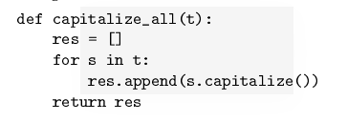

List Comprehensions
List comprehensions are concise and easy to read, at least for simple expressions
And they are usually faster than the equivalent for loops, sometimes much faster.
For example:
We can write this more concisely using a list comprehension:

Slide 19

Generator Expressions
Generator expressions are similar to list comprehensions, but with parentheses instead of square brackets
Writing generator Expression:
The result is a generator object that knows how to iterate through a sequence of values.
But unlike a list comprehension, it does not compute the values all at once; it waits to be asked

