Slide 1
LSTM
Long Short Term Memory

Slide 2
Need for LSTMs
Address the vanishing/exploding gradient problems in RNNs
Learn long-term dependencies efficiently in sequential data
To forget/change a memory, gates are used, which saturate at 0 and 1
Sigmoid functions have a natural tendency to saturate at 0 and 1
Applications: speech recognition, language modelling, translation, image captioning etc.

Slide 3
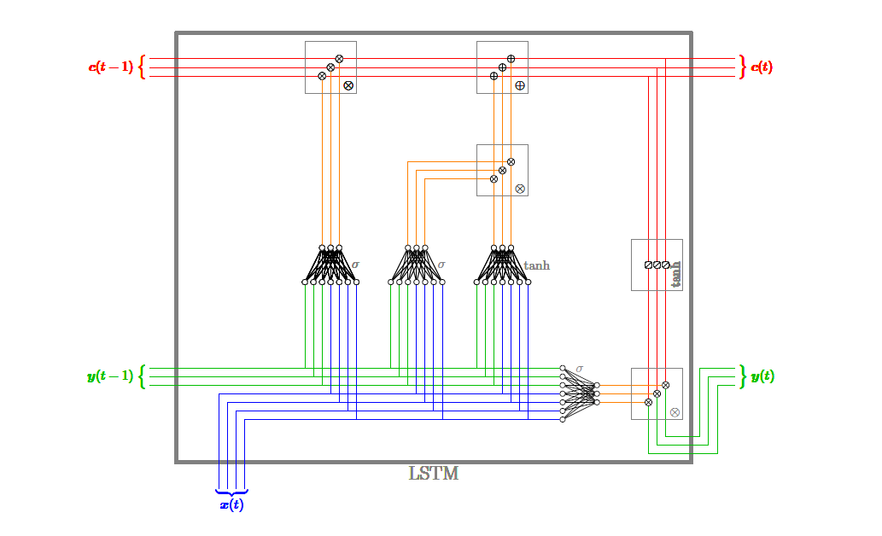
LSTM Architecture-I

Slide 4
Training an LSTM
We can train an LSTM by unwrapping it in time
It involves four dense layers, with sigmoidal (or tanh) output
Cell state runs down the entire chain, with minor linear interactions
Gates are used to optionally let information through
To decide what information will be thrown away from the cell state, “forget gates” are used

Slide 5
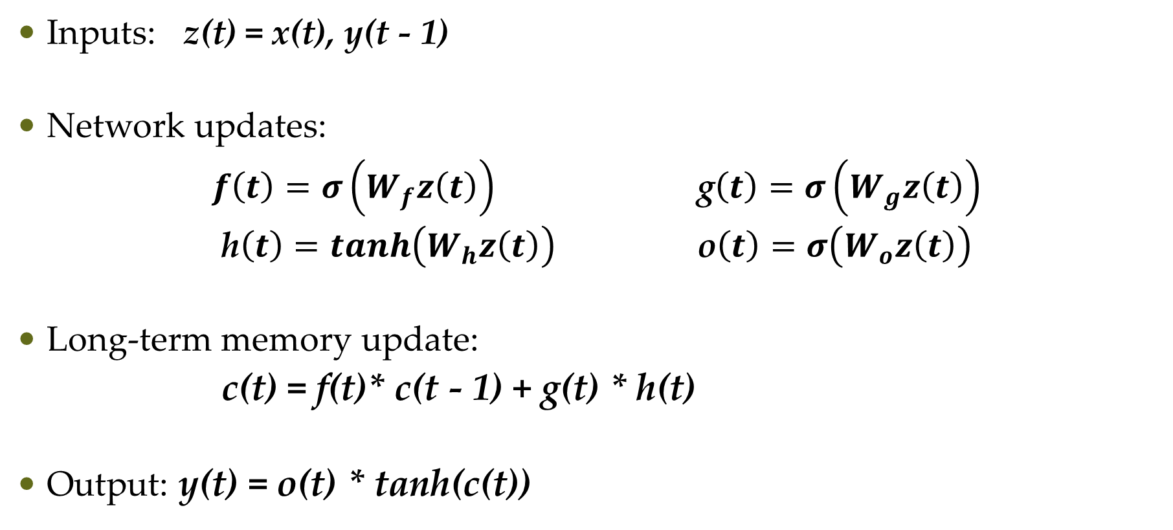
Update Equations
Inputs: z(t) = x(t), y(t - 1)
Network updates:
$f\left(t\right)=σ\left(W_{f}z\left(t\right)\right)$ g$\left(t\right)=σ\left(W_{g}z\left(t\right)\right)$
h$\left(t\right)=tanh\left(W_{h}z\left(t\right)\right)$ o$\left(t\right)=σ\left(W_{o}z\left(t\right)\right)$
Long-term memory update:
c(t) = f(t)* c(t - 1) + g(t) * h(t)
Output: y(t) = o(t) * tanh(c(t))

Slide 6
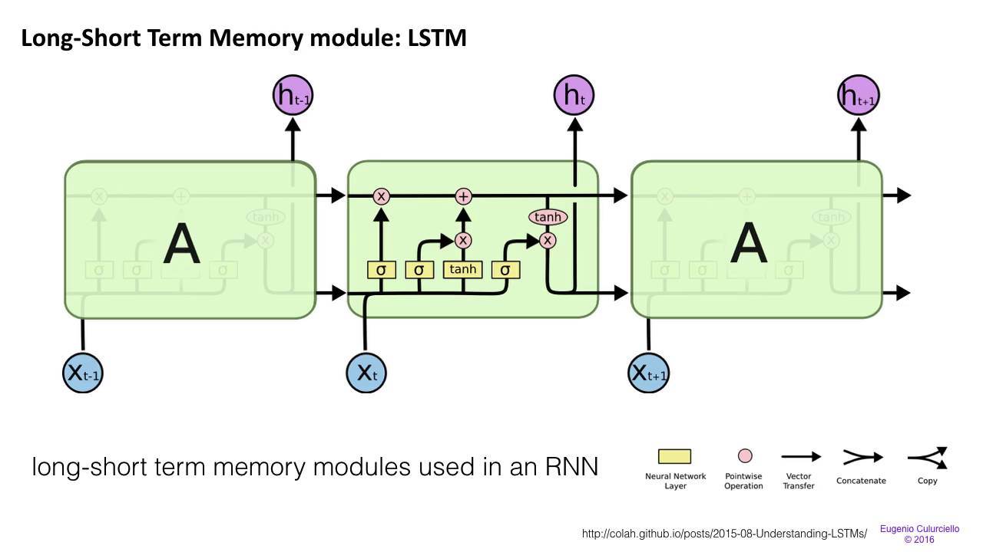
LSTM Architecture-II

Slide 7
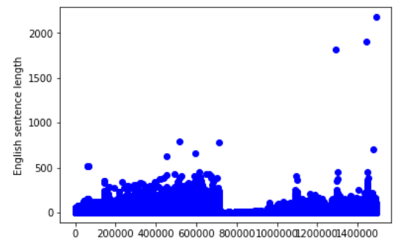
Data
Hindi-English parallel corpora of 1,492,827 sentences
About 1.85% of the words in Hindi document are in English
Max length of English sentences = 2178
Max length of Hindi sentences = 2068
Average length of English sentences ≈ 13
Average length of Hindi sentences ≈ 15
Challenges: Handling different languages text in English document, handling outliers

Slide 8
Next Steps
Pull out the gating signals from keras pre-defined functions
Train a model for translation on a small dataset
Perform secondary level analysis/cleaning on the Hindi-English parallel corpora (unique words, bigram models etc.)

