Slide 1
NMT
Neural Machine Translation
Richa Ranjan
MSc Data Science

Slide 2
German - English
Data: obtained from ManyThings.org website, 152,820 pairs of English to German phases, only 10k used for training and testing.
Pre-processing : removing special characters, tokenize etc.
Encode sequences : assign integers to every word.
Padding: add 0s to the end of all phrases (for uniform maximum phrase length)
1 hot encoding: Encode target sentences
Model: encoder-decoder LSTM model

Slide 3
German - English
Prediction: sequence of integers that we can enumerate and lookup in the tokenizer to map back to words. (reverse mapping)
perform this mapping for each integer in the translation and return the result as a string of words.
BLEU score: to evaluate accuracy of translation model
Results may differ on every execution due to random shuffling of the dataset and the stochastic nature of neural networks

Slide 4
German – English Results
TRAIN (BLEU: 0.497106)
src=[das ist nicht der grund], target=[thats not why], predicted=[this not me]
src=[das ist sein auto], target=[this is his car], predicted=[this is my car]
src=[er ist elegant], target=[hes smart], predicted=[hes]
src=[wer hat betrogen], target=[who cheated], predicted=[who cheated
TEST (BLEU: 0.471769)
src=[tom ist pilot], target=[tom is a pilot], predicted=[tom is]
src=[tom ist hier], target=[toms here], predicted=[tom is here]
src=[lassen sie es tom tun], target=[let tom do it], predicted=[let tom do it]
src=[einige fische fliegen], target=[some fish fly], predicted=[sit to]

Slide 5
Bidirectional LSTMs
To learn representations from future time steps to better understand the context and eliminate ambiguity
Example in NE Recognition:
He said, ’’Teddy Bears are on sale!’’
He said, ‘’Teddy Roosevelt was a great President!’’
For y<3>, future data is required to determine if this is a proper noun.
Forward propagation is done in two steps:
1) We move from left to right, starting with the initial time step we compute the values until we reach the final time step
2) We move from right to left, starting with the final time step we compute the values until we reach the initial time step
The entire sequence of data is needed before we start making predictions. (not good for real time speech recognition)

Slide 6
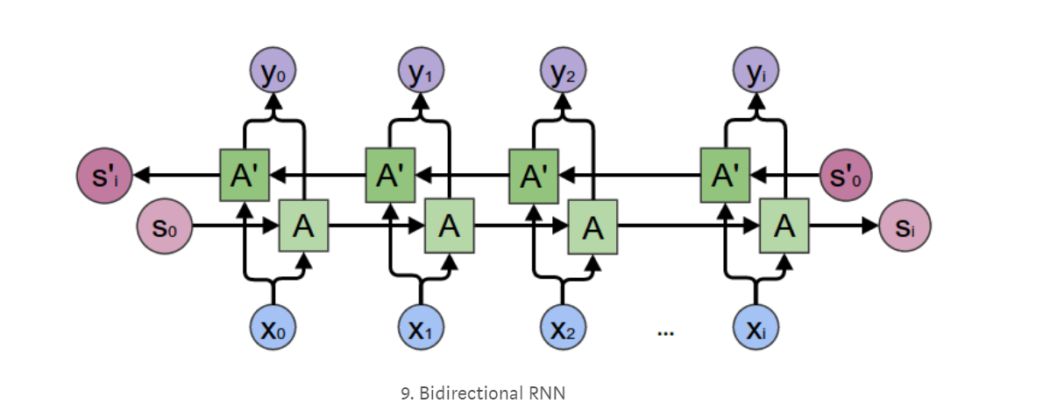
Bidirectional LSTMs
Image source: https://towardsdatascience.com/introduction-to-sequence-models-rnn-bidirectional-rnn-lstm-gru-73927ec9df15

Slide 7
German – English Results (With Bidirectional LSTMs)
TRAIN (BLEU: 0.494728)
src=[das ist nicht der grund], target=[thats not why], predicted=[thats not why]
src=[das ist sein auto], target=[this is his car], predicted=[this is his car]
src=[er ist elegant], target=[hes smart], predicted=[hes smart]
src=[wer hat betrogen], target=[who cheated], predicted=[who cheated]
TEST (BLEU: 0.480389)
src=[tom ist pilot], target=[tom is a pilot], predicted=[tom is]
src=[tom ist hier], target=[toms here], predicted=[tom is here]
src=[lassen sie es tom tun], target=[let tom do it], predicted=[let tom do it]
src=[einige fische fliegen], target=[some fish fly], predicted=[were fly]

Slide 8
Observations
Training predictions were perfect for the example sentences, but the BLEU score was slightly lower.
For the Test data, BLEU score showed slight, but noticeable improvement.
While using Bidirectional LSTMs, the model showed no improvement in validation loss after 20 epochs. (executed for 30)

Slide 9
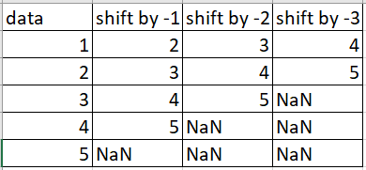
Time Series
Sine wave implementation, using a moving forward window of size 50
Forecast step by step on test dataset
Feed previous prediction back into the input window by moving it one step forward and then predict at the current timestep (2-layered LSTM)
First 3 columns: input
Last column: target
Example: in NLP context,
for a 3-word sentence, predict
the fourth word.

Slide 10
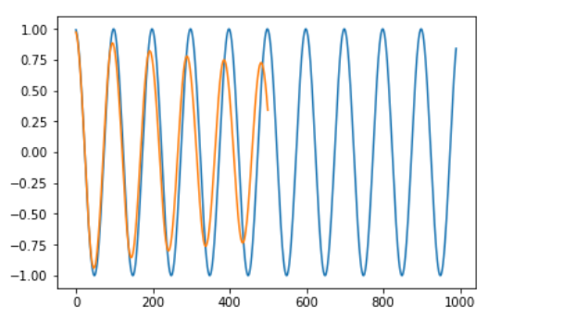
Time Series
Predicting step by step: overlapping plot (future window sequence is unavailable)
Predict one time step at a time into future and feed this prediction back into the input window.
Further in time, more error builds on
previous predicted error, which gives
a dampening sine-wave.

Slide 11
Next Steps
Analysis of the gating signals
Train a model for translation on a small (clean) dataset from Hindi-English corpus.
Apply Sequence to sequence approach for translation.
Make most of the 1.5 million sentences usable!

