Slide 1
NMT
Neural Machine Translation
Richa Ranjan
MSc Data Science

Slide 2
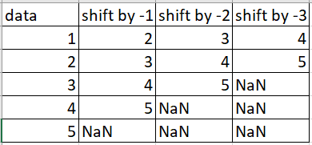
Time Series
Sine wave implementation, using a moving forward window of size 50
Forecast step by step on test dataset
Feed previous prediction back into the input window by moving it one step forward and then predict at the current timestep (2-layered LSTM)
First 3 columns: input
Last column: target
Example: in NLP context,
for a 3-word sentence, predict
the fourth word.

Slide 3
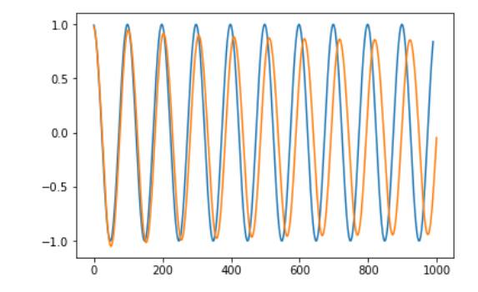
Time Series
Predicting step by step: overlapping plot (future window sequence is unavailable)
Predict one time step at a time into future and feed this prediction back into the input window.
Further in time, more error builds on
previous predicted error, which gives
a dampening sine-wave.

Slide 4
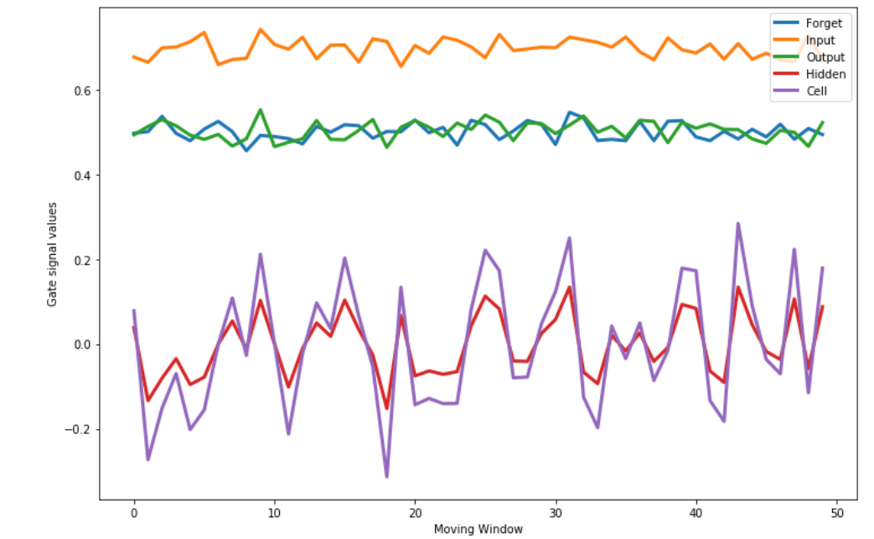
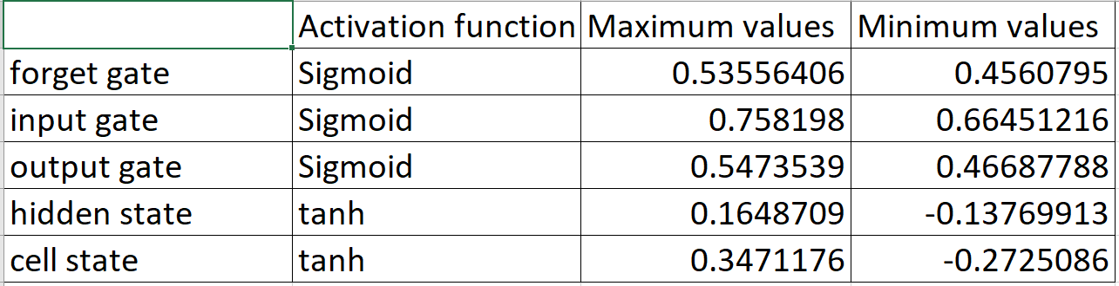
Gating signals

Slide 5
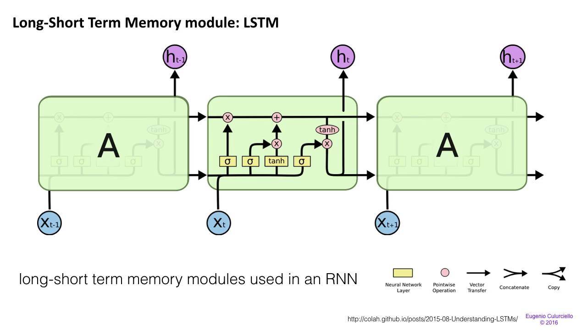
LSTM Architecture

Slide 6
German - English
Data: obtained from ManyThings.org website, 169,813 pairs of English and German sentences, 100k used for training and testing.
Pre-processing : removing special characters, tokenize etc.
Encode sequences : assign integers to every word.
Padding: add 0s to the end of all phrases (for uniform maximum phrase length)
1 hot encoding: Encode target sentences
Model: Sequence-to-sequence encoder-decoder LSTM model

Slide 7
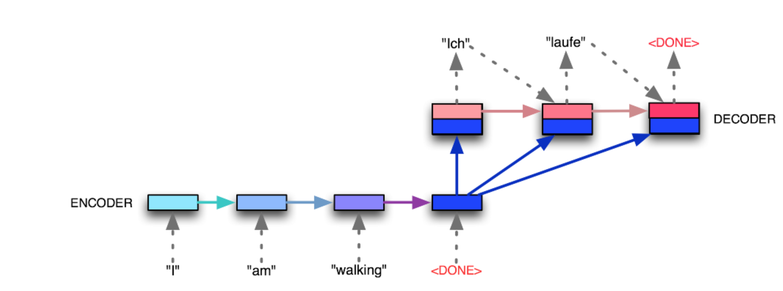
Sequence to Sequence
A multi-layered LSTM to map the input sequence to a vector of fixed dimensionality
another LSTM to decode the target sequence from the vector.

Slide 8
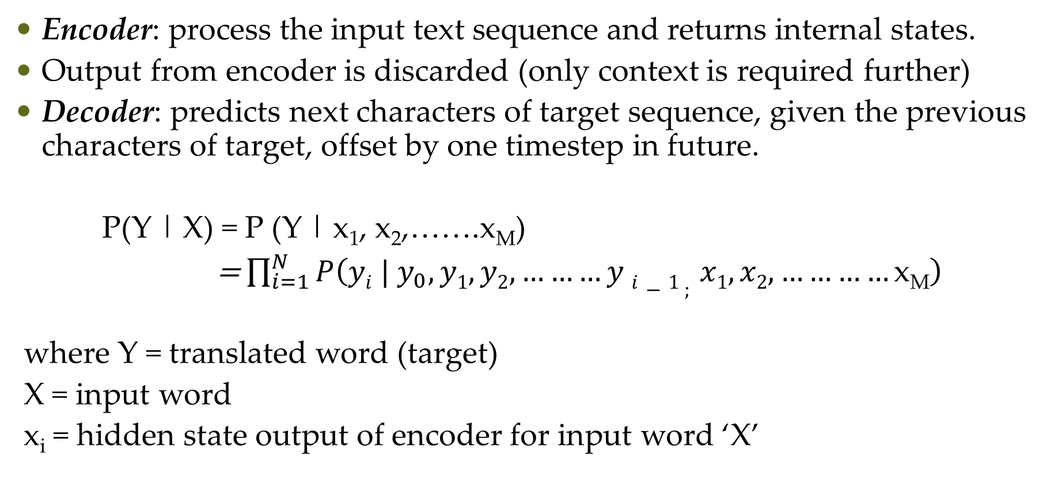
Sequence to Sequence
Encoder: process the input text sequence and returns internal states.
Output from encoder is discarded (only context is required further)
Decoder: predicts next characters of target sequence, given the previous characters of target, offset by one timestep in future.
P(Y | X) = P (Y | x₁, x₂,…….x_{M})
= $\prod_{i=1}^{N}{P\left(yi | y_{0}, y1, y2,………y i−1 ; x1, x2, …………\text{x}\text{M}\right)}$
where Y = translated word (target)
X = input word
x_{i} = hidden state output of encoder for input word ‘X’

Slide 9
Sequence to Sequence
Input sequence: fed into the encoder, state vectors obtained
(No. of pairs, Max German sentence length, No. of words in German vocab)
state vectors from the encoder fed into the decoder, along with target sequence
(No. of pairs, Max Eng sentence length, No. of words in Eng vocab)
Sample the next character (here, using highest probability of softmax layer)
Decoder output: same as decoder input, offset by 1 timestep.
Append this new character to the target sequence
Repeat this until <EOS> or character max limit reached.

Slide 10
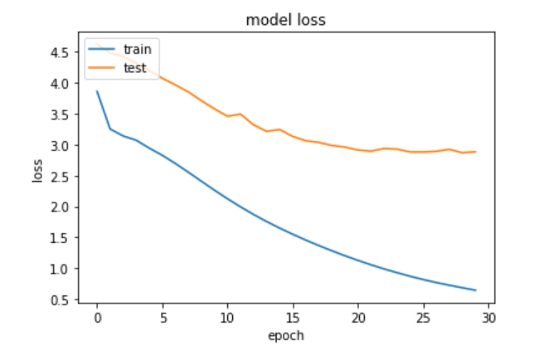
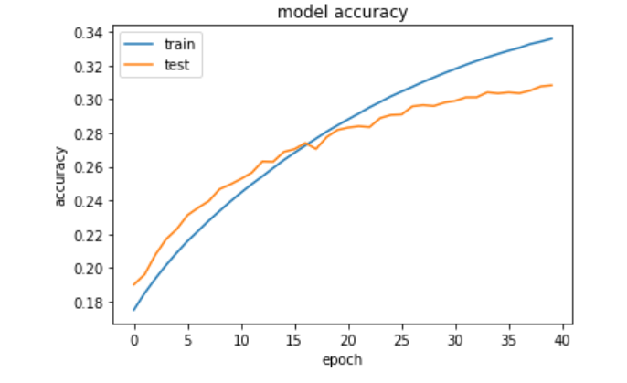
German-English Results
Trained first on 50k sentence pairs, and later on 100k pairs

Slide 11
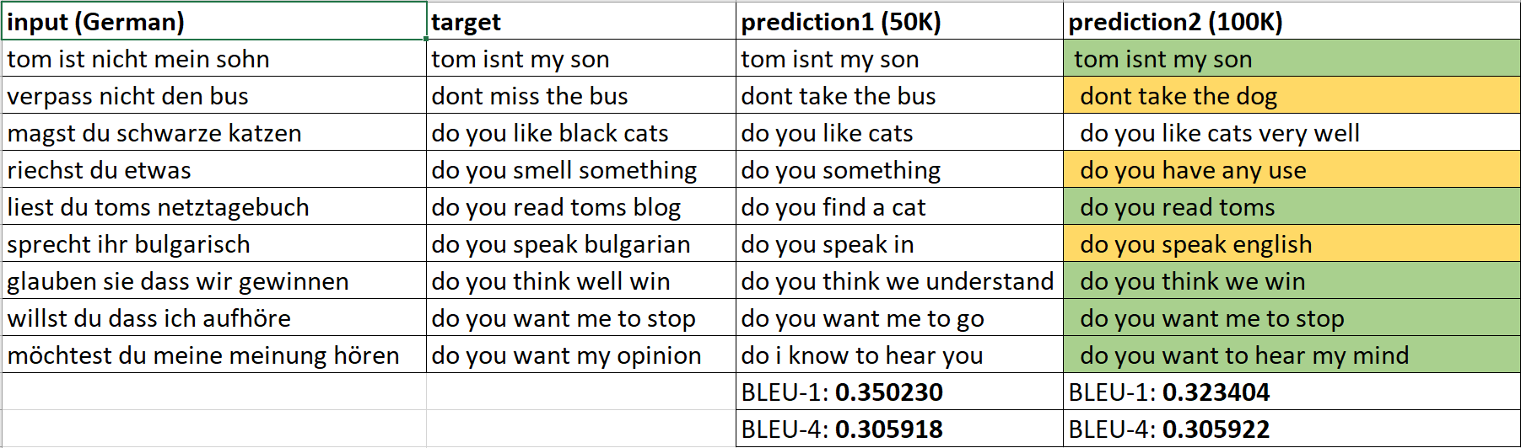
German – English Results

Slide 12
Next Steps
Hindi-English translation improve training methodologies
Parallelization of machines
Attention mechanism
Beam search algorithm

