Slide 1
NMT
Neural Machine Translation
Richa Ranjan
MSc Data Science

Slide 2
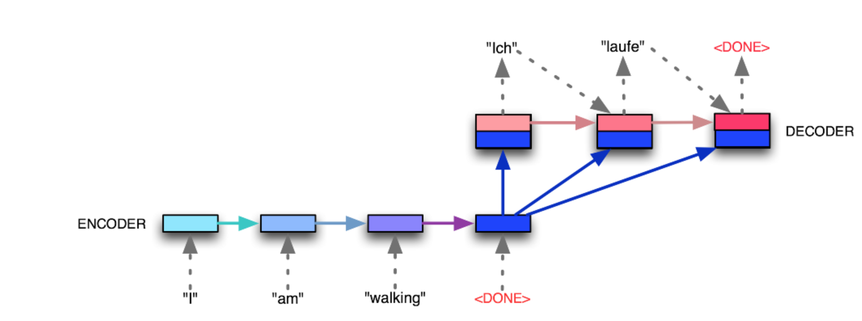
Sequence to Sequence
A multi-layered LSTM to map the input sequence to a vector of fixed dimensionality
another LSTM to decode the target sequence from the vector.

Slide 3
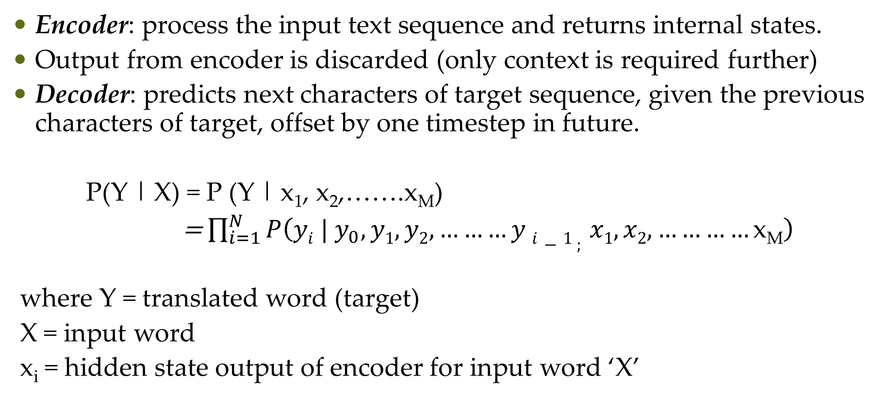
Sequence to Sequence
Encoder: process the input text sequence and returns internal states.
Output from encoder is discarded (only context is required further)
Decoder: predicts next characters of target sequence, given the previous characters of target, offset by one timestep in future.
P(Y | X) = P (Y | x₁, x₂,…….x_{M})
= $\prod_{i=1}^{N}{P\left(yi | y_{0}, y1, y2,………y i−1 ; x1, x2, …………\text{x}\text{M}\right)}$
where Y = translated word (target)
X = input word
x_{i} = hidden state output of encoder for input word ‘X’

Slide 4
Sequence to Sequence
Input sequence: fed into the encoder, state vectors obtained
(No. of pairs, Max Hindi sentence length, No. of words in Hindi vocab)
state vectors from the encoder fed into the decoder, along with target sequence
(No. of pairs, Max Eng sentence length, No. of words in Eng vocab)
Sample the next character (here, using highest probability of softmax layer)
Decoder output: same as decoder input, offset by 1 timestep.
Append this new character to the target sequence
Repeat this until <EOS> or character max limit reached.

Slide 5
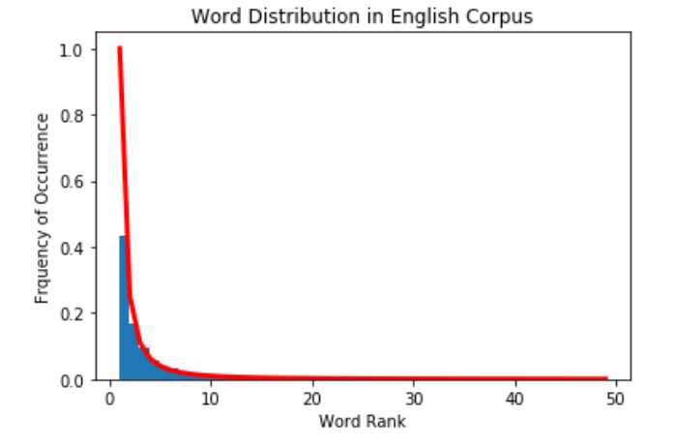
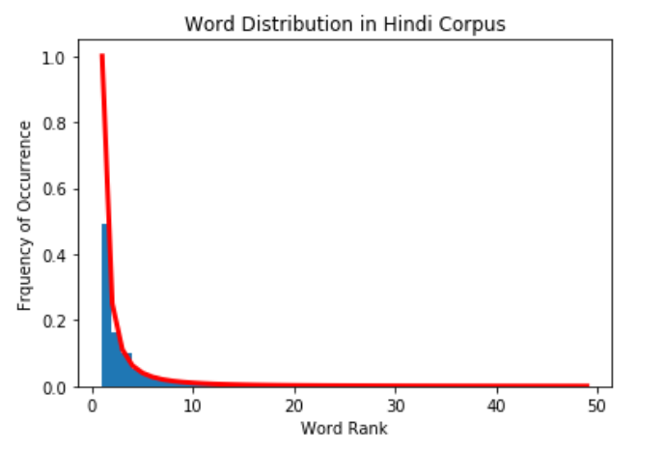
Zipf’s Law
Word distributions for both languages

Slide 6
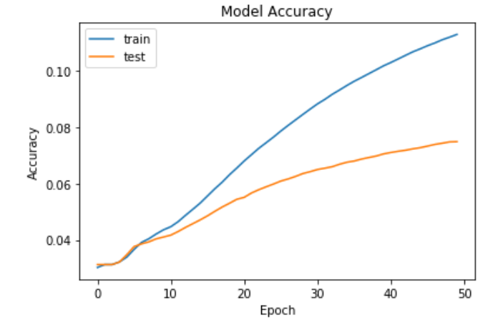
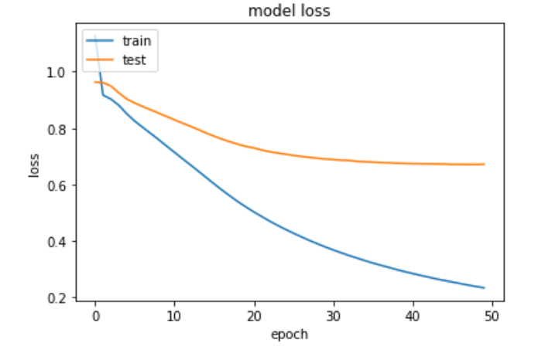
Hindi-English Results
Trained first on 150k sentence pairs

Slide 7
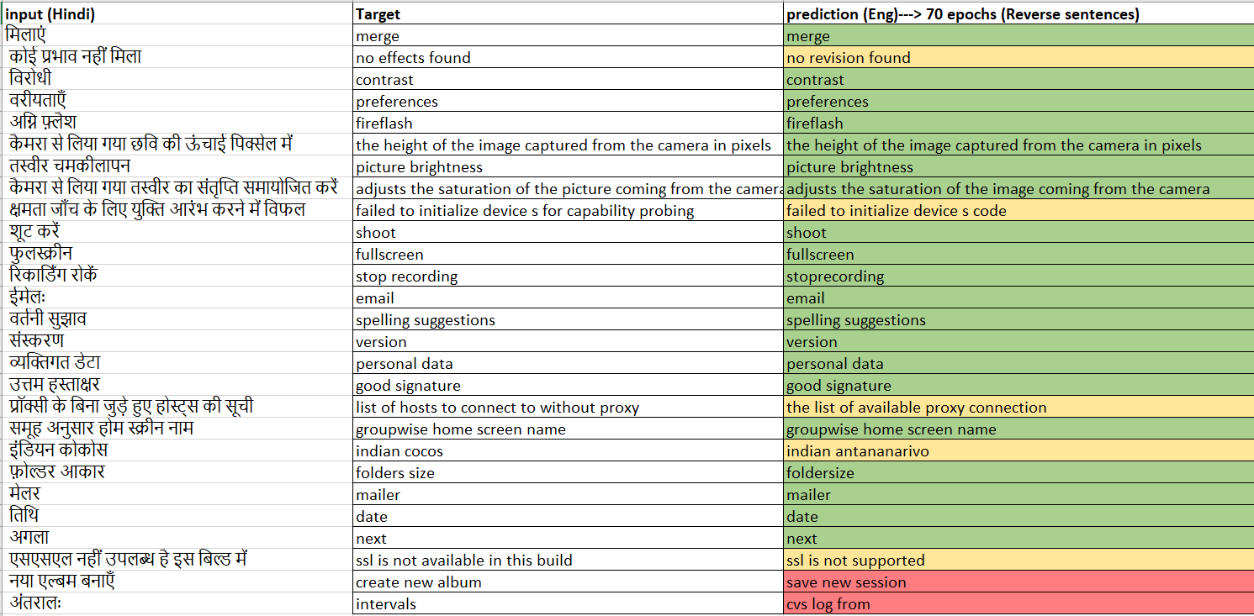
Hindi – English Results
BLEU-1: 0.52
BLEU-2: 0.44
BLEU-3: 0.37
BLEU-4: 0.32

Slide 8
Next Steps
Parallelization of machines
Beam search algorithm

