Slide 1


MACHINE LEARNING AND ARTIFICIAL INTELLIGENCE internship at Pincore Technologies India Pvt.Ltd
Under the Guidance of:
Dr. Shamanth Rai
Head & Asst. Professor
Dept. of ISE, SCEM
Mangaluru
Mr. Amitesh
General Manager
Pincore Technologies India Pvt.Ltd , Bengaluru
Presented by:
Sumanth Prabhu - 4SF18IS106

Slide 2
CONTENTS
Company Profile
Introduction
Weekly wise summary
Week 1
Week 2
Week 3
Week 4
Outcomes
Project
Conclusion
Certificate of Completion
23-06-2022

Slide 3
COMPANY PROFILE
Pincore Technologies focuses on “simplifying technology for life” and has been striving to deliver the same from the day of its inception since 2018.
The company focuses on delivering high quality products to its customers at the right cost considering the support and lifelong engagement with customers.
Pincore Technologies is one of the leading distributors of electronic development tools and a preferred vendor for open hardware in India and also consultant for delivering off the shelf services and quality-oriented design services.
23-06-2022

Slide 4
INTRODUCTION
Company introduction was handled by our guide Mr. Amitesh Pandey, who also talked about the topics that will be covered by the end of the internship
Week 1-Introduction to Machine Learning, Artificial Intelligence, Deep Learning and its Applications
Week 2-Introduction to Python Programming & Installation of Jupyter Notebook
Week 3-Work flow of Machine learning & Dataset
Week 4-Classification of Machine Learning
23-06-2022

Slide 5
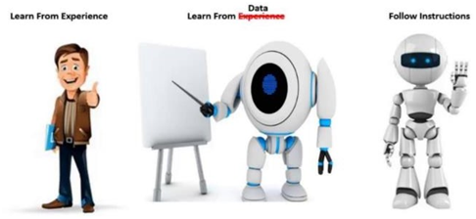
WEEK 1
Introduction to Machine Learning
Machine learning is type of artificial Intelligence that allows software application to become more accurate at predicting outcomes without being programmed to do that
Figure 1: What is Machine Learning[3]
23-06-2022

Slide 6
WEEK 1
Applications
Social Media Features
Product Recommendation
Sentiment Analysis
Introduction to Artificial Intelligence
Artificial Intelligence is the capability of a computer system to mimic human cognitive function such as learning and problem solving.
23-06-2022

Slide 7
WEEK 1
Applications
Visual Perceptron
Decision Making
AI in Industries
Introduction to Deep Learning
Deep Learning is a function that imitates the working of human brain in processing data and creating patterns for use in decision making.
Applications
Pixel Restoration
Image-Language Translations
Deep Dreaming
23-06-2022

Slide 8
WEEK 2
Introduction to Python Programming
Python is a high-level, general-purpose and a very popular programming language. Python programming language (latest Python 3) is being used in web development, Machine Learning applications, along with all cutting-edge technology in Software Industry.
Why Python is preferred for Machine Learning
Simple and Consistent
Extensive selection of libraries and frameworks
Platform Independence
23-06-2022

Slide 9
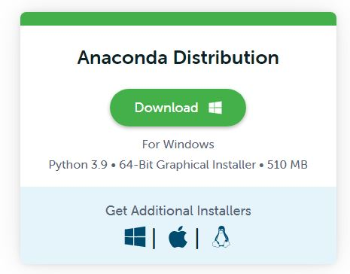
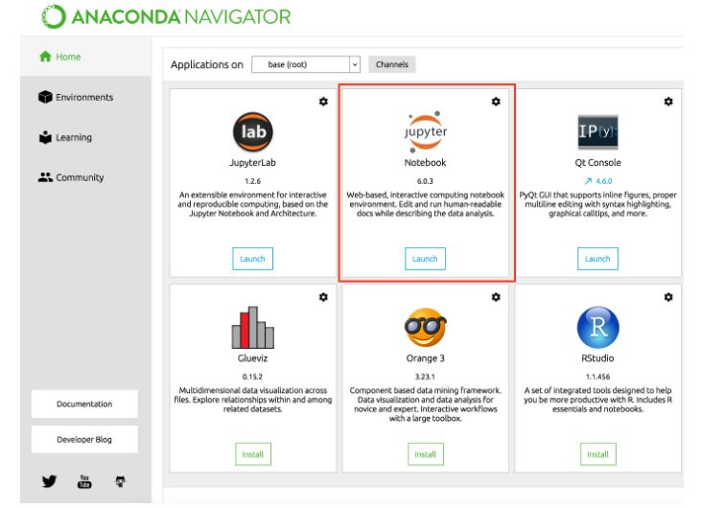
WEEK 2
Installation of Jupyter Notebook
Figure 2: Anaconda download and installation steps[4]
23-06-2022

Slide 10
WEEK 3
Learned Libraries in Python
Scipy
NumPy
Matplotlib
Pandas
Sklearn
23-06-2022

Slide 11
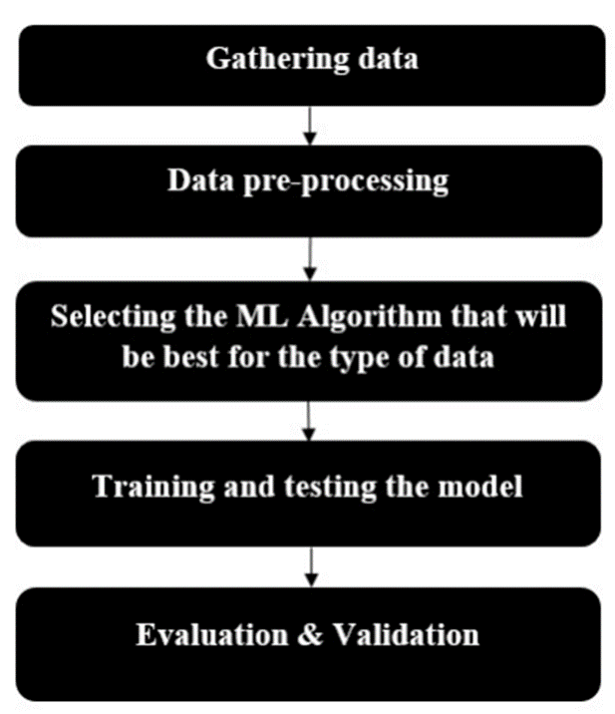
WEEK 3
Workflow of Machine learning
Figure 3: Workflow of ML[4]
23-06-2022

Slide 12
WEEK 3
Dataset
When the collection of data’s are brought together in table which is associated with a multiple rows and columns.
What is Data in Dataset?
Data is basically an observation or measurements represented in terms of text or numbers placed in a dataset. It is considered as raw values.
23-06-2022

Slide 13
WEEK 4
Classification of Machine Learning
Machine learning can be classified into three types:
Supervised learning
Unsupervised learning
Reinforcement learning
23-06-2022

Slide 14
OUTCOMES
Following are the outcomes of this internship:
In-depth understanding of ML and AI.
Knowledge on different ML models and steps to design the model.
Designing the model using pandas, Matplotlib, Seaborn, Sklearn.
Introduction and development of different algorithm.
23-06-2022

Slide 15
PROJECT
Predicting the sales of new TV from different marketing modes using linear regression
23-06-2022

Slide 16
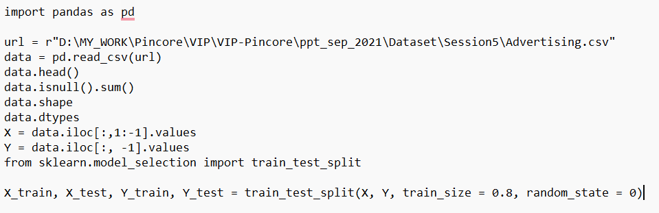
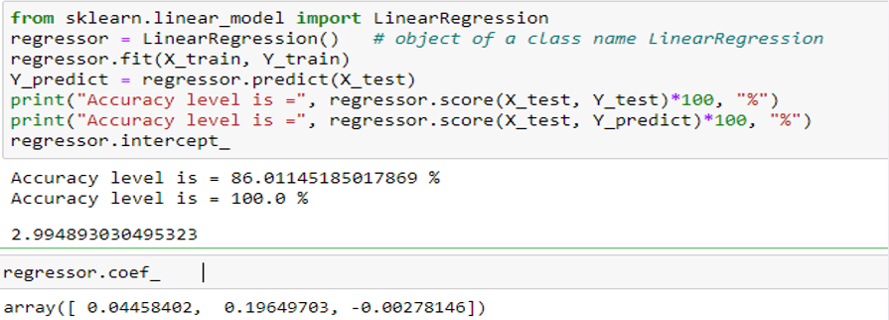
Predicting the sales of new tv from different marketing modes using linear regression
Figure 5: Code for Predicting the Sales of new TV
23-06-2022

Slide 17
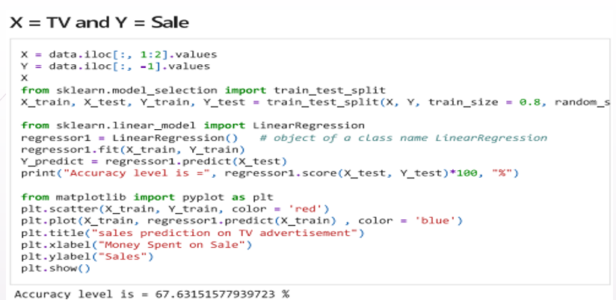
Figure 6: Code for Predicting the Sales of new TV
23-06-2022

Slide 18
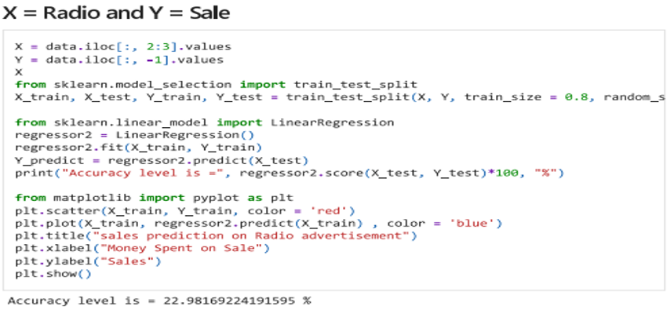
Figure 6: Code for Predicting the Sales of new TV
23-06-2022

Slide 19
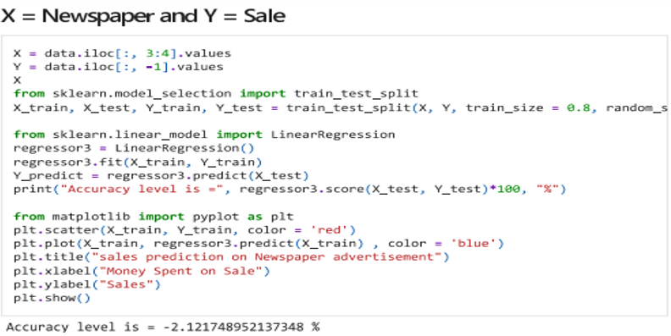
Figure 6: Code for Predicting the Sales of new TV
23-06-2022

Slide 20
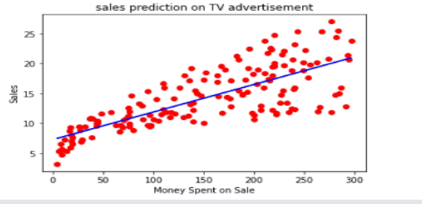
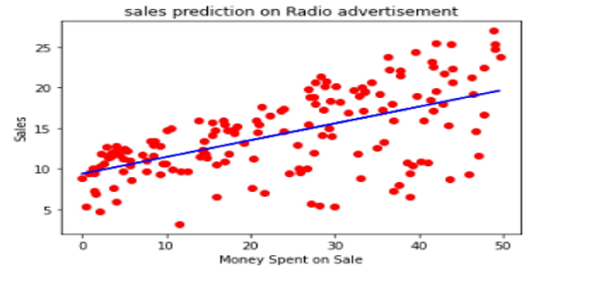
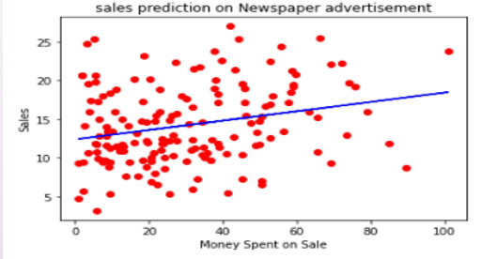
Figure 7: Output
23-06-2022

Slide 21
CONCLUSION
The internship provided the details about artificial Intelligence and Machine Learning algorithms. Under Machine Learning I studied about various algorithms, different ML models, steps for designing ML models.
23-06-2022

Slide 22
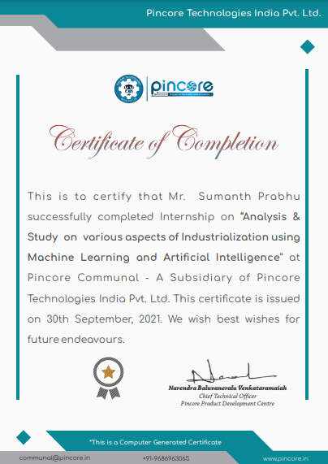
CERTIFICATE
23-06-2022

Slide 23
REFERENCES
[1] https://www.kaggle.com/datasets/Corona-Virus-Spread-Analysis-March-2020data
set/
[2] https://pandas.pydata.org/docs/reference/frame.html
[3] https://www.google.com/url?sa=i&url=https%3A%2F%2Fwww.javatpoint.com%2
Fmachine-learning&psig=AOvVaw0s_YQTM6LbwRaTU9NAC84K&ust=16521
08602323000&source
[4] https://pincore.in/
23-06-2022

Slide 24
THANK YOU
23-06-2022

