Slide 1
TEAM CODE_BRIGADE
SAHYADRI COLLEGE OF ENGINEERING AND MANAGEMENT
Members-
Sumanth
Ranjith
Anusha
Shravya
Elton
Amogh
1

Slide 2
PROBLEM STATEMENT
A point based Incentivized Tech Bin will have the facility to generate gift token for the bin users based on the frequency of the user using the bin. Design a system where the user is rewarded with a printed token key each time garbage of more than 1 kg is put into the bin indicating the amount of garbage. Design a gamified portal to provide rewards motivating users to throw more and more garbage.
2

Slide 3
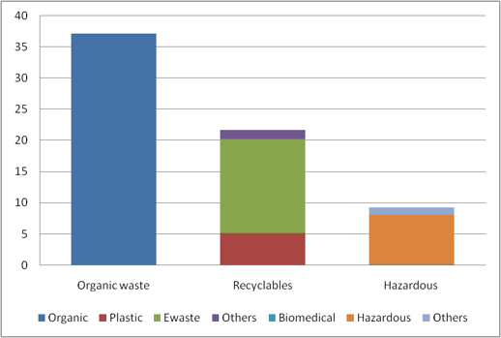
METHODOLOGY
India generates 62 million tons of waste (mixed waste containing both recyclable and non-recyclable waste) every year and nearly 50% of the total waste is organic.
This means there should be more focus on the domestic waste as people tend to dump it into the roadside gutters for clearance by street sweepers.
This even makes the situation worst by clogging the gutter and causing further problems.
Source- epw.in
3

Slide 4
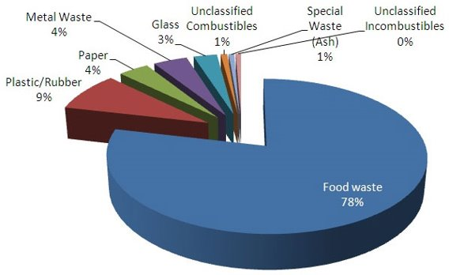
CONCLUSION
Community storage may reduce the cost of waste collection, and can minimize problems associated with lack of onsite storage space.
They should also be conveniently located for the ease of access.
And also, people will use it if they are getting benefitted in some way or the other.
Source - mbarendezvous.com
4

Slide 5

SOLUTION PROPOSED
An app that helps to connect with tech-bin which will be kept in the localities.
Unique feature- 2 interfaces, one for user and one for the municipality.
5

Slide 6
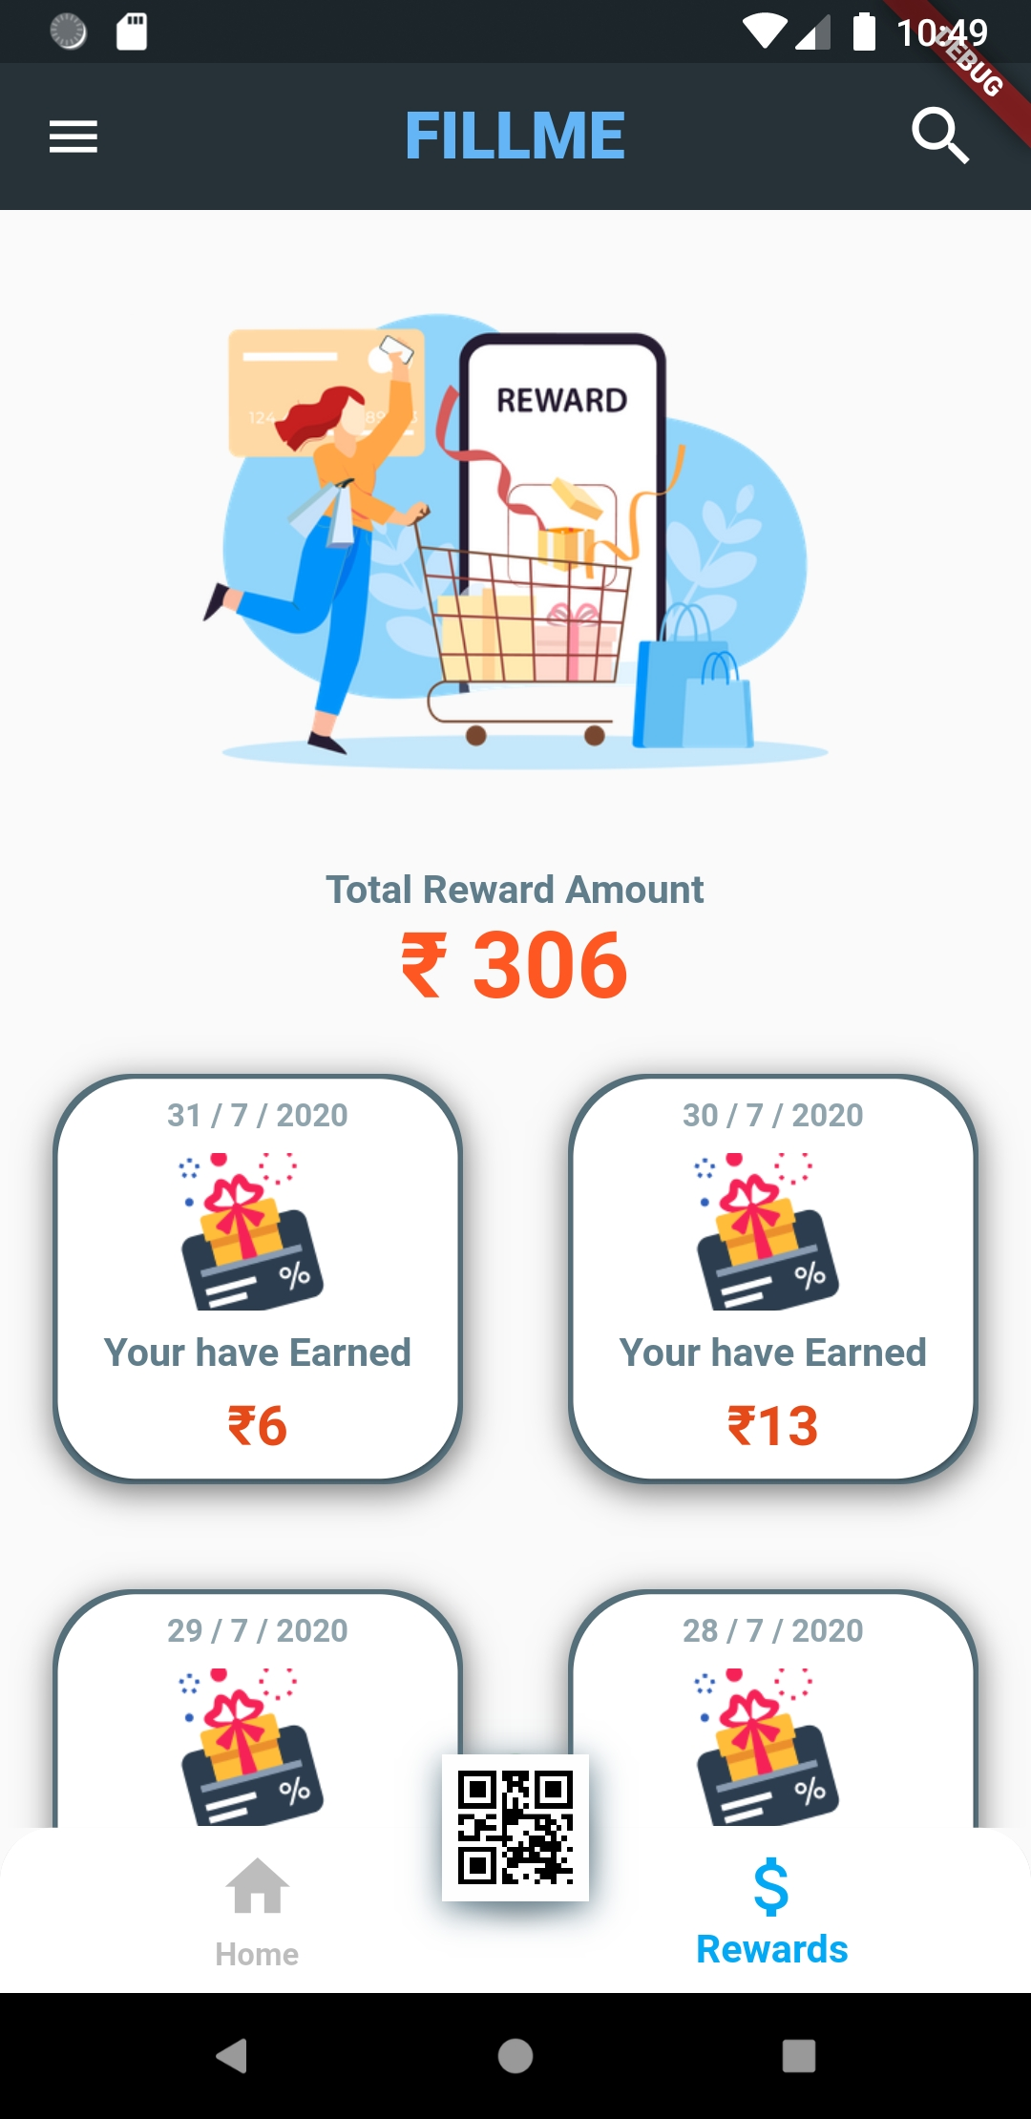
FEATURES OF THE APP
Registration for every member.
Locates the nearest bin in maps.
Scanning the QR code on bin gets the user logged in.
The amount of waste thrown will be updated in the app using IoT.
Based on the amount of waste
thrown the user will get rewards.
6

Slide 7

USE CASE DIAGRAM
USER
MUNICIPALITY
Throw the waste
Forwarding the data to app
Indicate on the App
IoT Monitoring
Send optimized route
7

Slide 8
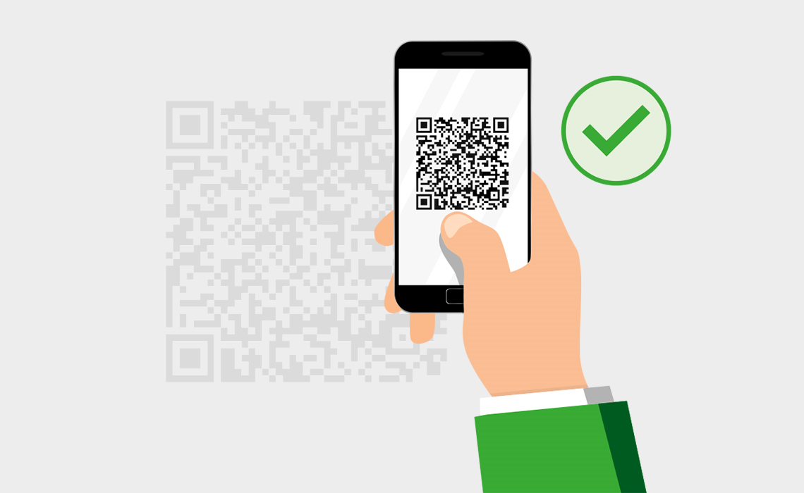
NOVELTY
The concept of QR code on tech-bin is unique in its own way.
Scanning the QR code present on the tech-bin gets the user logged in.
All the amount of waste thrown is then detected and is updated in the app.
8

Slide 9
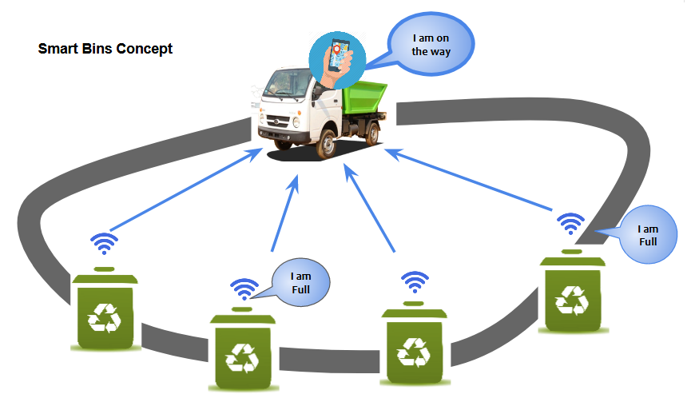
NOVELTY
The second interface which is made for the municipality people.
The amount of garbage filled in dustbin will be indicated in the app and also an optimized route will be displayed.
9

Slide 10
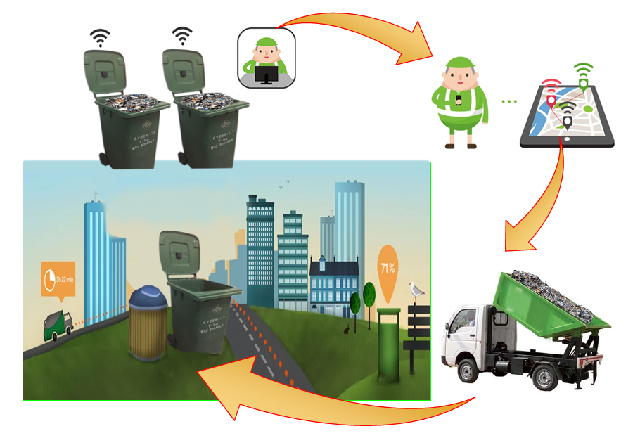
HOW THAT FEATURE WILL BE USEFUL?
The path will be indicated in the app, thus there will be less time consumption.
This will cut short a certain amount of fuel consumption for transportation.
10

Slide 11

HOW TO INCREASE THE SCALABILITY?
Referral code system.
They are powerful way to generate word of mouth.
All user will have their own referral code which when put by other user at the time of registration will make them get a certain bonus earned by the current user.
11

Slide 12



PRODUCT DEVELOPMENT
TOOLS
- Flutter
- Firebase
LANGUAGE
- Dart
COMPONENTS
- Bluetooth
- Weight sensors
13

Slide 13
THANK YOU
14

