Slide 1
NLP Sentiment Analysis using Deep Neural Network and Long Short Term Memory (LSTM)
Juan Chen
May 28, 2020
<number>
Notes:
<number>

Slide 2
Content
NLP Overview
Modeling Process
Transfer Learning with Word Embedding
RNN and Long Short Term Memory (LSTM)
Model – a 2-Layer DNN
Model – a 2-Layer LSTM
Conclusion and Future Work
<number>
Notes:
<number>

Slide 3
NLP Overview
Typical use cases (understand & generate)
Information Retrieval (Search)
Text Categorization (Spam, Sentiment)
Conversational Agent (Chatbot)
A field at the intersection of
Computer Science
Linguistics
Artificial Intelligence
NLP is hard because:
Sparsity
Ambiguity
I saw her duck.
The pope’s baby steps on gays.
Sentiment Analysis
Data Sample
I love you mum ❤️
I like you a lot ❤️
the game just finished ⚾
he is the best player ⚾
So sad you are not coming 😞
How dare you ask that 😞
I am proud of your achievements 😄
This is so funny 😄
I will have a cheese cake 🍴
do you want to join me for dinner 🍴
<number>
Notes:
<number>

Slide 4
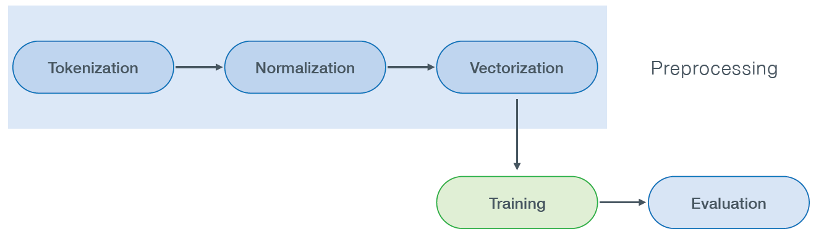
Modeling Process
(encoding/embedding)
(parse sentence)
(lower case, stem, lemmatization)
(NB, Logistic, NN)
(Accuracy, F1, ROC-AUC )
<number>
Notes:
<number>

Slide 5
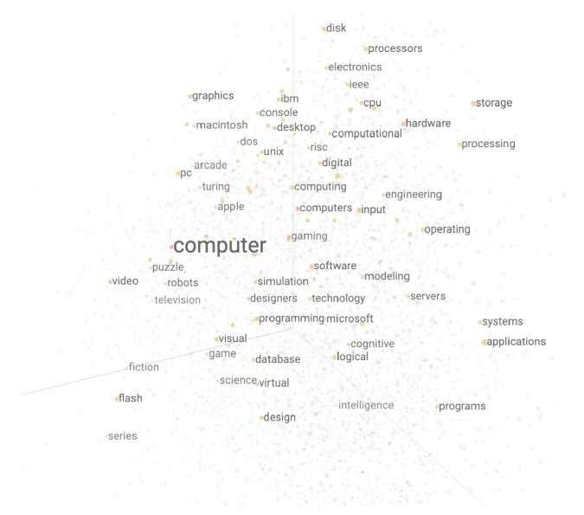
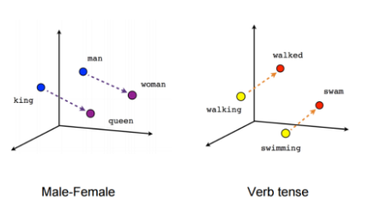
Transfer Learning with Word Embedding
GloVe represents word in a continuous vector space where semantically similar words are mapped in close neighborhood.
GloVe is trained on Wikipedia articles that projects each of the 400,000 words into a 50-dimension space. (https://nlp.stanford.edu/projects/glove/)
Energy: [ 0.068807, 0.36938 , 1.0194 , 0.72622 , 0.33166 , … , 0.75698 , -0.53484 , 0.86998 , 0.023162, 0.49219 ]
Italy: [ 1.7704 , -0.77758 , -0.95302 , 0.329 , 0.040391 , … , 1.1948 , -0.18 , -0.35325 , 0.44488 , -0.83675 ]
<number>
Notes:
<number>

Slide 6
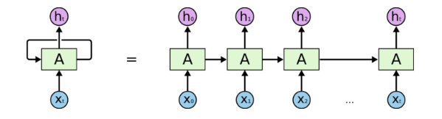
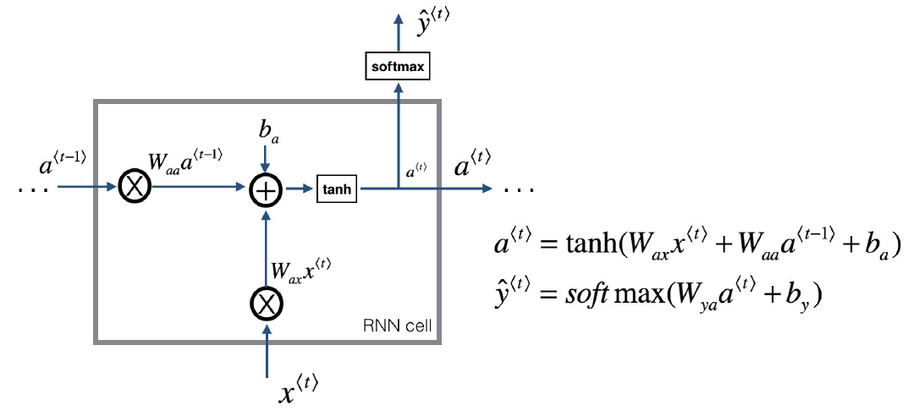
RNN
Based on the observations, RNN is a network that the input for each step is not only input data at this step, but also output from previous step.
Issues with basic RNN unit:
Gradient vanishes when doing network training
Memory cannot remember long sequence
<number>
Notes:
<number>

Slide 7
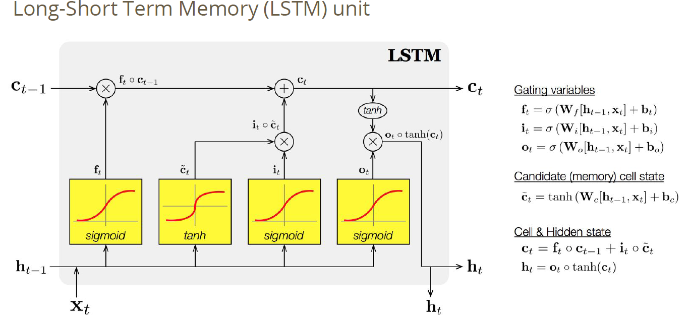
Long Short Term Memory (LSTM)
<number>
Notes:
<number>

Slide 8
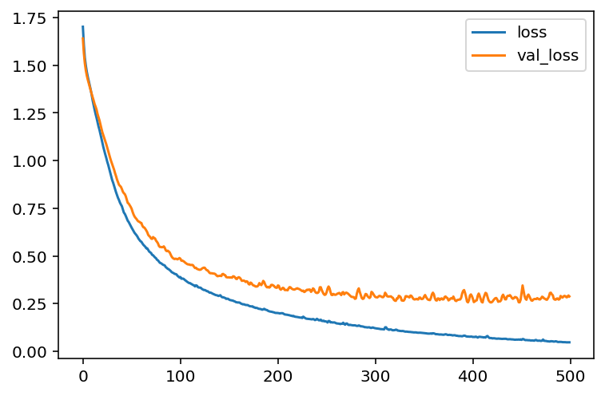
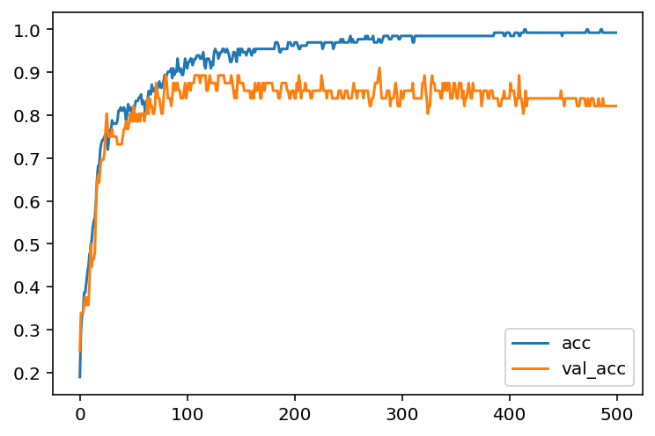
A 2-Layer DNN 1 hidden + 1 output layer
emoji_model = build_nn_model(
input_dim=50,
layers=[50],
output_dim=5)
emoji_model.compile(
loss='categorical_crossentropy',
optimizer='adam',
metrics=['accuracy'])
New Predictions
I love you ❤️
It's horrible 😞
Funny lol 😄
Lets play with a ball ⚾
Food is ready 🍴
I do not like it 😄
 | Loss | Accuracy
Train | 0.047 | 0.99
Validation | 0.288 | 0.82
<number>
Notes:
<number>

Slide 9
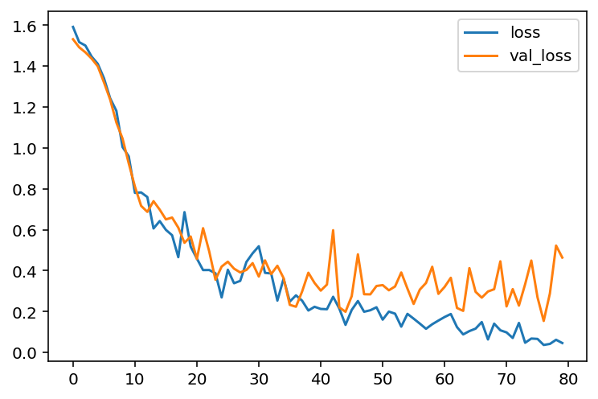
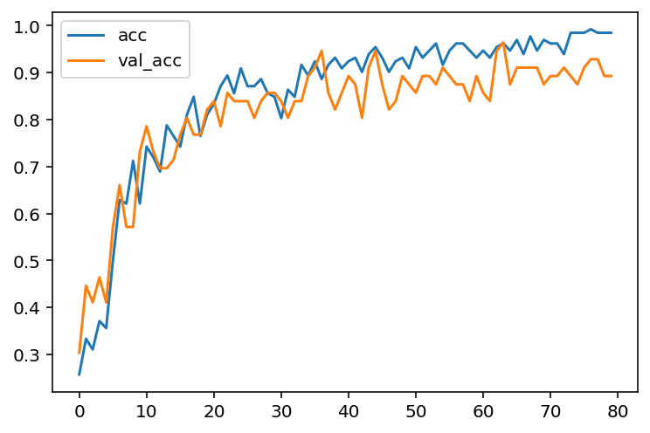
A 2-Layer LSTM
X = LSTM(128, return_sequences=True, recurrent_dropout=0.5)(embeddings)
X = Dropout(rate=0.2)(X)
X = LSTM(128, recurrent_dropout=0.5)(X)
X = Dropout(rate=0.2)(X)
X = Dense(5, activation='softmax')(X)
New Predictions
I love you ❤️
It's horrible 😞
Funny lol 😄
Lets play with a ball ⚾
Food is ready 🍴
I do not like it 😞
 |  | Loss | Accuracy
DNN | Train | 0.047 | 0.99
 | Validation | 0.288 | 0.82
LSTM | Train | 0.013 | 0.99
 | Validation | 0.464 | 0.89
<number>
Notes:
We need to build a embedding matrix where each row represent a word vector.
h is the hidden unit
First layer has parameters: 128*(128 + 50 +1) *4 = 91648
Second layer has parameters: 128*(128 + 128 +1) *4 =131584
<number>

Slide 10
Conclusion and Future Work
Word embedding is a powerful vectorization method for NLP problems that captures words semantic meaning.
RNN is quite versatile for modeling sequence input, and LSTM is good at capturing the long term dependency.
We can use Gated Recurrent Units (GNU), another version of RNN with fewer gates than LSTM, that may reduce the overfitting and increase training speed because of less parameters.
For Image processing, we can combine CNN-RNN models to improve the accuracy of image recognition problems. We can extract features from the CNN layer and loop through RNN network. Other extraction methods and combinations can be studied.
<number>
Notes:
<number>

