Slide 1
Location aware mobile applications
Student: pop robert daniel
Group: 2341
Technical University of Cluj-Napoca

Slide 2
What are location services?
How can we use them?
How we implement them into mobile applications?
Real life mobile app

Slide 3
What are location services?

Slide 4
How and for what can we use them?

Slide 5
How can we implement it ?

Slide 6
Introducing NowWhat mobile app

Slide 7
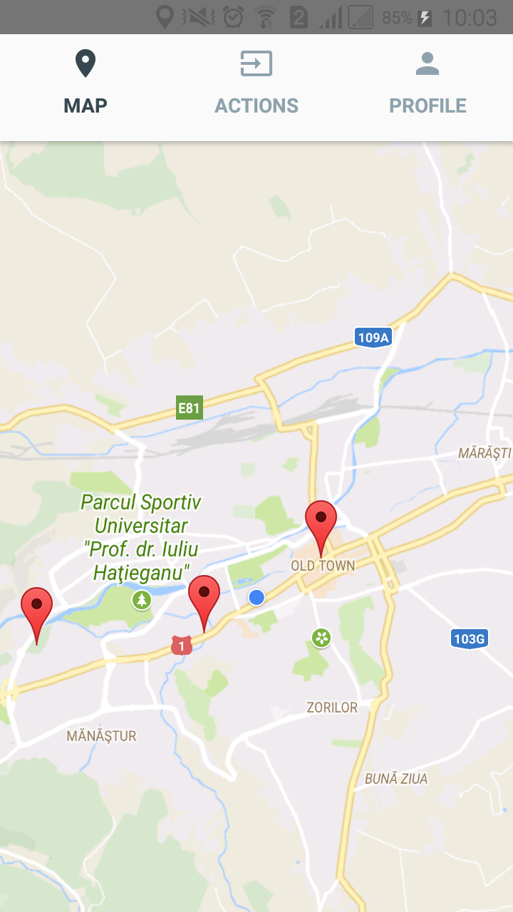
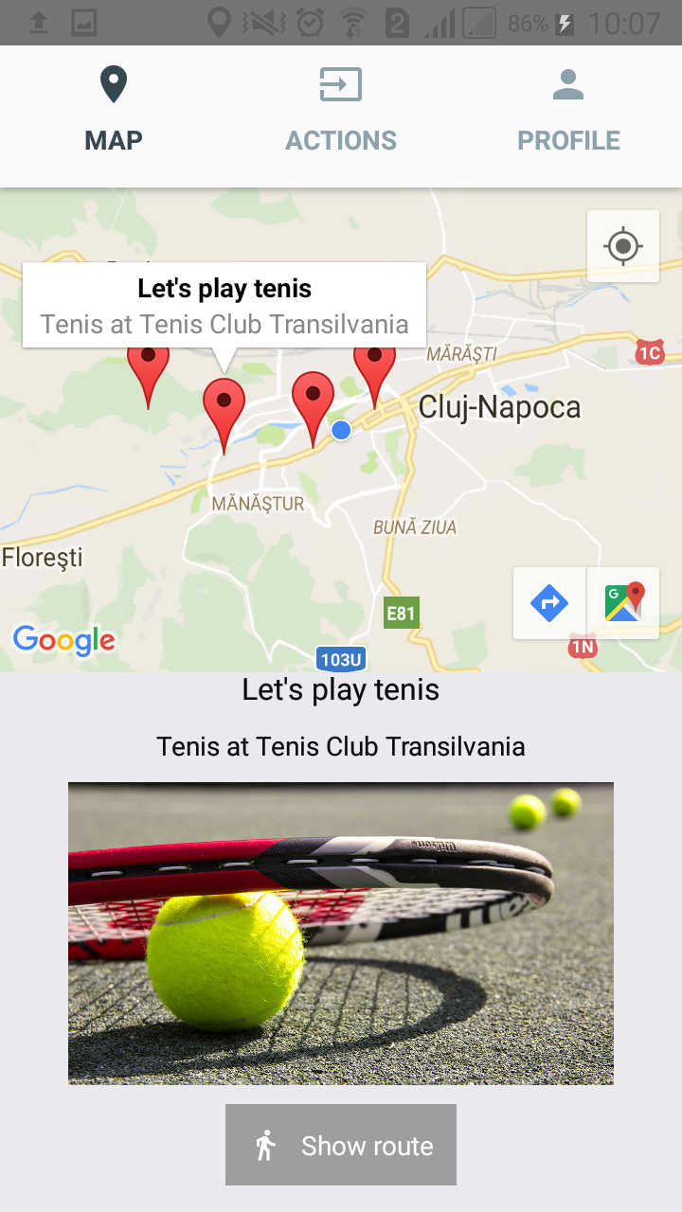
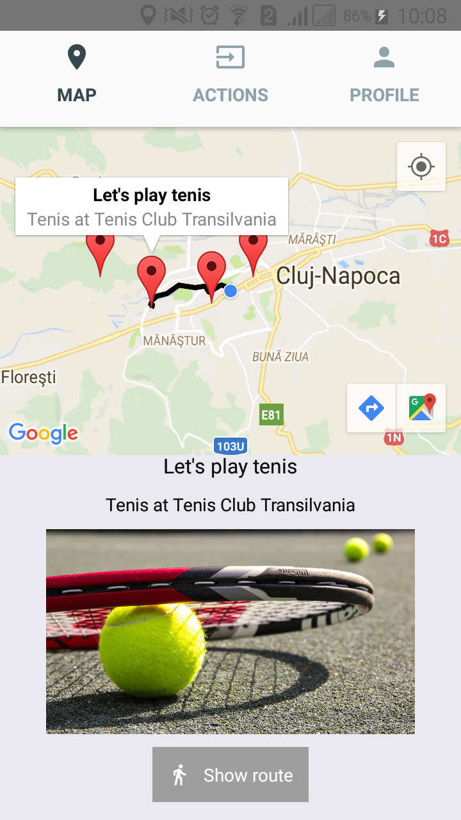

Slide 8
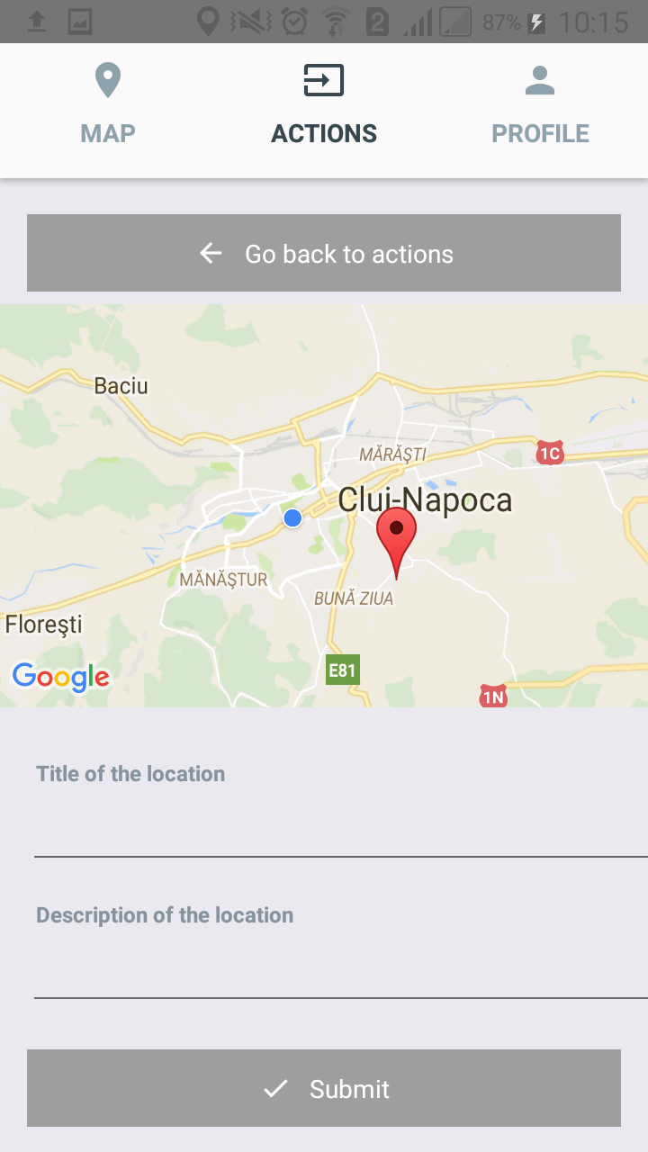
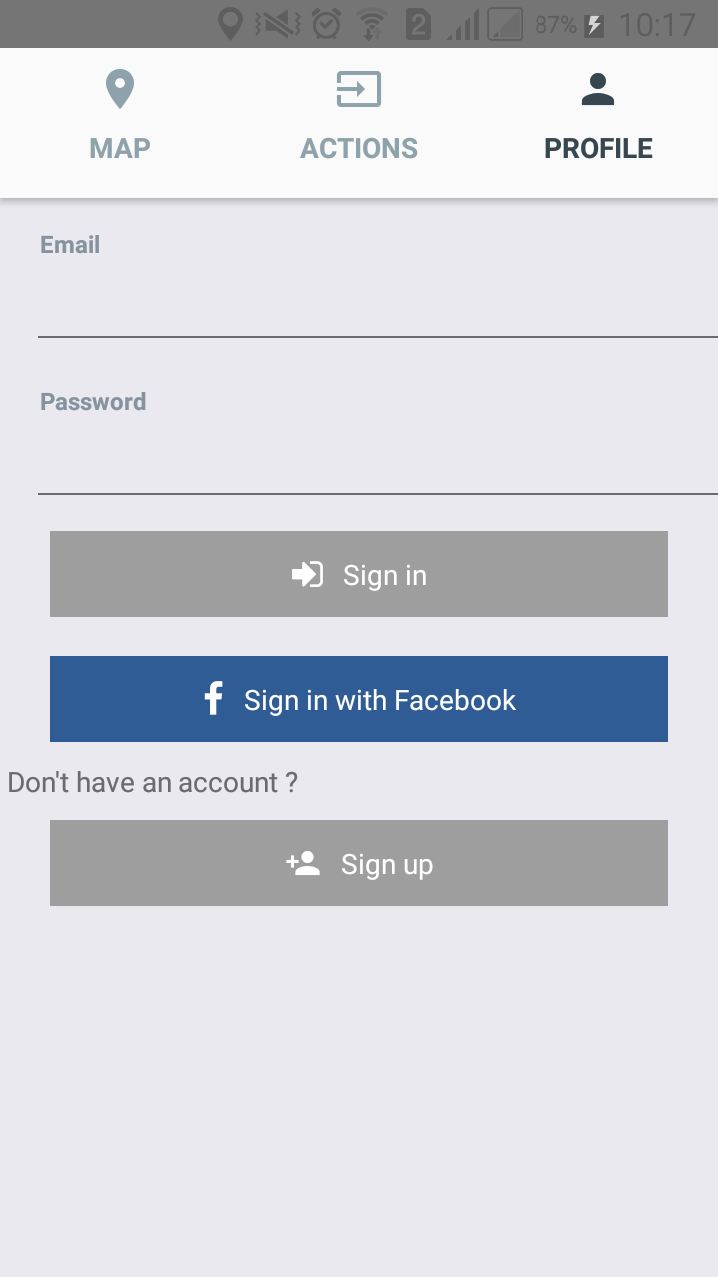

Slide 9
Thank you !

