Slide 1
SMART BUILDING
Making your vision come true, that is what we do

Slide 2
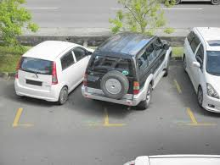
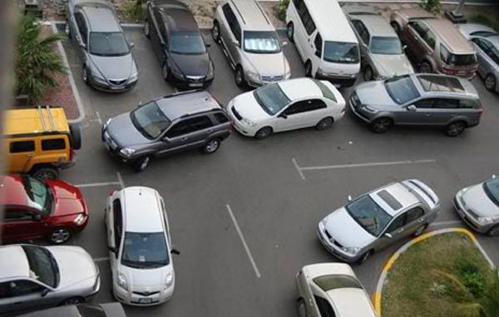
HAVE YOU FACED THE HASSEL OF PARKING VEHICLES?

Slide 3
What if we tell you that these days are over…..

Slide 4
Our Idea
We are trying to build a smart building management
Here we can consider car parking as a memory allocation problem.
We will be using Memory management techniques such as best fit to park cars
Also to check if the car is Parked we will kick in some CV
Other opportunities in smart building will be considered where we need to have security for people
Also we will guide the people parking using search algorithm to come out of parking.
Search algorithm will be organized with priority for small cars. Thus leading a process scheduling problem.

Slide 5
APIs Used
Python system APIs.
Deep Learning APIs Tensorflow, PyTorch, Keras.
Machine Learning APIs Sci-Kit Learn.
Computer Vision APIs Open-CV
Android Development to build an app for demonstration.

