Slide 1
SMART BUILDING
Making your vision come true, that is what we do

Slide 2
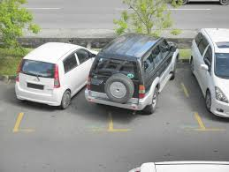
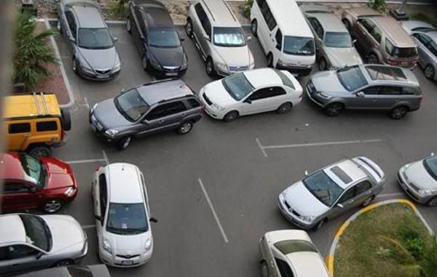
HAVE YOU FACED THE HASSEL OF PARKING VEHICLES?

Slide 3
What if we tell you that these days are over…..

Slide 4
Our Idea
We are trying to build a smart building management
Here we can consider car parking as a memory allocation problem.
We will be using Memory management techniques such as best fit to park cars
Also to check if the car is Parked we will kick in some CV
Other opportunities in smart building will be considered where we need to have security for people
Also we will guide the people parking using search algorithm to come out of parking.
Search algorithm will be organized with priority for small cars. Thus leading a process scheduling problem.

Slide 5
APIs Used
Python system APIs.
Deep Learning APIs Tensorflow, PyTorch, Keras.
Machine Learning APIs Sci-Kit Learn.
Computer Vision APIs Open-CV
Android Development to build an app for demonstration.

Slide 6
Our solution
1. Facial Detection and Recognition.
2. Car path guidance using memory scheduling.
3. Car parking detection.
4. Car parking lane detection.
5. Using ultrasound sensor for proper parking assistance.
6. Sending OTP to verify your identity using mobile number.
7. Sending messages if your car is not properly parked.
8. An app for all guidance.

Slide 7
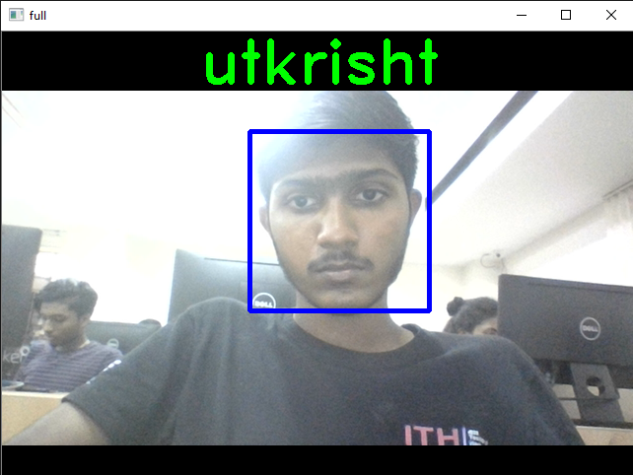
Facial Detection and Recognition
Technology used Open-cv HaarsCascade classifier.
This will help us to map the user with the car.
Real-time face detection and recognition for recognizing the owner of car.
Then use K Nearest Neighbours to find matching corresponding image.

Slide 8
Car path guidance using memory scheduling.
We consider best-fit and first-fit algorithms to determine the memory allocation.
We consider the possibilities of three vehicle types SUV, LUV and 2-wheelers.
This will help us to allocate resource properly.
Working code in python.
Link below https://github.com/abhishekkushwaha4u/OS-Hackathon/tree/master/Parking_Guide

Slide 9
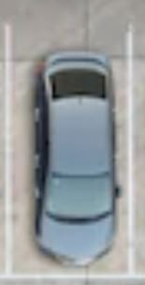
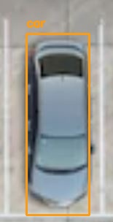
Car parking detection.
Parking detection is done using the top view image.
We assume that we have cameras at a little height, the images are of small sizes.
Technology used Deep Learning YOLO V3 approach.
We had experimented with other CV techniques such as HOG, Masked RCNN.

Slide 10
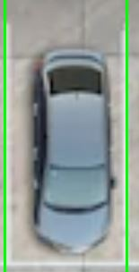
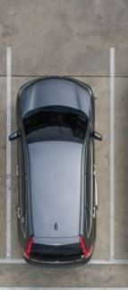
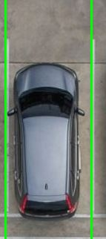
Car parking lane detection.
Difficult task considering the angles and quality of the image.
Working for top view of an image.
Used CV techniques HoughLineTransforms with sobel kernels.

Slide 11
Ultrasound sensor for distance estimation and guidance.
Ultrasound sensor was used to provide the user alert if his car is about to hit the wall.
This makes us a bit easier to check if car is parked properly or not. E.g. by using two tilted ultrasound sensors we can get the angle of parking.
Running code here
https://github.com/abhishekkushwaha4u/OS-Hackathon/tree/master/ultrasound

Slide 12
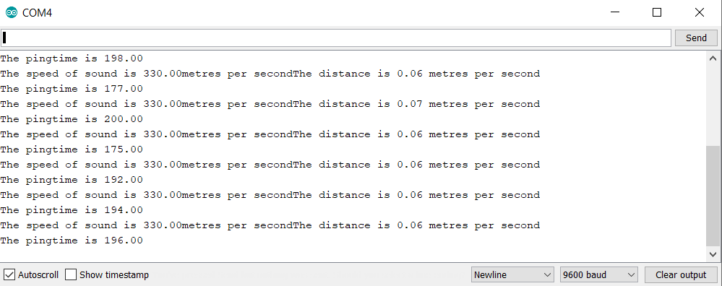
Ultrasound Outputs

Slide 13
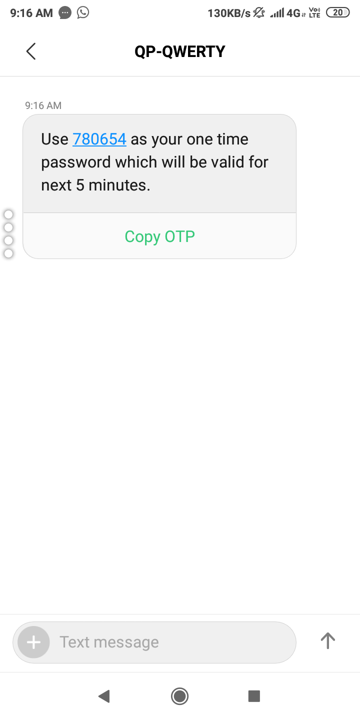
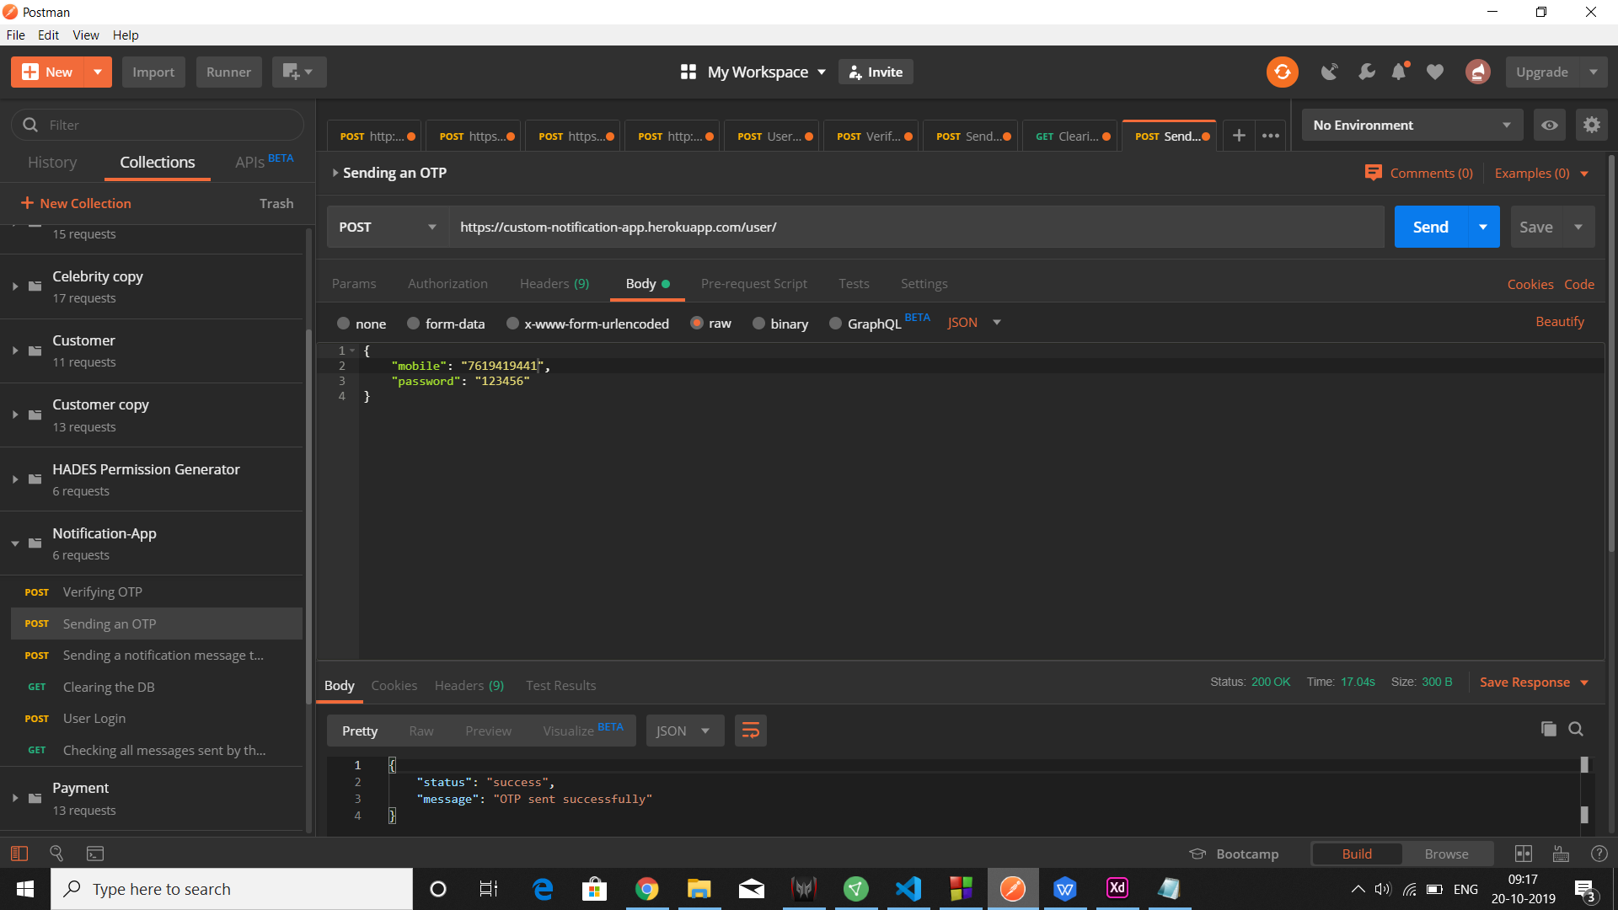
Sending OTP API tested using PostMan
We have used Postman API to simulate the OTP sending .
This code sending is hosted on Heroku.
We have verified OTP as well.

Slide 14
Sending message if your car is parked in improper fashion.
We use the two outputs from lines and the rectangle drawn from the image to show that the car is not parked properly.
The message generation API is again used to send the message to mobile of user whose car is parked improperly.
Here we verify the phone number and the number plate.

Slide 15
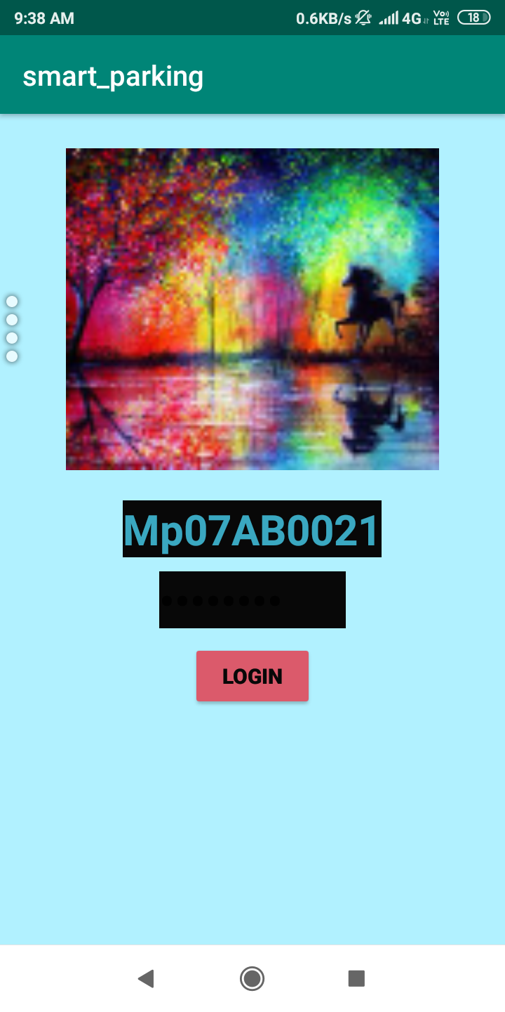

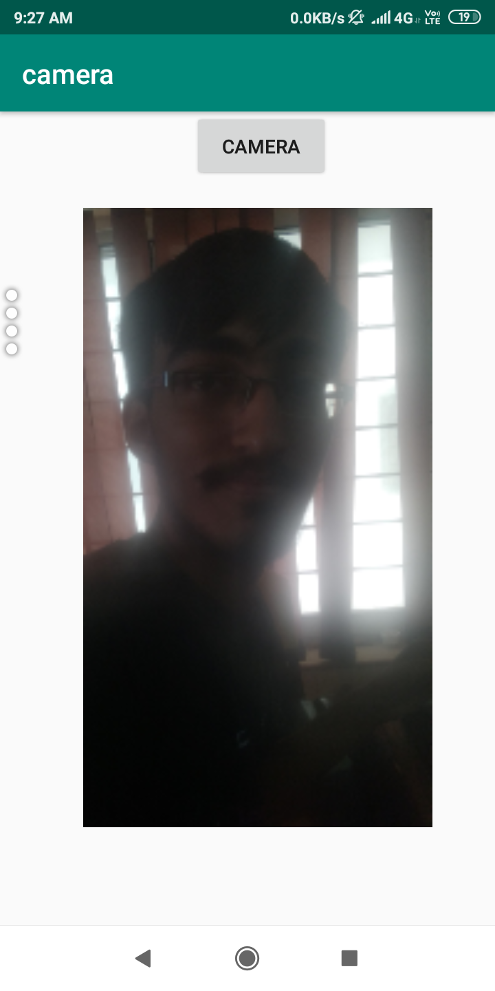
Integrated Mobile App
We have the mobile app under progress, which helps to help the people to guide.

Slide 16
Conclusion
We have a proof of concept which describes how a parking management system can be made better.
Operating System concepts such as:
1. Memory management for parking allotment.
2. System level C calls in Arduino for ultrasound detector.
3. Open-cv High level API for image processing techniques.
4. Little bit of Deep Learning techniques to segment the image.
5. Making an app for Mobile OS which helps the users.
6. Backend Postman API system calls for deploying the Mobile OS compatible part.

Slide 17
Thank You

