Slide 1
Philadelphia Bail Fund General Analysis
Maria Maltepes and Josh Voytek
OwlHacks 2020

Slide 2
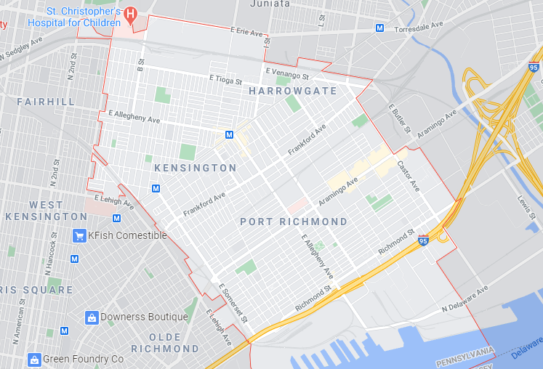
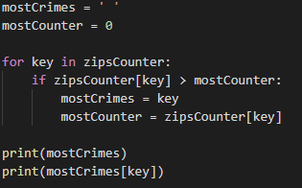
What ZIP code has the most charges?
Most arrests belonged to 19134 with 955 arrests
**Discrepancy: there are 964 missing zipcodes.

Slide 3
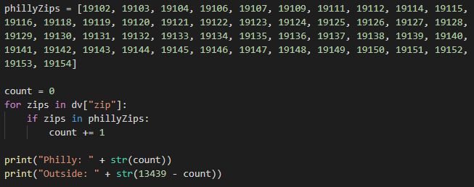
What is the regional makeup of people being arrested in Philadelphia? Are they Philly residents or out of county?
Philadelphia County Resident | Out of County Resident
10,996 | 2,443

Slide 4
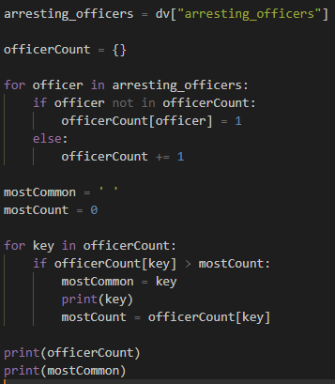
Which officer had the most arrests in 2020?
Results:
“Affiant” had 926 arrests
James. M Balmer had 182
C
O
D
E

Slide 5
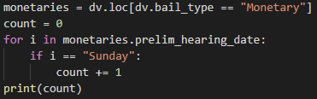
How common is it to get monetary bail in relation to the day of the week?
Preliminary Hearing on: | Amount of monetary bails set that day in 2020 so far:
Monday | 592
Tuesday | 733
Wednesday | 822
Thursday | 1045
Friday | 949
Saturday | 749
Sunday | 644

