Slide 1
TITLE
Word1 word2 word3 word4
Word5 word6
Word7 word8 word9
Word11 word12 word13 word14
word15 word16
word17 word18 word19
Notes:
,hjghjglj

Slide 2
TITLE
Word1 word2 word3 word4
Word5 word6
Word7 word8 word9
word11 word12 word13 word14
word15 word16
word17 word18 word19

Slide 3
Outline.
Machine learning.
Bla bla bla bla.
Seccend subject.
Bla bla.
Blo blo .
finish.

Slide 4
Outline
Machine Learning
Definitions
Text Mining
Learning Algorithm
Text mining for market prediction
Conclusions

Slide 5
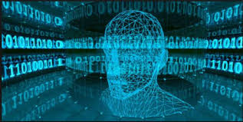
Definitions[1]
Machine Learning: Allow the computer to learn from examples, Runs on a variety of computational tasks where classic programming is not possible
Supervised Learning.Unsupervised Learning.Reinforcement Learning

Slide 6
A Review of Machine Learning Algorithms for
Text-Documents Classification
Aurangzeb Khan, Baharum Baharudin, Lam Hong Lee*, Khairullah khan
FEBRUARY 2010
Moran Abitbul
Tair Farangi

Slide 7
Outline
Machine Learning
Definitions
Text Mining
Learning Algorithm
Text mining for market prediction
Conclusions

Slide 8
Definitions [1]
Machine Learning
Allow the computer to learn from examples
Runs on a variety of computational tasks where classic programming is not possible
Supervised Learning
Unsupervised Learning
Reinforcement Learning

